Slide 1
~eAiiSH~
AIISH E-learning Platform
-Institutional Learning Management System-

Slide 2
Introduction
E-learning
Learning Management System (LMS)
Institutional Learning Management System
Commercial Vs. Free LMS
Moodle

Slide 3
MOODLE …
Modular Object-Oriented Dynamic Learning Environment
Martin Dougiamas in 2002
Moodle Proprietary Ltd, Australia
World’s most popular LMS
Sites: 1, 79 000+
Courses: 3, 11, 44,000+

Slide 4
eAiiSH
Latest version, 3.9
PG, UG & Diploma Courses
Types of accounts: Administrator, Teacher & Student
Username & Password

Slide 5
Dashboard &
Course homepage
Dashboard
Teachers: Assigned Courses
Students: Enrolled Courses
Course homepage
Participants
Content Area

Slide 6
Resources
Books
Files
Folders
Pages
URL

Slide 7
Activities
Assignments
Chat
Choice
Discussion Forums
Database
Feedback
Glossary
Quiz
Virtual Classroom

Slide 8
Tools
Attendance
Gradebook
Custom Certificate
Mobile App

Slide 9
Video Conferencing Systems
BigBlueButtonBN
Opensource & Free
Load test
200 + students in 5 concurrent sessions
Congrea
  Proprietary & Commercial
  Free plan (100 students in 10 concurrent sessions)
  $ 100 / Month Plan: 500 students in 50 concurrent sessions

Slide 10
www.aiish.ac.in
E-learning @ AIISH

Slide 11
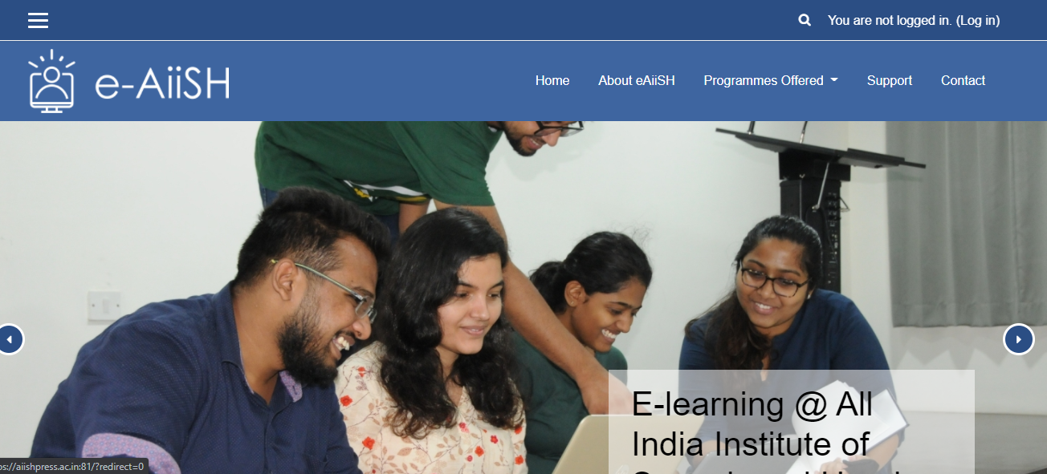

Slide 12
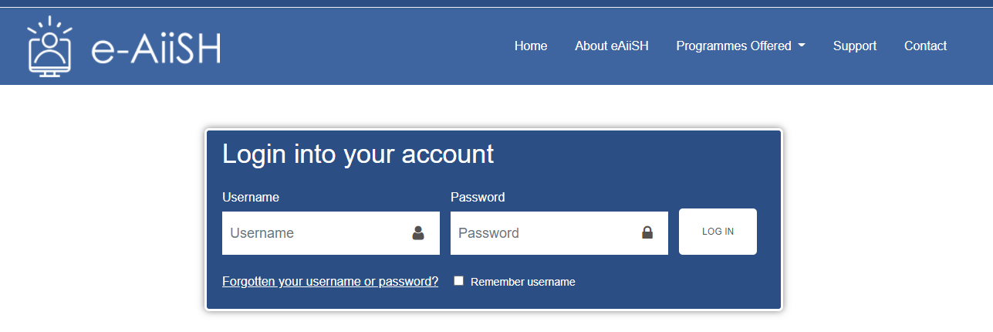
Enter your first name in small letters
Password : Your Register Number

Slide 13
Username Password
ashishk #Lp180011
fathimag #Lp180016
fathimak #Lp180017
fathimam #Lp180018
lakshmip #Lp180031
chandanan #Lp180039
sahanav #Lp180053

Slide 14
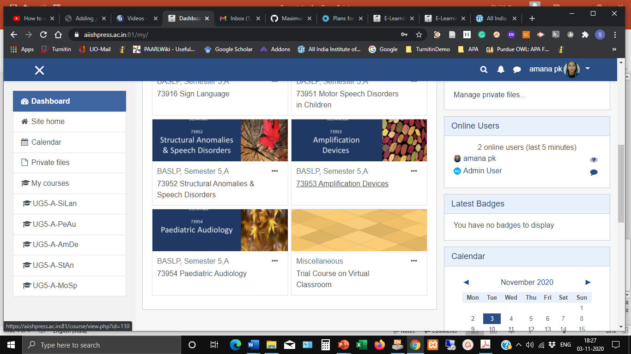

Slide 15
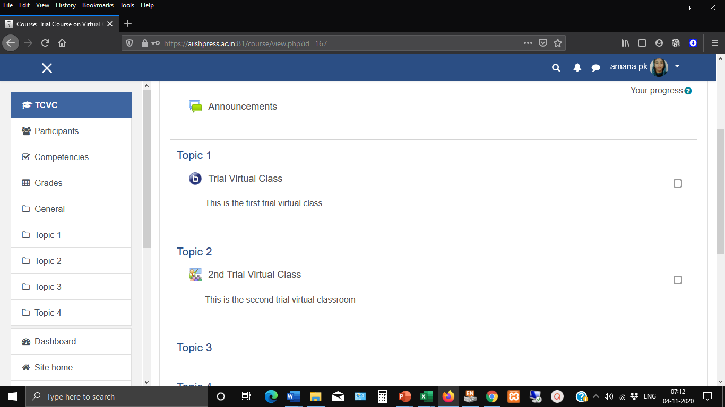

Slide 16
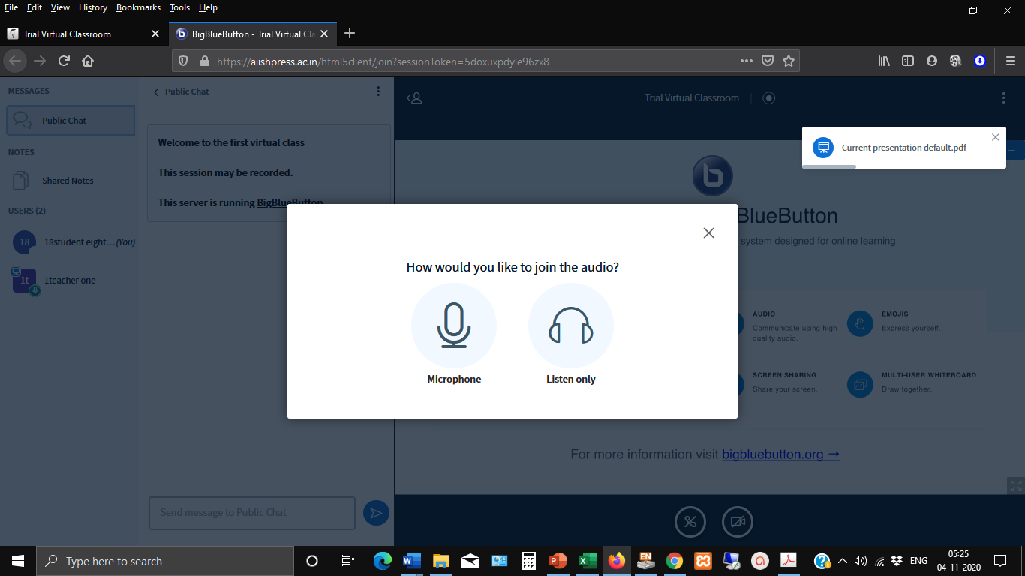

Slide 17
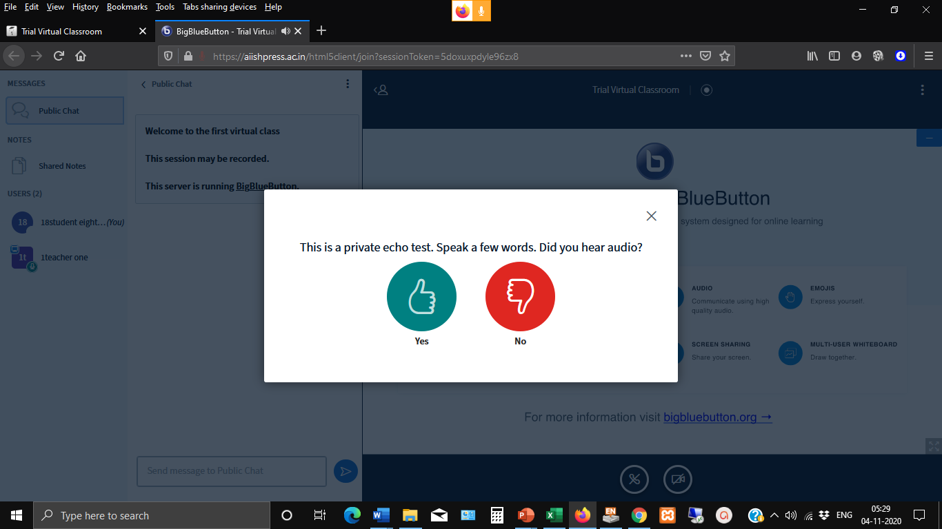

Slide 19
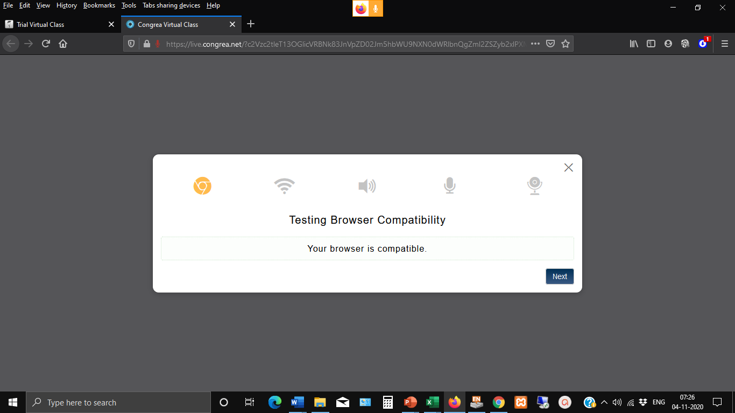

Slide 20
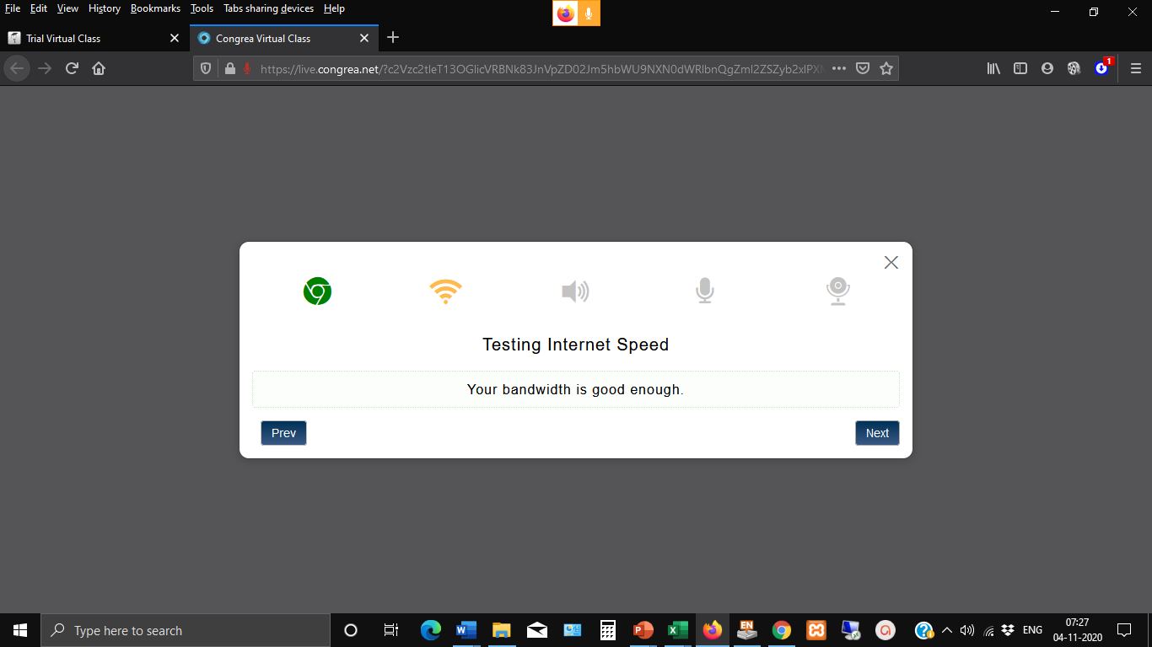

Slide 21


Slide 22
