Slide 1
All India Institute of Speech & Hearing Library and Information Centre
KNOW YOUR LIBRARY
WORKSHOP

Slide 2
Information Resources &
Services
Electronic
Traditional

Slide 3
Print Resources
Books
In-house Publications
Theses & Dissertations
Journals
Bound Volumes

Slide 4
E-Resources
Electronic Resources: Types
E-journals
E-books
Literature Databases
Digitized Research Reports
Standards

Slide 5
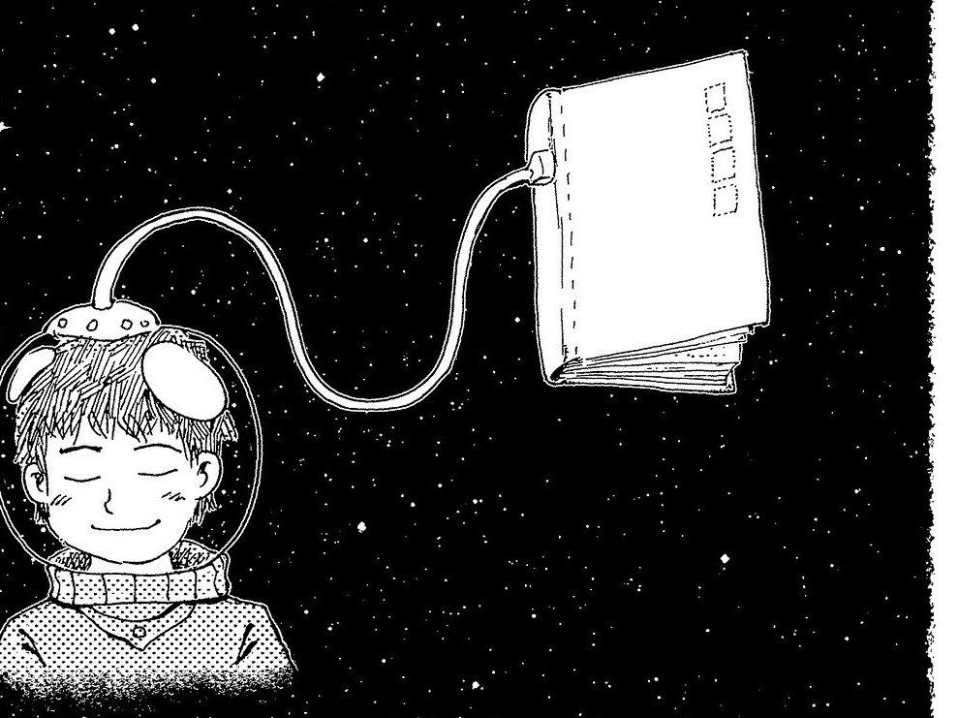
Electronic Resources: Access
www.aiish.ac.in
# Intranet Vs Internet
# Username & password
# Access Restrictions

Slide 6
Information Services…
1) Book Lending
2) ERMED Service
3) Institutional Repository
4) ISBN
5) Indian Lit. Database on Comm.Dis
6) JAIISH

Slide 7
…Information Services
7) N-LIST
8) Online Public Access Catalogue
9) Plagiarism detection
10) Reference management
11) Remote login
12) Scholarly writing support

Slide 9
ti:title au:author kw:keyword su:subject pb:publisher nb:ISBN
ti=title au=author kw=keyword su=subject pb=publisher nb=ISBN

