Slide 1
Elements of Advertisements
7th Grade 2.10
To understand the key elements of a print advertisement and the intended effects on an audience
To create an advertisement

Slide 2
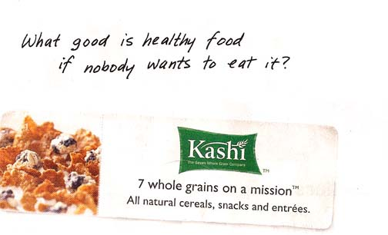
Five common elements of print advertising
Headline – A short piece of text; usually larger in type; designed to be the first words the audience reads; NOT the slogan but unique to the brand

Slide 3
Five common elements of print advertising
Image – any drawing, photograph, illustration, chart, or other graphic designed to affect the audience in a purposeful way

Slide 4
Five common elements of print advertising
Copy – actual text of an ad; particular claims are usually made and specific persuasive words are used

Slide 5
Five common elements of print advertising
Slogan – A catchphrase that evokes some kind of feeling about the company and product; are usually motivating and empowering; rarely change

Slide 6
Five common elements of print advertising
Logo – unique design symbol that helps identify the company visually; sometimes the company name is written distinctively and used as the logo

Slide 7
Ad Scavenger Hunt
Skim through the magazines and analyze how color is used persuasively in advertisements.
Select three different types of advertisements and explain how color is used to sell the product
  Reds and blues may be used to convey energy and vibrancy
  Earth tones (tan and brown) may be used to show stability and security

Slide 8
Create an Advertisement for a Common Object
Using the five elements of advertising, create an ad for a common object.
Include
  the product
  company name
  the purpose of the ad
  the target audience
  headline
  image
  copy
  slogan,

Slide 9
Essential Questions
How do advertisers attempt to influence consumers?
How do the purpose and audience shape the content in a persuasive text?

