Slide 1
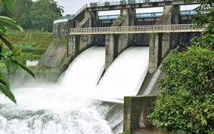
DAMS
Uses, Pros & Cons
Aarya S
X-D
Kendriya Vidyalaya
Mysuru

Slide 2
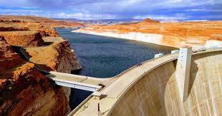
What is a dam?
Structure built across a river or
stream to hold
back water
Vary in size from small reservoir to high
massive concrete structures

Slide 3
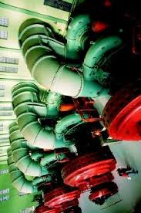
Uses of Dams
Drinking and irrigation
Generating of electricity
Regulate flow of water
Future requirements

Slide 4
Pros & Cons
Pros
Storage of water
Flood Control
Fostering greenery
Irrigation of crops
Production of electricity
Entertainment
Cons
Displacement of people
Disruption of local ecosystems.
Depletion of groundwater table.
Blocks progression of water to other areas

Slide 5
Dams in India
Tehri Dam: Highest dam
Bhagirathi River, Uttarakhand
Hirakud Dam: Longest dam
Mahanadi, Odisha
Sardar Sarovar Dam: Narmada Bachao Andolan
Narmada Gujarat

