Slide 1
Introduction to electronic resources management
Day Two : Management of electronic resources

Slide 2
Introduction to electronic resources management
Unit 2.1: Access models and registration
Notes:
Objective:
Consider the role of the library in electronic resource management, discuss different routes to access and the role of the library in e-resource provision, including legal issues and the setting up of access.

Slide 3
Recap of Day 1
Types of resource
Search process
Evaluation of results
Notes:
Ask for participant feedback to recall
Types of resources, search skills, evaluation

Slide 4
Categories
Electronic resources can be categorized into:
Purchases
Annual Subscriptions (journals and books)
One time purchase (books)
Pick and choose (selecting titles one needs)
Sometimes “cost” is negotiating free access
Open Access
Peer reviewed scholarly research, availed for unrestricted access
Notes:
Open Access is often confused with Free resources (not necessarily peer reviewed). Ensure the participants understand that Open access is peer reviewed research output.
With books it is advisable to use the one time purchase model so that you own the books
Pick and choose is a model that allows you to choose the titles you need from the database – This is an expensive approach

Slide 5
Why E-Resources?
Benefits
Requirements
Notes:
Plenary feedback of first day discussions around benefits
Ask what requirements are needed to feed into next slide

Slide 6
Implementation: Requirements
ICT Infrastructure
Reliable connectivity
Adequate bandwidth
Adequate computers to facilitate access
Reliable technical support
Strong collaboration with ICT Department
Skills development among staff
Sensitization of users
Budget (print vs electronic)
Notes:
-Emphasize collaboration with the ICT Department of the Organization
-A lot of librarians shy away from e-resources because of looking for additional budget. The best way is to start off by balancing out the book vote between print and electronic. This will encourage administrators to support the library and eventually to provide a budget line for e-resources

Slide 7
Role of the Library
E-resources is the current global trend in information management
The Library should ensure they take the lead in this area to remain relevant
Library professionals have the right training in information retrieval and management and should apply the same skills in e-resources
Notes:
-everybody is googling and a lot of users feel strongly that they do not need the library. It is up to the Library to prove them wrong and correct this notion
-explain a bit the special skills

Slide 8
Role of the Library - skills
Library staff understand the book industry and are better placed to deal with publishers
They have better skills to evaluate published quality research output
They have better skills to assist researchers find what is relevant to their research
It is the role of the library to sensitize users on effective googling

Slide 9
Role of the Library - awareness
The Library should take up the role of:
Sensitizing administrators to bring them on Board
Sensitizing users to maximize on usage
Advising ICT Departments on the best infrastructure for effective implementation

Slide 10
Role of the Library - finance
Negotiating with publishers to get good deals (value for money)
Marketing the e-resources to maximize usage
Budgeting for e-resources and getting best options for affordable deals

Slide 11
Challenges
Changing mind sets
Cost of e-resources
Negotiating skills (understanding publishers)
Reliable ICT infrastructure
Managing e-resources effectively
Evaluating usage
Notes:
Expand on each

Slide 12
Access and authentication
There are two main authentication access control mechanisms:
IP address
Passwords
Combination of the above sometimes permitted
Additionally, pay-per-view is available and growing

Slide 13
IP addresses
Institutions should obtain and use a fixed, external IP address.
Access by IP is preferred/required by publishers
Direct recognition of institution by publisher
Seamless access, no need for password
Easy administration - all networked PCs on campus can access e-resources
Greater security (no misuse of usernames)
A proxy server can be set up to allow for off-campus use.
Usage statistics are recorded
Using a router and firewall will safeguard your computer system
Notes:
(e.g. EZproxy http://en.wikipedia.org/wiki/EZproxy)

Slide 14
Access models
INASP
Research 4 Life
Direct subscriptions
Open access
Notes:
INASP – need to register
R4L – need to register
Direct subscriptions – access discussed directly between consortium/institution and publisher
OA – no registration in most cases

Slide 15
Registration process
Registration is required for most subscription-based resources
Differs for each access initiative
Required because
License agreements – legal issues
Branding
Customer services
Notes:
License agreements – what the publisher will offer, what use is deemed reasonable by library
Branding – should be able to put library logo onto publisher page to show resources are provided through the library (otherwise users think everything is free!)
Customer services – publisher can send email updates etc.

Slide 16
Legal issues
Authorised users
Employees, faculty, staff and students walk in users
Off campus use
Permitted use
Private use or research, no commercial use
Prohibitions
Altering, copying, systematic downloading
Withdrawal
Copyright
Remains with the publisher
Notes:
Legal issues raised in terms and conditions are commonly:
"Authorized Users", defined as: employees, faculty, staff and students who are officially affiliated with the Subscribing Institution's library facilities; Remote access by authorized users via the subscribing institution’s proxy server is permitted.; may also include users from the general public (walk in users) who are permitted by the Subscribing Institution to access the Resources from designated terminals within the Subscribing Institution's IP site.
Permitted use - download, save, or print text, search results or other information solely for the private use or research of the Authorized Users.
Prohibitions
Altering, recompiling, systematic or programmatic copying, reselling, redistributing, publishing or re-publishing the resource content or any part thereof without explicit permission from the copyright holder is prohibited.
Systematic downloading, printing for profit-generating purposes and/or the systematic making of electronic copies for transmission to non-subscribers or non-subscribing institutions are prohibited.
Downloading of Resources or parts of Resources to form a persistent local archive is not allowed without the expressed written permission of the Publisher.
Withdrawal of Resources or Parts of Resources
The Publisher reserves the right to withdraw from this Agreement any of the Resources or any part of any of the Resources in order to comply with any legal rule or court order, or if the Publisher is at risk of liability from the continued availability of the Item or part of it.
Copyright
Copyright in the Publisher's Resources and their contents, including the abstracts, is vested in the Publisher, whose proprietary and publishing rights are protected under national and international law. Neither Authorized Users nor the Subscribing Institution shall have any proprietary right in any of the Resources by reason of their access to them.

Slide 17
INASP registration – Part 1 Application
Application
Librarian registers for an account at http://www.inasp.info/en/accounts/login/
Select sign up as new member
Enter personal details and select correct country
Librarian receives an automatic email and activates link in email
Librarians can then log in, select their institution and associate themselves with their own institution
Keep a record of your username and password
Several librarians can register for the same institution
Shares workload
Allows for continuity
If the institution is not listed, it can be added. New institutions will need to be approved by their country coordinator. Users will be sent an email once the institution is accepted.
Notes:
Application ideally done as an individual as they can use the same log on details if they move job, just need to select new institution and remove themselves from old institution

Slide 18
INASP registration – Part 1 Application Register for an account
☞

Slide 19
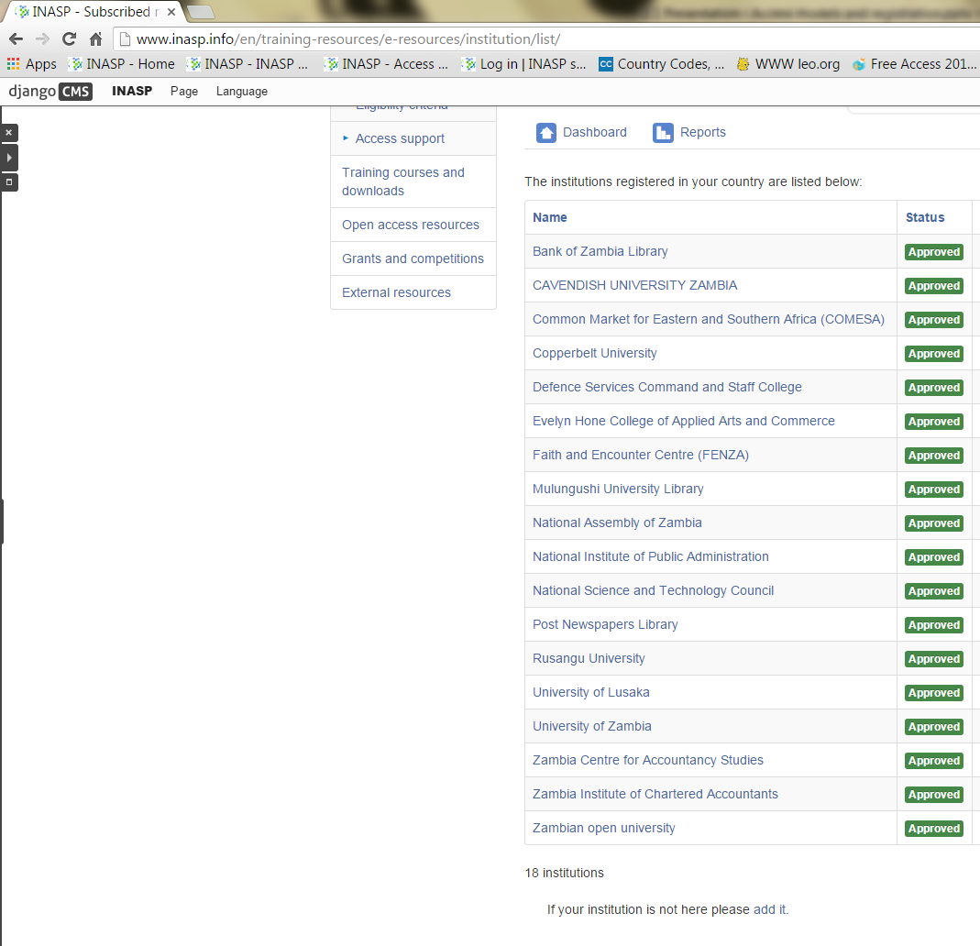
If your institution isn’t listed, add it
☞

Slide 20
INASP registration – Part 2 Registration
Registration with resources
Librarian returns to http://www.inasp.info/en/accounts/login/
Register in turn for each resource
Must read and accept the relevant license.
Allow 10 working days for access to the resource to be set up
Notes:
MUST remember to register for each resource, application will not lead to access to resources
This is one approach, research4Life also requires application, but this is done somewhat differently
Depending on the audience, facilitator might like to add or omit slides about consortium requirements or other access initiatives

Slide 21
INASP registration – Part 2 Registration Register for any additional resources
☞

Slide 22
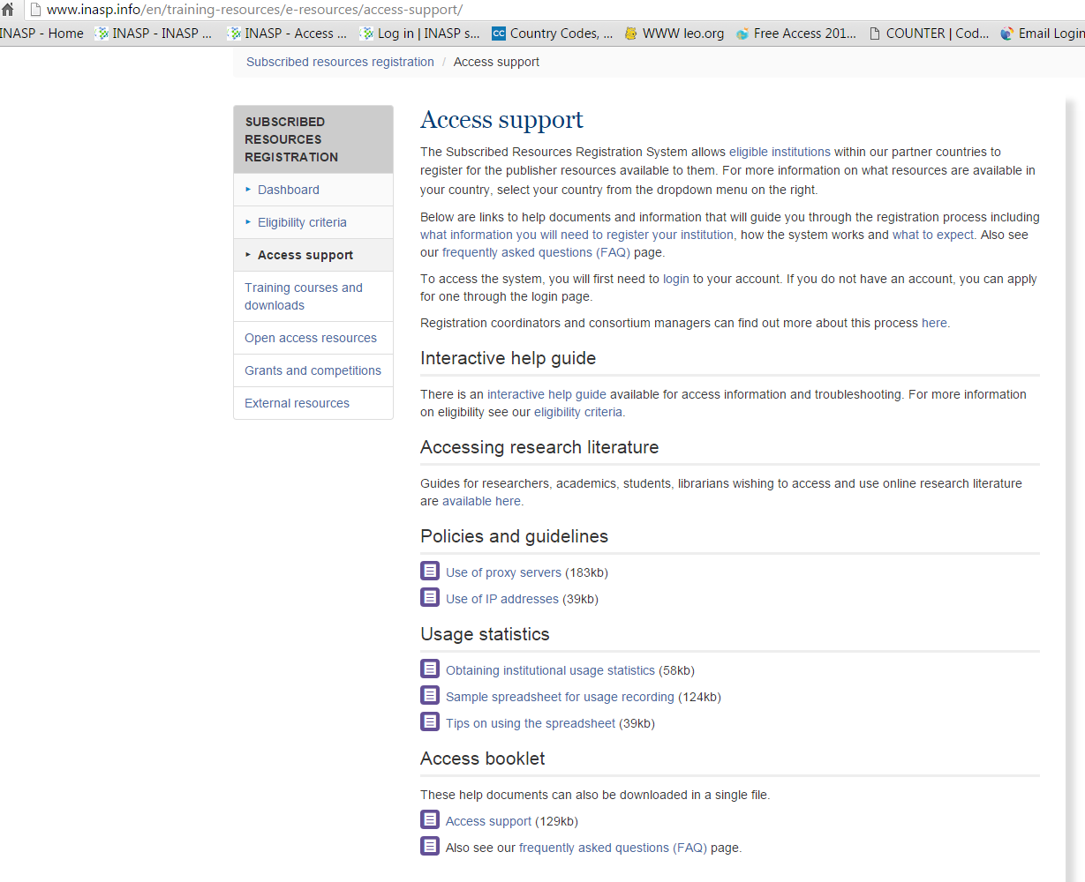
INASP registration - Access Support http://www.inasp.info/en/training-resources/e-resources/access-support/

Slide 23
Research4Life Registration

Slide 24
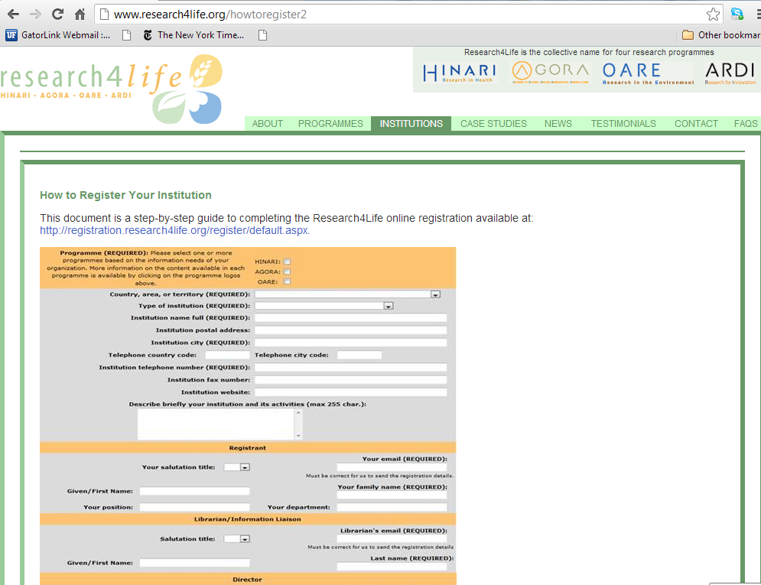
This is the step-by-step guide to completing the Research4Life online registration process. First, you need to make sure your institution is not already registered. There is a link to check the Registered Universities and Professional Schools: http://www.who.int/hinari/faq/registration_and_eligibility_registered_universities/en/index.html

Slide 25
http://registration.research4life.org/register/default.aspx
From this page, institutions can register for 3 Research4Life programmes* (do NOT need to register for each individually and do NOT need to register to all of them). Check eligibility of your institution.
*ARDI currently has a separate registration page: www.wipo.int/ardi/en/register_form.jsp
Notes:
Telephone and Fax fields are numeric. No blank spaces, nor symbols should be used.
Comments and Activities fields have a maximum number of characters. If you want to provide any explanation, please send by email to the HINARI HelpDesk hinari@who.int Include in the email your country and full institution name - in order to identify the application.

Slide 26
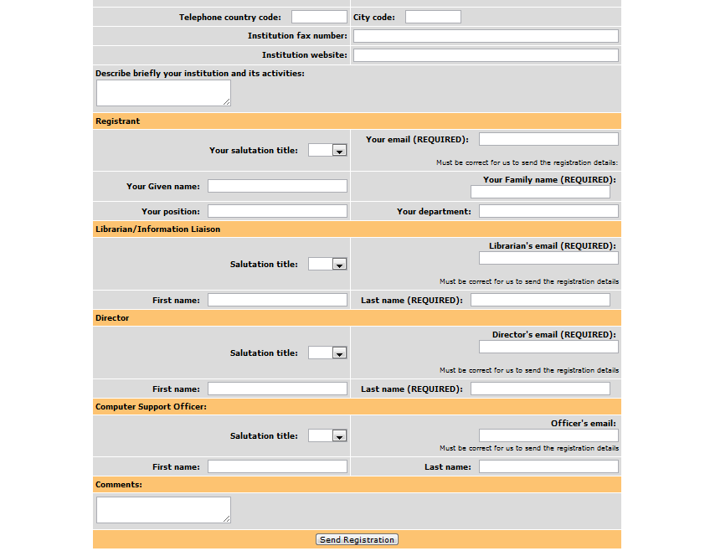
Note the detailed contact information that is required (Registrant, Librarian/Information Liaison, Director and Computer Support Officer). Please make sure you completely fill out the REQUIRED information or the registration cannot be properly processed.
Remember only one registration per institution is required. If not registered, complete form and click on Send Registration. Once the application is approved and processed, the library and director contacts will receive the HINARI welcome message. All members of the institution can use the institution’s User Name and Password.
Notes:
If possible, include an ‘institutional’ email address (e.g. smith@kemri.org or smitha@who.int not alan.smith@gmail.com )
If you have registered for one previously and want to register for the other two, add a note in the comments field with your institution and username. This will speed up the registration process for a 2nd or 3rd program.
Lastly, the whole validation and processing may take four to six weeks. Currently (October 2013) we have a huge backlog caused by the ‘Already Registered’ applications.

Slide 27
Thank you Any questions?
Thank you Any questions?
This work is licensed under a Creative Commons Attribution-ShareAlike 3.0 Unported License.
Notes:
You are free:
to Share — to copy, distribute and transmit the work
to Remix — to adapt the work
to make commercial use of the work
Under the following conditions:
Attribution — You must attribute the work in the manner specified by the author or licensor (but not in any way that suggests that they endorse you or your use of the work).
Share Alike — If you alter, transform, or build upon this work, you may distribute the resulting work only under the same or similar license to this one.
http://creativecommons.org/licenses/by-sa/3.0/

