Slide 1
Introduction to electronic resources management
Unit 1.4: E-resource evaluation tips
Notes:
Purpose: to enable participants to examine a website to determine the credibility of the contents

Slide 2
Contents
What can the url tell you?
Scan the page
Quality indicators
What do others say?
What is your opinion?
Notes:
Details on next slides

Slide 3
What can the url tell you?
Is it somebody’s personal page?
Look for a personal name in the url
Is the server a commercial ISP providing web page hosting e.g. blogspot?
What type of domain is it?
.gov; .edu etc
Check country code
Is it a publishing entity that makes sense?
Notes:
Identify if resource is provided by a commercial publisher or a host anyone can sign up to
Personal pages are not necessarily "bad," but you need to investigate the author carefully. For personal pages, there is no publisher or domain owner vouching for the information in the page.

Slide 4
Scan the perimeter of the page
Who wrote the page?
Is it dated and sufficiently current?
What are the author’s credentials?
Notes:
Look for copyright information, usually at the end of the page
Look for links that say "About us," "Philosophy," "Background," "Biography", etc.

Slide 5
Look for indicators of quality
Are sources documented with links or footnotes?
Is reproduced information complete, not altered?
Is permission acknowledged?
Are there links to other resources on the topic?
How recent is the copyright date?
Notes:
Review some sample documents on the resource – spelling mistakes are a give away on the quality and a small sample is usually representative of the whole resource

Slide 6
What do others say?
Paste url into Alexa.com
Will give subjective reviews, traffic etc
Who links to the page?
Is the page listed in reliable directories?
E.g. http://www.ipl.org/
What do others say about the author?
Google the name of the author
Notes:
Alexa.com on next slide = Analytics for any Website
IPL = Internet Public Library (quite slow)

Slide 7
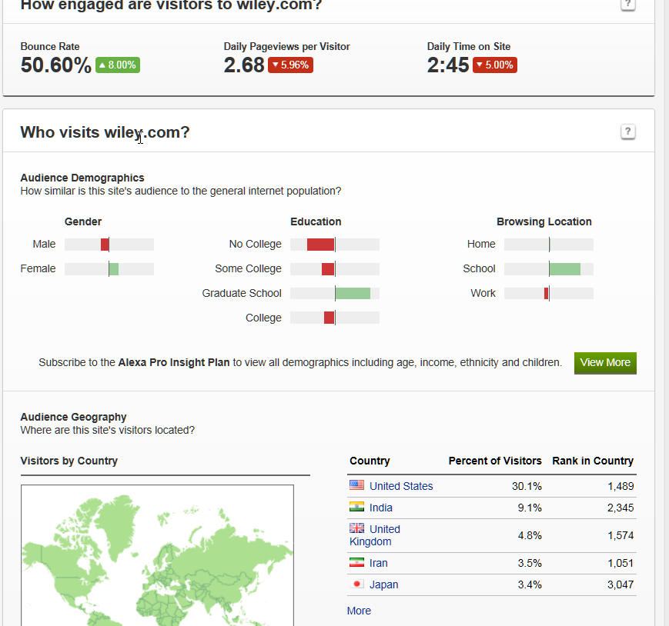
Notes:
Alexa.com review of Wiley
People are spending a relatively long time on the site (2.45 minutes is long!) and are mainly graduates

Slide 8
What is your own opinion?
Why was the page put on the web?
Does it feel trustworthy?
Is this as good as I would find if I used a library resource?
Notes:
Use your own feelings to judge if a site is current and reliable

Slide 9
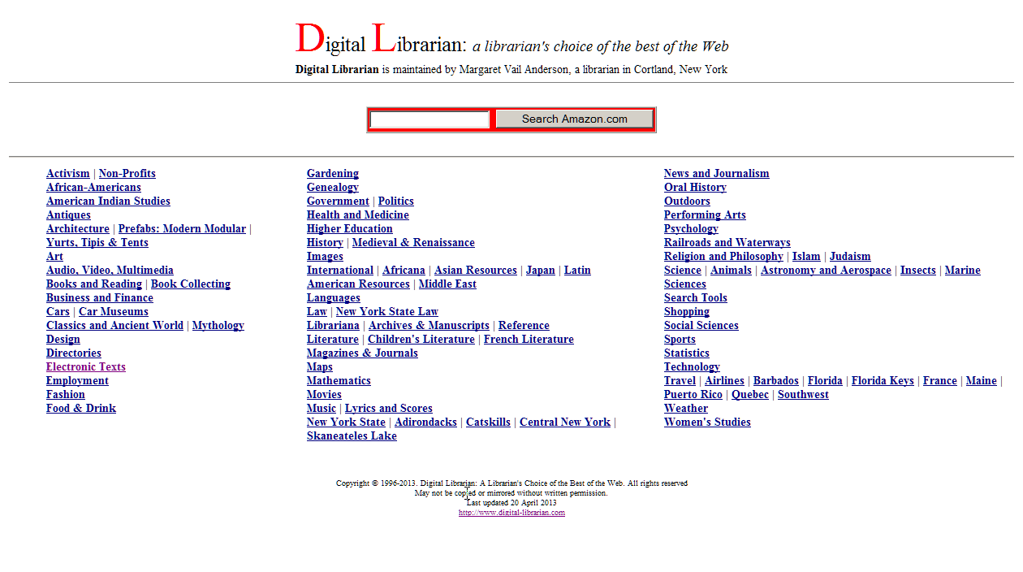
Notes:
This is a web browser which we might approach with caution
Maintained by just one individual
Courier typescript is seldom an indication of a good site
Last update quite a long time ago

Slide 10
Exercise 1.4.1
Resource evaluation from http://www.inasp.info/en/training-resources/open-access-resources/
Evaluate one resource from this page
Use the left menu for subject specific resources
Notes:
We’ll talk more about Open Access tomorrow but it is important now that participants realise they are valid research materials.
If possible, open this link and suggest that participants review at least one of the major resources on the opening page before moving to subject collections.
20 minutes for exercise, 10 minutes report back.

Slide 11
Reflections on the day
What have you learned today?
What actions will you take when you return to your library?
Notes:
Personal reflection on Day 1
Ask participants to take a few minutes to reflect by themselves
what have you learned today?
what action will you take when you return?
participants should make notes for themselves, to refer to on their return to work.
Then ask them to select one of the things they have written which they would like to share with colleagues. Ask for one or two volunteers to say what they have selected.

Slide 12
Thank you Any questions?
Thank you Any questions?
This work is licensed under a Creative Commons Attribution-ShareAlike 3.0 Unported License.
Notes:
You are free:
to Share — to copy, distribute and transmit the work
to Remix — to adapt the work
to make commercial use of the work
Under the following conditions:
Attribution — You must attribute the work in the manner specified by the author or licensor (but not in any way that suggests that they endorse you or your use of the work).
Share Alike — If you alter, transform, or build upon this work, you may distribute the resulting work only under the same or similar license to this one.
http://creativecommons.org/licenses/by-sa/3.0/

