Slide 1
Introduction to electronic resources management
Unit 1.3: Effective searching of e-resources
Notes:
On completion of this session participants will be able to:
Identify what one needs to know before searching
Determine the most likely sources of information
Identify an appropriate and effective search strategy
Evaluate different search strategies
Develop and improve search strategies

Slide 2
OUTLINE
Introduction
Search preparation
Searching
Refining a search
Boolean operators
Truncation
Evaluating a search
Notes:
This module is about searching in general, initially focused on general Web searching but the technique and principles apply to what ever e-resource / environment one is searching, so these apply to library e-resources that are the focus of the rest of the workshop.
Learning objectives
Identify what you need to know before you start searching
Review the importance of knowing what you are searching
Identify an appropriate and effective search strategy
Evaluate different search strategies
Practise and use personally appropriate search strategies

Slide 3
Introduction
The volume of electronic information is overwhelming
It is not easy to identify and access relevant information
Search skills can assist in retrieving relevant information and saving time
Librarians hold the key to such competencies
They need to understand effective search strategies
Notes:
Librarians can offer value and demonstrate their knowledge if they develop and practise good search skills. The exercises in this unit will help, there is also a handout with links to more reading. Expertise comes through practise and application of principles.

Slide 4
Preparing a search strategy
Effective searching is a process
Define a search topic
Identify possible search terms
Refine a search strategy
Notes:
The purpose of thinking about your topic before you start searching is to determine what terms to search for and what features you need to search successfully.

Slide 5
Defining a Search Topic
Your search topic
Sexual violence in armed conflicts
What do you know about the topic?
Define the scope
Regional coverage (continent, region, country, etc.)
e.g. in Africa, in Kenya, in Western Kenya…
Notes:
-Example – Sexual violence in armed conflicts in Africa (or in Kenya or in Western Kenya)

Slide 6
Identifying Search Terms
What are the possible terms you can use for searching?
Examples
Sexual violence
Sexual harassment, sexual crime, sexual assault, sexual abuse, rape
Armed conflicts
Regional conflicts, war, armed forces, women in armed conflicts,
Notes:
Allow participants to add more related terms where possible

Slide 7
Identifying Search Terms
Issues to consider
Synonyms (mobile phones, cellular phones)
Plural/singular forms (woman, women…)
Spelling variations (honour, honor…)
Variations of root word (feminism, feminist, feminine….)
Acronyms (CEO, Chief Executive Office…)
Lower/upper case
Notes:
What UNIQUE WORDS, DISTINCTIVE NAMES, ABBREVIATIONS, or ACRONYMS are associated with your topic?
Do any of the words to describe your topic belong in phrases or strings - together in a certain order, like a cliché?
Can you think of synonyms, variant spellings, or equivalent terms you would also accept in relevant documents?
Can you think of any extraneous or irrelevant documents these words might pick up?
What BROADER terms could your topic be covered by?

Slide 8
Where to start the search
Library website
INASP country page
Publisher platform
Google or other search engine
Other logical starting point
Notes:
Need to be able to identify the right place to search
Can you think of societies, organizations, or groups that might have information on your subject via their pages?

Slide 9
Searching
Any of the identified terms and related terms can be used in the search separately
The end results will be overwhelming making selection fairly time consuming
To enhance accuracy and save on time, one has to refine the search by combining search terms
Notes:
Just plunging in could bring up too many results, so need to develop means to refine your search

Slide 10
Predicting results
How many documents would you like to retrieve?
A few very specific ones?
Lots of general ones?
Notes:
Sometimes the best result is just a single answer to a question so just a few results which answer this are OK – Checking of a fact - Is the UN assisting in preventing sexual violence in Kenya?
Sometimes you want a few specific articles - commissioned research on how the response to sexual violence in Kenya compares with Sierra Leone
Sometimes you want a lot of general articles – a student preparing an assignment for a politics course

Slide 11
Refining a Search
Using the identified search terms separately is a broad search which may result in overwhelming results
To refine the search one has to narrow the search
Boolean Operators assist a researcher to combine two or more search terms to enhance accuracy

Slide 12
Boolean Operators
Boolean Operators consists of 3 words
AND
OR
NOT
These words can be used to combine search terms to narrow or broaden the search

Slide 13
Boolean Operators
AND: retrieves a document on condition that both search terms used are present
e.g. Sexual violence AND armed conflicts
OR: retrieves documents with either of the search terms used
e.g. sexual violence OR armed conflicts
NOT: Excludes documents with one of the search terms from the results
Sexual violence NOT rape
Notes:
Test participants to ensure they have grasped the meaning of the 3 terms.
Which of the above produces most documents? (or)
Which produces least? (and)
Which one carries a risk of losing useful documents?
Facilitator might like to have some more examples if the participants are confused by this.

Slide 14
Truncation
Truncation is another strategy for broadening a search
It helps to retrieve related terms in one search
It also solves the problem of singular and plural
But truncation is used with a code e.g. $ or * This depends on the search engine used
Notes:
- Computers are machines and cannot reason. A search using plural e.g. Economics will not retrieve documents with singular e.g. economic development

Slide 15
Truncation
EXAMPLES
Search Topic is Economics and development
Economic development will certainly be useful to this topic
Econ*. Will retrieve documents with both terms
Notes:
NB Very few unrelated terms start “econ” so also use another example to ensure that participants have grasped the difference
Need to be careful where you truncate – where would be best place to truncate a search for librarianship and library science? What would happen if you truncate too early?

Slide 16
Field searching
Most publisher resources offer advanced search functions
Author
Journal title
Article title
Date ranges
Abstract
Notes:
You can specify if your chosen search term should appear in any field
For example “Farmer” can be a surname so if you want articles by someone called “Farmer” you could get a lot of irrelevant items if you can’t specify that it is a name

Slide 17
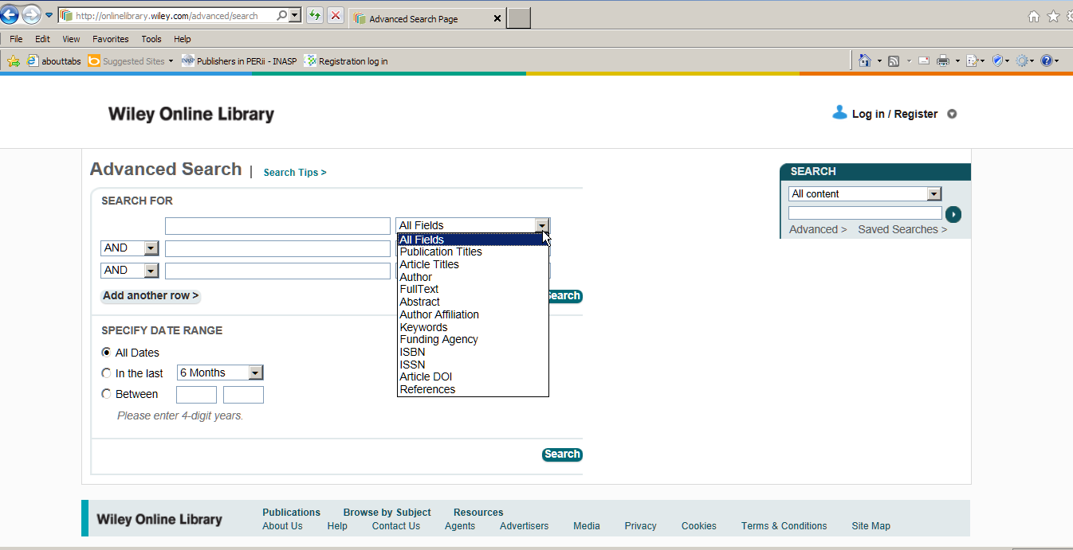
Notes:
Wiley advanced search fields (representative of many resources)
DOI = Digital Object Identifier
A CrossRef DOI is an alphanumeric name that identifies digital content, such as a book or journal article. The DOI is paired with the object's electronic address, or URL, in an updateable central directory, and is published in place of the URL in order to avoid broken links while allowing the content to move as needed. - See more at: http://www.crossref.org/03libraries/index.html#sthash.giW5theV.dpuf

Slide 18
Search modifications
Learner-centred – alternative spellings?
Pedagogical – where should we truncate?
Education – what will it produce?
Train the trainer – any irrelevant items? How would you use this?
Notes:
Ask participants for suggestions

Slide 19
Evaluating a Search Strategy
Too many results?
Review strategy
Use more specific terms
Combine search terms using AND or NOT
Too few results?
Review strategy
Use broader terms
Combine search terms using OR
Satisfied?
Download documents

Slide 20
Exercise 1.3.1
Practical searching
Resources linked from
www.inasp.info
http://www.inasp.info/en/training-resources/open-access-resources/

Slide 21
Thank you Any questions?
Thank you Any questions?
This work is licensed under a Creative Commons Attribution-ShareAlike 3.0 Unported License.
Notes:
You are free:
to Share — to copy, distribute and transmit the work
to Remix — to adapt the work
to make commercial use of the work
Under the following conditions:
Attribution — You must attribute the work in the manner specified by the author or licensor (but not in any way that suggests that they endorse you or your use of the work).
Share Alike — If you alter, transform, or build upon this work, you may distribute the resulting work only under the same or similar license to this one.
http://creativecommons.org/licenses/by-sa/3.0/

