Slide 1
Introduction to electronic resources management
Unit 1.2: Electronic
Resources in [country]
Notes:
Purpose
To demonstrate the electronic resources and materials available to librarians and researchers in the country through the INASP Website. To highlight information which will help librarians in selecting which resource to use – Content overview, subject strengths. To demonstrate sections which help librarians in using and raising awareness of resources – service strengths, librarians sections on publisher webpages which may contain training or promotional materials.

Slide 2
Outline
Routes to e-resources
INASP
Other access initiatives
Open access – publishers and institutional repositories
Direct subscriptions
Support for e-resource access and use
Publishers’ promotional materials
Usage statistics
Publisher help desks
Notes:
We will come back to talk about the routes in more detail tomorrow

Slide 3
INASP
Country resource pages on INASP website
Links to
Publishers’ promotional materials
How to collect usage statistics
How to contact a publisher
Open access resources
Notes:
Also demonstrate consortium website if appropriate – add slides or live demo as appropriate

Slide 4
INASP country resource pages
http://www.inasp.info/
Select your country
See a list of all resources available to your country
Url for access to resource
Description of content and service features
Notes:
Online demo if possible
See a list of all resources available to your country – paid (by consortium, free at point of use), negotiated free or Open Access
INASP will negotiate with some publishers to offer free access to certain INASP countries where libraries in the rest of the world pay a subscription

Slide 5
Country page
http://www.inasp.info/[name of country]
Url for access
Description of content and service features
Registration information
Administration information
Publisher’s contacts: email addresses
Notes:
Add slides or move to consortium webpage for demonstration if appropriate

Slide 6
Open Access resources
http://www.inasp.info/en/training-resources/open-access-resources/
Multi-disciplinary resources
Subject specific resources
Open access readings
Notes:
Open Access is often confused with Free resources (not necessarily peer reviewed). Ensure the participants understand that Open access is peer reviewed research output.

Slide 7
Institutional repositories
http://www.inasp.info/en/training-resources/open-access-resources/institutional-repositories/
“online space for collecting, preserving, and disseminating, in digital form, the intellectual output of an institution”
http://www.opendoar.org/search.php

Slide 8
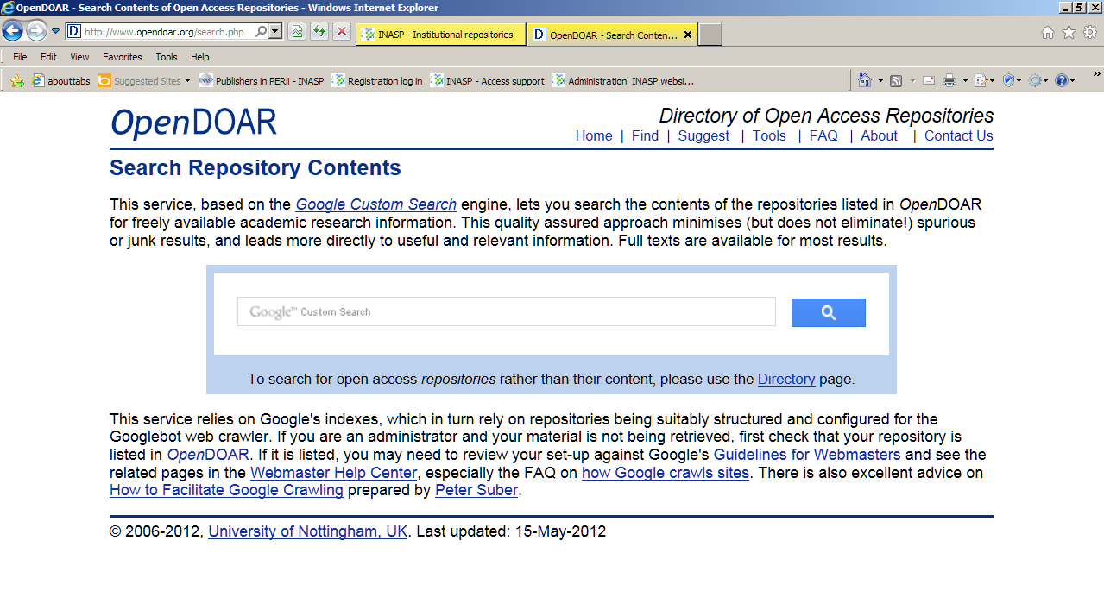

Slide 9
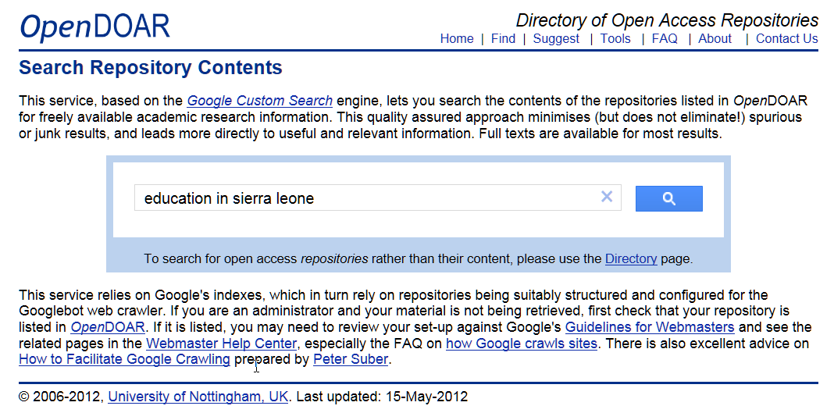

Slide 10
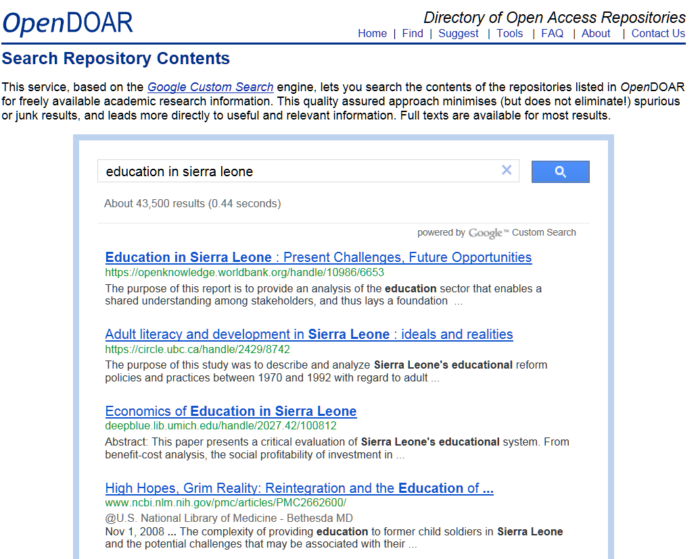

Slide 11
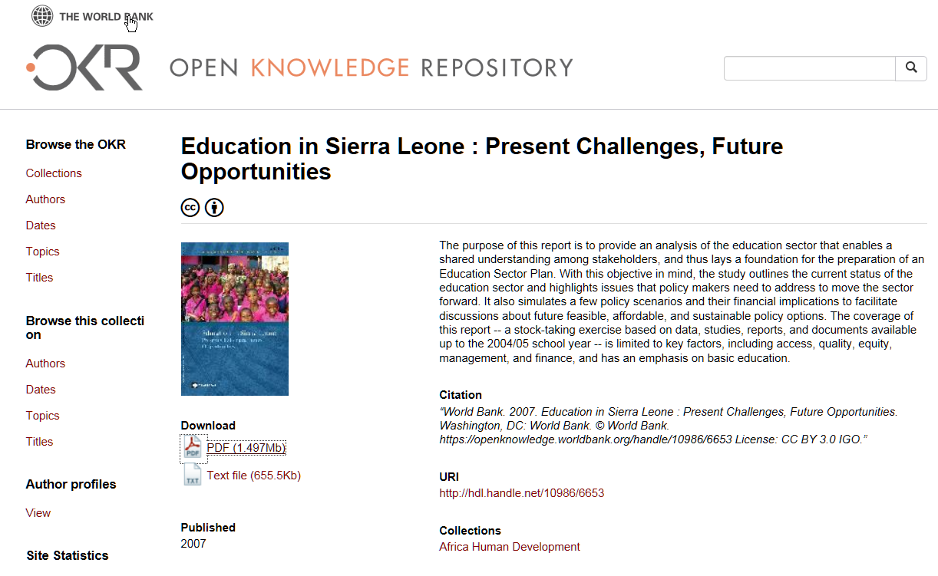

Slide 12
Other access initiatives
Research 4 Life http://www.research4life.org/
HINARI
Access to Research in Health
http://www.who.int/hinari/en/
AGORA
Access to Global Online Research in Agriculture
http://www.aginternetwork.org/en/
OARE
Online Access to Research in the Environment
http://www.unep.org/oare/en/
ARDI
Access to Research for Development and Innovation
http://www.wipo.int/ardi/en/
Oxford Journals
Notes:
Adapt as appropriate for each country – check http://www.research4life.org/institutions/ for R4L eligibility
Add a slide or move live to the consortium website if appropriate

Slide 13
Practical exercise 1.2.1
Use www.inasp.info
Collect information on the exercise sheet
Be prepared to report back
Time allowed: 30 minutes

Slide 14
Thank you Any questions?
Thank you Any questions?
This work is licensed under a Creative Commons Attribution-ShareAlike 3.0 Unported License.
Notes:
You are free:
to Share — to copy, distribute and transmit the work
to Remix — to adapt the work
to make commercial use of the work
Under the following conditions:
Attribution — You must attribute the work in the manner specified by the author or licensor (but not in any way that suggests that they endorse you or your use of the work).
Share Alike — If you alter, transform, or build upon this work, you may distribute the resulting work only under the same or similar license to this one.
http://creativecommons.org/licenses/by-sa/3.0/

