Slide 1
Introduction to electronic resources management
Workshop introduction and overview
Notes:
Welcome to the workshop
Introduce yourself and give some basic background information on:
What you do
Where you work
Hand out materials folders at this stage and explain their content, lay out and how we will use them during the workshop. Also mention that electronic versions of all materials are available online for all participants to download, customise and use in their institutions.

Slide 2
Workshop objectives
to introduce participants to a range of electronic resources
to demonstrate the range of e-resources available in your country
to provide hands-on experience on using and accessing e-resources
to introduce / review management and implementation activities associated with e-resources
to examine copyright and licensing implications for e-resources
to develop ideas, strategies and policies for e-resources management
to develop skills in training others in the use of e-resources
Notes:
Go through the aims and objectives of the workshop
Objectives to introduce participants to a range of electronic resources
to demonstrate the range of e-resources available in thiscountry
to provide hands-on experience on using and accessing e-resources
to introduce / review management and implementation activities associated with e-resources
to examine copyright and licensing implications for e-resources
to develop ideas, strategies and policies for e-resources management
to develop skills in training others in the use of e-resources

Slide 3
Workshop expectations
Follow-on training to share learning with colleagues should be held at each institution represented within 6 months of the workshop.
Notes:
Remind participants of the expectation that they will all deliver training within their institution within 6 months of the workshop.
Should there be a question on this, the assumption is there will be no cost associated with follow on training as it is entirely within their institution and for the benefit of their institution.

Slide 4
Welcome and introductions
Workshop facilitator
Hosts
Participants
Housekeeping
House rules
Notes:
Welcome and details about participants, introduce any helpers or others who will be involved in the workshop.
Facilitator – introduce yourself and give a brief background about where you are from and what you do (if not done already).
Assistant facilitator – introduce the assistant facilitator (they should be known to the attendees) and outline the role that they will be playing i.e. they will be helping with some aspects of the workshop facilitation and then running the next workshop (in …)
Hosts – thank that host institution and participants from there. Thanks for hosting the workshop and the facilities (if not done already in the opening ceremony)
Participants:
If appropriate, get all the people in the room to introduce themselves and briefly describe their jobs (for their benefit as well as yours) and what they hope to get from the workshop. You may like to ask:
What are they most interested in from the workshop?
Anything not mentioned that people would like to see covered?
Housekeeping
Mention directions to facilities, entrance, exits (if appropriate) and details for refreshments, lunch, etc.
House rules
What should be do to make this workshop as effective as possible? Phones, time keeping, listening to others etc.

Slide 5
Content outline
Review the range and scope of e-resources
Identify skills, knowledge and attitudes required to support effective e-resource use
Identify the core competencies for e-resource use
Review the importance of effective searching
Identify the key target users of the e-resources in participant’s organisations
Review e-resource access, use and training case studies
Notes:
Content outline:
Stress that this is flexible as we go along and that it can be changed/adapted to suit local needs and requirements of the participants.

Slide 6
Content details
Overview – what is available
Searching
Evaluation and quality
Downloading and document delivery
Supply models
Storage, archiving, copyright and licensing
Managing access and use
Training others to use e-resources
Notes:
Overview—what are the range of electronic journals and scholarly databases available for use in Libraries. Including review of the PERI programme and the resources available within it.
Searching—searching electronic journals, scholarly databases and associated online resources. Generic techniques and approached suitable for all systems plus specific approaches and techniques that are required for particular services.
Evaluation and quality—examining the issues of quality and evaluating electronic journals and scholarly databases and their use in libraries.
Downloading and document delivery—once documents and resources have been located, then how can these be accessed by users within a library environment? An examination of different methods that can be used for downloading and document delivery.
Archiving—what are the archiving issues associated with electronic journals. What issues do these raise for libraries and library services? Copyright and licensing—overview and detailed coverage of copyright and licensing or electronic journals and scholarly databases, with particular reference to resources available as part of PERI.
Software—what are the software requirements for electronic journals and scholarly databases? Are there any specific requirements for packages available within the PERI programme?
Managing implementation and user access—developing local implementation and usage management policies and strategies in light of local conditions and cost/financial limitations. Ideas for user/reader services and institutional wide access to electronic journals
Supply models—how can libraries access electronic journals and scholarly databases? What resources are included in the PERI programme? Overview and demonstration of all resources. Including
Managing access and purchase—how can a library effectively manage access to electronic journals and scholarly databases. What are the cost and purchase implications, in the short, medium and long term? Recognising and planning for changing costs and resource requirements

Slide 7
Expected outcomes - access
After the course all workshop participants will:
have been introduced to a range of e-resources and scholarly databases available online
have hands-on experience of using full range of e-resources / scholarly databases available
Notes:
Outcomes. These are similar to the content but this what we’re aiming that all participants will be able to do by the end of the workshop. Of course some or all of you may be able to do some of these already. We’ll review these as we go along.

Slide 8
Expected outcomes - use
After the course all workshop participants will have examined:
tools, tips and techniques to effectively and efficiently use e-resources
legal implications for e-resource use
issues surrounding e-resource management in libraries
Notes:
After the course all workshop participants will have: • been introduced to the full range of e-journals and scholarly databases available online
• have hands-on experience of using full range of electronic journals / scholarly databases available
• been intro. to tools, tips and techniques that will allow them to effectively & efficiently use e-journals
• been introduced to concepts & details of copyright & licensing implications for electronic journal and scholarly database usage, with particular reference to those resources available through PERI
• been introduced and worked with the issues surrounding electronic journals and scholarly databases resource management within a library context
u may be able to do some of these already. We’ll review these as we go along.

Slide 9
Expected outcomes - training
After the course all workshop participants will:
Understand the importance of training users to use resources effectively
Basic techniques…

Slide 10
Workshop format
Informal - questions please!
Hands on - instruction, practise and support
Adaptable – we can add or remove things as go along, so please say
Sharing of information and experiences with and between workshop participants
Notes:
The format that the training sessions will take
Informal (stress this point, two way communication is important to the success of the workshop)
Teach yourself with support
Activity based group work
Cascading resource—for use by librarians, lecturers, academics and students back at their university/departments
Take the materials and experience you gain here and pass them on—all the materials are available free on the Web
Ask questions at any stage: can’t hear, jargon, language problems, too fast.
It is a pretty intensive course, so stay alert and please let me know if there are any problems.
Finally introduce the course materials, which have been duplicated and distributed to each participant.

Slide 11
Workshop partners and thanks
Host institution – venue, catering
Participant’s institutions – time, transport
Notes:
Use this slide to indicate any local contribution to the workshop e.g. a host institution providing a free venue, participants’ employers allowing them time to attend the workshop/

Slide 12
International Network for the Availability of Scientific Publications www.inasp.info
Notes:
Brief introduction to INASP as participants may be familiar with their consortium but not with INASP

Slide 13
About INASP
UK based charity
Established in 1992
Co-operative network of partners
Aims to improve access, production and use of research information and knowledge, so that countries are equipped to solve their development challenges
Small: 20 FTE staff
Notes:
Network is very important

Slide 14
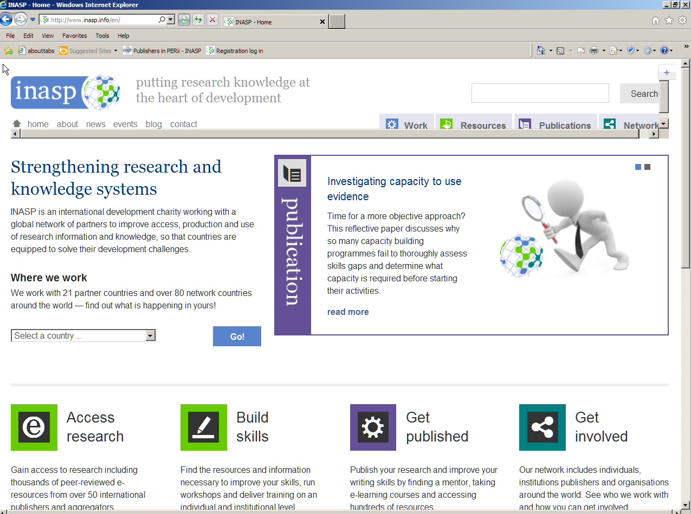
Notes:
Use the “select a country” box for a country-specific page
Facilitator could go to live link at www.inasp.info or download a screen grab of the relevant country page

Slide 15
Thank you Any questions?
Notes:
Move onto:

