Slide 1
Introduction to Creative Commons Licensing Considerations

Slide 2
What is it?
Creative Commons is a nonprofit organization that enables the sharing and use of creativity and knowledge through free legal tools.
Introduction to Creative Commons

Slide 3
Licensing
Creative Commons licenses allow content creators to openly declare the level of sharing that is allowed with their work.

Slide 4
Why is CC licensing needed?
Vs.

Slide 5
Why is CC licensing needed?
Vs.
“All rights reserved” is assumed for any creative work even if the copyright symbol is not used.

Slide 6
Why is CC licensing needed?
Vs.
Allows creators that want to share their work a legal way to define exactly what kind of sharing is allowed.
“All rights reserved” is assumed for any creative work even if the copyright symbol is not used.

Slide 7
Why is CC licensing needed?
Vs.
Allows creators that want to share their work a legal way to define exactly what kind of sharing is allowed.
“All rights reserved” is assumed for any creative work even if the copyright symbol is not used.
Creative Commons licensing is a legally valid and accepted form of licensing and is meant to work in conjunction with and support “all rights reserved” rights.

Slide 8
How is CC licensing structured?

Slide 9
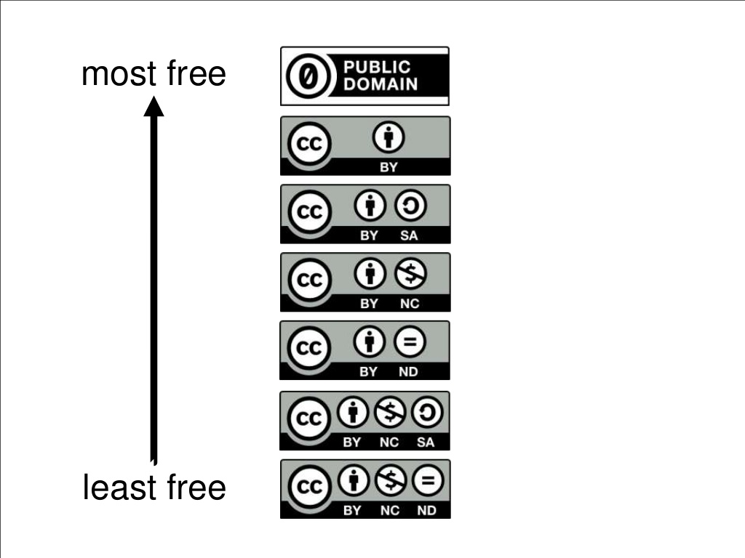
Image Source: Cable Green (http://www.slideshare.net/cgreen/textbook-rebellion-summit-7-1311)

Slide 10
Attribution
Information Source: http://creativecommons.org

Slide 11
Attribution
Attribution-ShareAlike
Information Source: http://creativecommons.org

Slide 12
Attribution
Attribution-ShareAlike
Attribution-NonCommercial
Information Source: http://creativecommons.org

Slide 13
Attribution
Attribution-ShareAlike
Attribution-NonCommercial
Attribution-NoDerivs
Information Source: http://creativecommons.org

Slide 14
Attribution
Attribution-ShareAlike
Attribution-NonCommercial
Attribution-NoDerivs
Attribution-NonCommercial-ShareAlike
Information Source: http://creativecommons.org

Slide 15
Attribution
Attribution-ShareAlike
Attribution-NonCommercial
Attribution-NoDerivs
Attribution-NonCommercial-ShareAlike
Attribution-NonCommercial-NoDerivs
Information Source: http://creativecommons.org

Slide 16
Attribution
Attribution-ShareAlike
Attribution-NonCommercial
Recommended License Selections for the most versatility and openness
Attribution-NoDerivs
Attribution-NonCommercial-ShareAlike
Attribution-NonCommercial-NoDerivs
Source: Cable Green (http://www.slideshare.net/cgreen/textbook-rebellion-summit-7-1311)

Slide 17
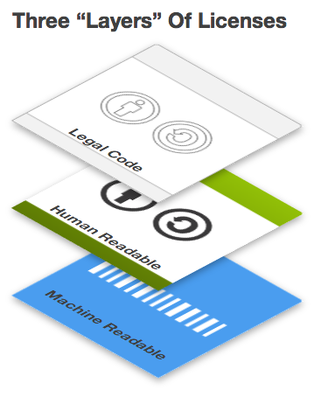
Source: http://creativecommons.org

Slide 18
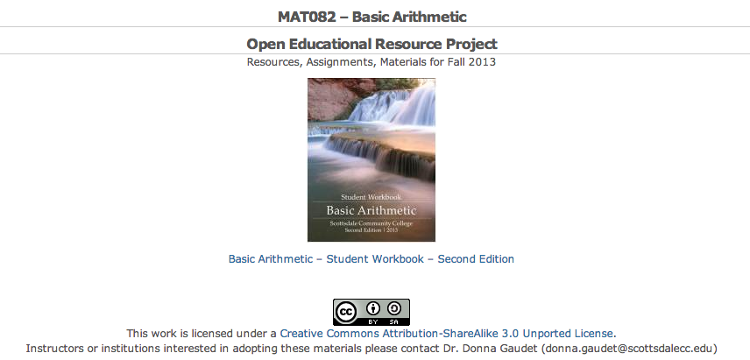
Example – Web Page
SCC Math Blog: http://sccmath.wordpress.com

Slide 19
Example – Web Page
SCC Math Blog: http://sccmath.wordpress.com

Slide 20
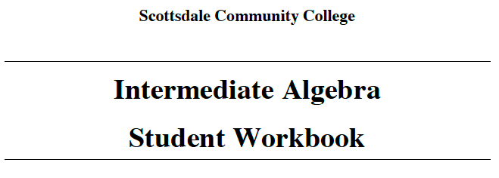
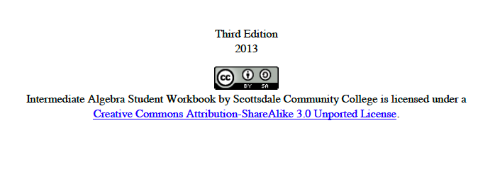
Example – Print

Slide 21
Example – Print

Slide 22
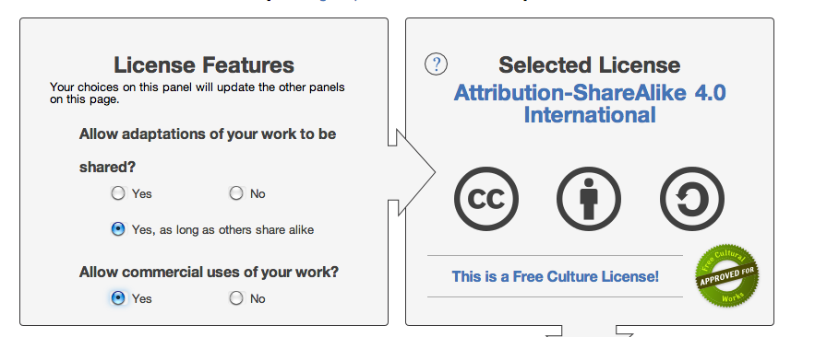
Generating a License
Creative Commons License Chooser

Slide 23
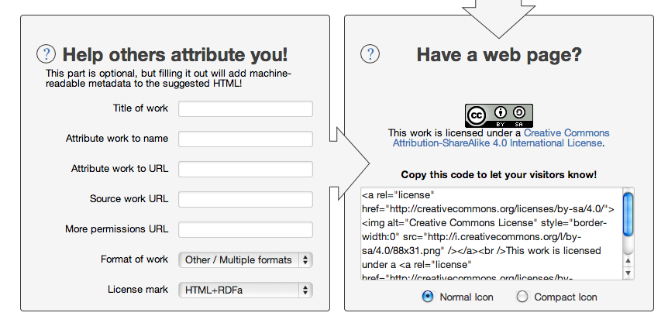
Generating a License
Creative Commons License Chooser

Slide 24
Resources
Creative Commons (creativecommons.org)
License chooser (creativecommons.org/choose/

Slide 25
Additional Attributions
Creative Commons Logo – http://creativecommons.org - CC-BY
Copyright Logo – Public Domain

