Slide 1
Plagiarism Detection
Shijith Kumar C

Slide 2
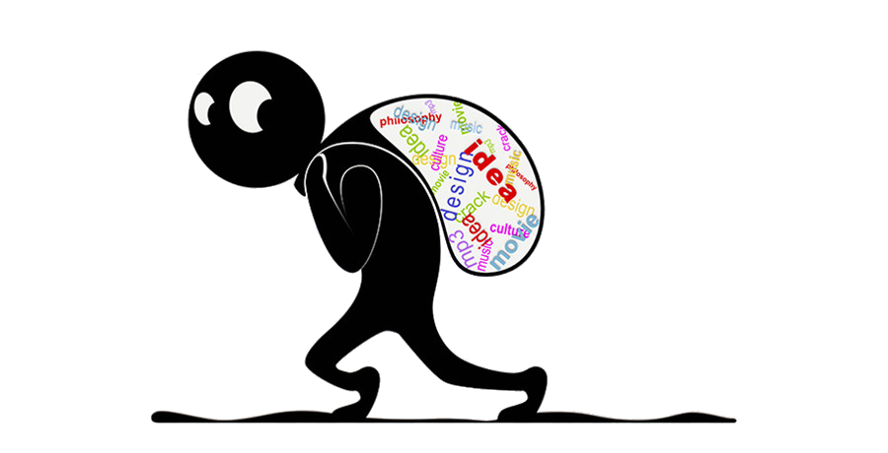
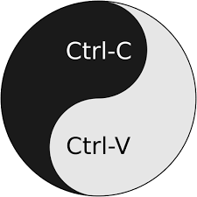
What is plagiarism?
Image Source: www.pinterest.com
“The practice of taking someone else's work or ideas and passing them off as one's own” Oxford

Slide 3
Stealing
Lying
Academic Misconduct

Slide 4
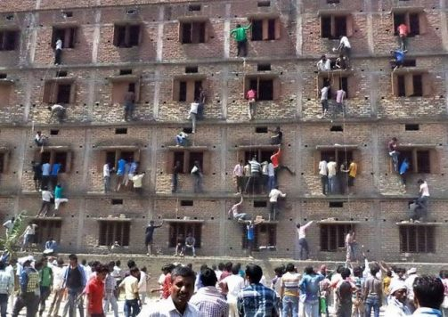

Academic Misconduct

Slide 5
Common Knowledge

Slide 6
Public Domain

Slide 7
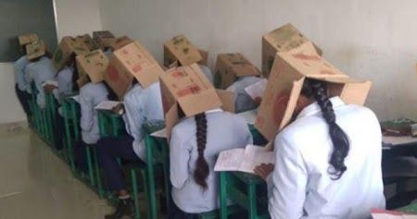
Plagiarism Detection Tools

Slide 8
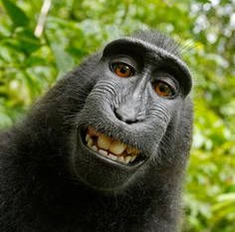
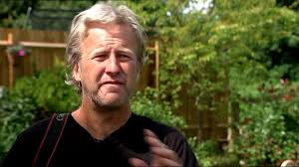

Slide 9
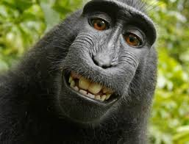

Slide 10
Purview of Plagiarism…
1. Presenting an entire work as our own
2. Copying words without giving credit
3. Omitting quotation in quotation marks
4. Giving incorrect reference
5. Changing words but copying sentence structure
6. Copying so many words or ideas from a single source

Slide 11
…Purview of Plagiarism
Copying images from other websites
Making a video using footage from others
Performing a copyrighted music
Composing music from another

Slide 12
www.pixabay.com
www.pexels.com
www.flickr.com

Slide 13
Plagiarism Detection Tools
Web-based
Fee/Free
E-resources
Coverage
Concern

Slide 14

Publishr’s choice
Excellent coverage
Cost-effective
Instructional tool

Slide 15
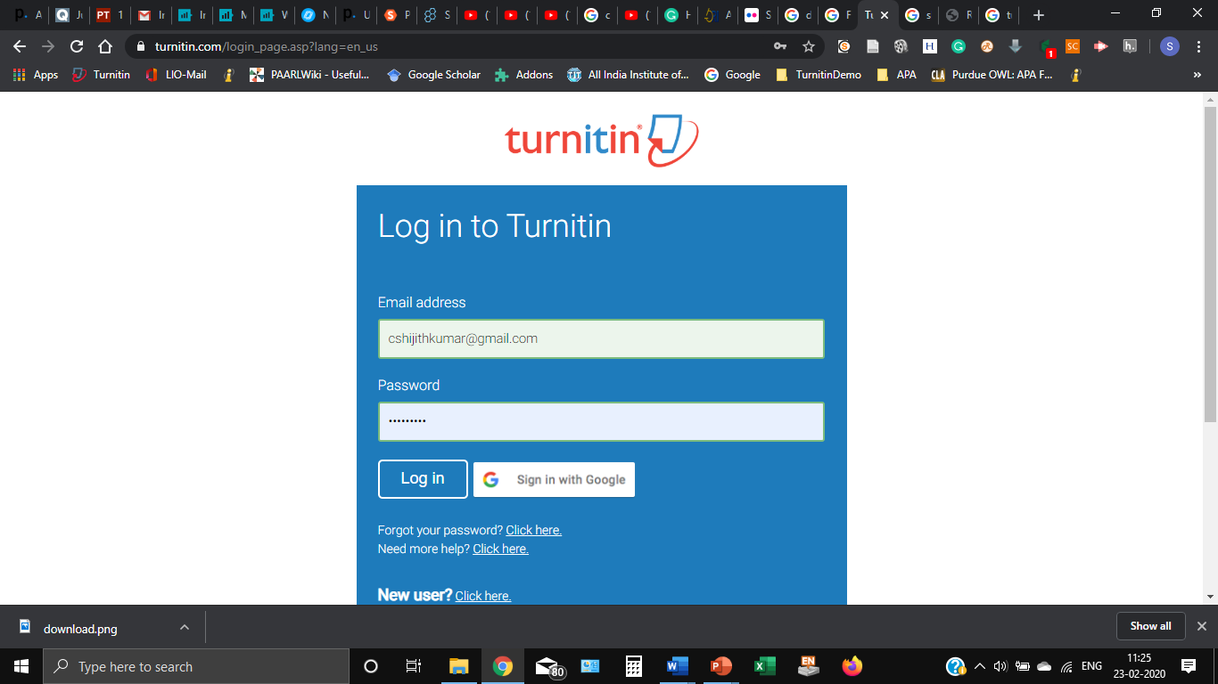

Slide 16
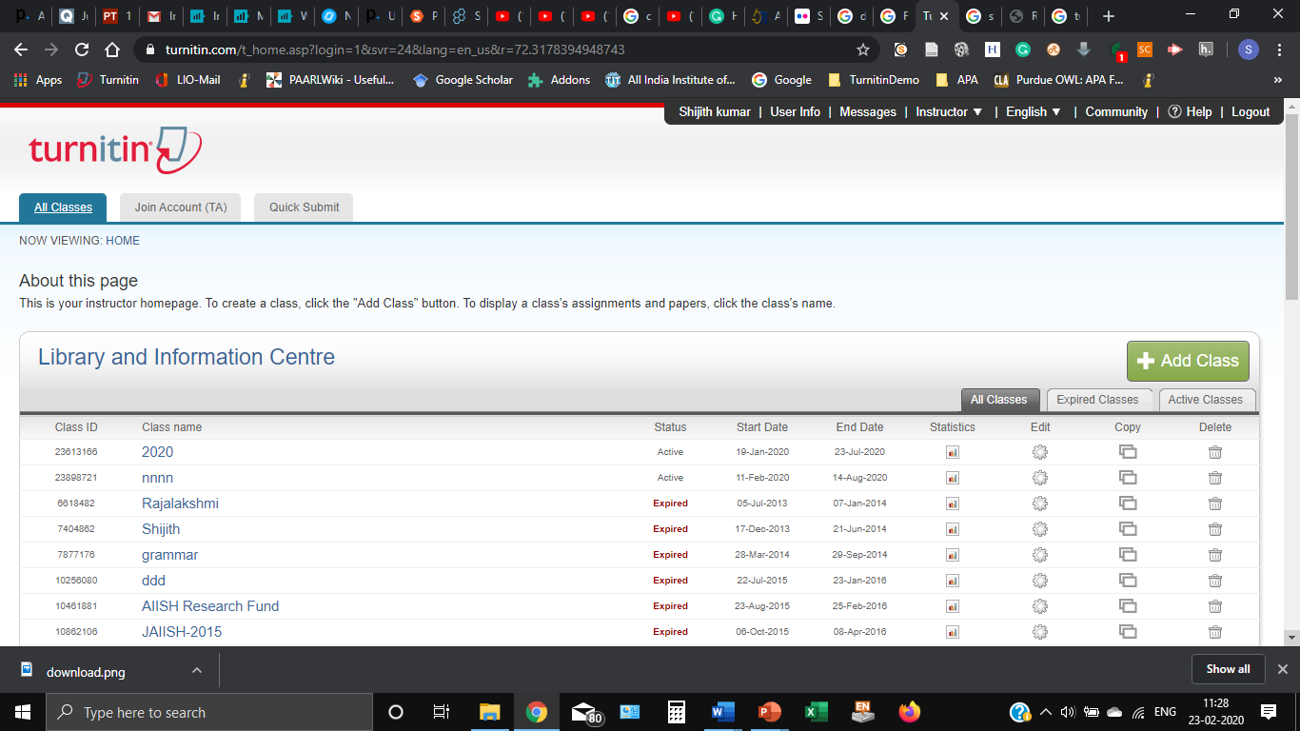

Slide 17
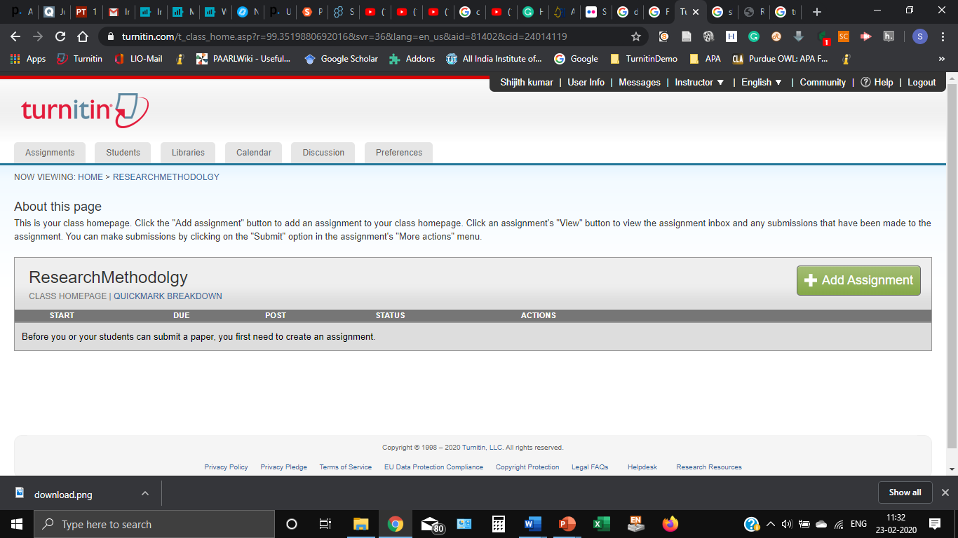

Slide 18
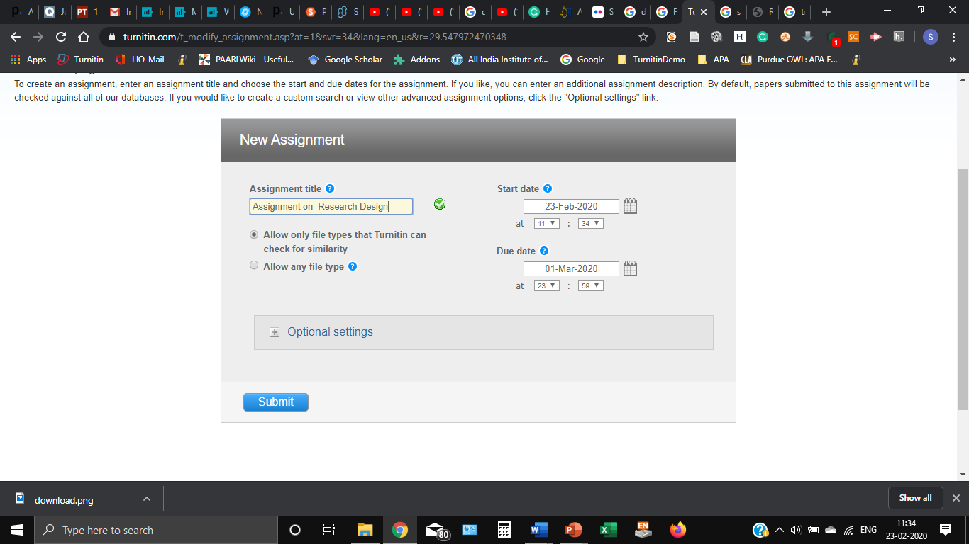

Slide 19
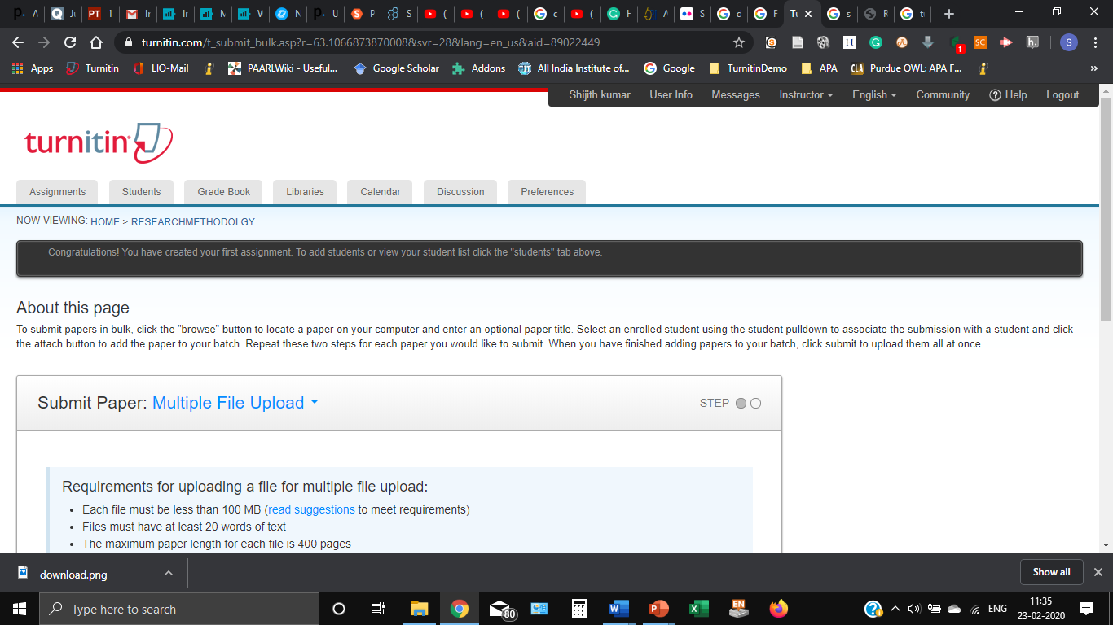

Slide 20
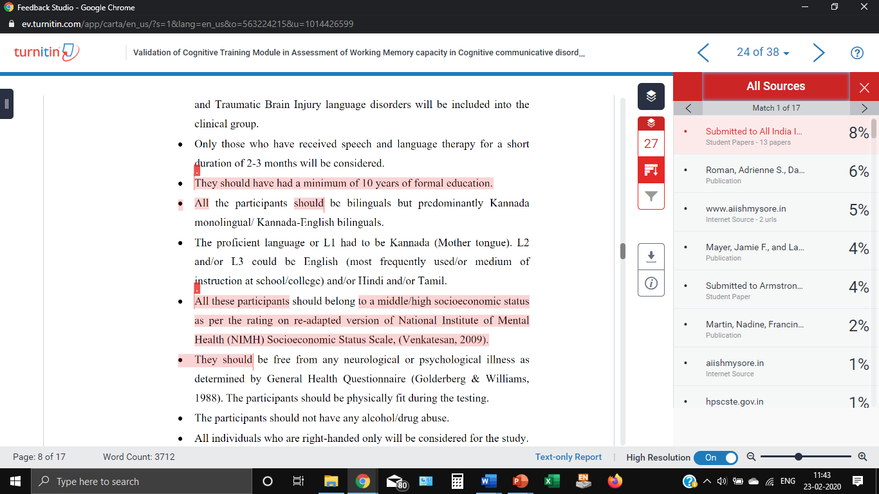

Slide 21
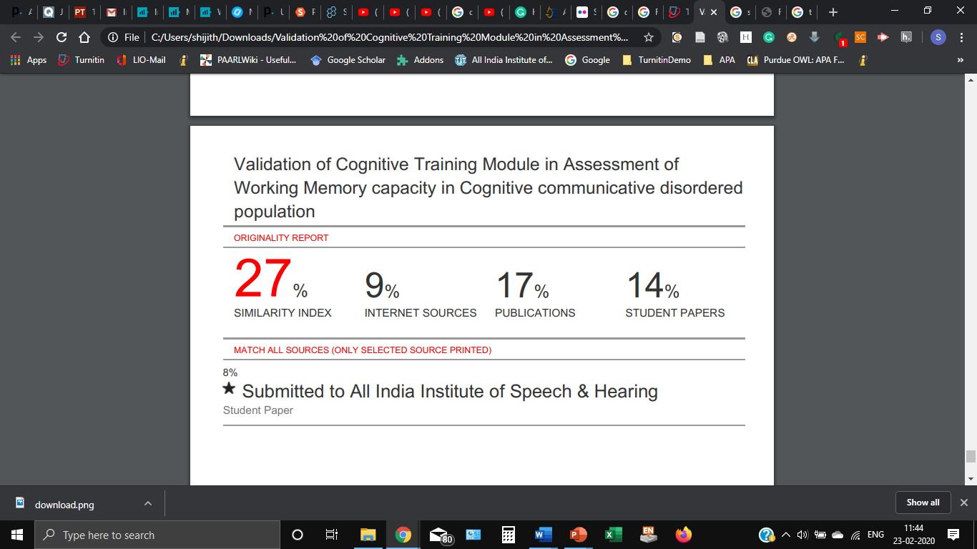

Slide 22
UGC Regulations
on
Promotion of Academic Integrity
&
Prevention of Plagiarism
in
Higher Educational Institutions

