Slide 1
UGC Regulations
on
Promotion of Academic Integrity
&
Prevention of Plagiarism
in
Higher Educational Institutions

Slide 2
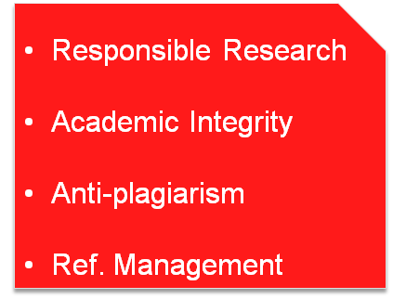
Objectives
Create
awareness
Education & Training

Slide 3
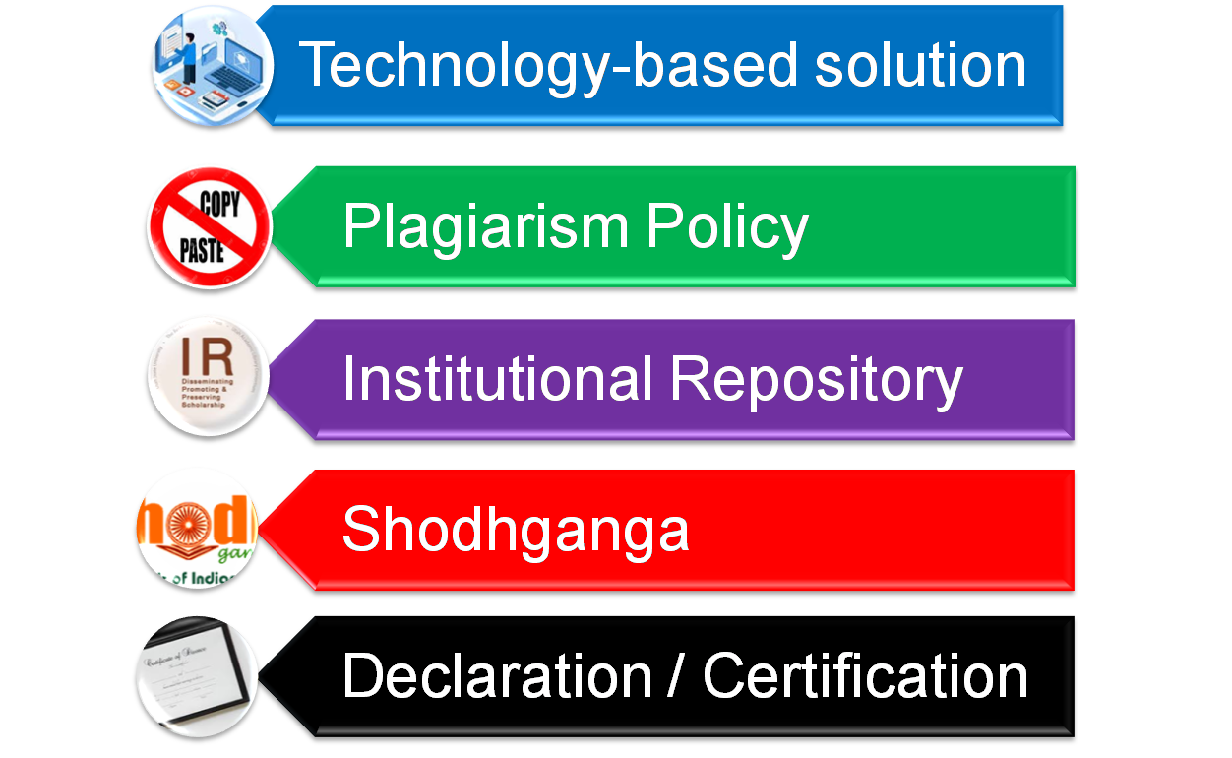
Curbing Plagiarism

Slide 4
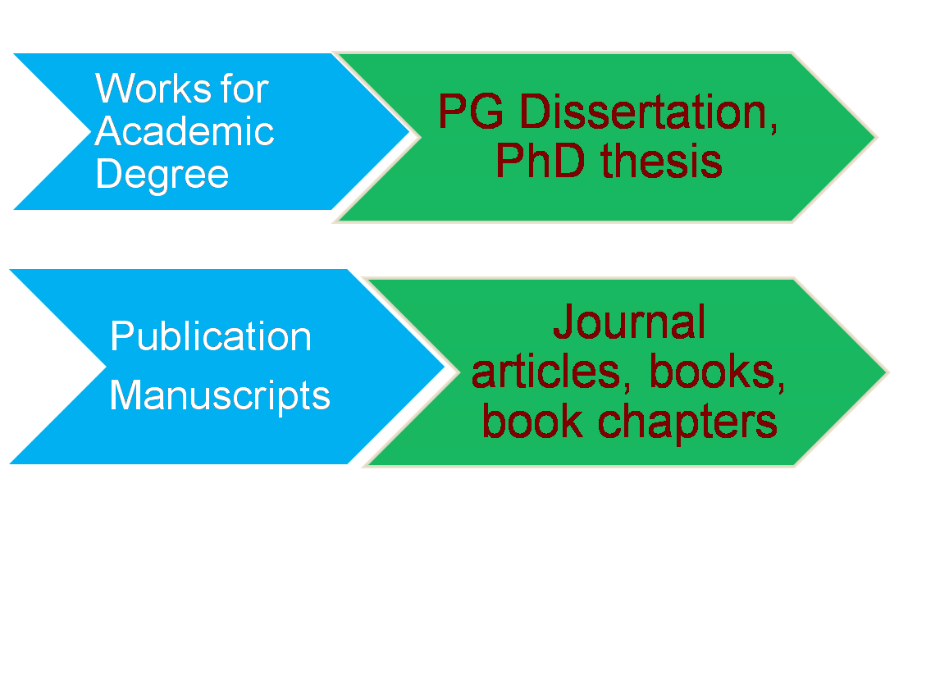
Types of Research Works
Exclusions: Assignments, Term Papers, Essays, Course Works & Projects Reports

Slide 5

Exclusion from Similarity Check
Acknowledgement
Bibliography / References
Generic terms, laws, std. equations
Preface
Table of contents

Slide 6
Levels of Plagiarism
Level 3
(Above 60%)
Level 2
(40-60 %)
Level 1
(10-40 %)
Level 0
(Below 10%)

Slide 7

Penalty
Plagiarism Level | Thesis & Dissertation | Publication Manuscript
L0 (0-10%) | No penalty | No penalty
L1 (10-40%) | Revise in 6 months | Manuscript withdrawal
L2 (40-60%) | 1 year debarment | Manuscript withdrawal Increment denial (1no.) Guideship suspension(2yrs)
L3 (60% & above) | Registration cancellation | Manuscript withdrawal Increment denial (2 no.) Guideship suspension(3 yr)

Slide 8
Handling of Plagiarism
Departmental Academic Integrity Panel (DAIP)
Chairman: Head of the Dept.
Member: Faculty from other Dept.
Member: Expert in anti-plagiarism tools
Chairperson: PVC/Dean/Sr. Faculty
Member: Sr. Faculty
Member: Faculty from outside the organization
Member: Expert in anti-plagiarism tools
Institutional Academic Integrity Panel (IAIP)

Slide 9
Concerns & Conclusion
  Technology-based solution
  Quantification of plagiarism
  Incomplete penalty clause
  Bold initiative

