Slide 1
Library & INFORMATION CENTRE, AIISH Resources and Services

Slide 2
Library Resources
Print
Electronic

Slide 3
Print Resources
Books
Newspapers
Journals
Bound volumes of journals
Theses & Dissertations/ Research Reports

Slide 4
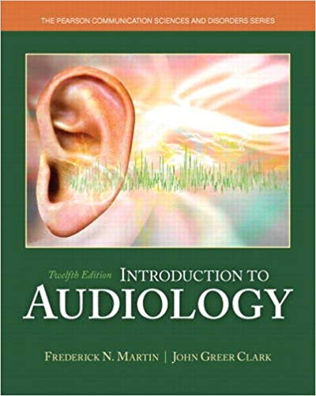
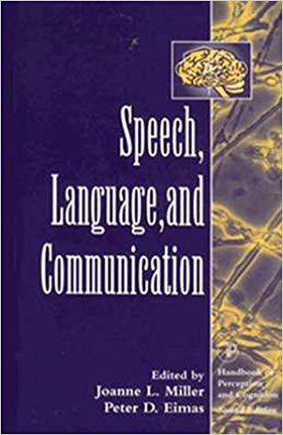
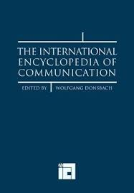
Books
Textbooks
Edited books
Reference books
Textbook Edited book Reference book

Slide 5
Book Sections & Loan Period
Reference
Textbooks/ edited books 2 days
Reference books
Stack
Textbooks/ edited books 7 days
Literature books 14 days
Dewey Decimal Classification of Books

Slide 6
Book Circulation
Library Card
Fine for late return & loss of books
Electronic Surveillance

Slide 7
Journals
Periodical Publication
Frequency
Year, Volume & Issue No.

Slide 8
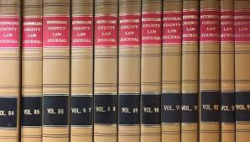
Bound Volumes

Slide 9
Theses & Dissertations/ Research Reports
PG Dissertations
PhD Thesis
Funded Projects

Slide 10
E-Resources
E-books
E-journals
Book CD-ROMs
Digital repository
Databases

Slide 11
Information Services…
1) Book Lending
2) ERMED Service
3) Institutional Repository
4) ISBN

Slide 12
…Information Services
5) N-LIST
6) Plagiarism detection
7) Reference management
8) Scholarly writing support

Slide 14
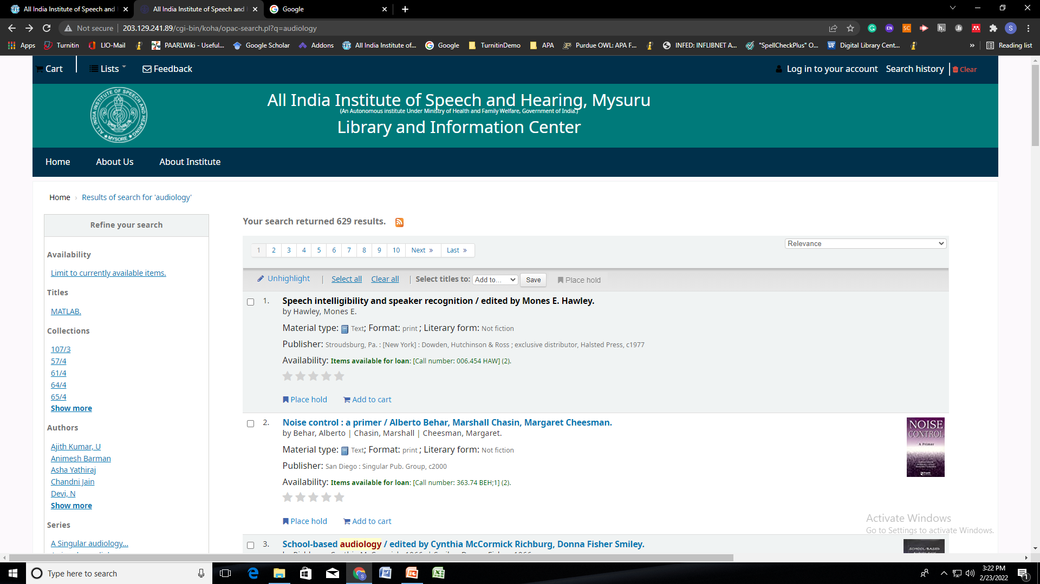
Online Public Access Catalogue

Slide 16
NLIST .....
National Library and Information Services Infrastructure for Scholarly Content
MHRD, UGC, INFLIBNET
6000 + e-journals & 135000+ e-books
Ebrary
Publisher & Subject-wise browsing
Searching through search interface
Al626786 chuda_99@yahoo.com

Slide 17
N-LIST
Access
User name & password-based
Only for AIISH staff & students
No self-generation of account
Global access

Slide 18
Rules & Regulations
Loan Period
Fine: Late return, loss of books, loss of cards
Discipline
Restrictions for print materials
Gate register
Security gate
Holidays

