Slide 1
Tackling Plagiarism in Academic Writing
Week-1
Tutorial-1
Basics of Plagiarism
Plagiarism definition
Types of plagiarism

Slide 2
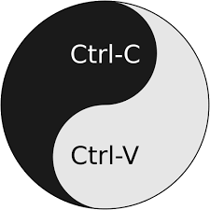
What is plagiarism?
The practice of taking someone else's work or ideas and passing them off as one's own.
from oxford
Image Source: in.pinterest.com

Slide 3
Types of plagiarism
There are different types of plagiarism–unintentional and intentional.
Sometimes students commit plagiarism intentionally, such as when they cut-and-paste sections from sources and drop them into the text of their paper.
Other times, plagiarism happens by accident.
Whether plagiarism occurs intentionally or unintentionally, it carries academic sanctions which could range from losing points or failing an assignment, to failing a class or expulsion from school.

