Slide 1
Academic Integrity
& Plagiarism

Slide 2
Academic Integrity
& Plagiarism

Slide 3
Academic Integrity
& Plagiarism
Photo by Peter Griffin/ CC0

Slide 4
PART 1
Basics

Slide 5
Cheating
Collusion
Impersonation
Plagiarism
Sabotage
Deception
Falsification
1
7
2
Academic Dishonesty
6
3
5
4

Slide 6
Notes:
Poll Title: In your opinion, what are the academic integrity values and qualities that are to be followed or practised by a student doing higher education? https://www.polleverywhere.com/free_text_polls/dDlBLdzjStcPofnHqS0bq

Slide 7
Academic
Integrity
1
Honesty
2
Trust
6
Courage
5
Responsibility
3
Fairness
4
Respect
International Centre for Academic Integrity (ICAI)

Slide 8
Academic
Integrity
Honesty
Trust
Responsibility
Courage
Respect
Fairness

Slide 9
Notes:
Poll Title: Severe form of Academic Dishonesty https://www.polleverywhere.com/surveys/GLT4dIZMBAJtKGKOZfmgh

Slide 10
Notes:
Poll Title: Which amomg the following is https://www.polleverywhere.com/multiple_choice_polls/iQMHwpYTlAwbZ53LyH3Jj

Slide 11
Notes:
Poll Title: Forms of Plagiarism https://www.polleverywhere.com/surveys/Ccysdr2vW7dUBhb3mSAZw

Slide 12
Types of Plagiarism
Unintentional
Intentional

Slide 13
Poor language skills
Lack of subject knowledge
Plagiarism

Slide 15
Copyright
Right to Copy & Prevent Copying
© Copyright 2020
All Rights Reserved

Slide 16
Copyrightable
1) Literary Work
3) Cinematograph Film
5) Music Work
2) Artistic Work
4) Dramatic Work
6) Sound Recording

Slide 17
You purchased a book. Do you also own the copyright?

Slide 18
How to?
1. Automatic
2. Copyright
Office
How long?
Country of origin
Life of author +
60 years (India)
Who owns
1. Author
2. Creator
3. Composer
4. Producer
Employer
What rights?
1. Reproduce
2. Distribute
3. Rent or lend
4. Translate
5. Adapt
6. Perform

Slide 19
Copyright Infringement
Violation of copyright rules
Use of any copyrighted work without the permission
Copies of copyrighted work are made for sale/hire without permission or authority, like in the case of online piracy
A copyrighted work is performed in a public place
Infringing copies are distributed for the purpose of trade and personal gains
Public exhibition of infringing copies by way of trade prejudicial to the owner
Infringing copies are imported from another country into India
imprisonment for not less than 6 months and up to 3 years, or fine of at least Rs. 50,000 to Rs. 2 lakhs.

Slide 20
Copyright Infringement
Selling pirated books
Selling art work
Performing a play in public
Online piracy
Making copies of copyrighted works for sale or hire or letting them for hire.
Permitting performance of copyright infringed works at any place for the performance of works.
Distributing copyright infringing works.
Public exhibition of copyright-infringing works.
Importing copyright infringing works into India

Slide 21
Remedies for Infringement
Civil Remedies
Permanent Injunction
Rendition of accounts of profits ( monetary remedy measured by the profits made by the defendant illegally )
Damages for conversion (Compensation)
Delivery and destruction of infringing copies
Litigation costs
Criminal Remedies
Imprisonment ( Minimum six months & maximum 3 years)
Fine ( Minimum Rs. 50,000 & Maximum Rs. 2 lakhs)
Filing of cases: 3 years from the date of infringement

Slide 22
Exceptions
Research &
private study
Criticism / Review
Current events
Judicial proceeding
Amateur club performance
Sound recordings, dramatic/ musical works
(Under certain conditions)

Slide 23
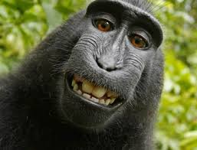
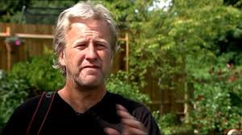

Slide 24
Intellectual Property
Right
Industrial Property Right
Patents
Trademarks
Copyright
Geographical Indicators

Slide 25
Creative Commons Licences
Some Rights Reserved

Slide 26
BY
Acknowledge
Non-commercial
Share alike
No derivatives
NC
ND
SA

Slide 27
1
Distribute, Adapt, Remix , Commercial & Non-commercial Attribution

Slide 28
2
Distribute, Adapt, Remix , Commercial & Non-commercial Attribution
Share Alike

Slide 29
3
Distribute, Commercial & Non-commercial Attribution
No Derivatives

Slide 30
4
Distribute, Adapt, Remix Attribution
Non-commercial

Slide 31
5
Download, Copy, Distribute, Modify, Build Upon
Attribution, Non-commercial, Share alike

Slide 32
6
Download, Copy, Distribute
Attribution, Non-commercial, No Derivatives

Slide 33
CCO
No Rights Reserved

Slide 34
Citing CC Materials: TASL model
Title & Source (Hyperlink)
Author
License Version & type (Hyperlink)
Example
Academic Integrity and Plagiarism by Shijith Kumar c licensed by CC BY 4.0

Slide 35
Creative Commons License Chooser
https://creativecommons.org/choose/

Slide 36
Plagiarism Vs. Copyright Infringement
Activity | Plagiarism | Copyright Infringement
Copying from copyright expired resources | ✓ | ✗
Copying in judgement | ✓ | ✗
Copying a small portion of a copyrighted work without attribution | ✓ | ✗
Copying large portion of a copyrighted work without attribution | ✓ | ✓
Copying a large portion of a copyrighted work with attribution | ✗ | ✓
Copying a copyrighted image in a work with attribution | ✗ | ✓

Slide 37
Plagiarism Detection Tools
Web-based
Fee-based/
Free
Coverage
Similarity Report
Cross checking

Slide 38
Name | Fee | Free
Codequiry | ✓ | ✓
Copyscape | ✓ | ✓
Docol©c | ✓ | ✓
DupliChecker |  | ✓
Exactus Like |  | ✓
Glatt Plagiarism Screening Program | ✓
Grammarly Plagiarism checker | ✗ | ✓
iThenticate | ✓
Maulik | ✓
Plagiarism Detector | ✓ | ✓
Plagiarisma | ✓ | ✓

Slide 39
Plagium | ✓ | ✓
PlagScan | ✓ | ✓
PlagTracker | ✓ | ✓
Quetext | ✓ | ✓
Safe Assign -Blackboard |  | ✓
Turnitin | ✓
Unicheck | ✓ | ✓
Urkund | ✓
Viper | ✓ | ✓
WCopyfind | ✓

Slide 40
TURNITIN iParadigm
Fee
Username
&
Psswd
Instruction support Tool

Slide 41
TURNITIN iParadigm
Instructional Tool
Username &
Password
E-mail
Subscription
Student
Instructor
Administrator

Slide 66
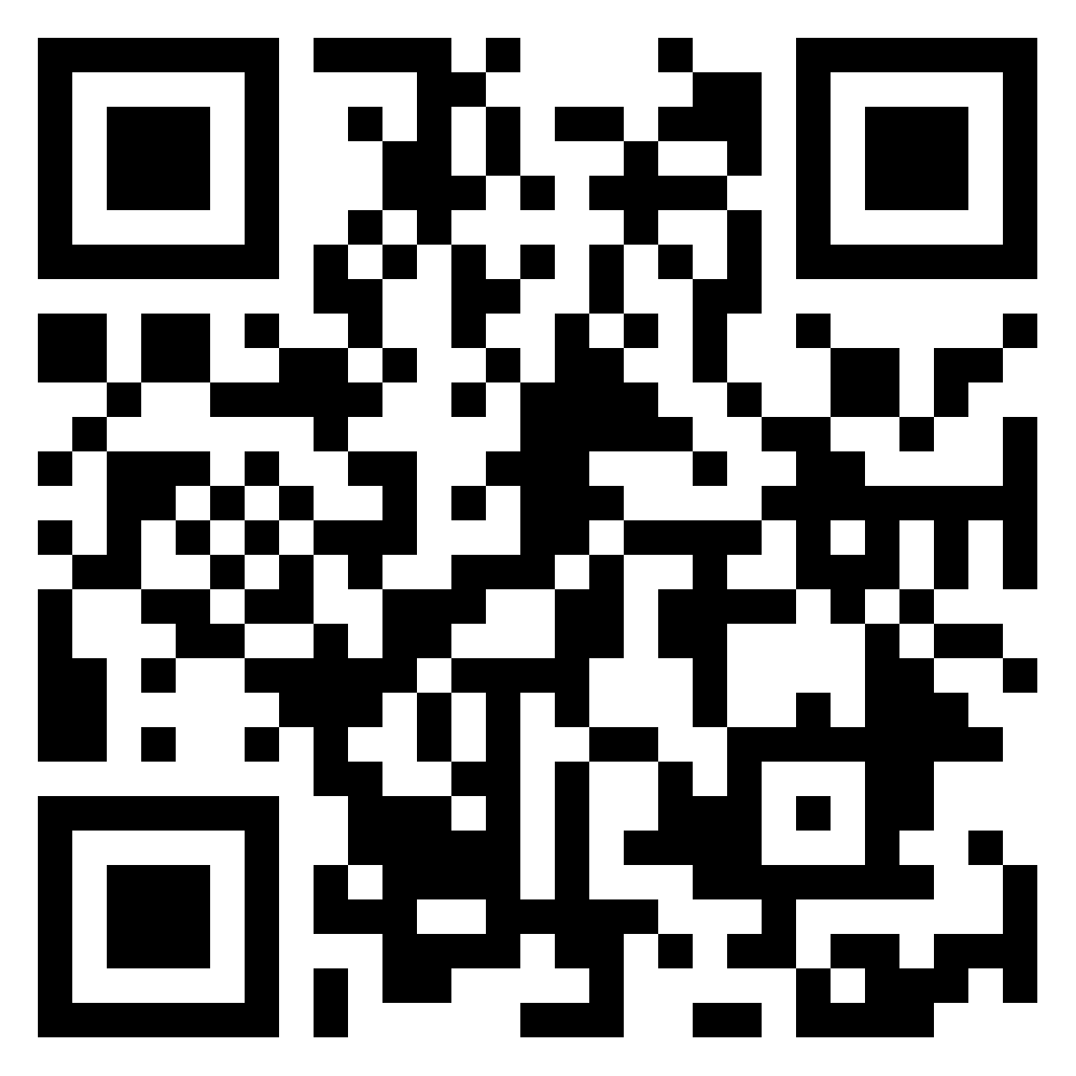
Feedback & Comments
https://padlet.com/cshijithkumar/123

