Slide 1
Electronic Information Resources/Services @ AIISH: Types and Access Modes

Slide 2
E-Resources
E-books
E-journals
3. Databases
4. Research Repository

Slide 3
E-services
Bibliographic management
Discovery system
Online Public Access Catalogue
Plagiarism detection
Remote login
Writing support tool

Slide 4
E-Books
Electronic counterparts of print journals
Born Digital or Digitized
Features
Links to related information
Multimedia
Content Searching
Evolving technology
Not many in Speech & Hearing

Slide 5
E-Journals
Electronic counterparts of print journals
Born Digital or Digitized
Features
Links to related information
Multimedia
Content Searching
Evolving technology
Not many in Speech & Hearing

Slide 6
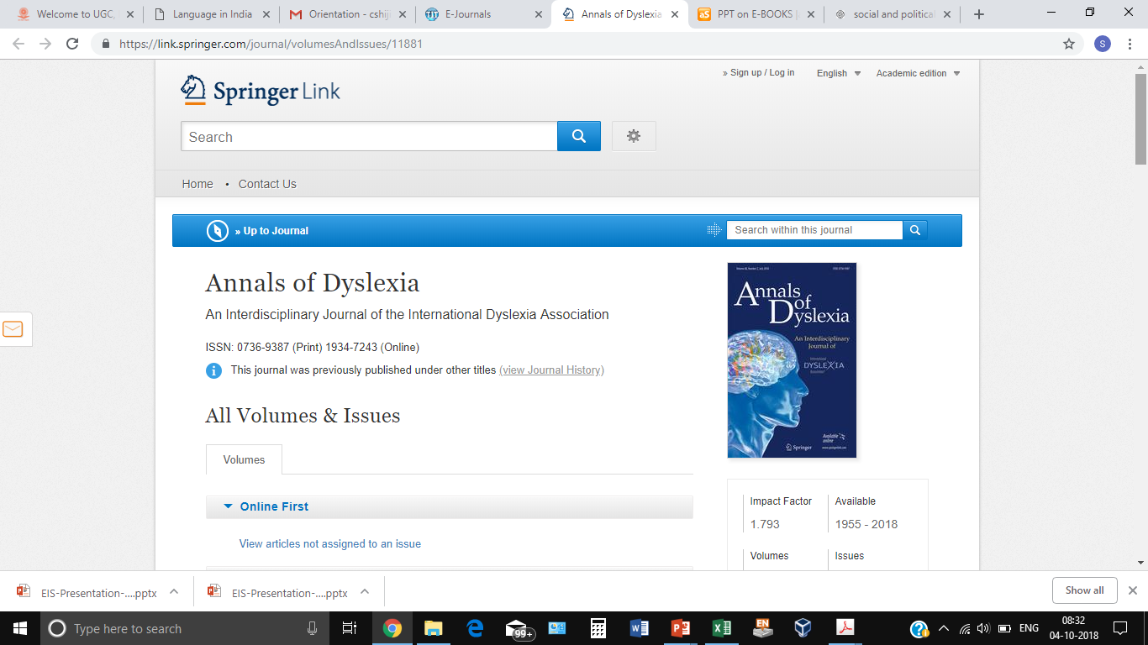

Slide 7
Databases
Collection of resources in a field
Content Types:
Journal articles
Conference papers
Book chapters
Theses & dissertations
Nature of Content:
Full-Text
Bibliographic

Slide 8
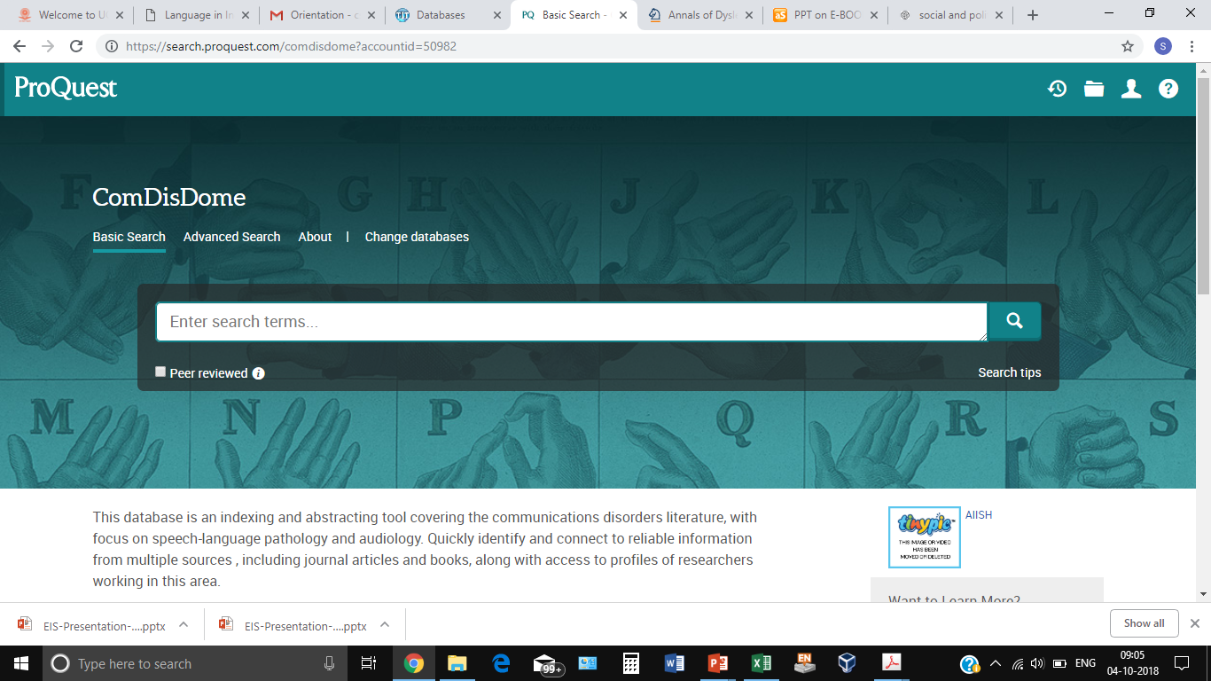

Slide 9
Research Repository
Organized Collection of Research Reports
Institutional Repository Vs National
Subject-specific Repository Vs General

Slide 10
Bibliographic management system
Software tools for managing bibliography
Free Vs Fee-based
EndNote
Zotero
Mendley

Slide 11
Discovery System
A Variety of E-Resources
Scattered Information
Manual Searching
Common Search Tool

Slide 12
Online Public Access Catalogue
Tool for searching the print resources
Mainly books
Author, Title, Subject
Status, No. of Copies
Modern tools: Feedback

Slide 13
Plagiarism Detection Tool
Unauthorized copying
Unethical
Tools for detecting plagiarism

Slide 14
Remote Login Tool
Intranet Access
Access from Across the Globe

Slide 15
Writing support tool
Grammar
Style
Format

Slide 17
AIISH Library and Information Centre
E-books, E-jrnls, databases, Research Repository
OPAC, Remote login, Bibliographic management Plagiarism detection, Grammar checker
N-LIST service
ERMED

Slide 18
Access Modes www.aiish.ac.in
Username & password based
Self-created
Created by Us
Intranet-based
Time-bound
Any time
User Restrictions
Only for AIISH Staff & students
For all

Slide 19
Research Repository ...
A digital repository of research reports of AIISH
Contents
PG Dissertations
Independent Projects
ARF Projects
PhD Theses

Slide 20
Research Repository ...
Features & drawbacks
Largest sp.& hg. Repository
Various search options
Updated on a daily basis
Not downloadable
Not copyable
No full-text searching
Content errors (Help us)
Missing pages

Slide 21
Research Repository ...
Access
User name & password based
Self registration
Free for all
Globally accessible

Slide 22
Databases..
Bibliographic
COMDISDOME
LLBA
Full-text
PsycARTICLES
MedOne ComSci
Hybrid
J-Gate
Free: PubMed, RehabData

Slide 23
Databases: Access Mode
Intranet-based only
Facility for personal account creation

Slide 24
N-LIST ...
MHRD, UGC, INFLIBNET
6000 + e-journals & 135000+ e-books
Publisher & Subject-wise browsing
Searching through common interface
Ebrary

Slide 25
N-LIST: Access
User name & password-based
Only for AIISH staff & students
No self-creation of account
Global access

Slide 26
ERMED
Educational Resources in Medicine
Ministry of Health & Family Welfare, GOI
Only E-journals
Intranet-based access

Slide 27
E-journals
Types
AIISH subscribed – 115 nos.
N-LIST – 66 nos.
ERMED – 240 nos.
Open Access – 200 nos. (Do not publish)
AIISH Archive- 14 nos.
Access
AIISH subscribed & ERMED: Intranet
N-LIST: Username & Password based

Slide 28
E-books
Types
AIISH subscribed – 176 nos.
N-LIST – 2826 nos.
Access
AIISH subscribed: Intranet
N-LIST: Username & Password based
E-book searching interface

Slide 29
Book CD-ROMs
Features
Supplementary materials
Total = 250 +
Search: Keyword, title, subject & author
Access
Intranet
Time-bound

Slide 30
Online Public Access Catalogue
Tool for searching print books
Intranet-based
Provides:
Location
No. of Copies
Status

Slide 31
Plagiarism Detection
Software: Turnitin
Access
User name & password based
Only for AIISH staff & students
Global access

Slide 32
Remote Access Information Service
Remote login to intranet
Access from across the globe
Username and password-based
Joint creation of username & password
Only for AIISH staff & students

Slide 33
Bibliographic Management System
Software: EndNote
Desktop based Activation
Writing Support Tool
Software: Grammarly
User name & Password based

