Slide 1
Electronic Information Resources & Services @ AIISH

Slide 2
E-Resources
E-books, E-journals, Databases, Research Repository
E-Services
Bibliographic Management, OPAC, Remote Login, Plagiarism Detection, Writing Support

Slide 3
National Information Services
National Library and Information Services Infrastructure for Scholarly Content –(N-LIST)
INFLIBNET, UGC
Higher Education Institutions
E-books, E-journals, Databases
Educational Resources in Medicine (ERMED)
MHFW
Health Institutions
E-Journals

Slide 4
Access Modes www.aiish.ac.in
Username & password based
Self-created
Created by Us
Intranet-based
Time-bound
Any time
User Restrictions
Only for AIISH Staff & students
For all

Slide 5
Research Repository ...
Digital collection of research reports of AIISH
Content
PG Dissertations
Independent Projects
ARF Projects
PhD Theses

Slide 6
Research Repository: Features
Largest Sp.& Hg. Repository
Various search options
Updated on a daily basis
Not downloadable
Not copyable
No full-text searching
Content errors (Help us)
Missing pages

Slide 7
Research Repository: Access Modes
User name & password based
Self registration
Free for all
Globally accessible

Slide 10
Databases..
Bibliographic
COMDISDOME
Linguistic and Lang. Behav. Abstract
PubMed, RehabData
Full-text
PsycARTICLES
MedOne ComSci
Hybrid
J-Gate

Slide 11
Databases: Access Mode
Intranet-based only
Facility for personal account creation

Slide 12
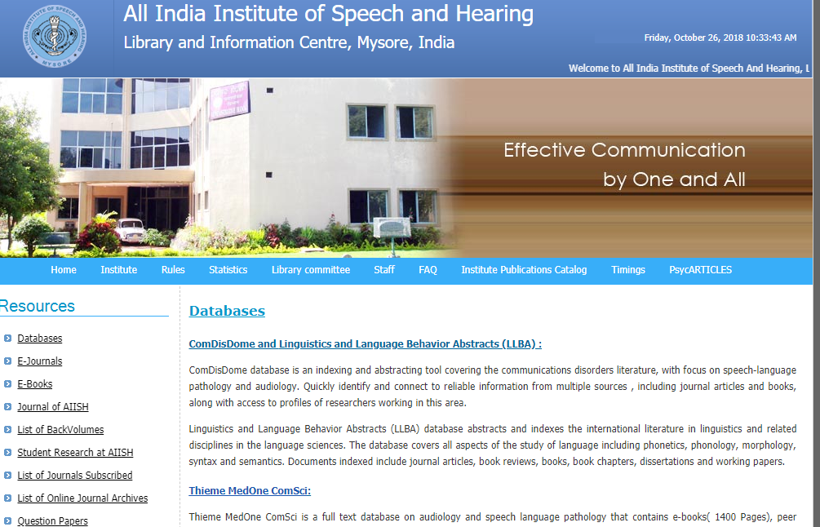

Slide 13
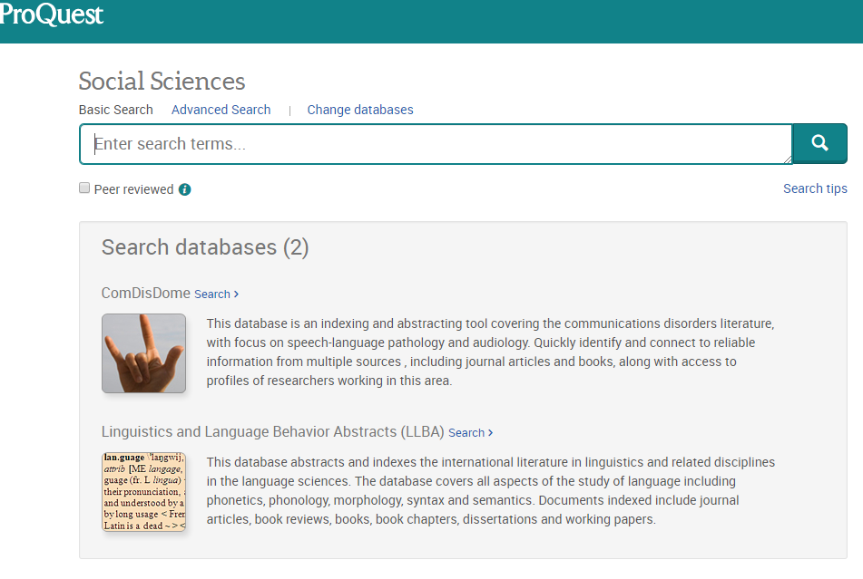

Slide 14
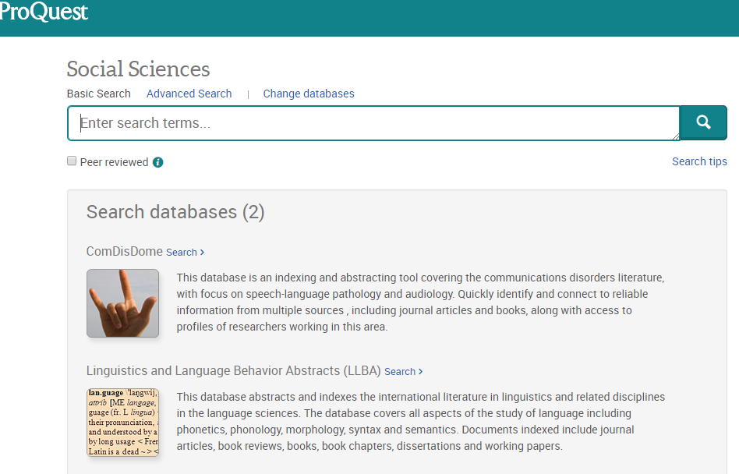
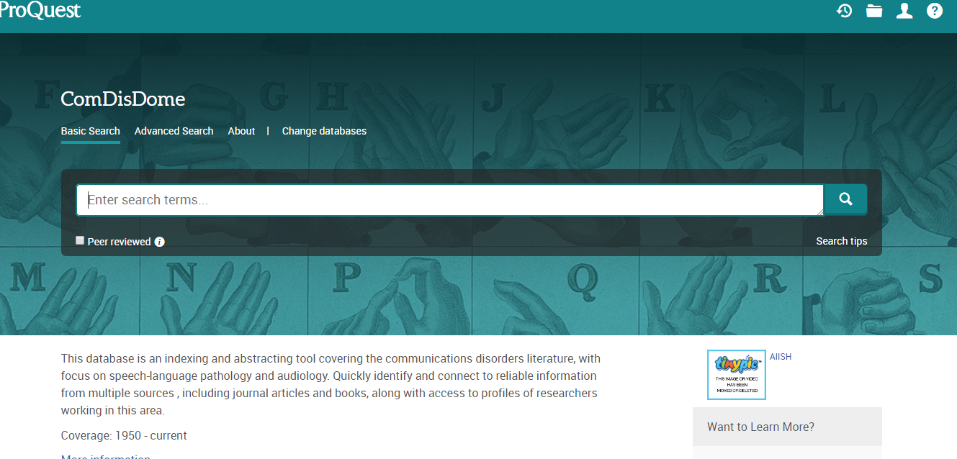

Slide 15
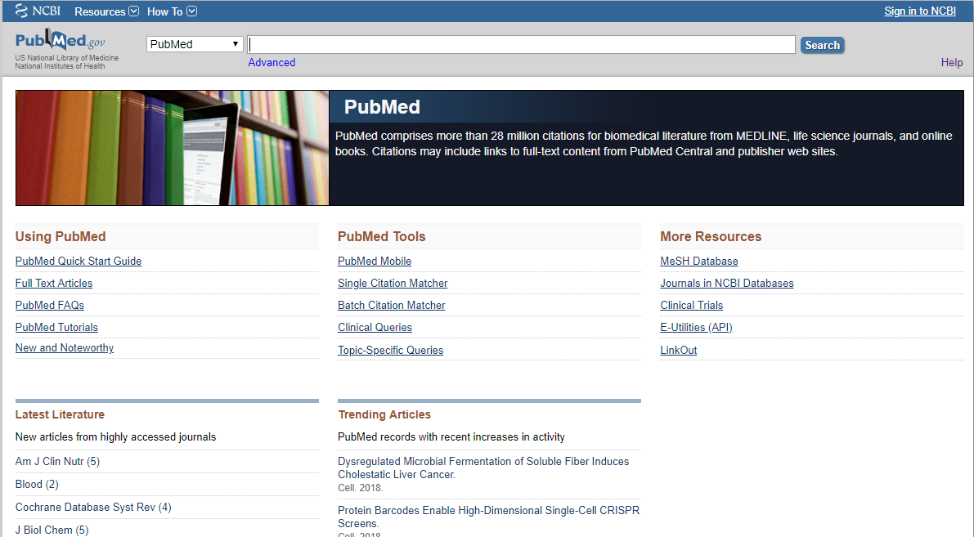

Slide 17
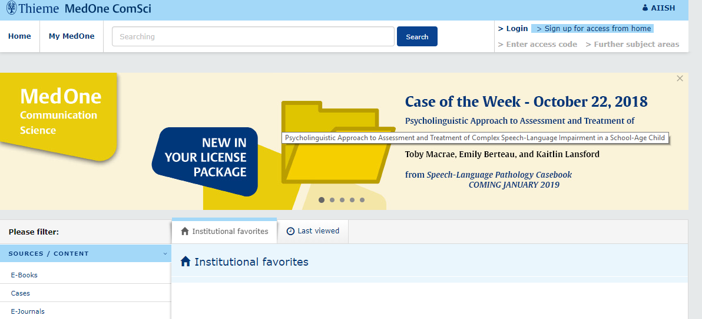

Slide 18
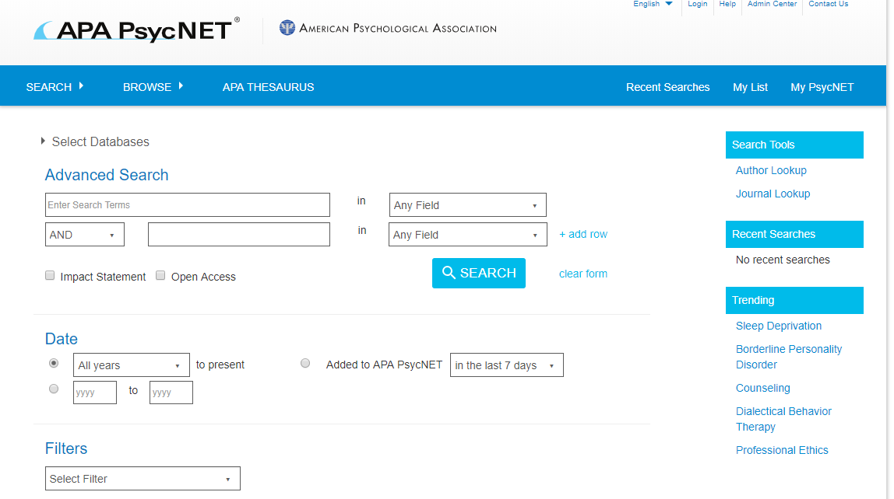

Slide 19
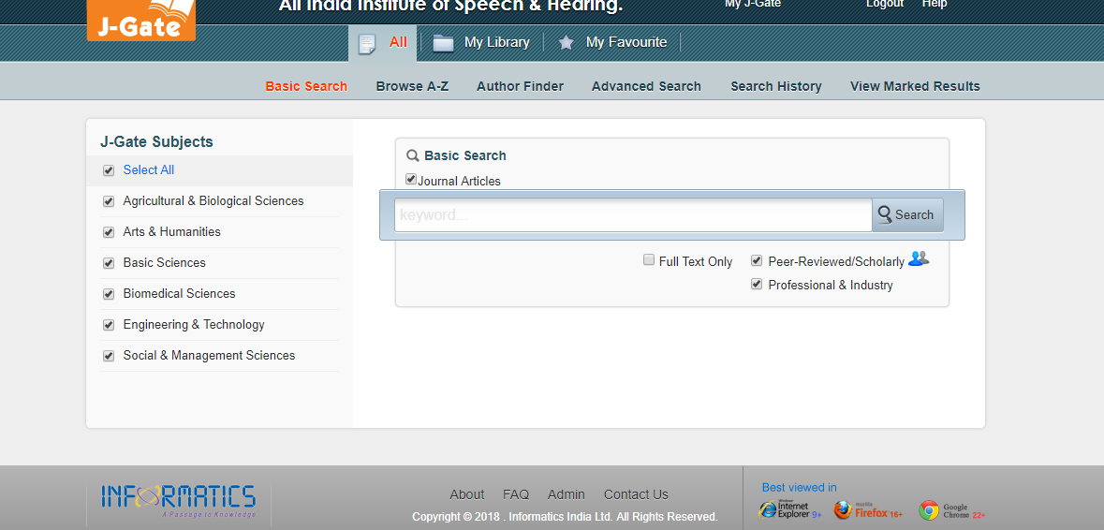

Slide 20
E-journals
Types
AIISH subscribed – 115 nos.
N-LIST – 66 nos.
ERMED – 240 nos.
Open Access – 200 nos.
AIISH Archive- 14 nos.
Access
AIISH subscribed & ERMED: Intranet
N-LIST: Username & Password based

Slide 22
N-LIST ...
MHRD, UGC, INFLIBNET
6000 + e-journals & 135000+ e-books
Publisher & Subject-wise browsing
Searching through common interface
Ebrary

Slide 23
N-LIST: Access
User name & password-based
Only for AIISH staff & students
No self-creation of account
Global access

Slide 25
ERMED
Educational Resources in Medicine
Ministry of Health & Family Welfare, GOI
Only E-journals
Intranet-based access

Slide 27
E-books
Types
AIISH subscribed – 176 nos.
N-LIST – 2826 nos.
Access
AIISH subscribed: Intranet
N-LIST: Username & Password based

Slide 29
Book CD-ROMs
Features
Supplementary materials
Total = 250 +
Search: Keyword, title, subject & author
Access
Intranet
Time-bound

Slide 31
Online Public Access Catalogue
Tool for searching print books
Intranet-based
Provides:
Location
No. of Copies
Status

Slide 33
Plagiarism Detection
Software: Turnitin
Access
User name & password based
Only for AIISH staff & students
Global access

Slide 34
Remote Login
Remote login to intranet
Access from across the globe
Username and password-based
Joint creation of username & password
Only for AIISH staff & students

Slide 35
Bibliographic Management
Software: EndNote
Desktop based Activation

Slide 36
Writing Support Tool
Software: Grammarly
User name & Password based

