Slide 1
Electronic Information Resources & Services

Slide 2
E-Resources
E-books
E-journals
3. Databases
4. Digital Research Repository

Slide 3
E-Services
Bibliographic management
Discovery system
Online Public Access Catalogue
Plagiarism detection
Remote login
Writing support

Slide 4
E-Books
Electronic counterparts of print journals
Born Digital or Digitized
Features
Links to related information
Multimedia
Content Searching
Not many in Speech & Hearing

Slide 5
E-Journals
Electronic counterparts of print journals
Born Digital or Digitized
Features
Links to related information
Multimedia
Content Searching

Slide 6
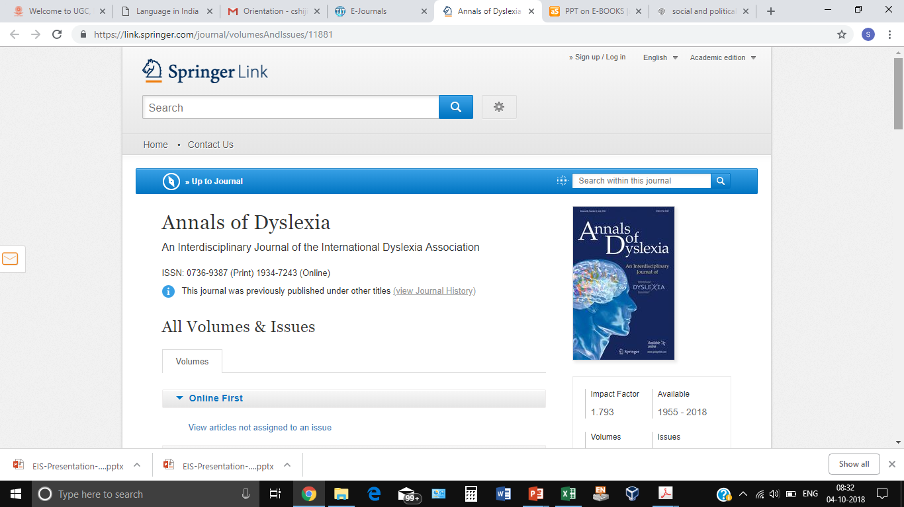

Slide 10
Databases
Collection of resources in a field
Content Types:
Journal articles
Conference papers
Book chapters
Theses & dissertations
Nature of Content:
Full-Text
Bibliographic

Slide 11
Research Repository
Organized Collection of Research Reports
Institutional Repository Vs National
Subject-specific Repository Vs General

Slide 12
Bibliographic Management System
Tool for managing bibliography
Free Vs Fee-based
EndNote
Zotero
Mendley

Slide 13
Discovery System
Variety of E-Resources
Scattered Information
Manual Searching
Common Search Tool

Slide 14
Online Public Access Catalogue
Tool for searching the print resources
Mainly books
Author, Title, Subject
Status, No. of Copies
Modern tools: Feedback

Slide 15
Plagiarism Detection Tool
Unauthorized copying
Unethical
Tools for detecting plagiarism

Slide 16
Remote Login Tool
Intranet Access
Access from Across the Globe

Slide 17
Writing Support Tool
Grammar
Style
Format

