Slide 1
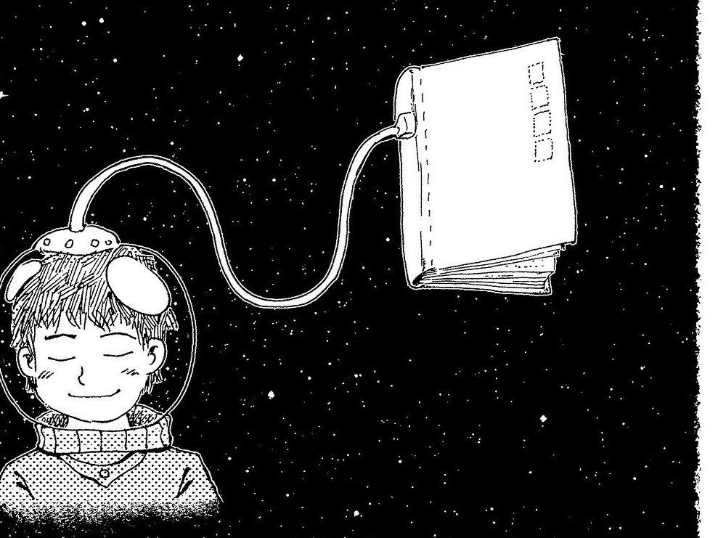
Library & Information Resources & Services @ AIISH
Shijith Kumar C
Library & Information Officer

Slide 2
Information Sources
Print
Electronic
Information Services
Print
Electronic
Library & Information Centres

Slide 3
Print Resources
Books
Journals
Bound Volumes
In-house Publications
Theses & Dissertations

Slide 4
E-Resources
1. E-journals
2. E-books
3. Databases
4. Digital Research
Reports

Slide 5
Resource Organization &
Management
Accessioning
Classification
Cataloguing
Shelf Rectification
Stock Verification
Weeding

Slide 6
Information Services
Author Solution
Book Circulation
Book CD-ROM service
ERMED Service
ISBN
N-LIST
Online Public Access Catalogue
Plagiarism detection
Publisher Solution
Reference Management
Remote login
Writing support

Slide 7
www.aiish.ac.in

Slide 8
Access Modes
Username & password
Self-created
Created by Us
Intranet
Time-bound
Any time
User Restrictions
AIISH Staff & students
For all

Slide 9
Author Solution
Automatic
manuscript formatting
1,000,00
Journal formats
50
Accounts

Slide 10
Book CD-ROM Service
06
Newly added
445
Total Collection

Slide 11
Electronic Resources in Medicine
Electronic Resources in Medicine
242 Medical Journals
National Medical Library

Slide 12
Institutional Repository ...
A digital repository of research reports of AIISH
Content types
PG Dissertations
Independent Projects
ARF Projects
PhD Theses

Slide 13
Internet / Computer Service
Events | Numbers | Participants
Skill Test for Jobs | 04 | 156
Workshops/Orientations/Other Programmes | 16 | 303

Slide 14
ISBN Service
03
Newly allotted
245
Total allotted

Slide 15
National Library and Information Services Infrastructure for Scholarly Content
New Users
168
Total
969
Resources
6237 e-journals
31 lakhs e-books

Slide 16
OPAC
Online Public Access Catalogue
Number of records created 480

Slide 17
Publisher Solution
ePUB
PDF
E-JAIISH
MS Word templates
HTML
PG Dissertations
PhD Thesis
ARF Projects

Slide 18
Reference Management System
04
New installations
71
Total installations

Slide 19
Remote Access Information Service
E-journals
&
Databases
Active Users
55
Downloads
40

Slide 20
Anti-Plagiarism
Service
Total Users
156
New Users
35
Submissions
3033
Similarity Report
3021

Slide 21
Writing Support Service
92
07
28547546
Total
Users
New
Users
Words Checked

Slide 22
New IT Facilities / Upgradations
Suo Motu Disclosure Website | E-Journal Platform
Open Source Digital Repository | Open Source OPAC
E-learning Platform | New Library Website

Slide 25
New facilities/ Applications-1
Open Source Digital Repository

Slide 26
Online Public Access Catalogue

Slide 27
New website

Slide 28
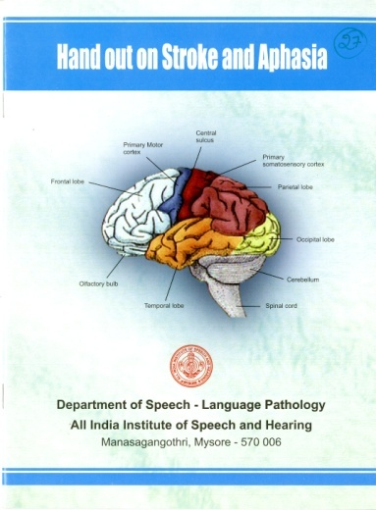
Product Development Cell
Total no. of Publications : 118

Slide 29
Future Plan
Research Data Repository
E-Content Development Lab
Extensive Training Programmes

