Slide 1
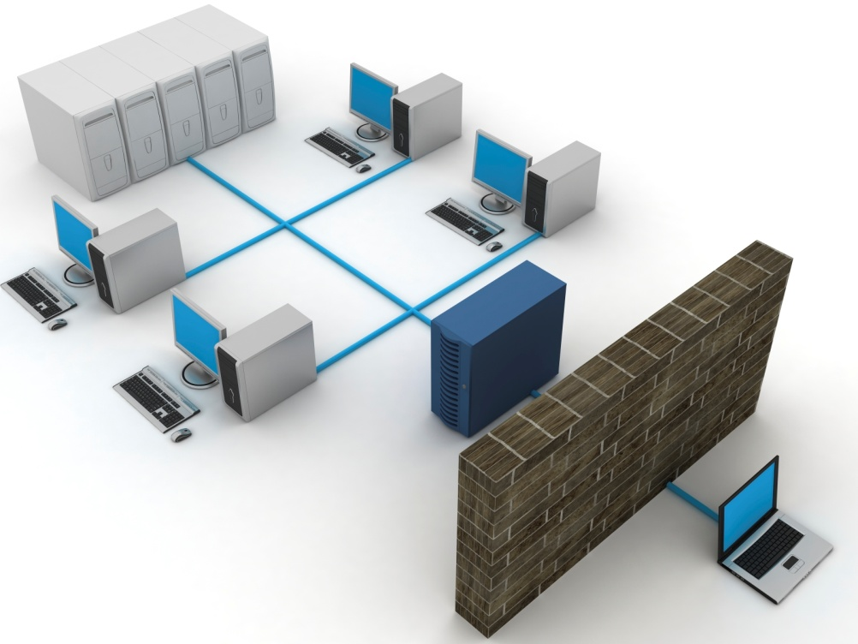
IT Infrastructure
State-of-the-art computer network with a 1 Gbps LAN comprising 5 servers and 400 systems, with 32 Mbps dedicated internet link
Extended network through MPLS VPN link connecting to DHLS centres
Wi-Fi networking
In-house email server which supports 1000 e-mail ID and 10 Gb of backup
Physical Infrastructure
All India Institute of Speech and Hearing
2021-22

Slide 2
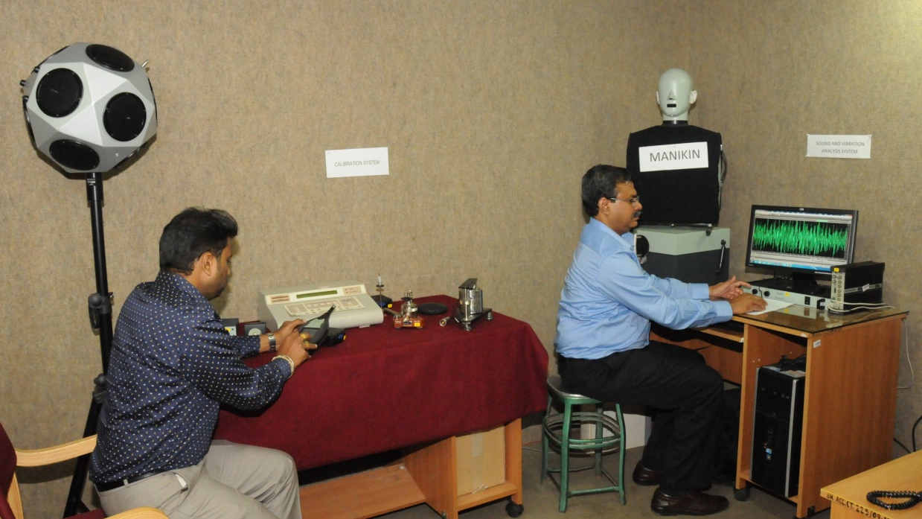
Electrical & Electronic Infrastructure
Uninterrupted power back up provided by one 250 KVA and 2x125KVA diesel generators with automatic switching ON facility.
11 KVA electrical substation with 315 KVA HT transformer.
Siemens Hipath 4000 EPABX with 1000 intercoms with Direct Inward Dialing, IP telephony, soft phones and call billing.
Physical Infrastructure
All India Institute of Speech and Hearing
2021-22

