Slide 1

Academic Integrity
&
Plagiarism

Slide 2
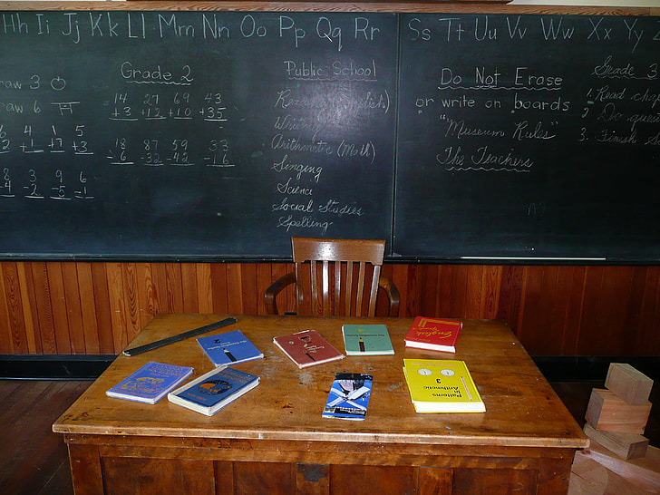
Academic Integrity
&
Plagiarism

Slide 3

Academic Integrity
&
Plagiarism
Photo by Peter Griffin/ CC0

Slide 4
PART 1
Basics

Slide 5
Cheating
Collusion
Impersonation
Plagiarism
Sabotage
Deception
Falsification
1
7
2
Academic Dishonesty
6
3
5
4

Slide 6
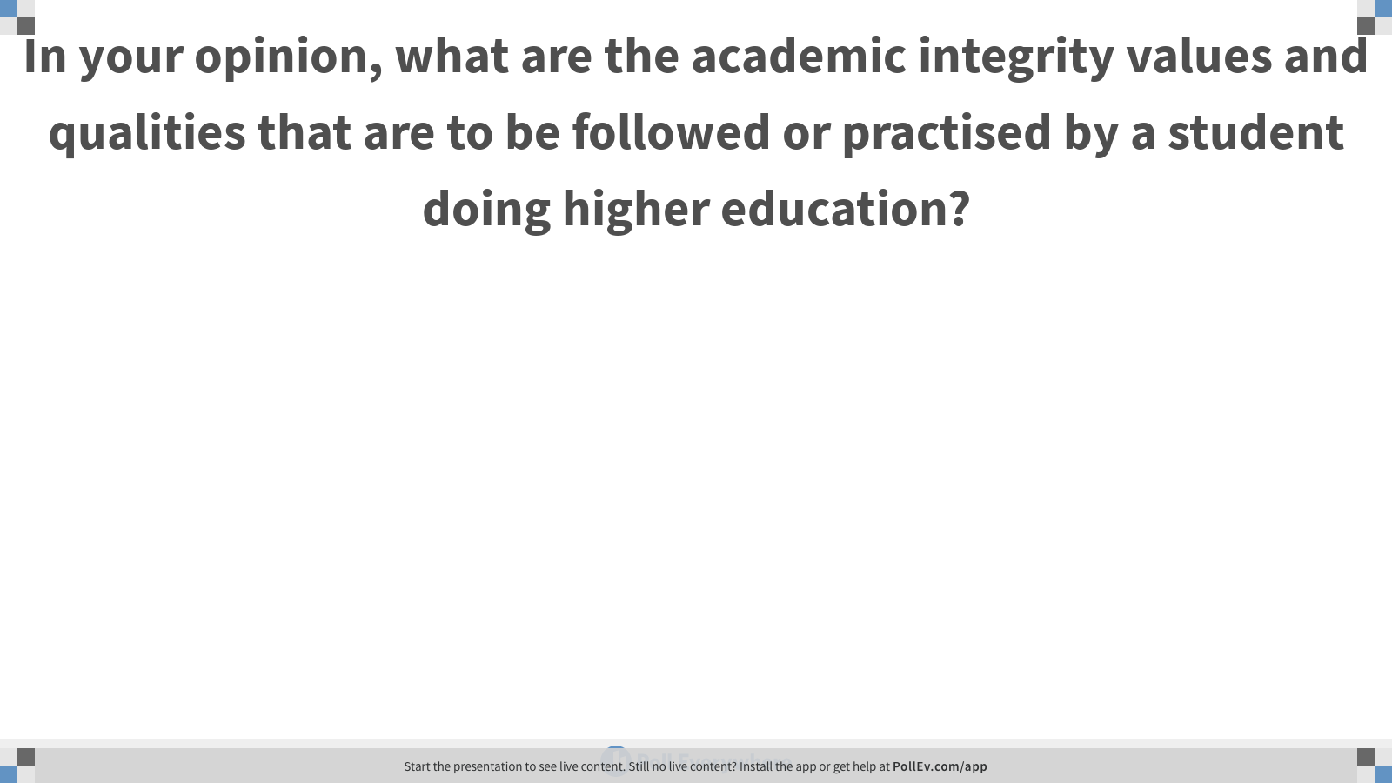
Notes:
Poll Title: In your opinion, what are the academic integrity values and qualities that are to be followed or practised by a student doing higher education?
https://www.polleverywhere.com/free_text_polls/dDlBLdzjStcPofnHqS0bq

Slide 7

Academic
Integrity
Honesty
Trust
Responsibility
Courage
Respect
Fairness
International Centre for Academic Integrity

Slide 8
Notes:
Poll Title: Forms of Plagiarism
https://www.polleverywhere.com/surveys/Ccysdr2vW7dUBhb3mSAZw

Slide 9
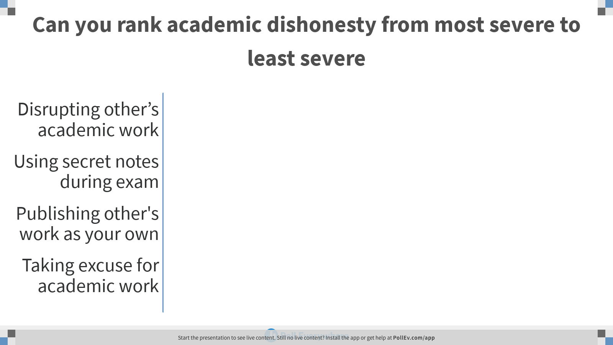
Notes:
Poll Title: Can you rank academic dishonesty from most severe to least severe
https://www.polleverywhere.com/ranking_polls/u5yHg4zbX0MeyDGpYqhHG

Slide 10
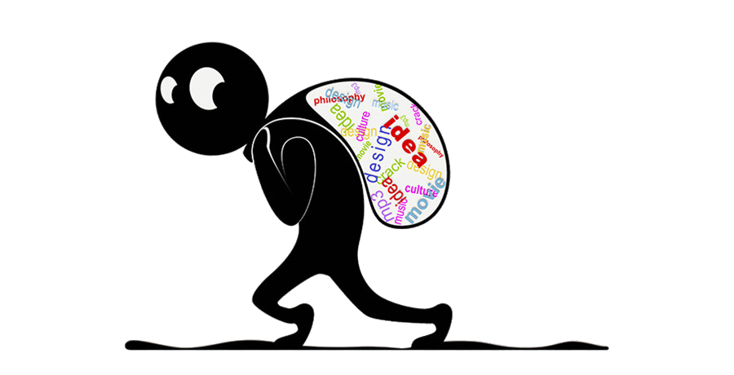
What is plagiarism?
The practice of taking someone else's work or ideas and passing them off as one's own
Oxford
Image Source: www.pinterest.com

Slide 11
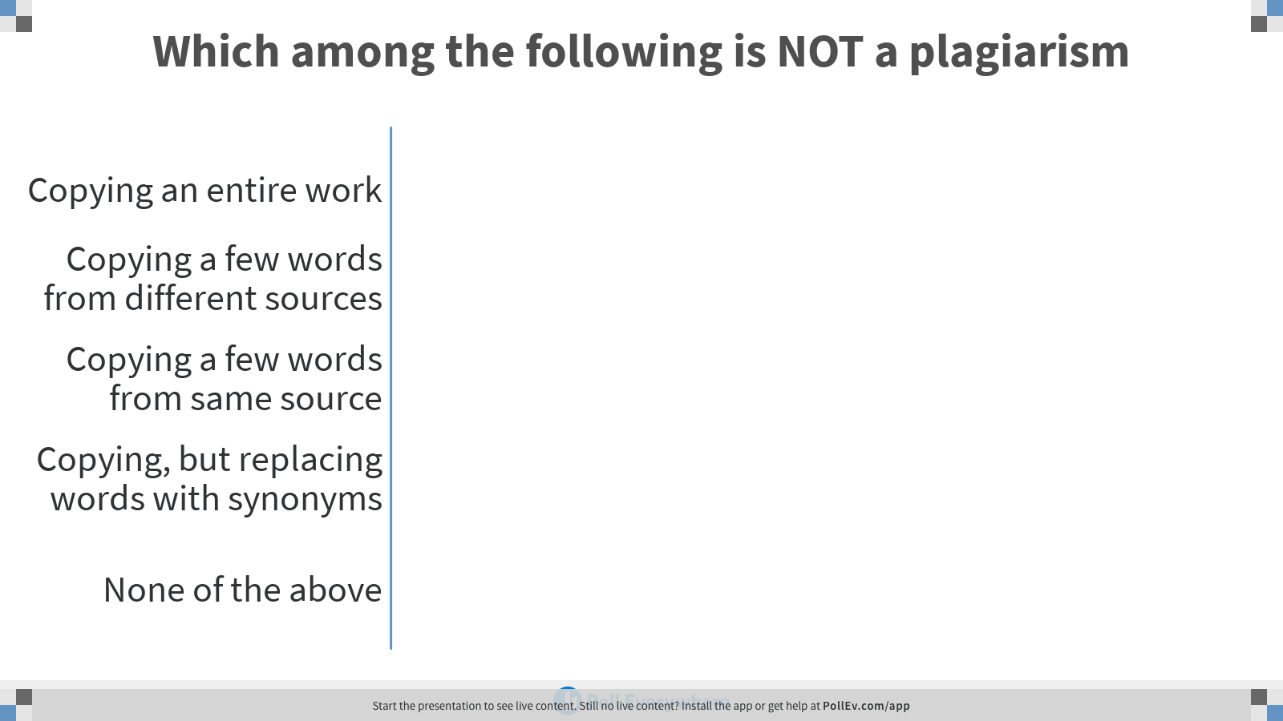
Notes:
Poll Title: Which among the following is NOT a plagiarism
https://www.polleverywhere.com/multiple_choice_polls/X8rNahERIK0xRz5NG137B

Slide 12
Citing
Referencing
Reference
Citation
or

Slide 13
In-text Citation
Literature from the United States suggests that diagnosis can alter the family context and result in parents experiencing a loss of their own identity, sense of self and role (Atwood & Gallo, 2010)
*** *** ***
Reference List Entry
References
Abbott, M., Bernard, P., & Forge, J. (2013). Communicating a diagnosis of autism spectrum disorder–A qualitative study of parents’ experiences. Clinical Child Psychology and Psychiatry, 18, 370–382.
Atwood, J. D., & Gallo, C. (2010). Family therapy and chronic illness. Piscataway, NJ: Transaction Publishers.
Avdi, E., Griffin, C., & Brough, S. (2000). Parents’ constructions of professional knowledge, expertise and authority during assessment and diagnosis of their child for an autistic spectrum disorder. Psychology and Psychotherapy: Theory, Research and Practice, 73, 327–338.
*** *** ***

Slide 14

In-text Citation
Quotation
Short quotation
Long quotation
Paraphrasing

Slide 15
Short quotation
According to James (2014), "Students often had difficulty in speaking and writing, especially those in age group 5-10" (p. 199)
Paraphrasing
Children between 5 and 10 years had trouble in communication (James,2014)
Long Quotation/ Block Quotation
Today, world wide web applications have practically taken over Internet. As Johnson (2010) explained,
Web now make up 90% of Internet based tools and services. This increase in growth of the web can be partially attributed to the hyperlinking feature of the web, which has made development of web-based applications very easy. (p. 23)

Slide 16

APA
Style
MLA
Style
Chicago
Style
Vancouver
Style
Citation Styles
American Psychological
Association
University of
Chicago
Modern Language Association
National
Library of
Medicine

Slide 17
Reference Management System
EndNote
RefWorks
Zotero
Mendeley

Slide 18
Poor language skills
Lack of subject knowledge
Plagiarism

Slide 19
Types of Plagiarism
Unintentional
Intentional

Slide 20
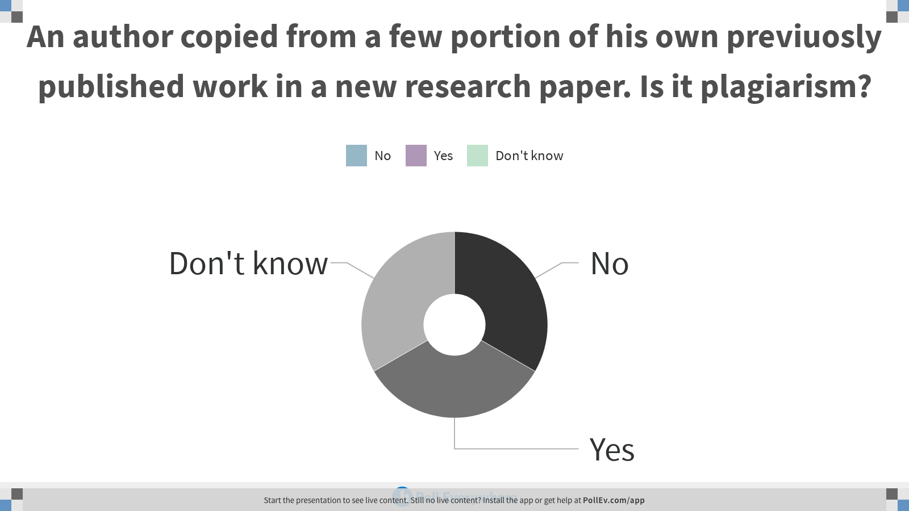
Notes:
Poll Title: An author copied from a few portion of his own previuosly published work in a new research paper. Is it plagiarism?
https://www.polleverywhere.com/multiple_choice_polls/ZRPBCFe4lUAc7IuPgeI1S

Slide 21
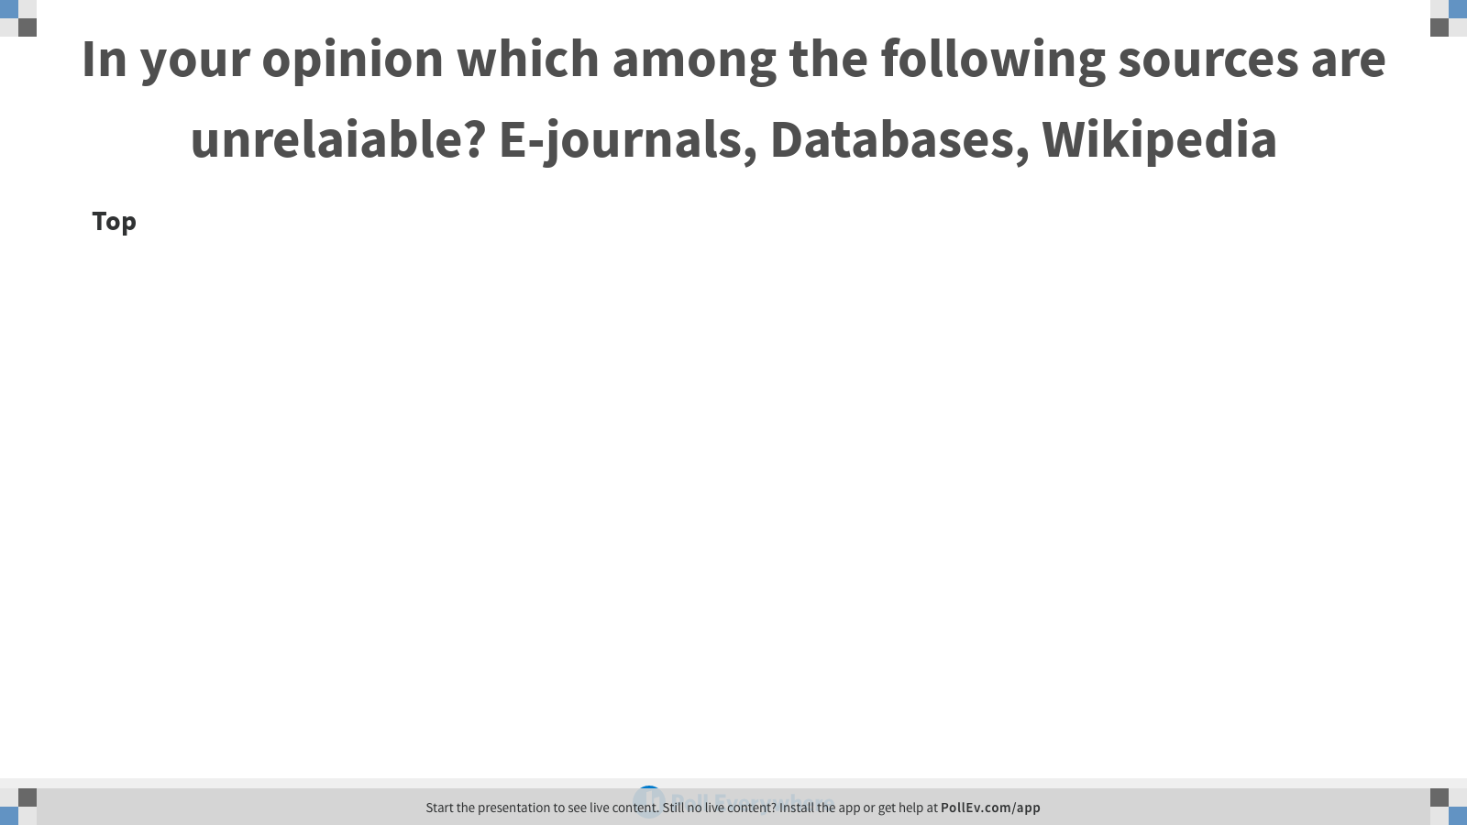
Notes:
Poll Title: In your opinion which among the following sources are unrelaiable? E-journals, Databases, Wikipedia
https://www.polleverywhere.com/discourses/NUYMoAyFDaf6q6dGmPeSv

Slide 22


Slide 23
Legal right granted to the owner of an intellectual work
Copyright Act
© Copyright 2020
All Rights Reserved

Slide 24
Intellectual Works
1. Literary work
3. Cinematographic film
5. Music work
2. Artistic work
4. Dramatic work
6. Sound recording

Slide 25
You purchased a book. Do you also own the copyright?

Slide 26
How to?
1. Automatic
2. Copyright
Office
How long?
Country of origin
Life of author +
60 years (India)
Who owns
1. Author
2. Creator
3. Composer
4. Producer
Employer
Assignee
What rights?
1. Reproduce
2. Distribute
3. Rent or lend
4. Translate
5. Adapt
6. Perform

Slide 27
Copyright Infringement
Reproduction
Distribution
Display
Translation
Adaptation
Performance
Unauthorized

Slide 28
Remedies for Infringement
Civil Remedies
Permanent Injunction
Rendition of accounts of profits ( monetary remedy measured by the profits made by the defendant illegally )
Damages for conversion (Compensation)
Delivery and destruction of infringing copies
Litigation costs
Criminal Remedies
Imprisonment ( Minimum six months & maximum 3 years)
Fine ( Minimum Rs. 50,000 & Maximum Rs. 2 lakhs)
Filing of cases: 3 years from the date of infringement

Slide 29
Exceptions
Res private study
earch &
Criticism / Review
Current events
Judicial proceeding
Amateur club performance
Sound recordings, dramatic/ musical works
(Under certain conditions)

Slide 30
Public Domain Materials

Slide 31
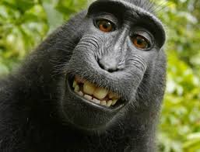
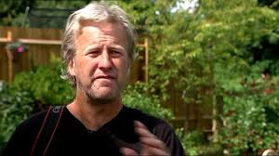

Slide 32
Intellectual Property
Right
Industrial Property Right
Patents
Trademarks
Copyright
Geographical Indicators

Slide 33

Creative Commons Licences
Some Rights Reserved

Slide 34
BY
Acknowledge
Non-commercial
Share alike
No derivatives
NC
ND
SA

Slide 35

1
Distribute, Adapt, Remix , Commercial & Non-commercial Attribution

Slide 36

2
Distribute, Adapt, Remix , Commercial & Non-commercial Attribution
Share Alike

Slide 37

3
Distribute, Commercial & Non-commercial Attribution
No Derivatives

Slide 38

4
Distribute, Adapt, Remix Attribution
Non-commercial

Slide 39

5
Download, Copy, Distribute, Modify, Build Upon
Attribution, Non-commercial, Share alike

Slide 40

6
Download, Copy, Distribute
Attribution, Non-commercial, No Derivatives

Slide 41

CCO
No Rights Reserved

Slide 42
Citing CC Materials: TASL model
Title & Source (Hyperlink)
Author
License Version & type (Hyperlink)
Example
Academic Integrity and Plagiarism by Shijith Kumar c licensed by CC BY 4.0

Slide 43
Creative Commons License Chooser
https://creativecommons.org/choose/

Slide 44
Plagiarism Vs. Copyright Infringement
Activity | Plagiarism | Copyright Infringement
Copying from copyright expired resources | ✓ | ✗
Copying in judgement | ✓ | ✗
Copying a small portion of a copyrighted work without attribution | ✓ | ✗
Copying large portion of a copyrighted work without attribution | ✓ | ✓
Copying a large portion of a copyrighted work with attribution | ✗ | ✓
Copying a copyrighted image in a work with attribution | ✗ | ✓

Slide 45
Plagiarism Detection Tools
Web-based
Fee-based/
Free
Coverage
Similarity Report
Cross checking

Slide 46
Name | Fee | Free
Codequiry | ✓ | ✓
Copyscape | ✓ | ✓
Docol©c | ✓ | ✓
DupliChecker |  | ✓
Exactus Like |  | ✓
Glatt Plagiarism Screening Program | ✓
Grammarly Plagiarism checker | ✗ | ✓
iThenticate | ✓
Maulik | ✓
Plagiarism Detector | ✓ | ✓
Plagiarisma | ✓ | ✓

Slide 47
Plagium | ✓ | ✓
PlagScan | ✓ | ✓
PlagTracker | ✓ | ✓
Quetext | ✓ | ✓
Safe Assign -Blackboard |  | ✓
Turnitin | ✓
Unicheck | ✓ | ✓
Urkund | ✓
Viper | ✓ | ✓
WCopyfind | ✓

Slide 48
TURNITIN iParadigm
Fee
Username
&
Psswd
Instruction support Tool

Slide 49
TURNITIN iParadigm
Instructional Tool
Username &
Password
E-mail
Subscription
Student
Instructor
Administrator

Slide 50
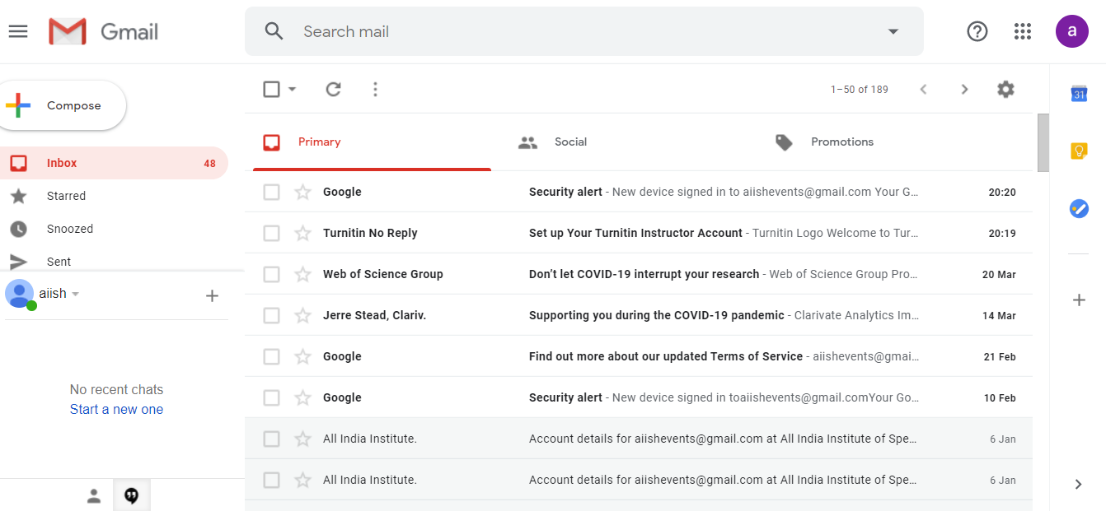

Slide 51
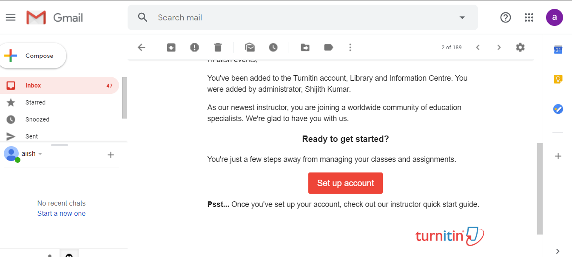

Slide 52
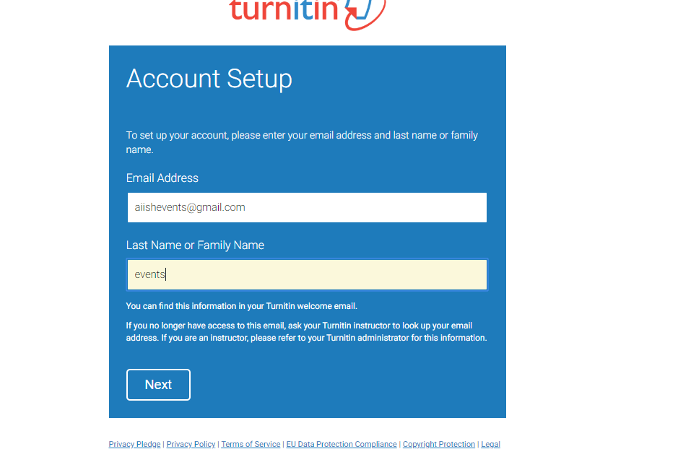

Slide 53
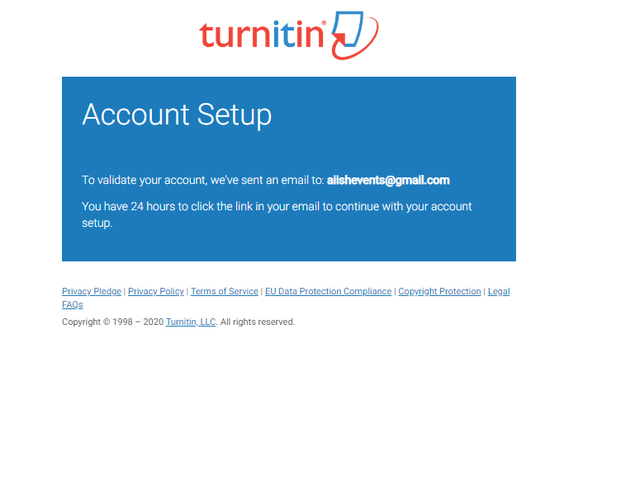

Slide 54
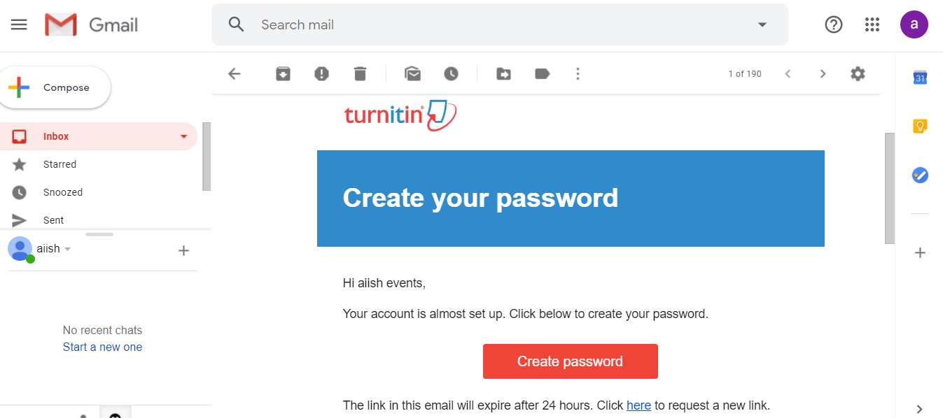

Slide 55
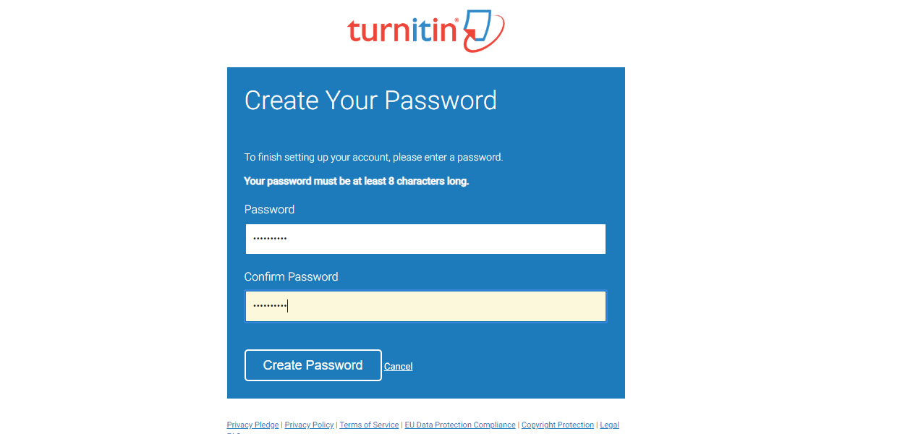

Slide 56
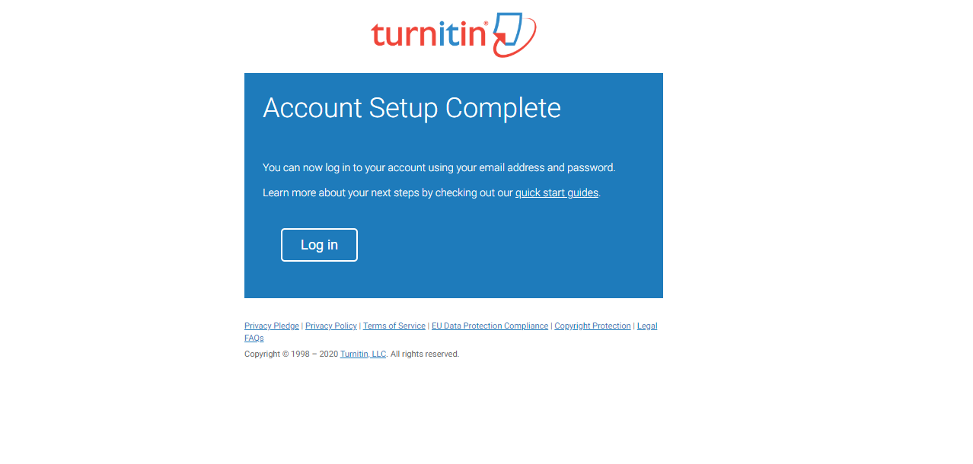

Slide 57
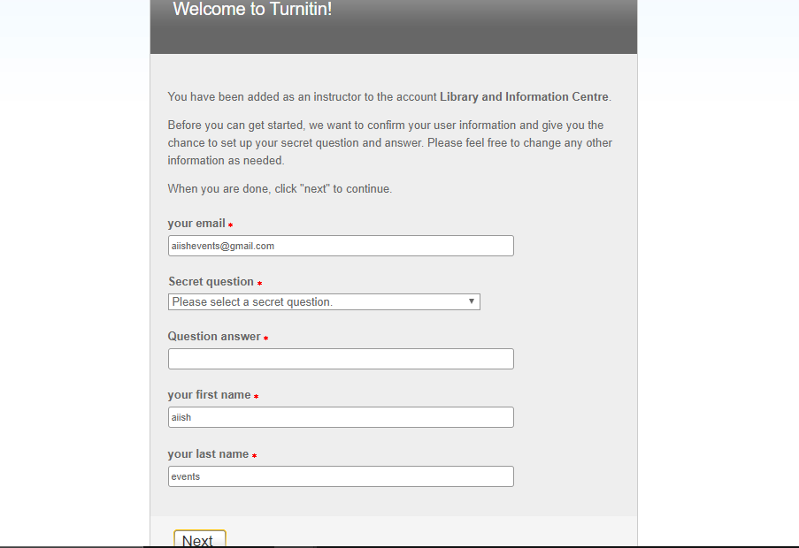

Slide 58
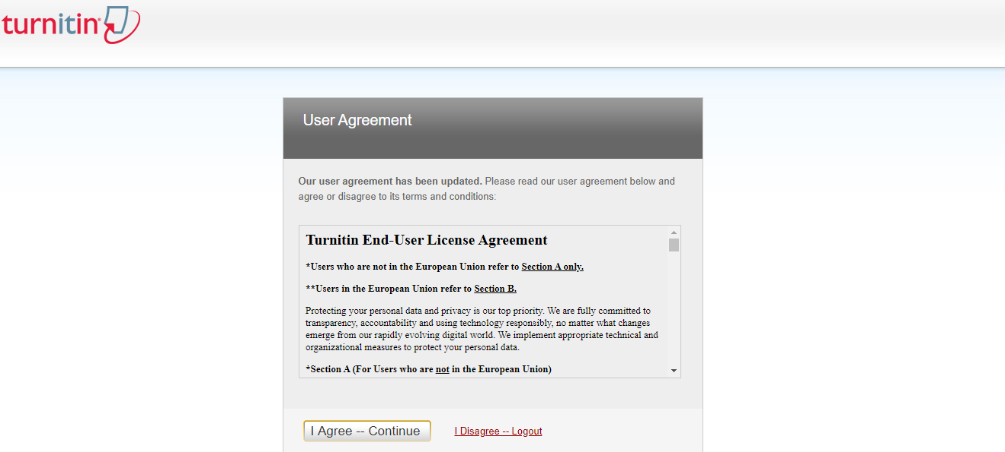

Slide 59
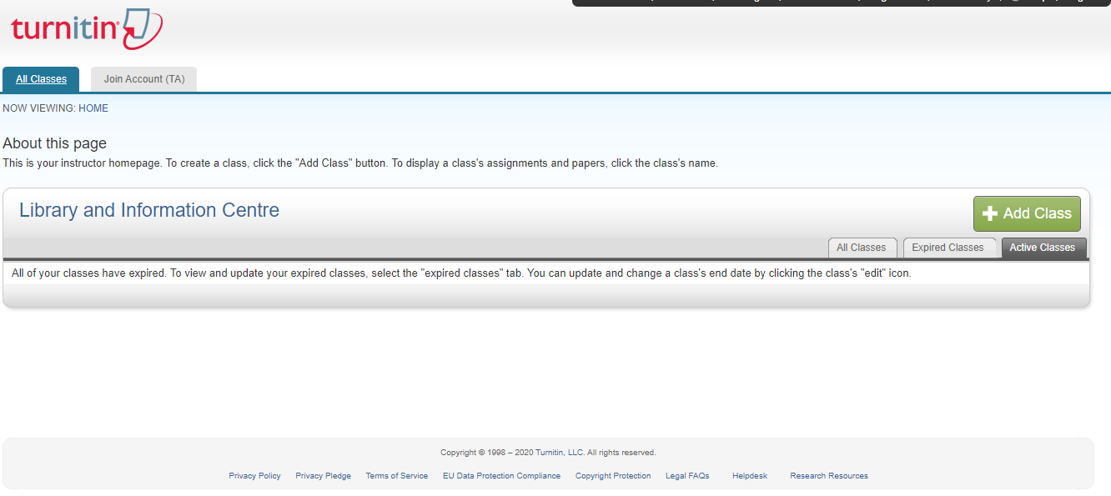

Slide 60
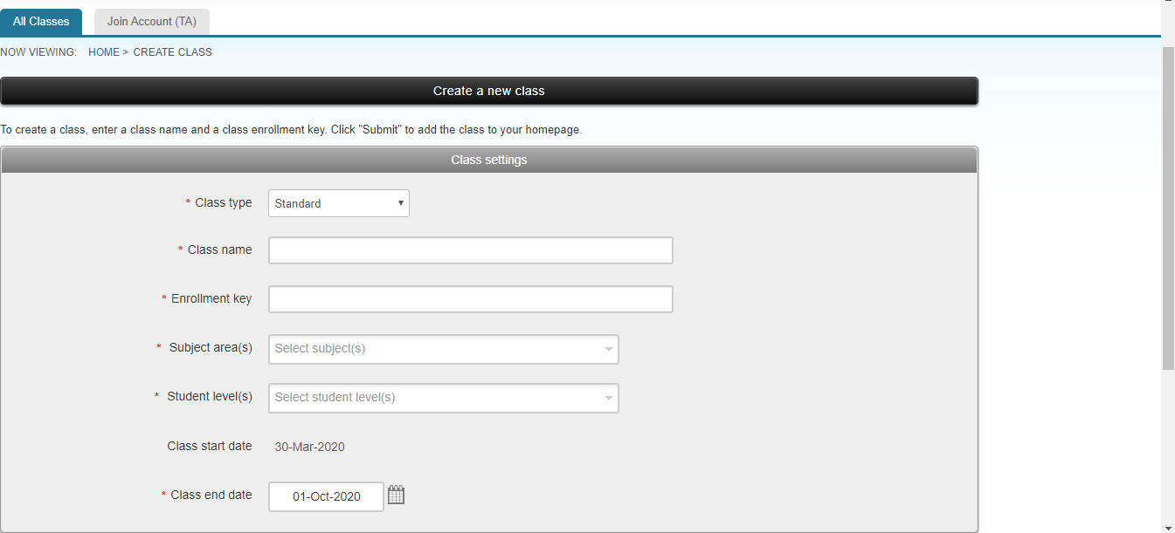

Slide 61
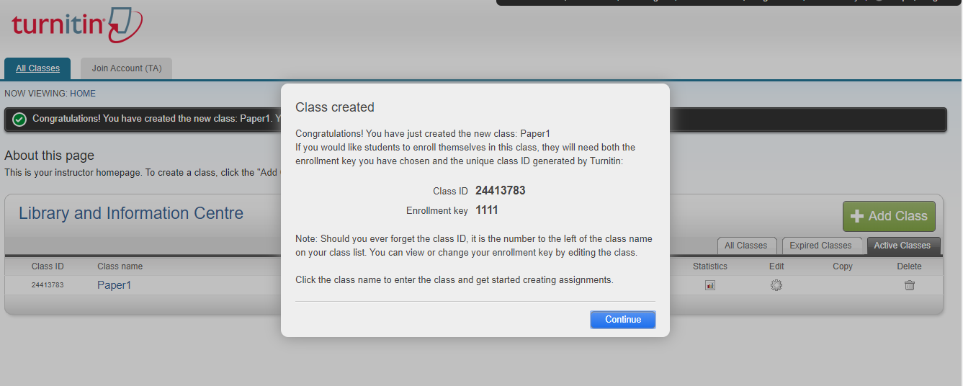

Slide 62
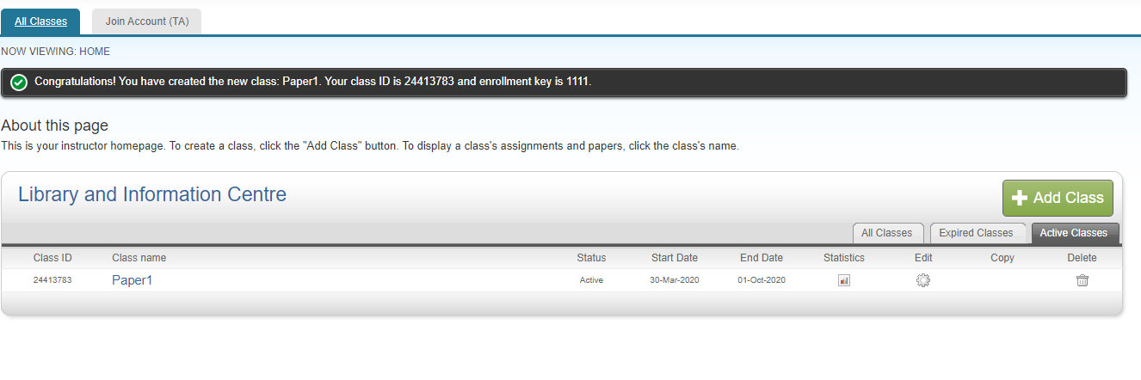

Slide 63
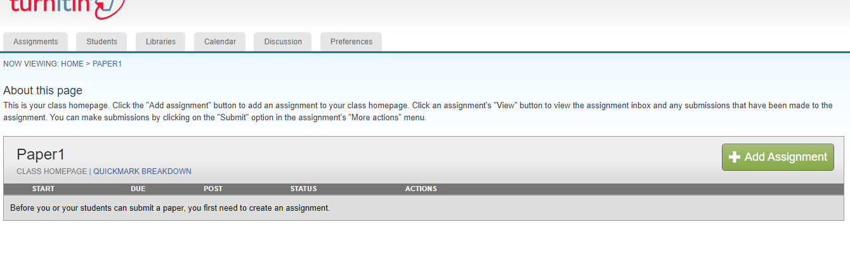

Slide 64
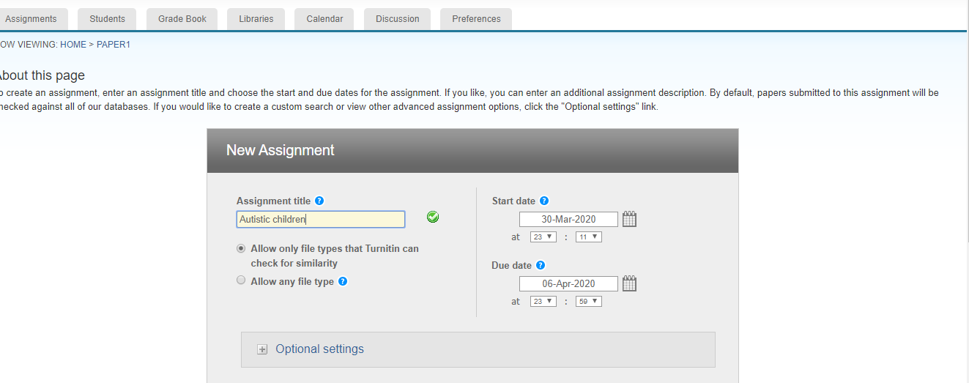

Slide 65
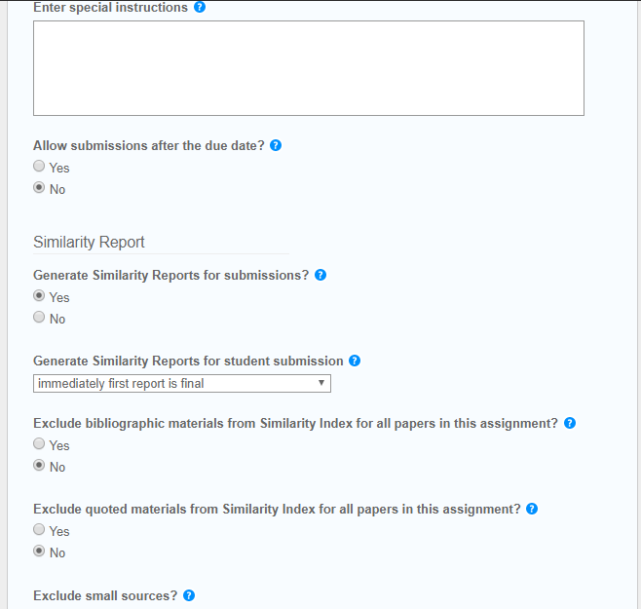

Slide 66
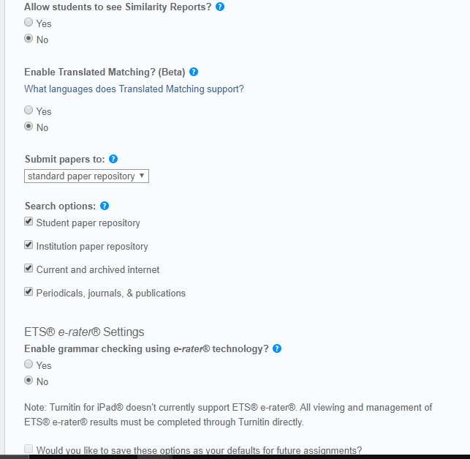

Slide 67
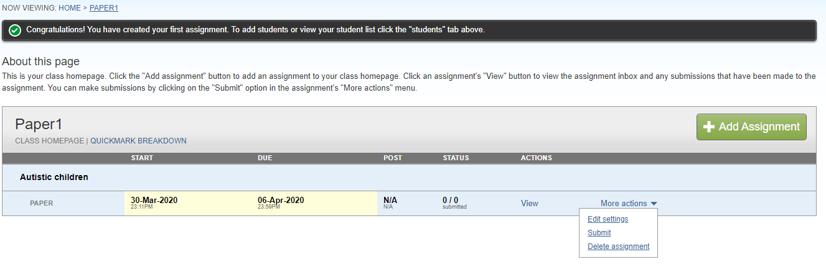

Slide 68
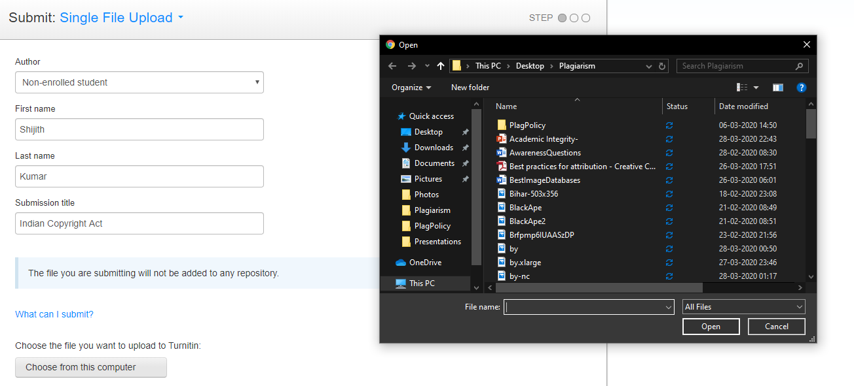

Slide 69
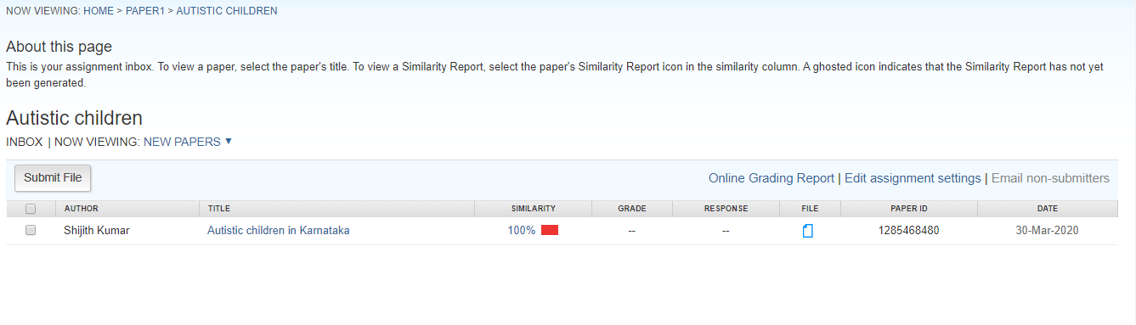

Slide 70
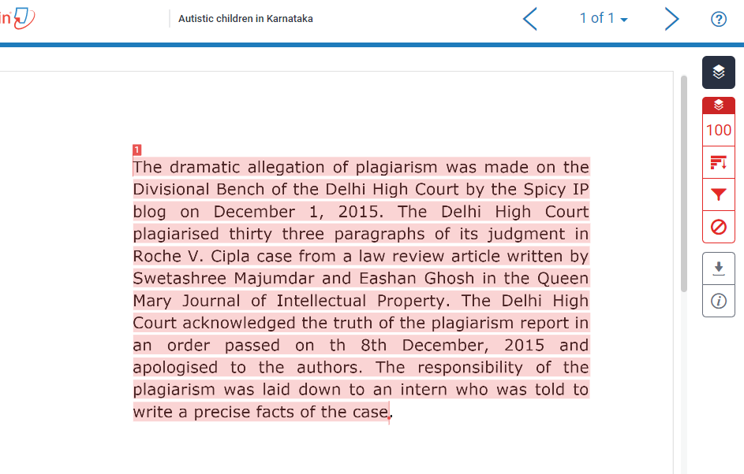

Slide 71
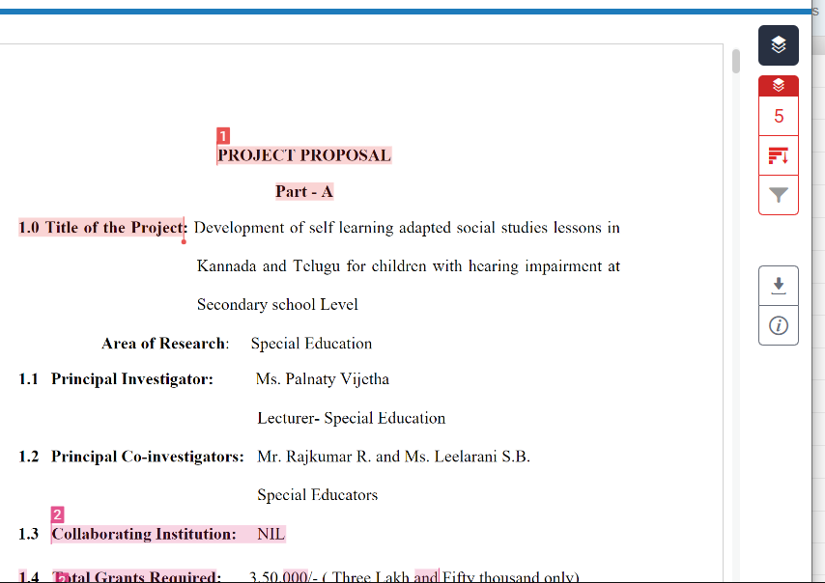

Slide 72
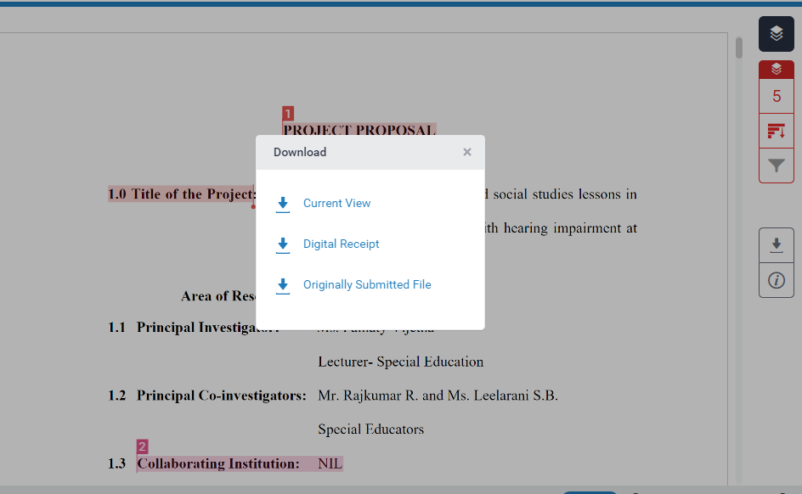

Slide 73
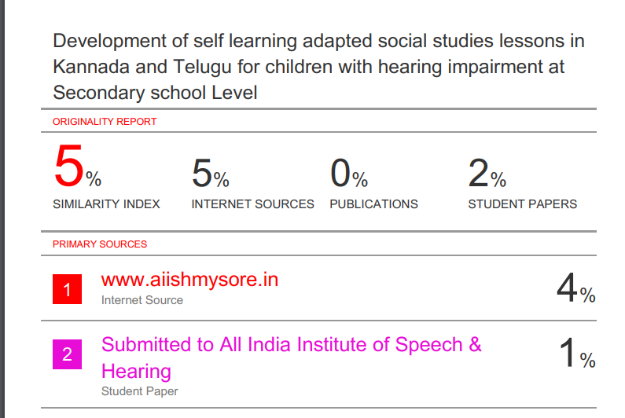

Slide 74
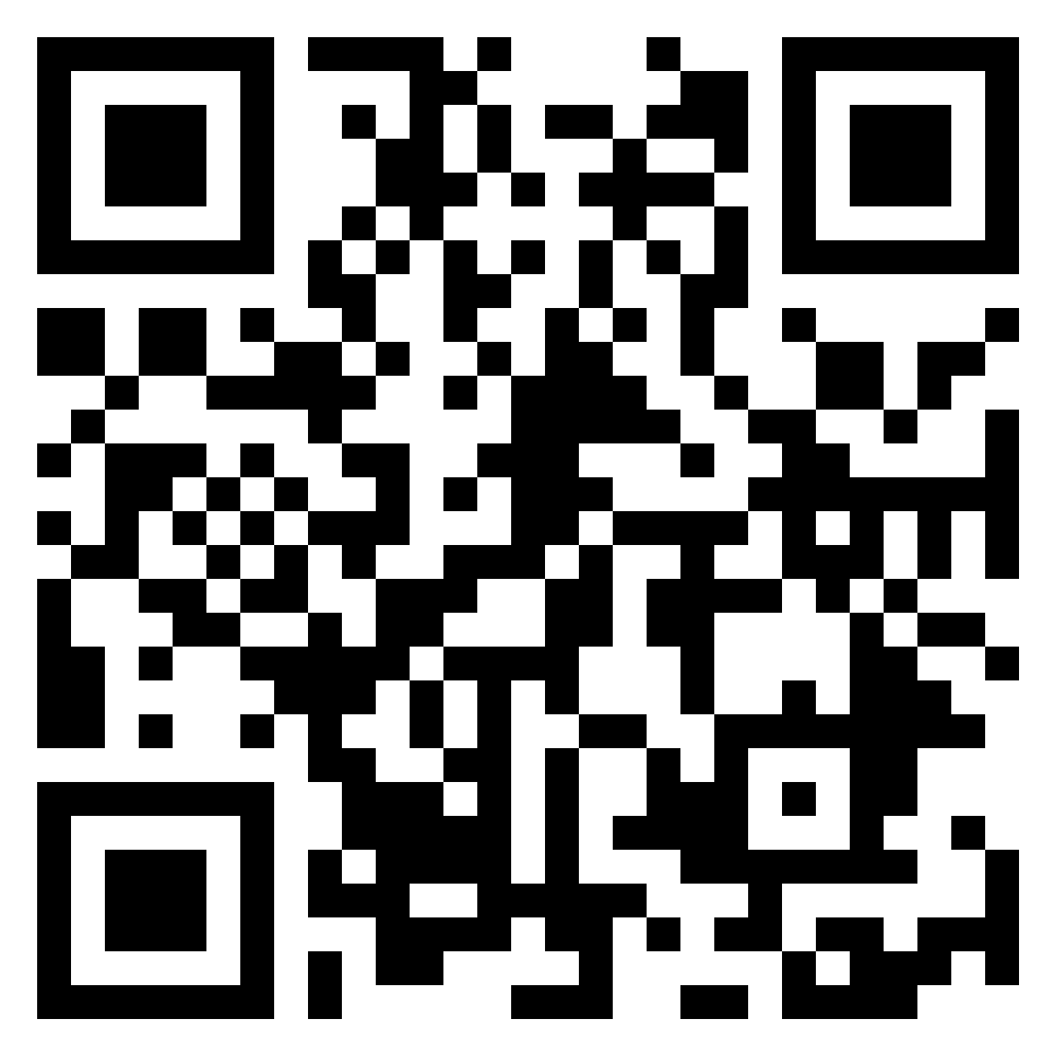
Feedback & Comments
https://padlet.com/cshijithkumar/123

