Slide 1
UGC Regulations on Promotion of Academic Integrity & Prevention of Plagiarism in Higher Educational Institutions
Workshop on Academic Integrity and Plagiarism: Session 4

Slide 2
Awareness /
Education & training
Responsible Research
Academic Integrity
Anti-plagiarism
Objectives
System for plagiarism detection & imposition of penalty

Slide 3
> Publication Ethics
>Academic Integrity
>Ref. Management
>Plagiarism detection
Awareness/ Sensitisation Pgrms
Workshops/
Refresher courses
UG/ PG Curricula/
Ph.D. Course Work

Slide 4
Technology-based solution
Plagiarism Policy
Institutional Repository
Shodhganga
Declaration/ Certification

Slide 5
Publication
Manuscripts
Works for Academic Degree
Exclusions: Assignments, Term Papers, Essays, Course Works & Project Reports

Slide 6
Exclusion from Similarity Check
Quoted works
Bibliography / References
Table of contents
Preface
Acknowledgement
Generic terms, laws, std. equations
Common knowledge of 14 consecutive words

Slide 7
Levels of Plagiarism
Level 3
(Above 60%)
Level 1
(10-40 %)
Level 2
(40-60 %)
Level 0
(Below 10%)

Slide 8
Handling of Plagiarism
Departmental Academic Integrity Panel (DAIP)
Chairman: Head of the Dept.
Institutional Academic Integrity Panel (IAIP)
Chairperson: PVC/Dean/Sr. Faculty
Member: Faculty from other Dept.
Member: Expert in anti-plagiarism tools
Member: Sr. Faculty
Member: Faculty from outside the organization
Member: Expert in anti-plagiarism tools

Slide 9
Penalty
Plagiarism Level | Thesis & Dissertation | Publication Manuscript
L0 (0-10%) | No penalty | No penalty
L1 (10-40%) | Revise in 6 months | Manuscript withdrawal
L2 (40-60%) | 1 year debarment | Manuscript withdrawal Increment denial (1no.) Guideship suspension(2yrs)
L3 (60% & above) | Registration cancellation | Manuscript withdrawal Increment denial (2 no.) Guideship suspension(3 yr)

Slide 10
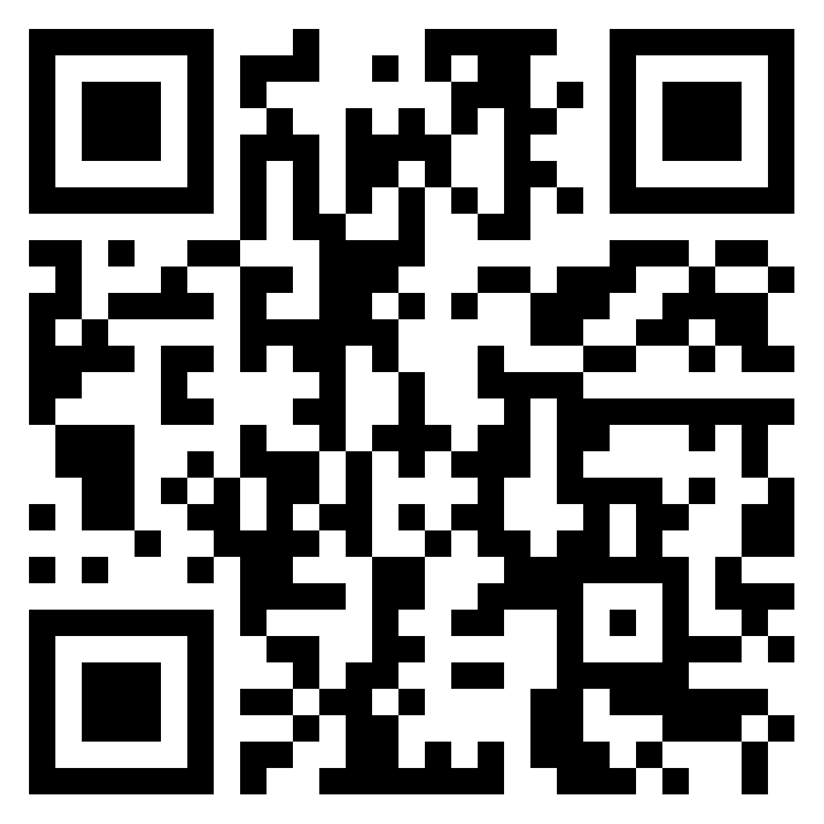
Feedback & Comments
https://padlet.com/cshijithkumar/123
https://padlet.com/cshijithkumar/6nyc41s692ecu8tr

