Slide 1
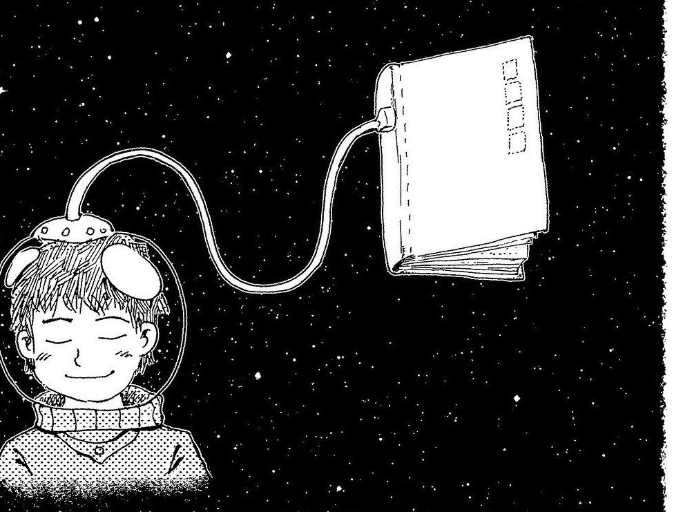
Library & Information Resources & Services @ AIISH

Slide 2
Print Resources
22,000+
Books
118
Journals
4,000+
Bound Volumes
115+
In-house Publications
2,000+
Theses & Dissertations

Slide 3
E-Resources
1. E-journals
2. E-books
3. Databases
4. E-Research
Reports

Slide 4
E-Services
Author Solution
Bibliographic mangmnt
CD-ROM service
Digital Repository
ERMED Service
ISBN
N-LIST
OPAC
Plagiarism detection
Publisher Solution
Remote login
Writing support tool

Slide 5
www.aiish.ac.in

Slide 6
Access Modes
Username & password
Self-created
Created by Us
Intranet
Time-bound
Any time
User Restrictions
AIISH Staff & students
For all

Slide 7
Research Repository ...
A digital repository of research reports of AIISH
Contents
PG Dissertations
Independent Projects
ARF Projects
PhD Theses

Slide 8
…Research Repository
Access
User name & password based
Self registration
Free for all
Globally accessible

Slide 9
Databases..
Bibliographic
COMDISDOME
LLBA
Full-text
PsycARTICLES
MedOne ComSci
Hybrid
J-Gate
Free: PubMed, RehabData

Slide 10
Databases: Access Mode
Intranet-based only
Facility for personal account creation

Slide 11
N-LIST
MHRD, UGC, INFLIBNET
6000 + e-journals & 135000+ e-books
Publisher & Subject-wise browsing
Searching through common interface
Ebrary

Slide 12
ERMED
Educational Resources in Medicine
Ministry of Health & Family Welfare, GOI
Only E-journals
Intranet-based access

Slide 13
E-journals
Types
AIISH subscribed – 118 nos.
N-LIST – 66 nos.
ERMED – 240 nos.
Open Access – 200 nos.
AIISH Archive- 14 nos.
Access
AIISH subscribed & ERMED: Intranet
N-LIST: Username & Password based

Slide 14
E-books
Types
AIISH subscribed – 176 nos.
N-LIST – 2826 nos.
Access
AIISH subscribed: Intranet
N-LIST: Username & Password based
E-book searching interface

Slide 15
Book CD-ROMs
Features
Supplementary materials
Total = 250 +
Search: Keyword, title, subject & author
Access
Intranet
Time-bound

Slide 16
Online Public Access Catalogue
Tool for searching print books
Intranet-based
Provides:
Location
No. of Copies
Status

Slide 17
Plagiarism Detection
Software: Turnitin
Access
User name & password based
Only for AIISH staff
& Students
Global access

Slide 18
Remote Access Information Service
Remote login to intranet
Access from across the globe
Username and password-based
Joint creation of username & password
Only for AIISH staff & students

Slide 19
Bibliographic Management System
Software: EndNote
Desktop based Activation

Slide 20
Writing Support Tool
Spelling
Grammar

Slide 21
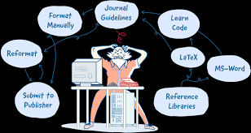
Author Support Solution

Slide 22
Publisher Support Solution

Slide 23
ISBN Service
Raja Ram Mohan Roy National Agency for ISBN, MHRD, Govt. of India

Slide 24
Funded Research Project-1
Digital Library
&
OPAC

Slide 25
Funded Research Project-2
Development of Useful Products

Slide 26
Funded Research Project-3
Development of E-learning Platform

Slide 27
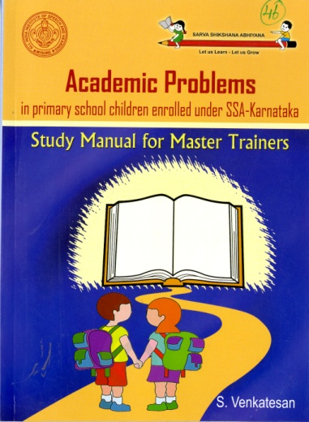
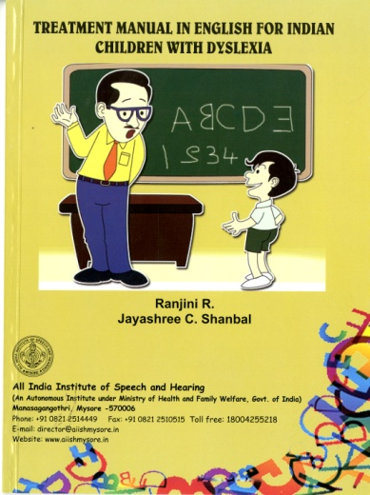
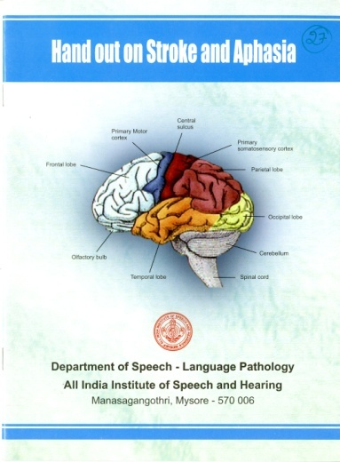
Product Development Cell
Publications : 118

Slide 28
Expenditure: 2018-19
Books – Rs. 9,06,954/-
Journals - Rs. 1,13,37,915/-
Databases – Rs. 10,00000/-
Others - Rs. 11,00000/-

Slide 29
Infrastructure
Three-floor building in 27,000 sq.ft
Exclusive website & Digital Repository Platform
Spacious & serene reading areas
Language Lab
Own Web Server with 10 TB space
Computer Centre with Internet
Printing & Scanning Solutions
Binding Solutions

Slide 30
Personnel- 10 Nos
Designation | Strength (Number) | Remarks
Library & Information Officer | 1
Assistant Library & Information Officer | 1
Senior & Information Assistant | 2
Library & Information Assistant | 1 | Vacant
Library Assistant | 1
MTS- Regular | 1
Clerk-Outsourced | 1
MTS-Outsourced | 2
Research Officer-Contract– 1 no. | 1

