Slide 1
Evaluation of Information Resources

Slide 2
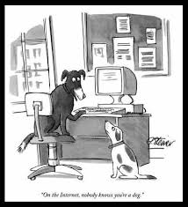
“On the Internet nobody knows you are a dog”

Slide 3
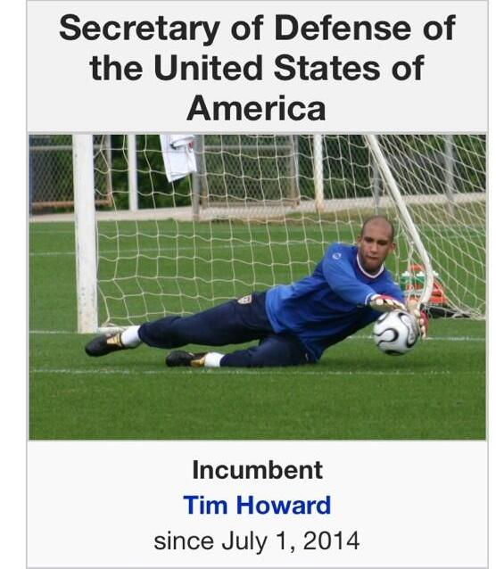
…Evaluation of Information Resources…

Slide 4
…Evaluation of Information Resources…
More than 700 billion websites
ANYONE can publish on the Web
No quality control
Out-dated information
  No selection guidelines for search engines

Slide 5
…Evaluation of Information Resources…
Authority
-Domain type
- About Us
- Qualifications/Credibility/Expertise
- Affiliation
- Contact information

Slide 6
…Evaluation of Information Resources…
Accuracy
Free from spelling errors
Grammar
Editing
Facts

Slide 7
…Evaluation of Information Resource
Objectivity
-Unbiased
Currency
  - Latest information
  - Frequency of up-dation
-Updated links

