Slide 1
Internal Marks
Total Marks = 20
Slabs Internal Marks
16 & above 22
13- 15 21
10-12 20
Below 10 19

Slide 2
Evaluation of Information Resources

Slide 3
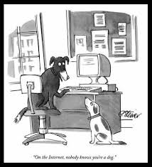
“On the Internet nobody knows you are a dog”

Slide 4
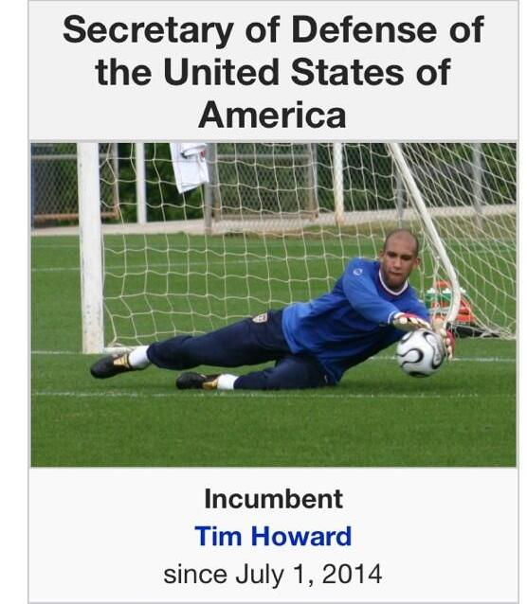
…Evaluation of Information Resources…

Slide 5
…Evaluation of Information Resources…
More than 700 billion websites
ANYONE can publish on the Web
No quality control
Out-dated information
  No selection guidelines for search engines

Slide 6
…Evaluation of Information Resources…
Authority
-Domain type
- About Us
- Qualifications/Credibility/Expertise
- Affiliation
- Contact information

Slide 7
…Evaluation of Information Resources…
Accuracy
Free from spelling errors
Grammar
Editing
Facts

Slide 8
…Evaluation of Information Resource
Objectivity
Currency
  - Latest information
  - Frequency of up-dation
-Updated links

Slide 9
Subject Gateways and Portals
Organized collection
Specific subject area
Search Interface
Links to other resources
More genuine and relevant web pages
Wide spectrum of resources
www.MedScape.com; www.medlineplus.gov

