Slide 1
Evaluation of Information Resources

Slide 2
Evaluation
More than 1.24 billion websites
No control
Out-dated information
  Search engines selection
  Health/Medical Websites

Slide 3
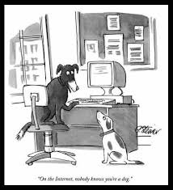
“On the Internet nobody knows you are a dog”

Slide 4
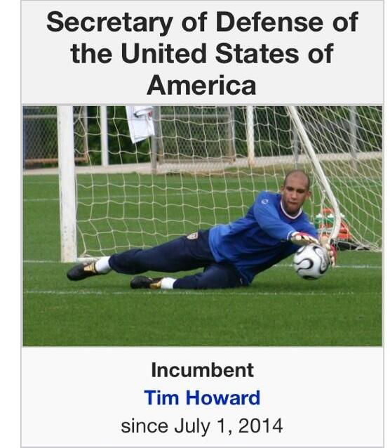
…Evaluation of Information Resources…

Slide 5
…Evaluation of Information Resources…
Authority
-Domain name/ type
- About Us
- Qualifications/Credibility/Expertise
- Affiliation
- Contact information

Slide 6
…Evaluation of Information Resources…
Accuracy
Free from spelling errors
Grammar
Facts

Slide 7
…Evaluation of Information Resource
Objectivity
Currency
  - Latest information
  - Frequency of up-dation
-Updated links

Slide 8
…Evaluation of Information Resource..
Navigation
Contact
Feedback

