Slide 1
Database searching

Slide 2
definition
A database is an organized collection of information, generally stored and accessible using a computer system

Slide 3
Literature database
Scholarly journal articles
Magazine articles
Newspaper articles
E-books
Images
Standards
Patents
Conf. Proceedings

Slide 4
Basic Components: fields
Author(s)
Title
Source
Type of publication
Keywords
Subject
Year of publication

Slide 5
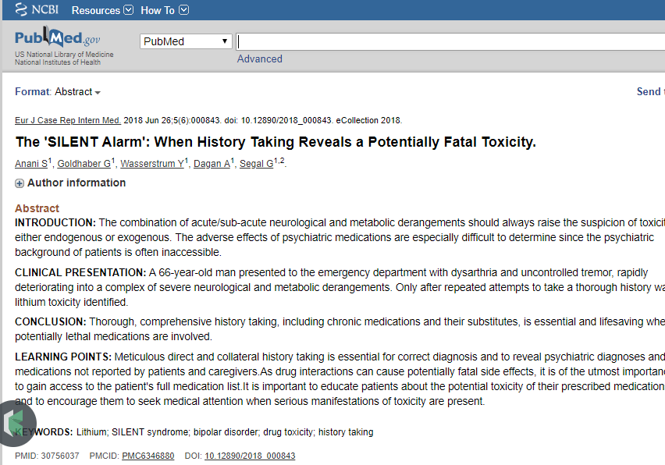
Basic Components: record

Slide 6
Content levels
Bibliographic
Full-text
Hybrid

Slide 7
need
Non-database/Internet Resources
Unstructured information
No control
Databases
Focus on specific subject areas
Organized
Peer-reviewed content
Significant publications & trend in research

Slide 8
Steps in database searching
Identification of Keywords
Formulation of Search Statements
Boolean operators; Truncation; Wildcard; Nesting; Phrase formation
Execution of Search
Filters
Revision
Re-execution

Slide 9
Identification of keywords
Major Concepts
Exclusion of Stop Words

Slide 10
Boolean operators
Operators to connect the search words
AND OR NOT
Broaden or Narrow Results
AND
Narrow down the results
OR
Broaden the results
NOT
Narrow down the results

Slide 11
Truncation
Word variants
Ensure more search results
Symbol: asterisk
Example:
audiol*
audiology, audiological

Slide 12
Wild card
Spelling variation
More results
Symbol: question mark
Example:
organi?ation
sensiti?ation

Slide 13
phrase searching
Exact phrase
Double quotation
Precise and specific results
Example:
“COGNITIVE-LINGUISTIC ABILITIES IN BILINGUAL CHILDREN”

Slide 14
Limiters
Narrowing or Limiting the results using some criteria
Publication type
Year
Language
Population
Research type

