Slide 1
PubMed

Slide 2
Introduction
Web-based health literature database
National Library of Medicine, USA
Since 1996

Slide 3
Origin & Development
Index Medicus: Abstracting Journal: 1879
MEDLARS: MEDical Literature Analysis &
Retrieval System-1964
MEDLINE: 1971
MEDLINE: Commercial vendors, CD-ROMs

Slide 4
Coverage
Medicine
Nursing
Dentistry
Veterinary Medicine
Health Care Systems
Pre-clinical Sciences

Slide 5
Content
29 million records
5600 journals
87 % English Language Abstracts
Link to Full-text

Slide 6
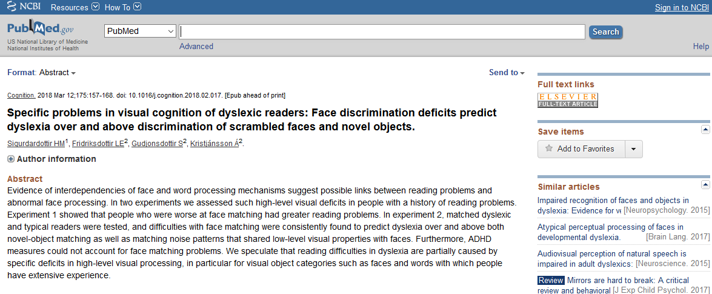
Bibliographic, with link to fee-based full-text on Publisher’s Website

Slide 7
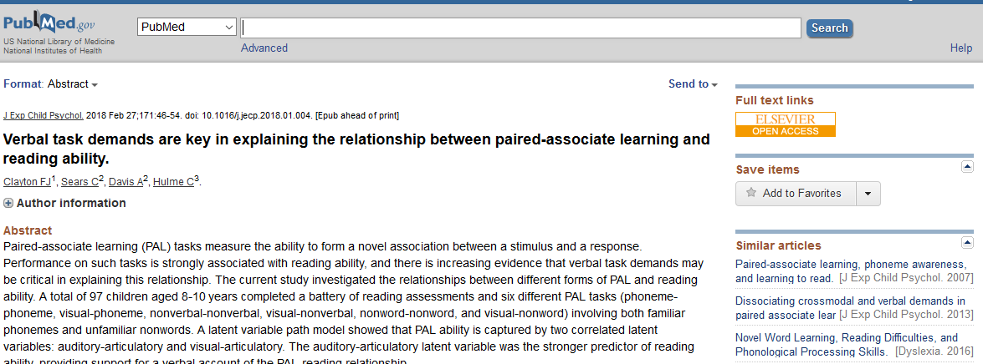
Bibliographic, with link to free full-text on Publisher’s Website

Slide 8

Bibliographic, with link to free full-text on PubMed Central Website

Slide 9
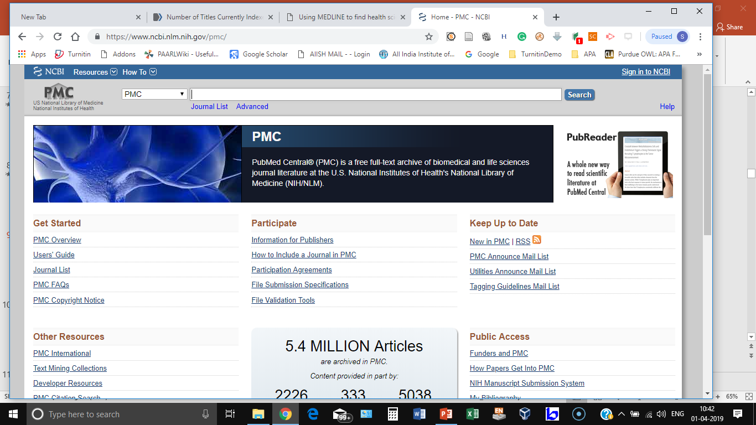
PubMed Central (PMC)

Slide 10
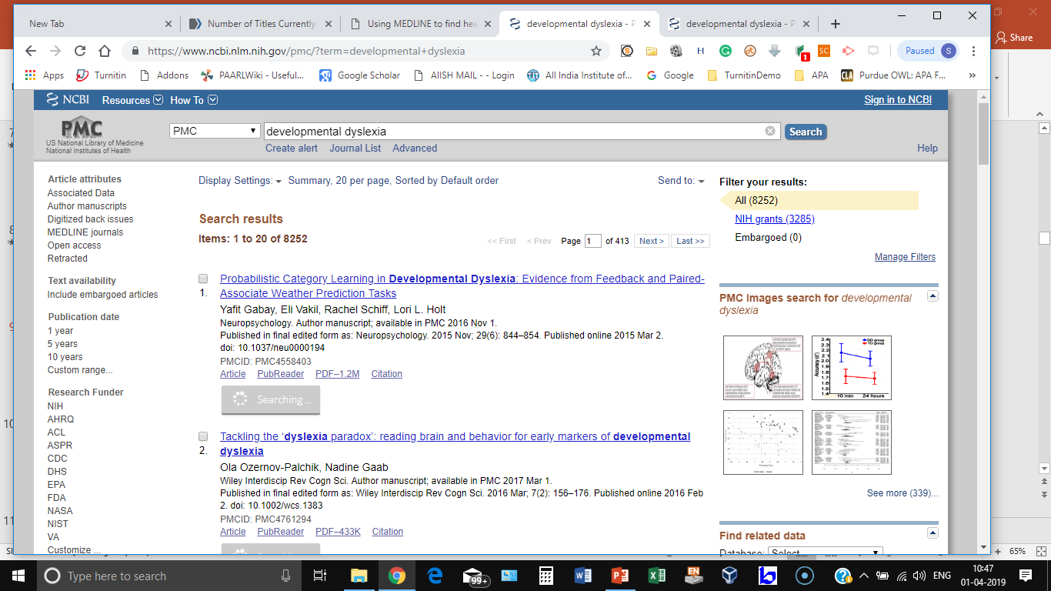
PMC Search for Developmental Dyslexia

Slide 11
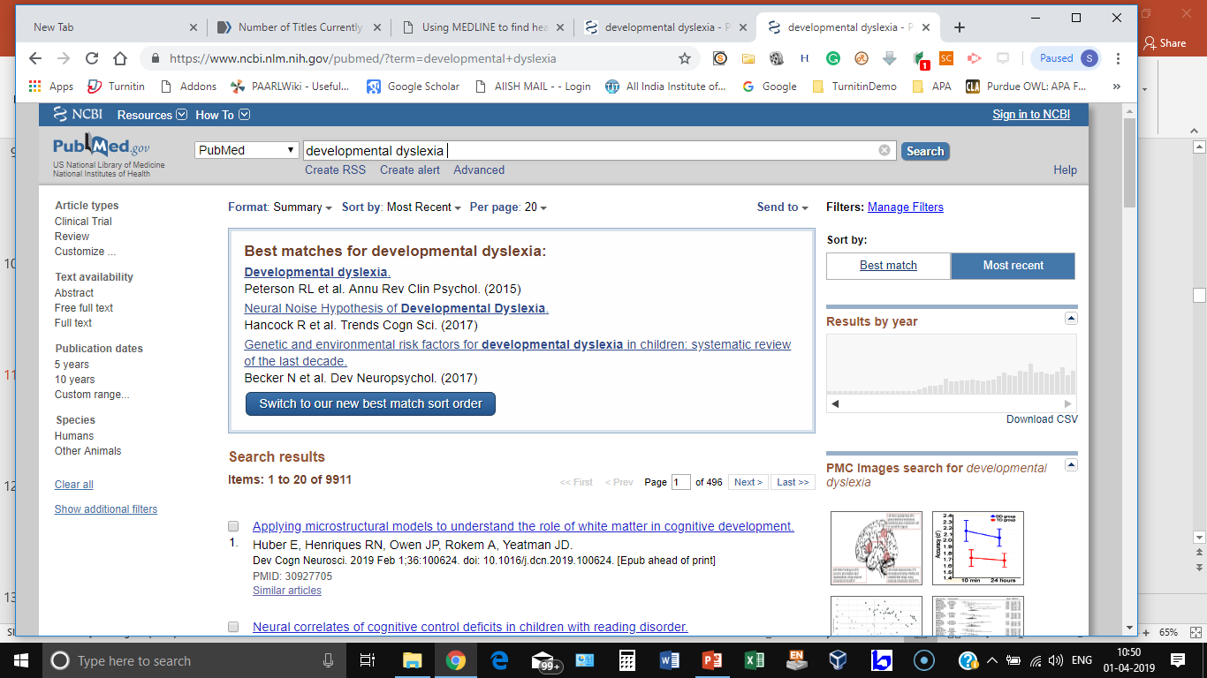
PubMed Search

Slide 12
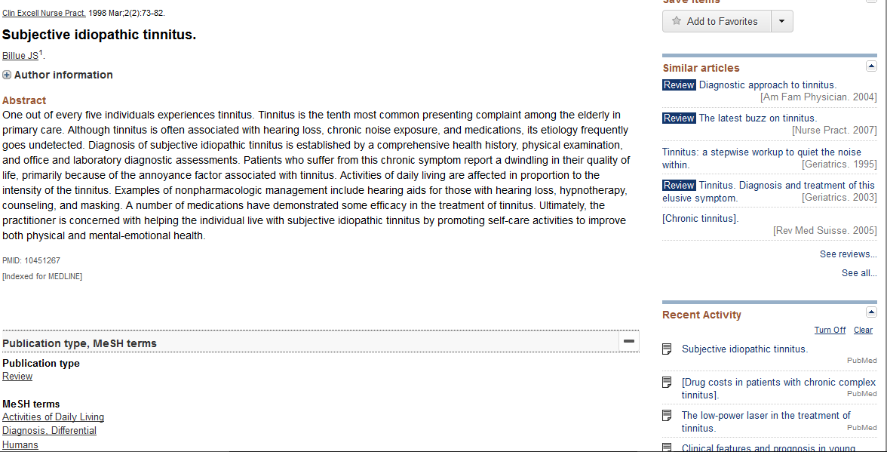
PubMed Record
Journal source
Title
Author
Abstract
Publication type
Con. Vocabulary

Slide 13
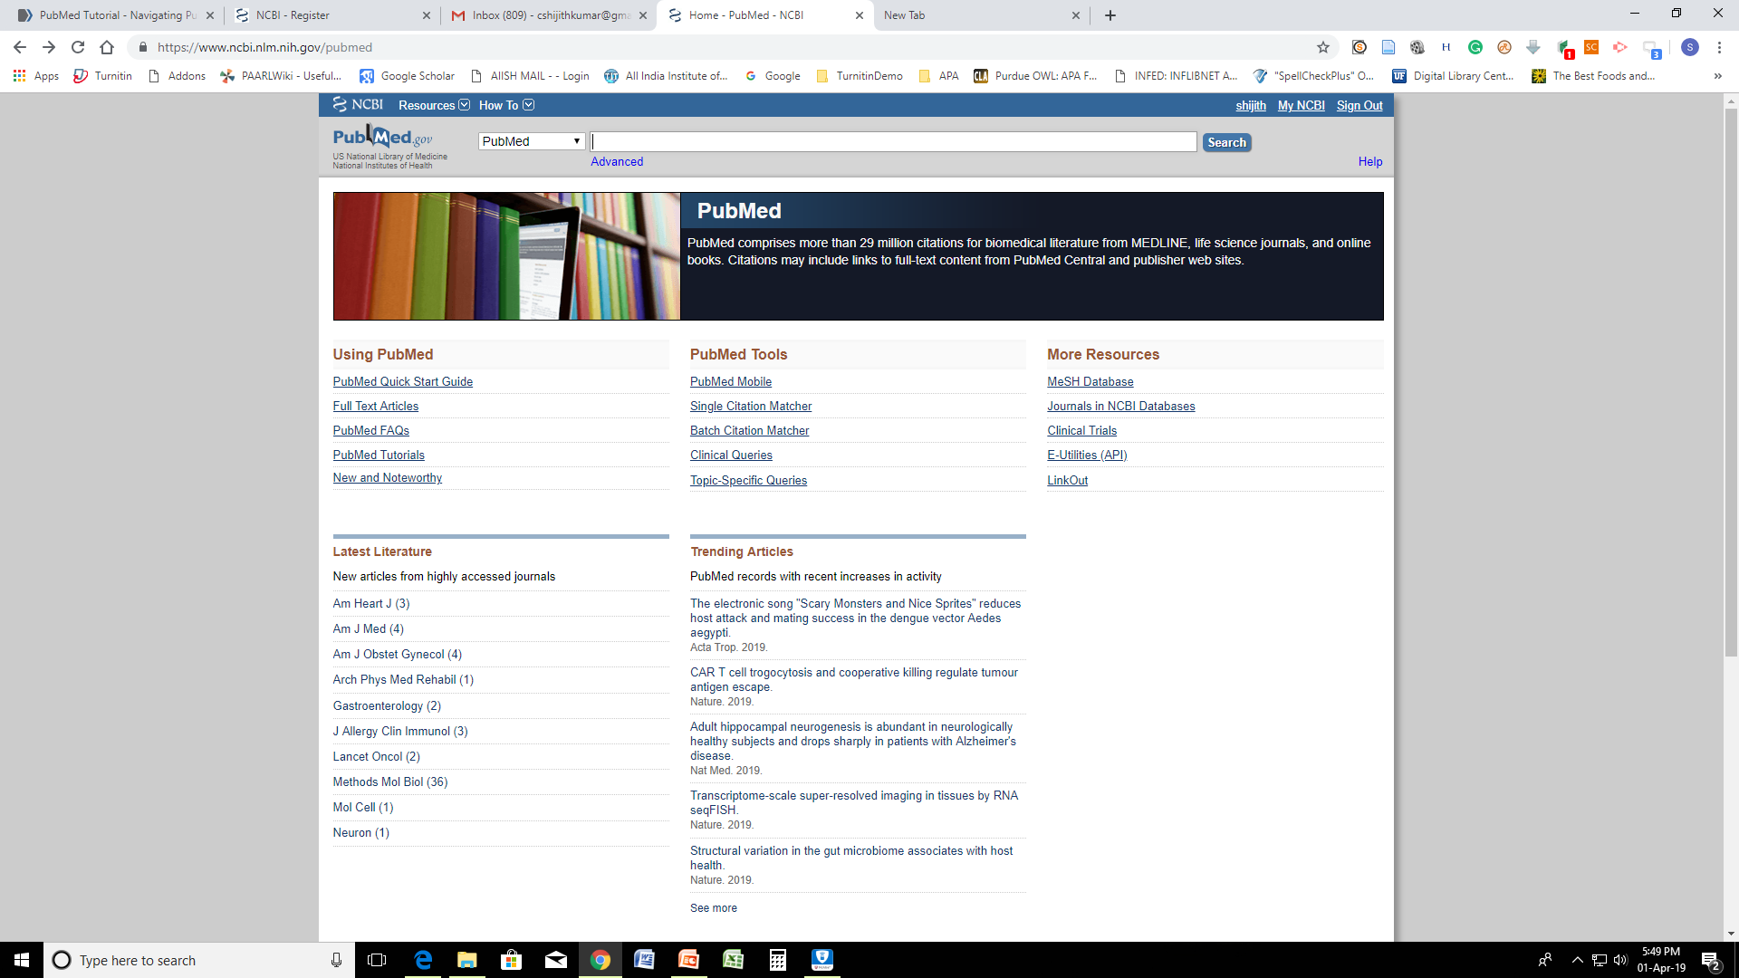
Home Page: PubMed…

Slide 14
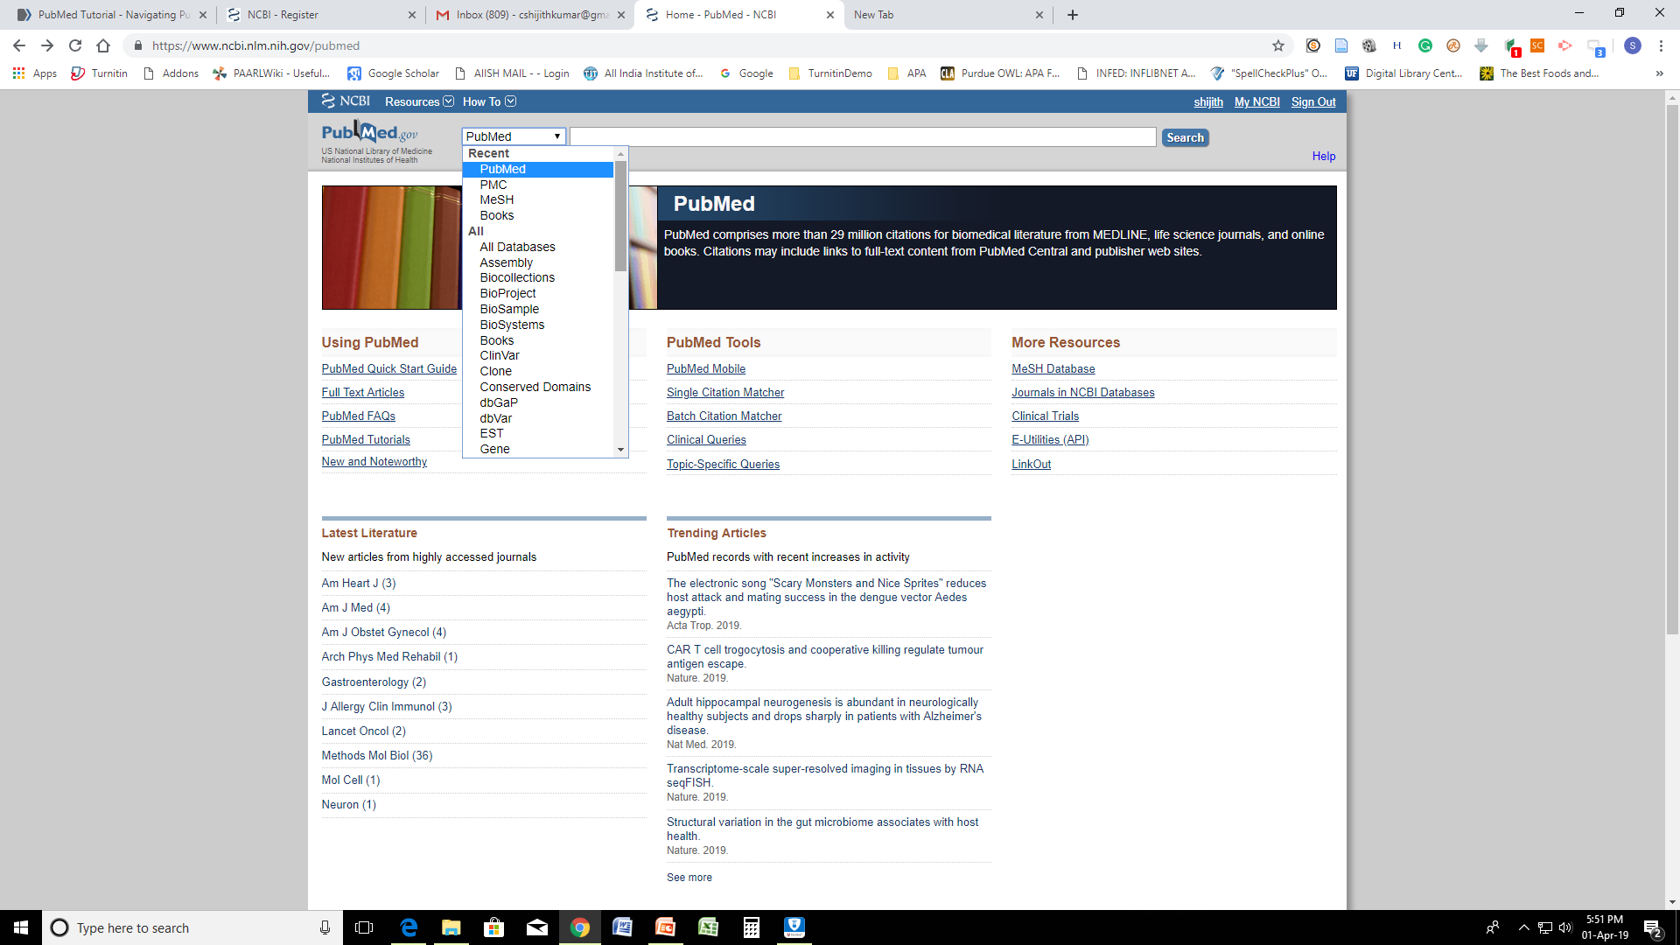
…Home Page: PubMed

Slide 15
MeSH
Controlled Vocabulary: List of terms
Used to index & retrieve content
Uniformity and consistency to indexing
Effective Retrieval
MeSH-Medical Subject Heading
Controlled Vocabulary of MEDLINE

Slide 16
MeSH Terms
Headings
Subheadings
Supplementary Concept Records
Publication Types /Characteristics

Slide 17
Headings
Concepts used to repr. biomedical literature
Also known as Main Headings/Descriptors
26,000 + MeSH headings
Eg.
Hearing Loss, Speech Sound Disorder,
Phonological Disorder, Articulation Tests

Slide 18
Subheadings
Terms for qualifying the headings
Examples
Autism/Diagnosis
Autism/Therapy

Slide 19
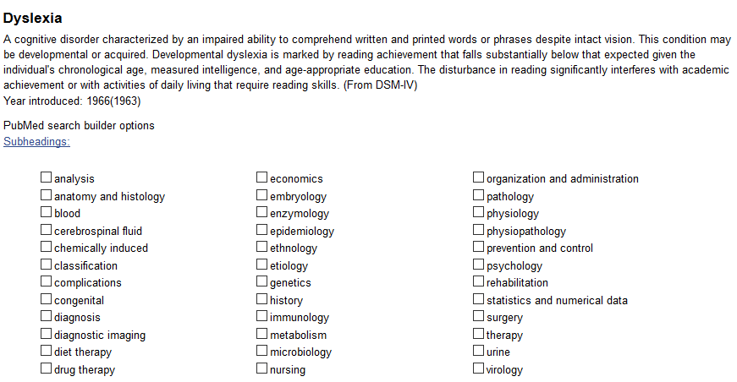
Heading & SubHeadings: Example
Scope note

Slide 20
Supplementary Concept Records (SCR)
Chemicals, drugs & rare diseases
200,000 + terms
Updated weekly

Slide 21
Publication Types / Characteristics
Case Reports
Editorial
Journal Article
Letter
Review
Randomized Controlled Trial

Slide 22
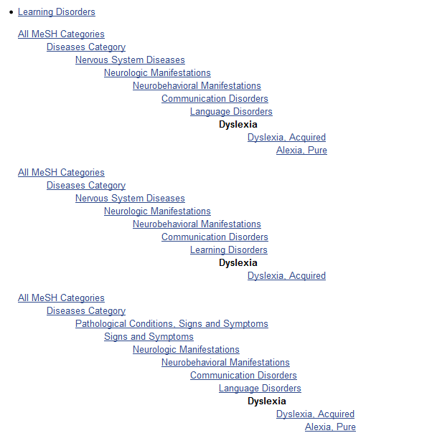
MeSH Tree

Slide 23
MeSH – Hierarchy
Anatomy
Body Regions
Head
    Ear
Anatomy
Sense Organs
  Ear
    Ear, External
    Ear, Middle
    Ear, Inner

Slide 24
MeSH – Hierarchy
Terms appear in more than one branch
Search for a broader term include narrower
Automatic Explosion

Slide 25
MeSH Tree: 16 Main branches
1. Anatomy
2. Organisms
3. Diseases
4. Chemicals and Drugs
5. Analytical, Diagnostic and Therapeutic
6. Techniques and Equipment
7. Psychiatry and Psychology
8. Phenomena and Processes
9. Disciplines and Occupations
I0 Anthropology, Education, Sociology and Social
11.Phenomena
12.Technology, Industry, Agriculture
13. Humanities
14. Information Science
15. Named Groups
16. Health Care

Slide 26
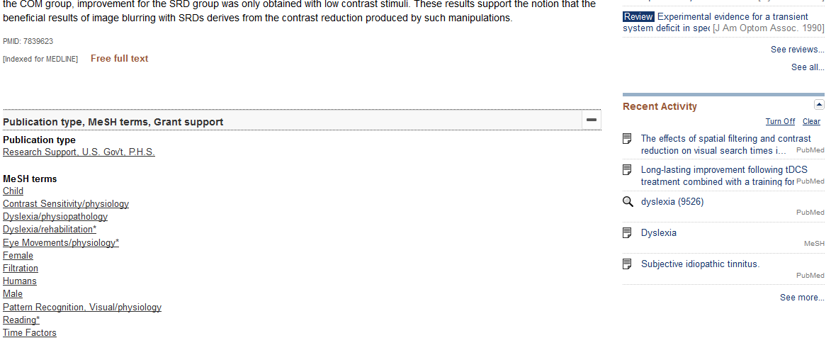
Major Topics

Slide 27
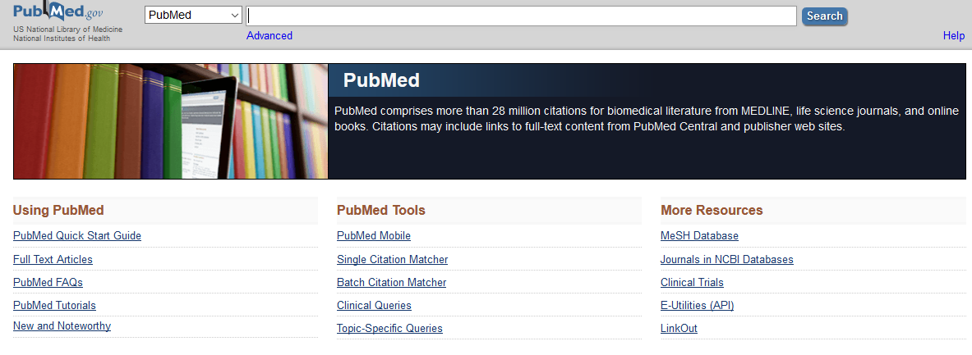
Basic Search

Slide 28
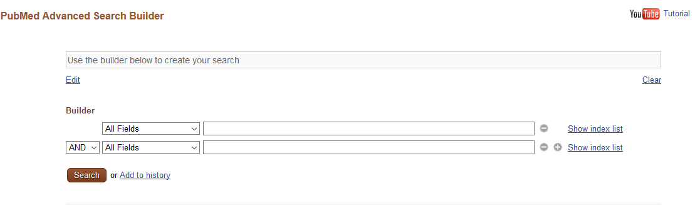
Advanced Search

Slide 29
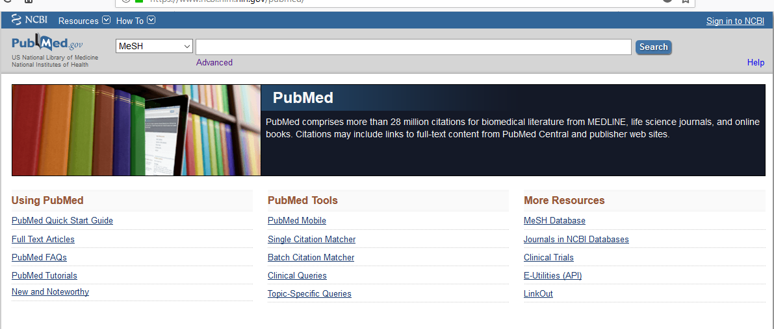
MeSH Based Search

Slide 30
Other Facilities/ Features
My NCBI
Filters
History
Similar Articles
Clipboard

