Slide 1
Google Scholar

Slide 2
Since 2004
Type of Contents:
a) Article
b) Theses & Dissertations
c) Books
d) Conference papers
e) Court opinions

Slide 3
Contributors
Academic publishers
Professional societies
Online repositories
Universities / Higher Edu. Insti

Slide 4
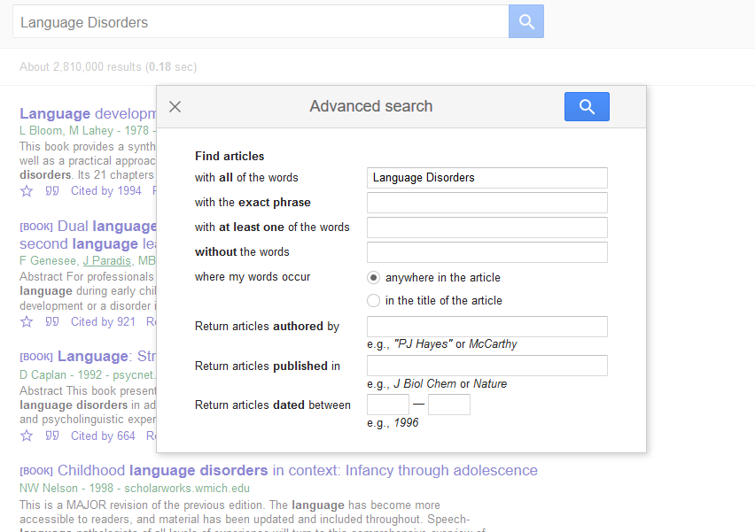
Advanced Search

Slide 5
Ranking by Relevance
Uses computer algorithms
Ambiguous on determination of relevancy

Slide 6
Subject Coverage
Science, Technology, Engineering, Medicine
Social Science (Education & Counselling)
Humanities

Slide 7
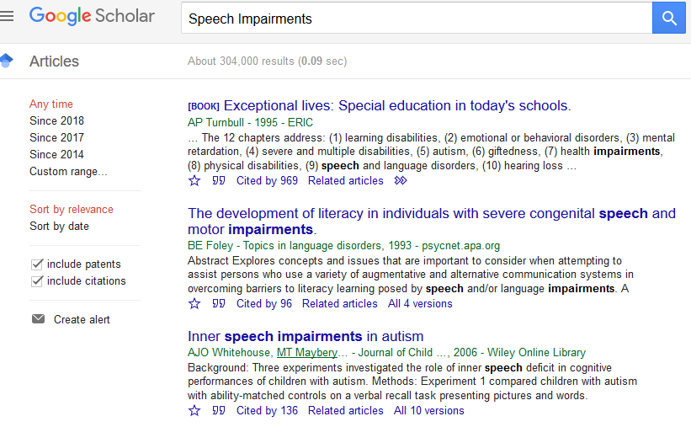
Refining of search results

Slide 8
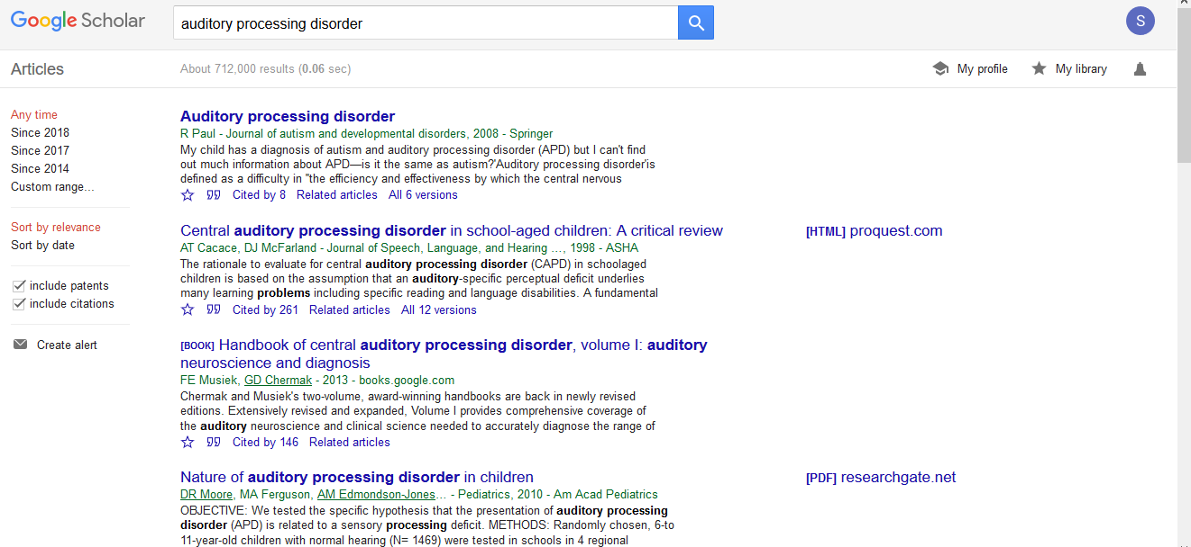
Reference Manager

Slide 9
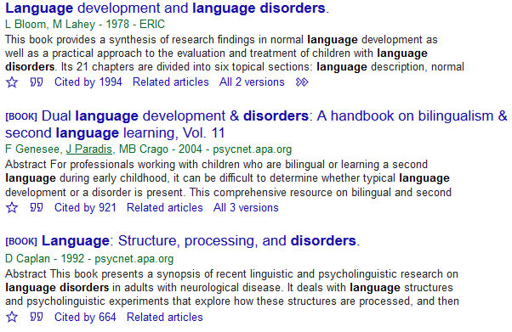
Cited by

Slide 10
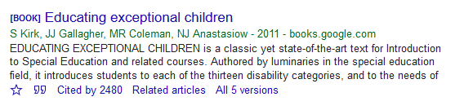
Related Articles

Slide 11
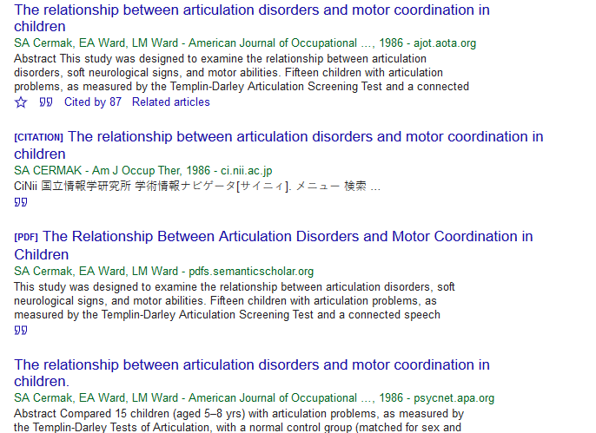
All … versions

Slide 12
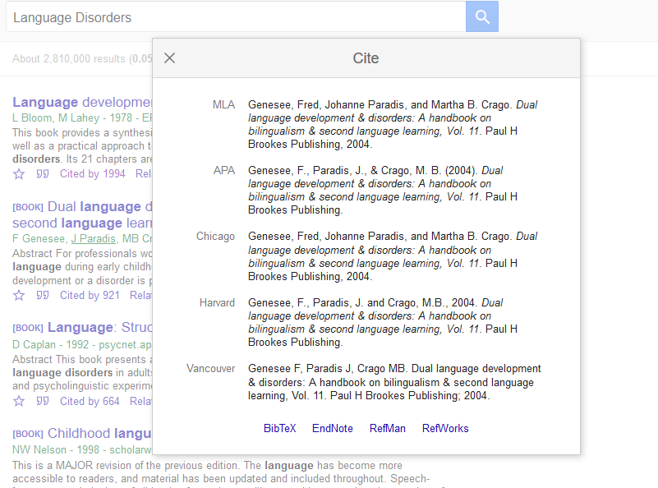
Cite

Slide 13

My Library

Slide 14
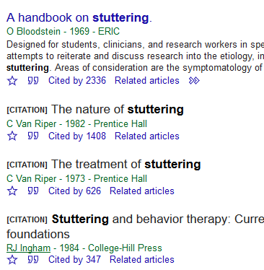

Slide 15
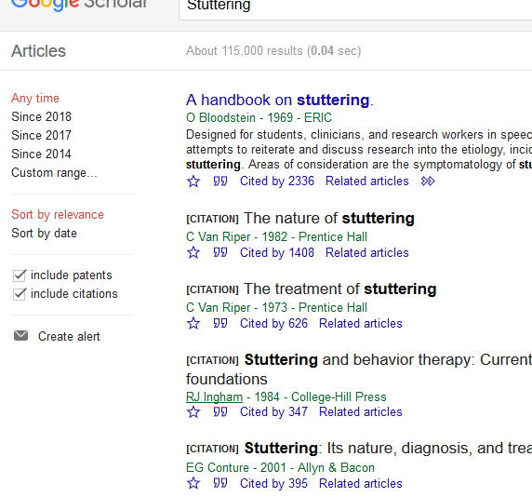
Alerting

Slide 16
Linking with Institutional Resources
Link subscribed resources

Slide 17
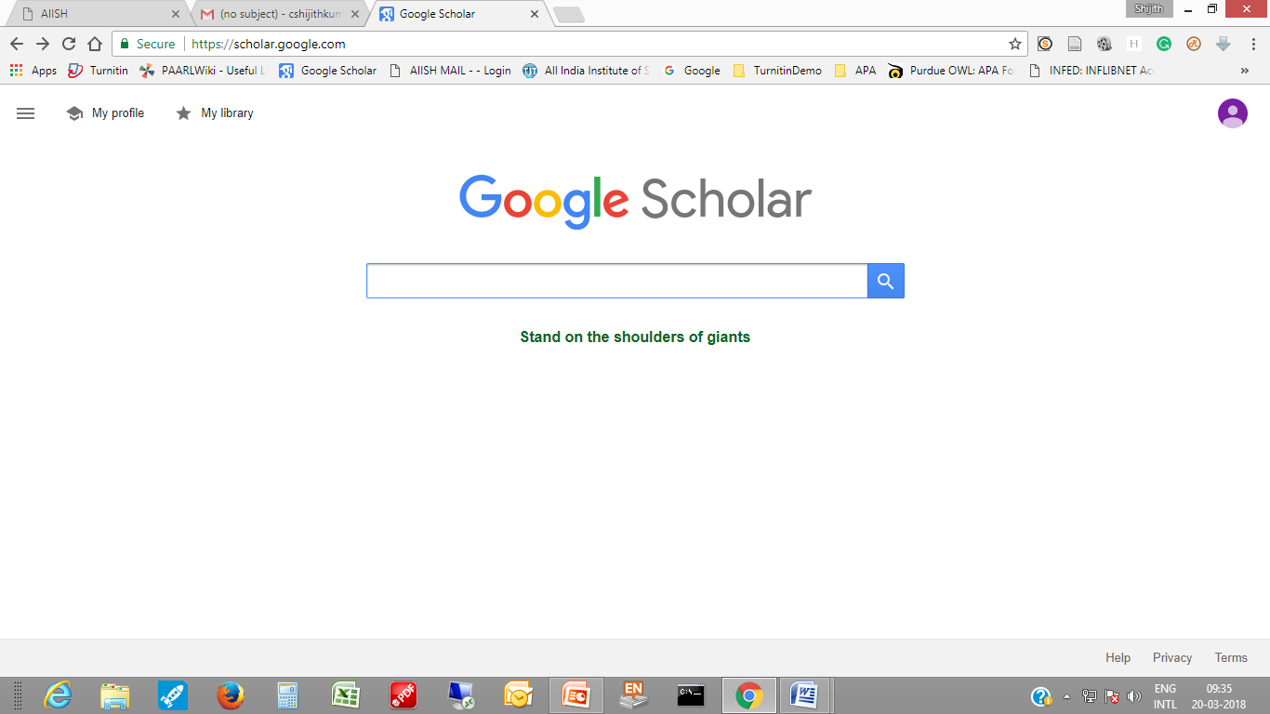
My Profile

Slide 18
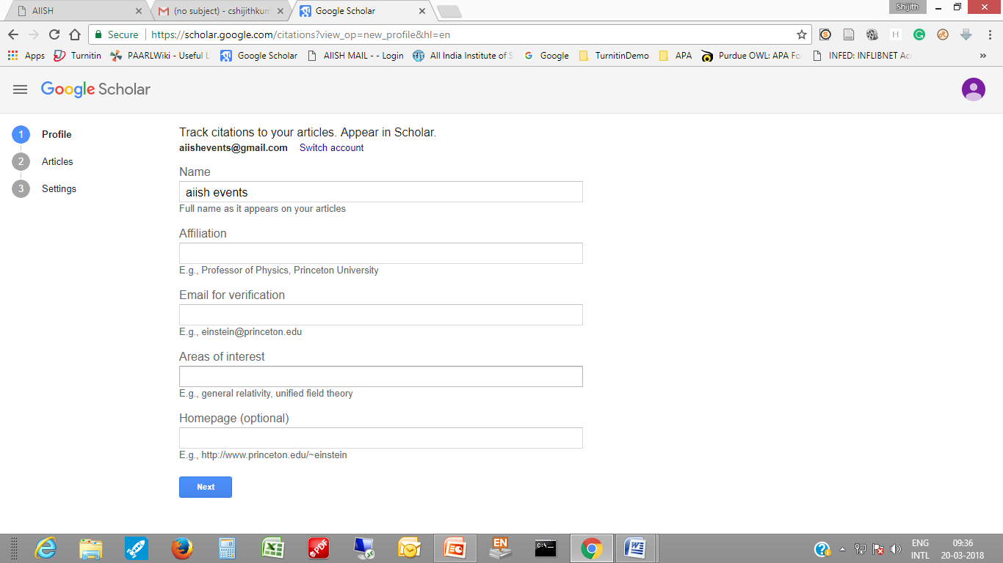
My Citations

Slide 19
Other Features & Drawbacks
Locating Incomplete Citation
Free Resource
Lack of Controlled Vocabulary
Incomp. with Std. Database Search
Numerical Errors
Shortfall / delay in Indexing
Limited Search Options

