Slide 1
COMDISDOME

Slide 2
Introduction
Proquest Inc., USA
University Micofilms International
Hundreds of databases
Proquest Dissertations and Theses Global – PQDT

Slide 3
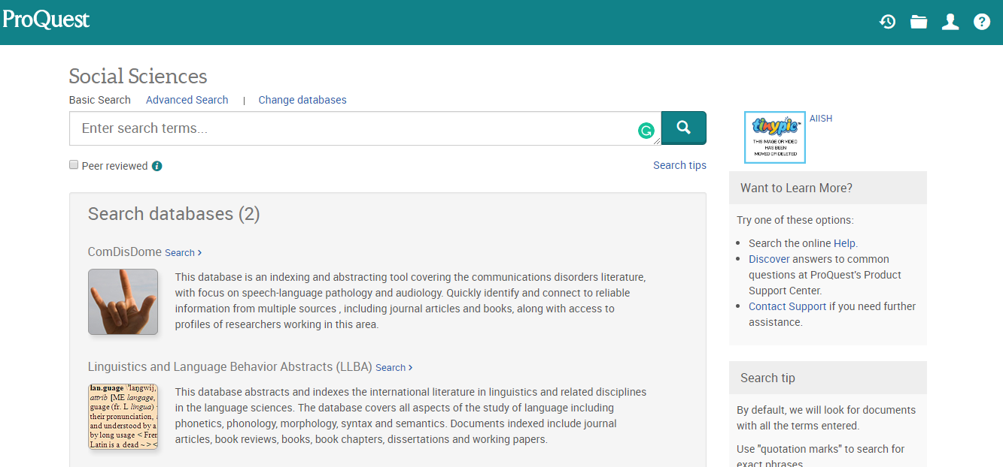
Common search interface of AIISH-Subscribed Databasess

Slide 4
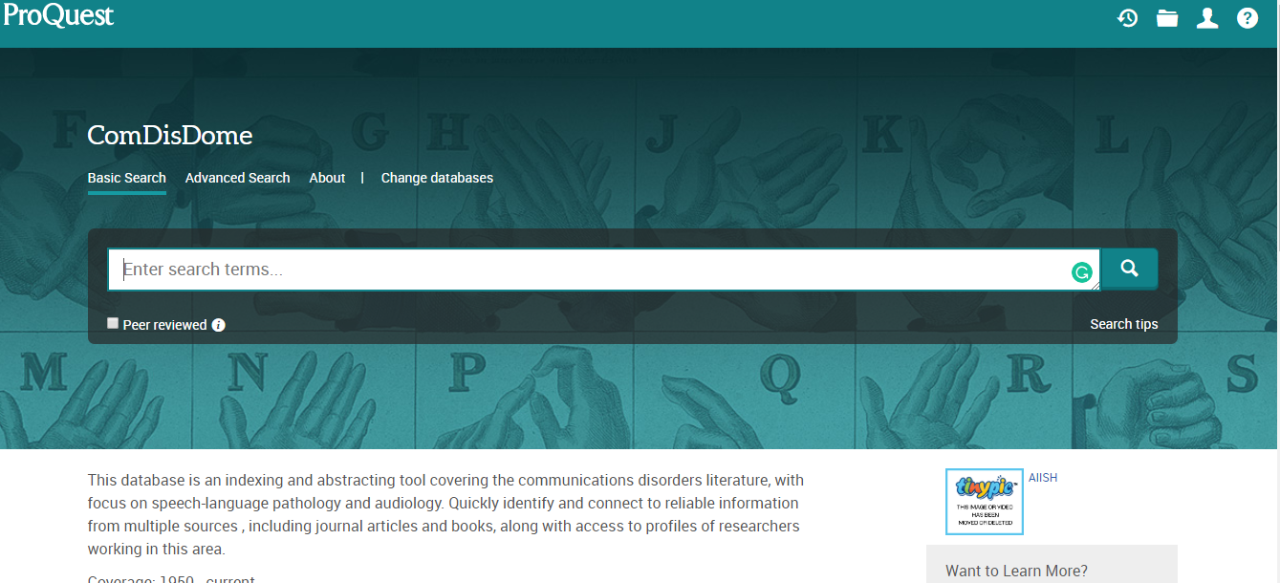

Slide 5
Sources
Journal articles
Books
Conference proceedings
Theses/dissertations
Professional Profiles

Slide 6
Subject Coverage
Audiologic Management, Augmentative and Alternative Communication, Communication Mechanism and Systems, Electroneuronography, Hearing Assessment, Hearing Conservation, Hearing Impairment, Hearing Science, Pediatric Audiology, Rehabilitative Audiology, Speech/Articulation, Speech-Language Pathology

Slide 7
Update Frequency & Period of Coverage
Monthly
400 records per update
  1958

Slide 8
Types of Searching
Basic search
Advanced search
Thesaurus based search
Command line search

Slide 9
Basic Search
Single Search Frame
Any search term
Search the entire records
More no. of retrieval

Slide 10
Advanced Search
Multiple Search Frames to search individual fields
Facilitate searching in single or multiple fields
Author
Title
Keywords
Publication Year
Sources
Combination of different fields using Boolean Operators

Slide 11
Command Line Search
Special in Proquest databases
Search box for placing the search statement
Combination of field codes
      SU, TI, AB (dysarthria)

Slide 12
Thesaurus based Search
Controlled Vocabulary
List of Subject Headings / Terms
Indexers
Users
Controlled & Structured

Slide 13
Thesaurus
A collection of selected vocabulary, preferred terms or descriptors, with links among synonymous, equivalent, broader, narrower, and other related terms

Slide 14
Search Filters
Peer-reviewed or not
Source type
Publication date range
Publication title (mainly in case of journals)
Document type such as article, feature, case study etc.
Subject category such as female, male, age
Language

Slide 15
Search Results
Sort: ‘Oldest’ or ‘Latest’
Display: brief view, detailed view, preview
Saving Format: html, pdf, text, rich text, ris, excel
Save in: EndNote, RefWorks

Slide 16
My Research
Personalized Service of Proquest Database
Save Search Results and Search Statements
Alert Service
Remote Login

Slide 17
Search Techniques
Phrase Searching
AND is implicit
SPEECH HEARING
Spelling Variants
Word Variants

