Slide 1
COMDISDOME
04.04.18

Slide 2
Introduction
Bibliographic Database on Communication Disorders
Publisher : M/s Proquest Inc., USA
Coverage: World Literature since 1950
Monthly Updation

Slide 3
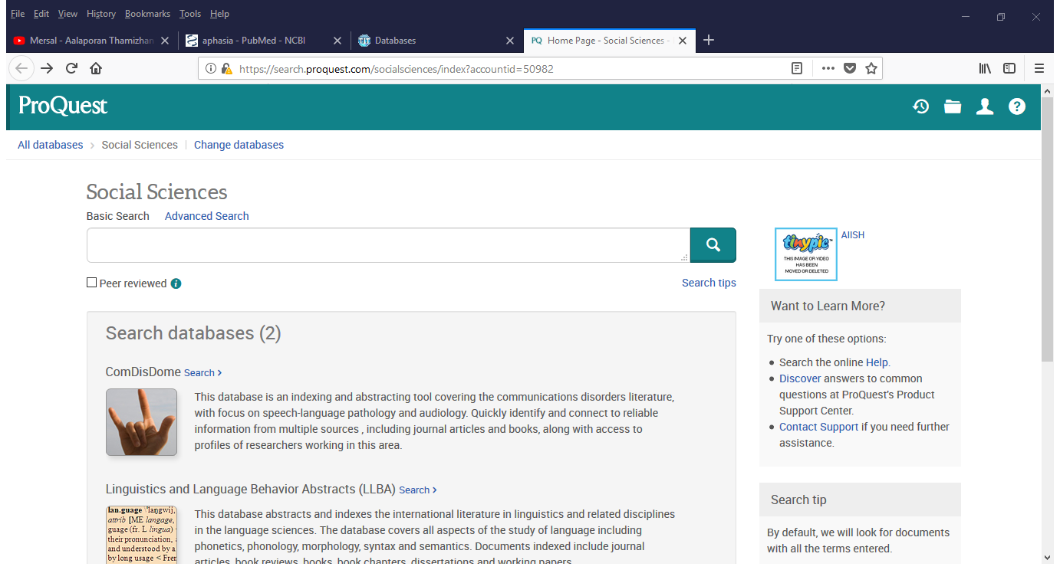
Proquest Databases

Slide 4
Basic Search

Slide 5
Basic Search
Searching Anywhere
Boolean Searching
Search Fields & Codes
Author (AU)
Abstract (AB)
Document Title (TI)
Publication Title (PUB)

Slide 9
Advanced Search
Thesaurus Based Searching
Command Line Search
Phrase Searching
Limiters/Filters
Stop words
Wildcards and Truncation

Slide 10
Duplicate documents
My Research
Re-running Previous Search
Search Expansion
Search Within
Related Searches
Alert Creation
Result View
Email
Saving the Selected Documents
Document Preview

