Slide 1
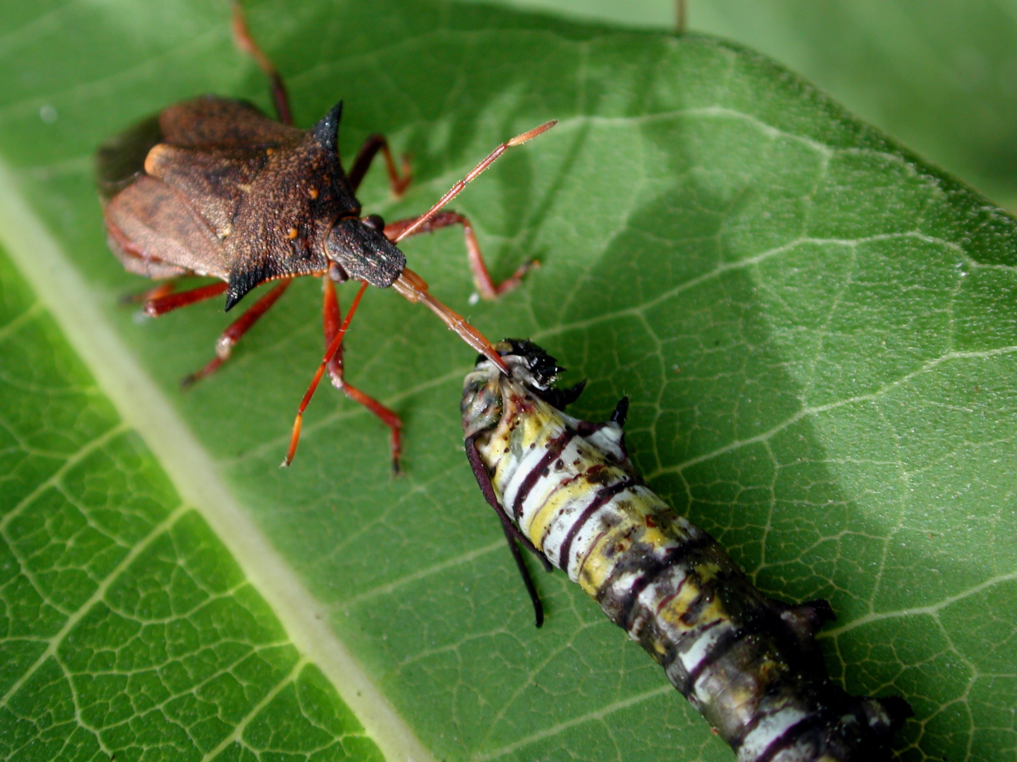
PREDATORY JOURNALS

Slide 2
What is it?
  A publication that actively asks for manuscripts from researchers. They have no peer review system and no true editorial board and are often found to publish mediocre or even worthless papers. They also ask for huge charges for publication.

Slide 3
Jeffrey Beall, University of Colorado , USA
Beall List
Cabell’s Blacklist
4,000 + titles

Slide 4
…Reasons & Implications
Availability of User-friendly Technology
‘Publish or Perish’
Standard of reputed journals
Poor communication skills
Quantity over quality

Slide 5
Reasons & Implications…
Loss of credibility
Loss of Control of Copyright
Lost Opportunity
Exploitation of Profile

Slide 6
Check List….
Editorial board
Peer-review system
Association membership
DOAJ - Directory of Open Access Journals
  COPE - Committee On Publication Ethics
  OASPA - Open Access Scholarly Publishers Association

Slide 7
…Checklist…
  Indexing
  Popularity
  Clarity on fee
  Misleading title
  Poorly maintained website

Slide 8
…Checklist
More no. of unrelated journals
Broad discipline
More no. of articles
Use boastful language
Incomplete contact details

