Slide 1
www.asha.org
American Speech-Language-Hearing Association (ASHA)

Slide 2
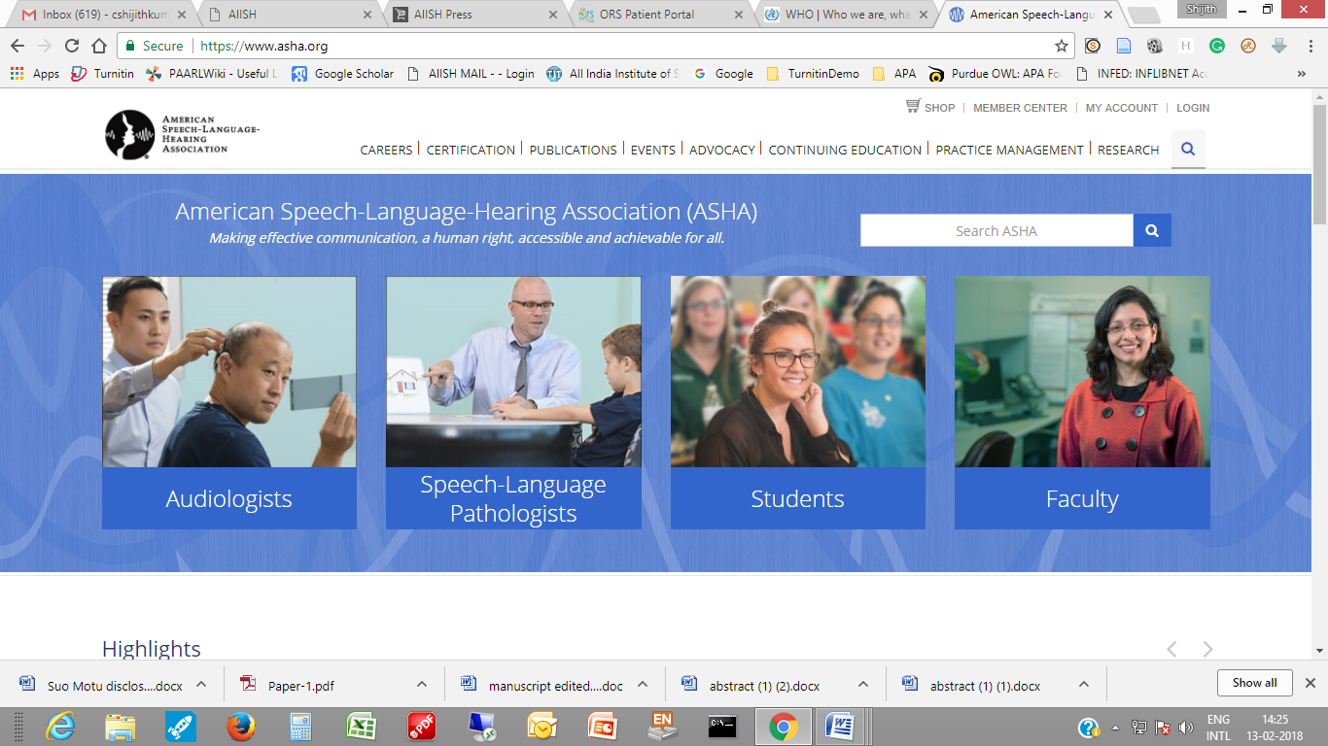
Information for Audiologists, SLPs, Students & Faculty

Slide 3
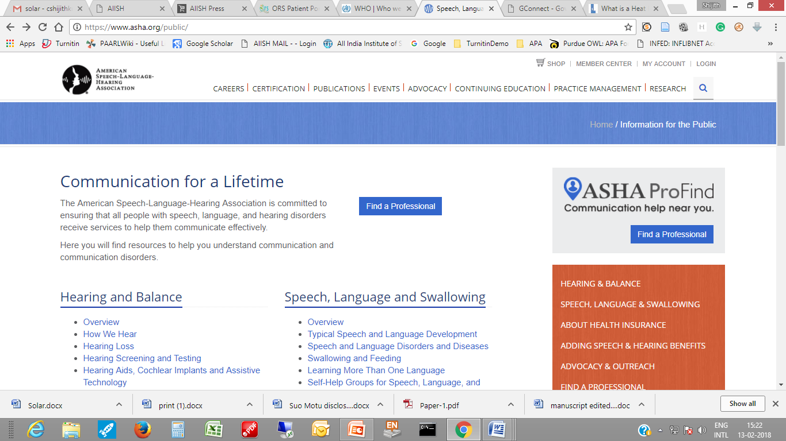
Information for General Public

Slide 4
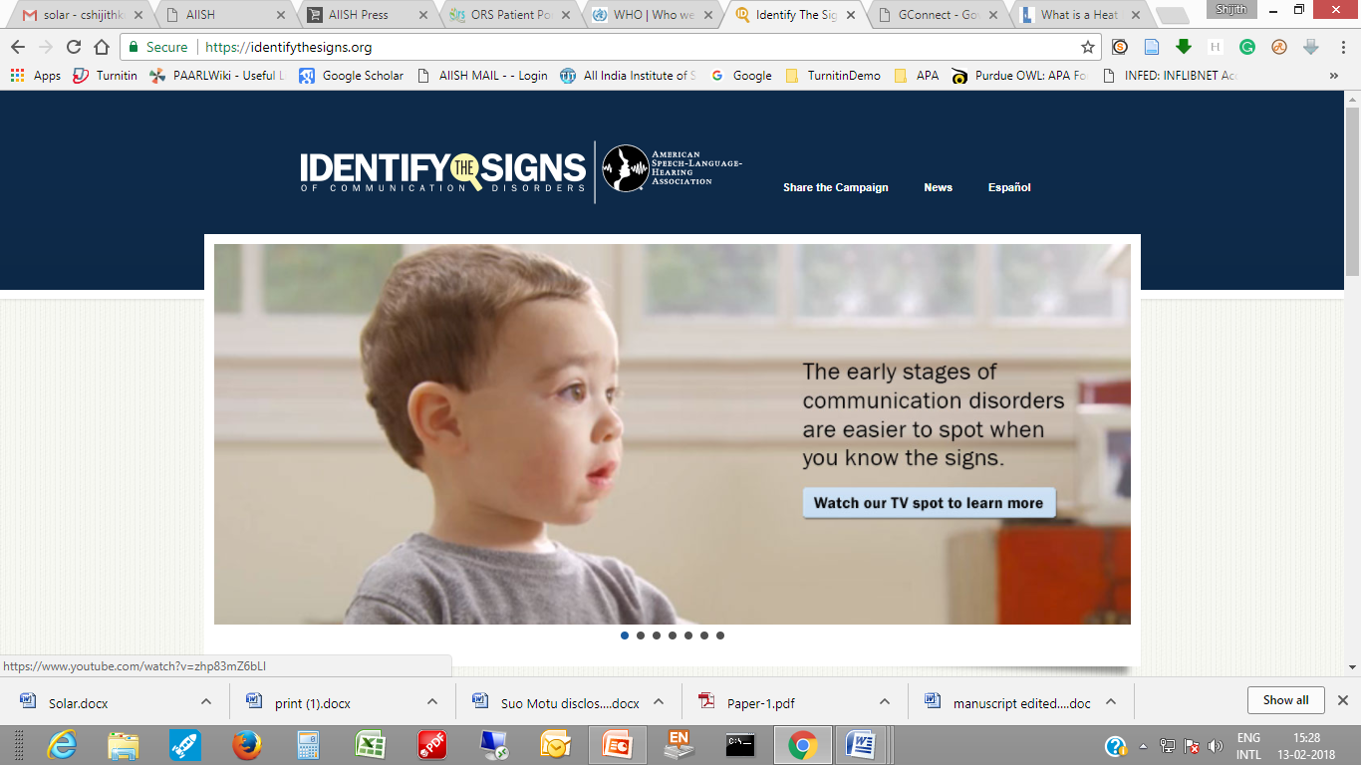
Information for General Public

Slide 5
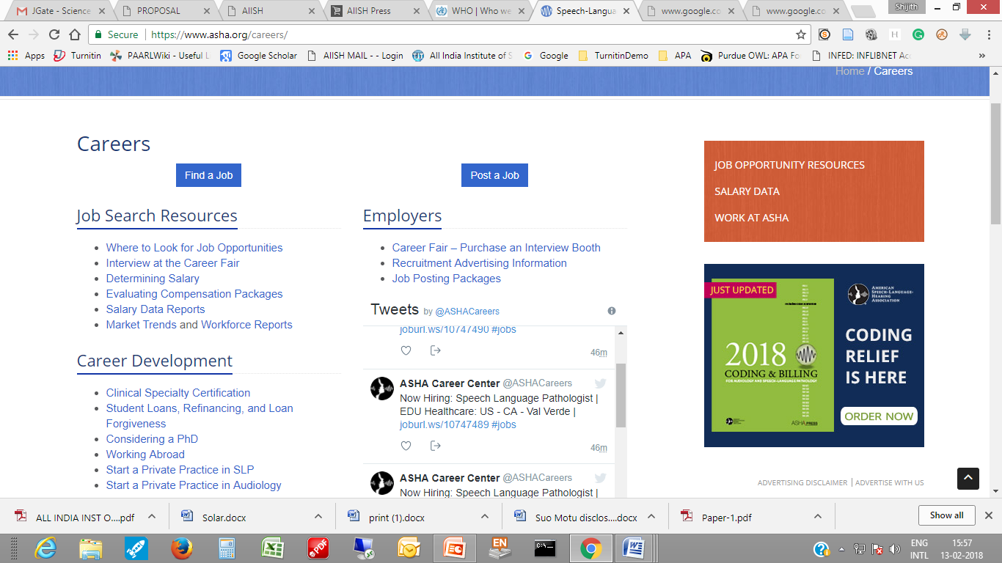
Career Section

Slide 6
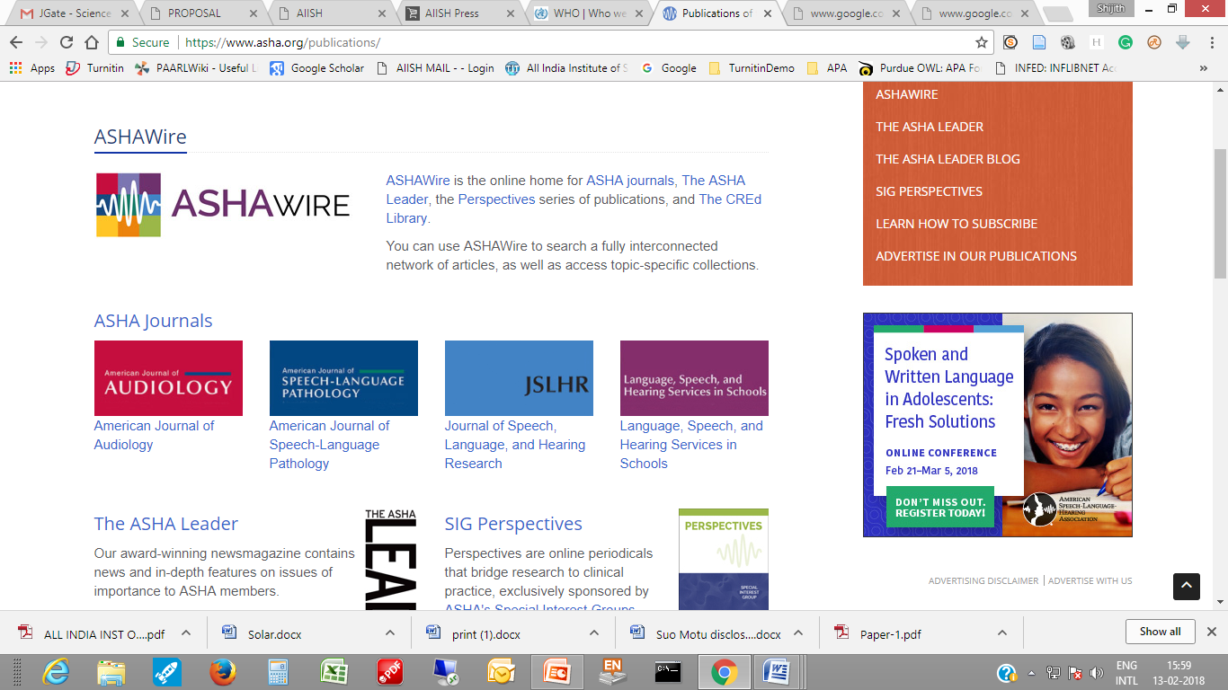
Publication Section

Slide 7
Practice Portal
Research
Events
Certification
Member login facility
Search Facility

Slide 8
Subject Gateways / Portals
Centralized access to resources on a specific subject.
Example: National Health Portal
www.nhp.gov.in/

Slide 9
National Health Portal
Centre of Health Information, NIHFW, MHFW
Authentic health information/services

Slide 10
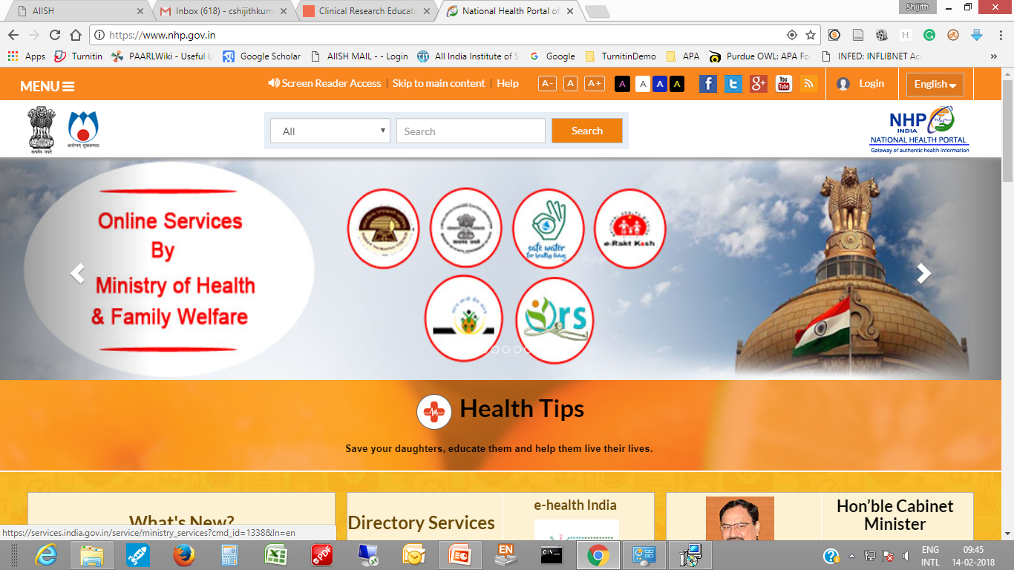

Slide 11
Disease / Conditions: A-Z

Slide 12
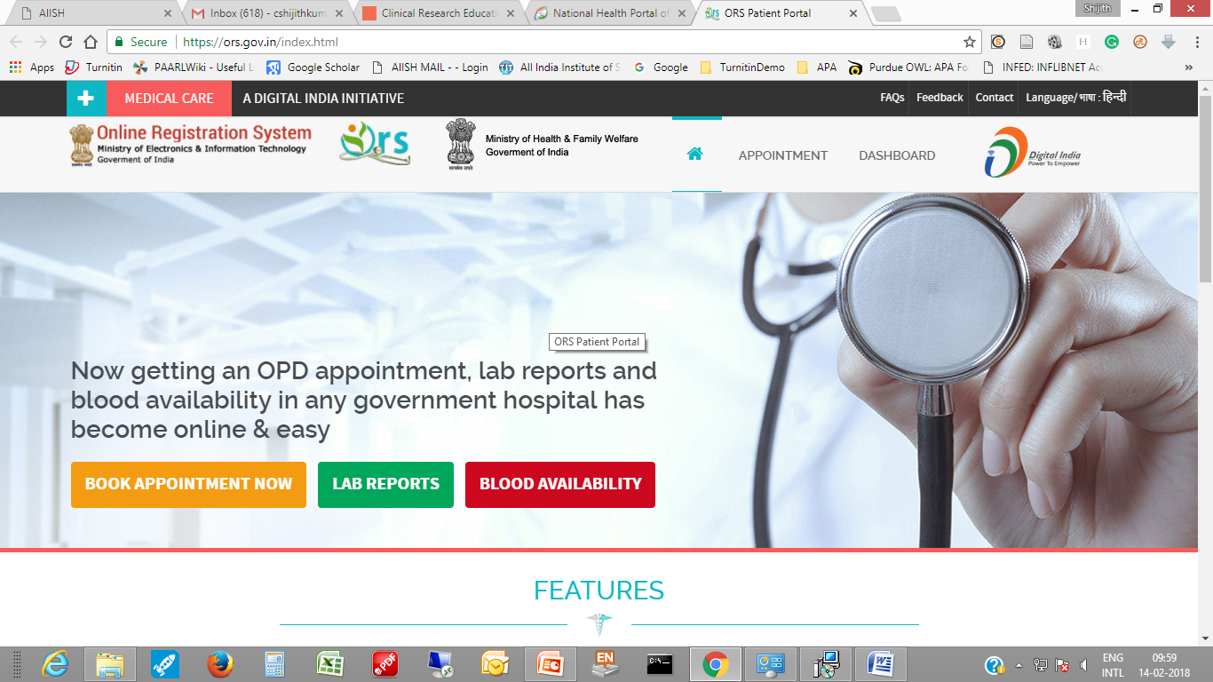
Online Registration System

Slide 13
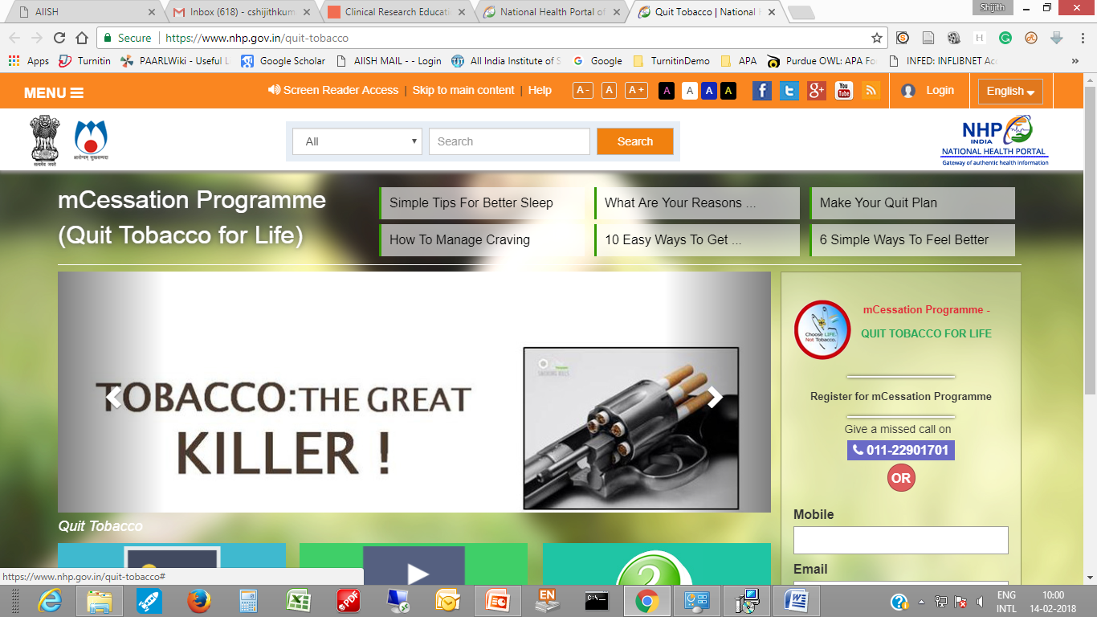
mCessation Programme

Slide 14
NHP Voice Web

Slide 15
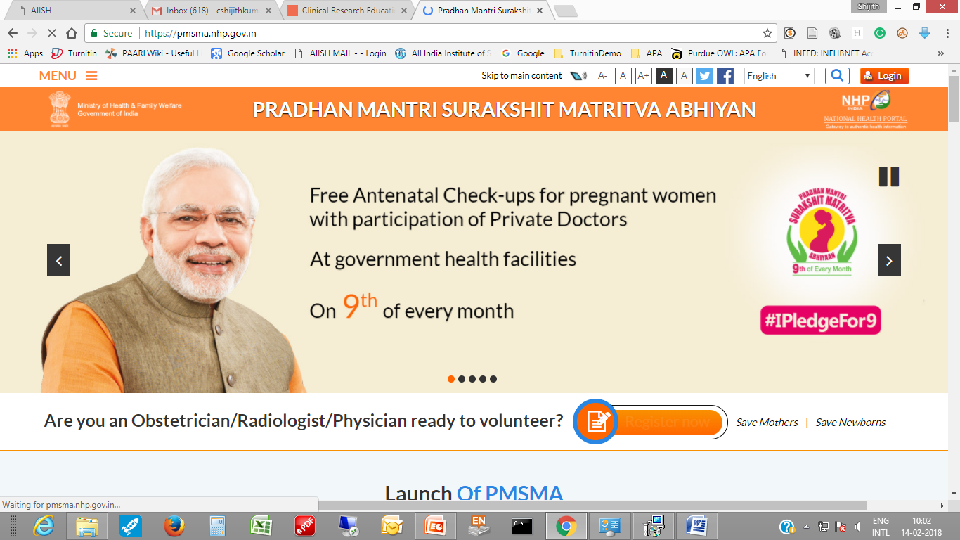
Pradhan Mantri Surakshit Matritva Abhiyan

Slide 16
My Hospital

Slide 17
eRaktKosh

Slide 18
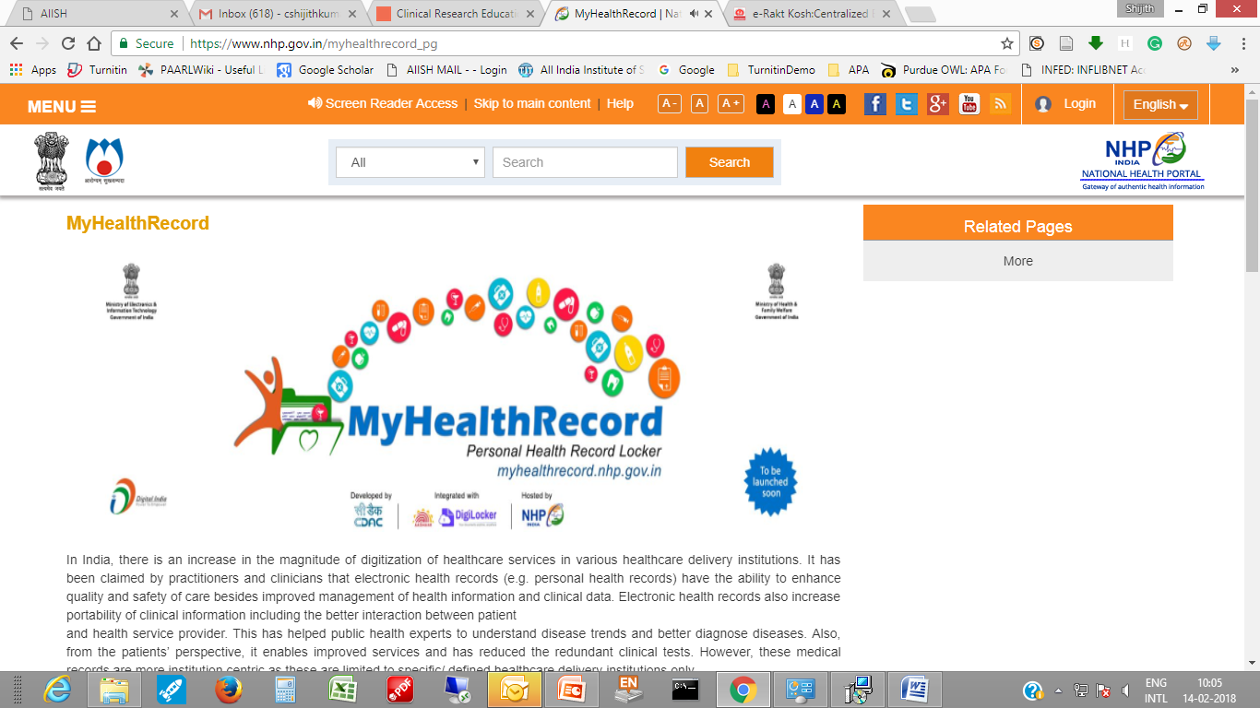
MyHealthRecord

Slide 19
Health Calendar

Slide 20
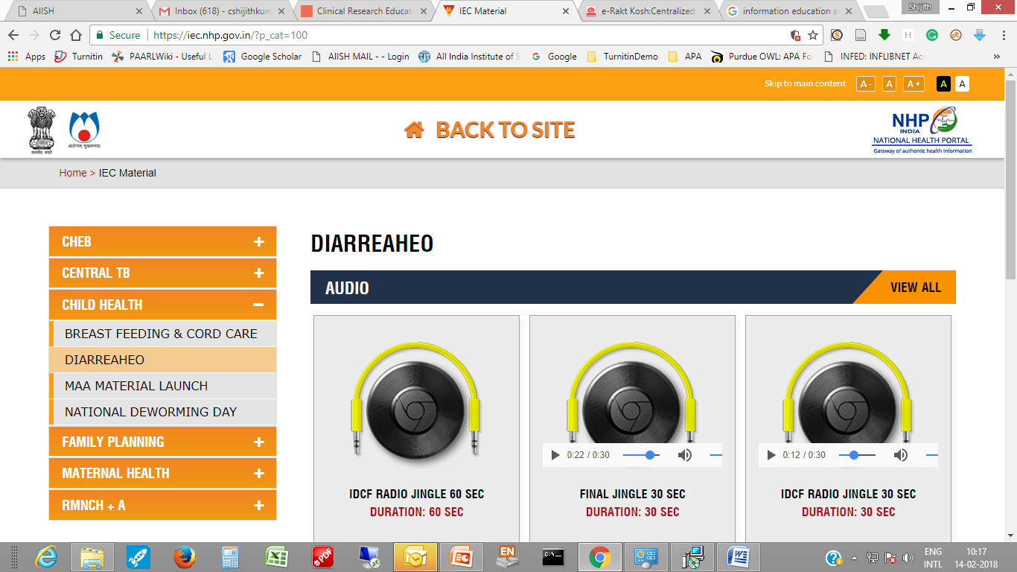
IEC Materials

Slide 21
Family Planning

Slide 22
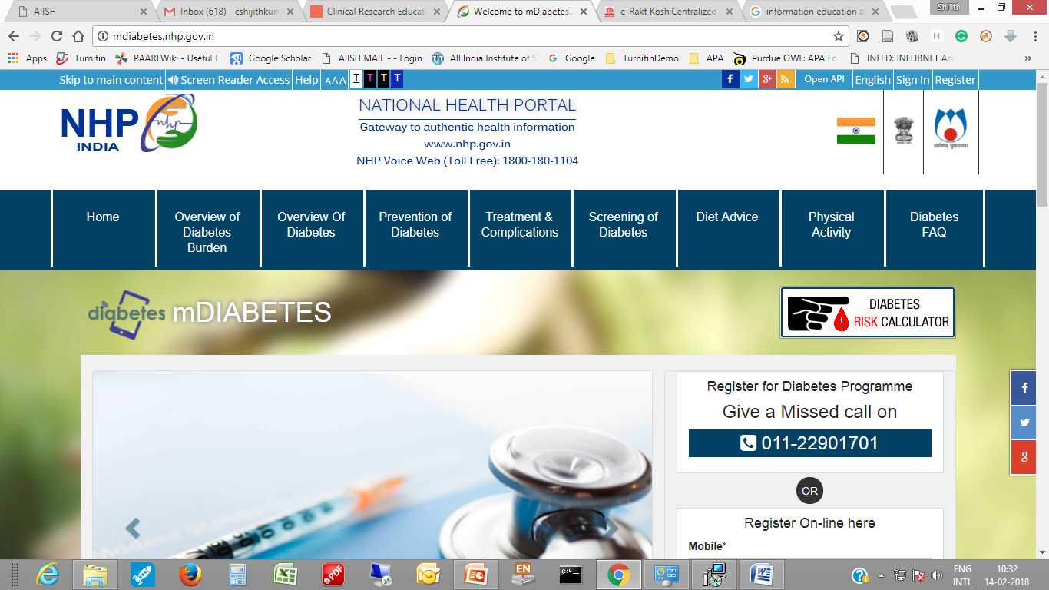
mDiabetes

Slide 23
TeleMedicine

