Slide 1
Indian Copyright Act

Slide 2
Legal Right
on
Intellectual Work

Slide 3
Intellectual Works
Artistic works
Cinematographic films
Dramatic works
Literary works
Music
Sound recordings

Slide 4
Copyright Owners
Literary work : Author
Dramatic work : Performer
Music: Composer
Cinematographic film: Producer
Photograph: Photographer
Sound Recording: Lyricist, Composer, Singer/ Producer
Employer
Assignee

Slide 5
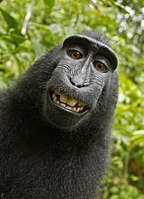

Slide 6
Bundle of Rights
Reproduction
Communication
Performance
Adaptation
Translation

Slide 7
How to Claim?
Automatic
Copyright Office, Department of Education, MHRD, GOI
Register of Copyrights

Slide 8
Term of Copyright
Protected for a limited period of time
60-year from the year following the death of the author
60-year from the date of publication

Slide 9
Foreign Works
International Copyright Order
Berne Convention for the Protection of Literary and Artistic Works

Slide 10
Copyright Infringements
  Making infringing copies for sale
  Performance of works in public
  Distributing infringing copies for trade
  Importation of infringing copies
  Crim. offence u/s 63 of Copyright Act
  Six months Imp. & fine of Rs. 50,000/-
  Second & subsequent conviction

Slide 11
Creative Common Licences

Slide 12

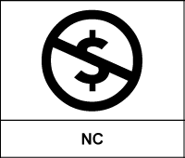
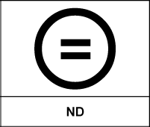

Licence Elements
Attribution
Non-commercial
No Derives
Share Alike

Slide 13

Creative Common Licence-1
Attribution
Copy, Display, Distribute, Perform, Modify both for commercial & non-commercial purposes

Slide 14

Creative Common Licence-2
Attribution, Non-commercial
Copy, Display, Distribute, Perform, Modify: Non-commercial purpose

Slide 15

Creative Common Licence-3
Attribution, No Derivative
Copy, Display, Distribute, Perform Commercially & Non-Commercially: Verbatim copies

Slide 16

Creative Common Licence-4
Attribution, Share Alike
Copy, Display, Distribute, Perform, Modify commercial or non-commercial purposes- Share alike

Slide 17

Creative Common Licence-5
Attribution, Non-Commercial, Share Alike
Copy, Display, Distribute, Perform, Modify Non-commercial purposes & Share alike

Slide 18

Creative Common Licence-6
Attribution, Non-Commercial, No Derivative
Copy, Display, Distribute, Perform-Verbatim, Non-Commercially

