Slide 1
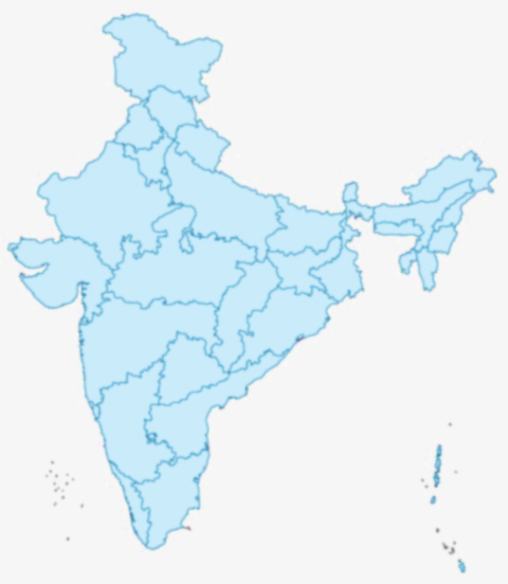

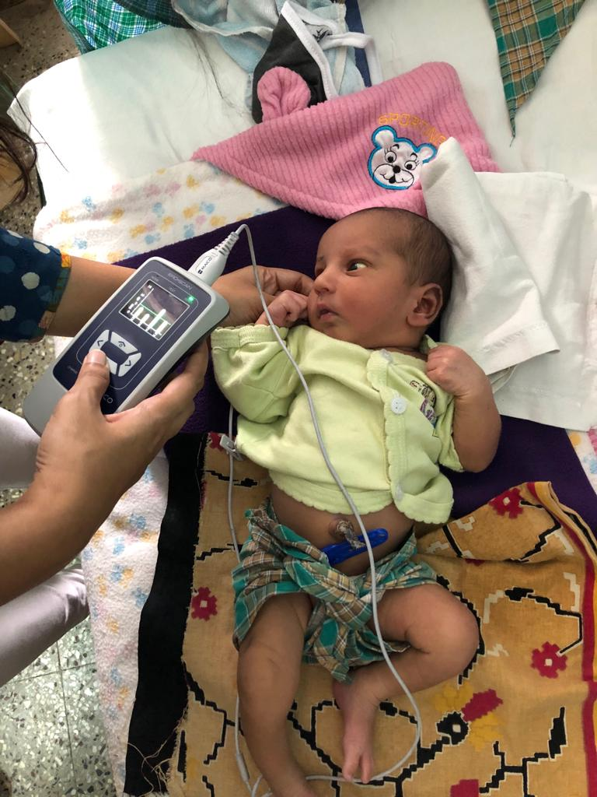



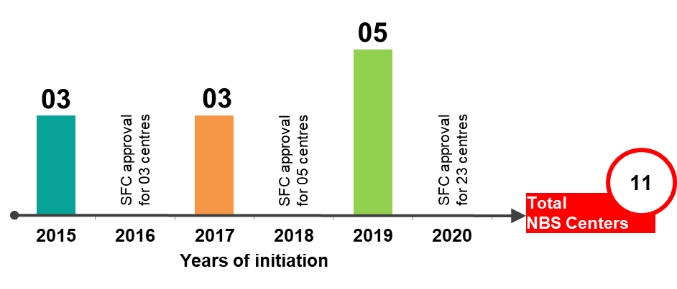

New-born Screening Centres
Clinical Outreach Centres of AIISH
IGMC
Shimla
11
KGMU
Lucknow
10
7
1
JLNMCH
Ajmer
KGMU
Lucknow
8
13
3
JLNMCH
Bhagalpur
AIIMS
Patna
RIMS
Imphal
4
5
NSCB
Jabalpur
RIMS
Ranchi
2
12
SCBMCH
Cuttack
AIIPMR
Mumbai
9
11
6
SVMH
Sarguru
SUDHER
Kolar
JIPMER
Puducherry
AIISH
Mysuru
03 Existing centre (in First cycle)

Slide 2
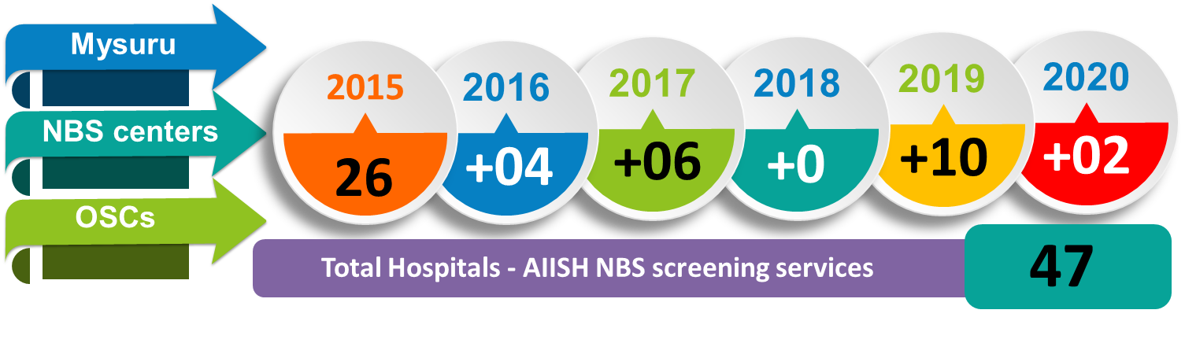
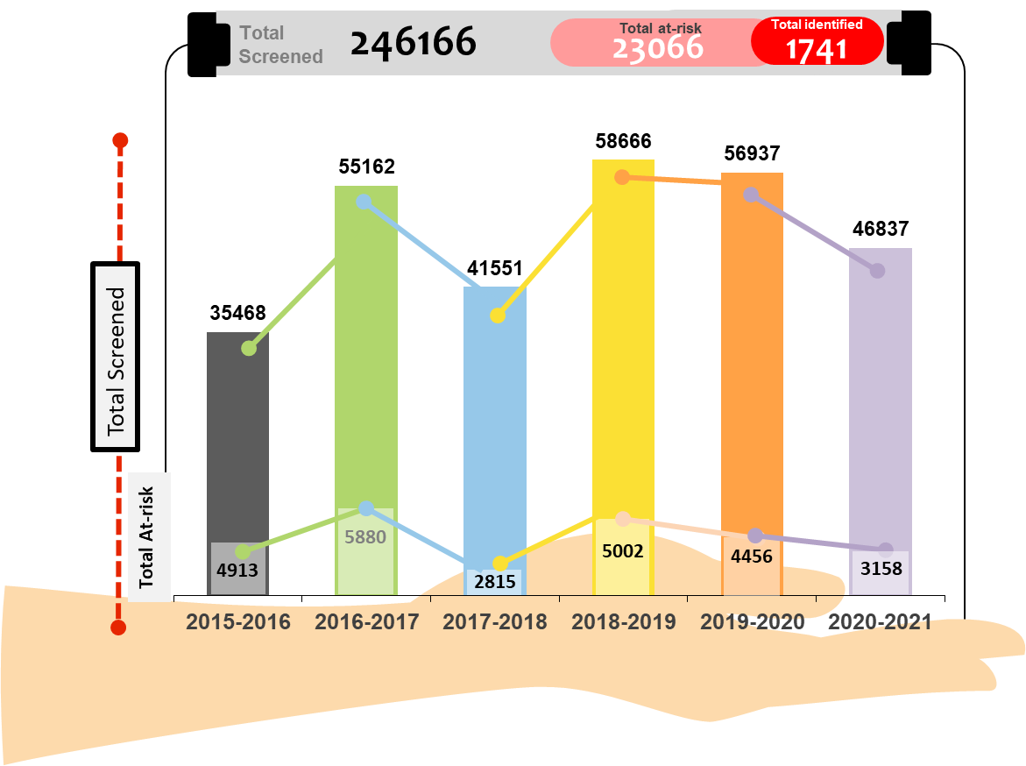
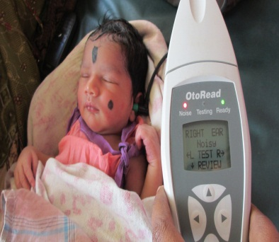
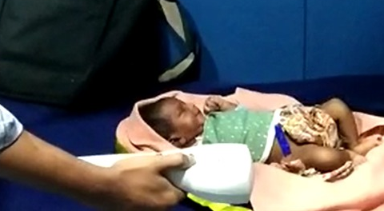
Total
Beneficiaries

Slide 3
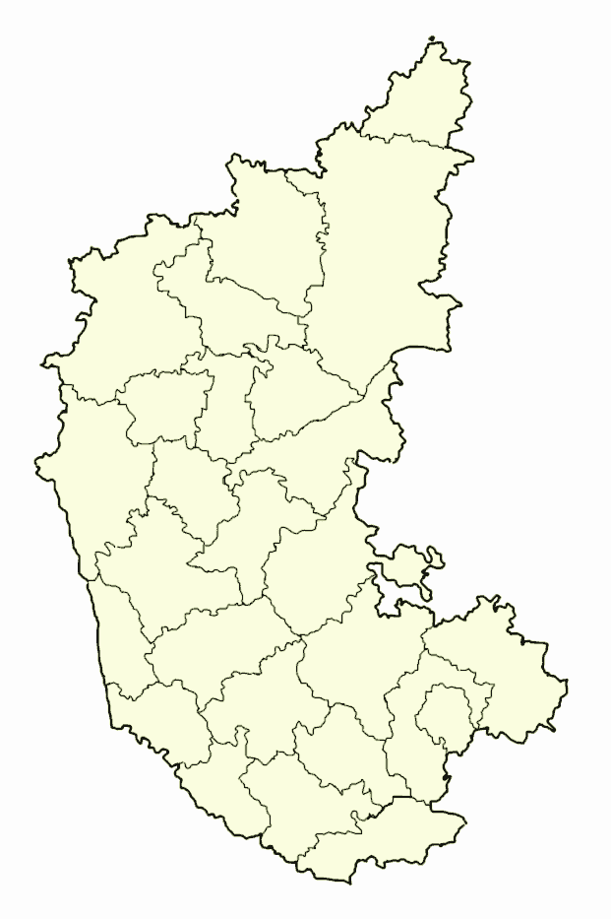
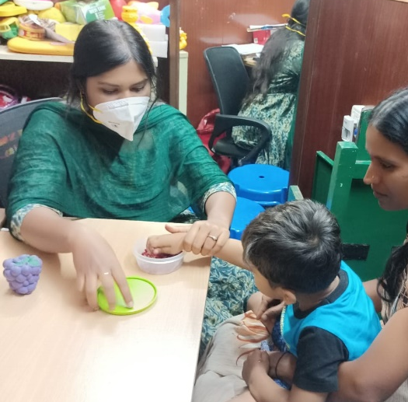

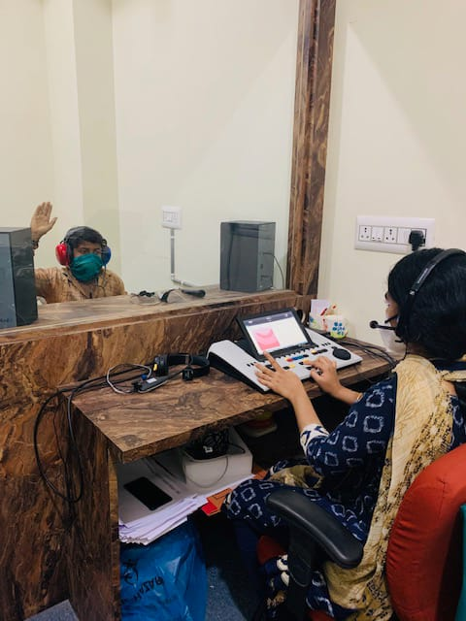
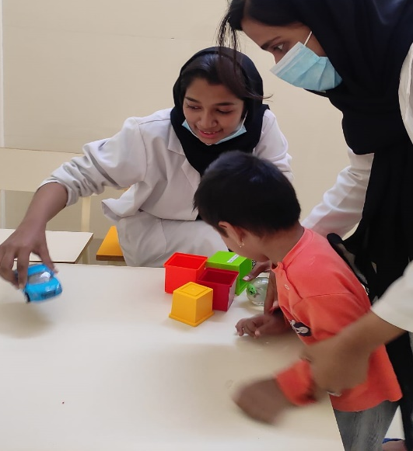

Outreach Service Centres
A centre for Hearing, Speech and Language Disorders
GIMS
Kalaburagi
BIMS
Belagavi
Total Centres: 07
SDH
Shivamogga
SFC approval for 01 centre
SFC approval for 05 centres
SFC approval for 23 OSCs
TGH
K R Pete
TGH
Nanjangudu
PHC
Akkibebbalu
03 Existing centre (in First cycle)
KoIMS
Kodagu
CHC
Hullahalli
PHC
Gumballi
SVMH
Sarguru

Slide 4
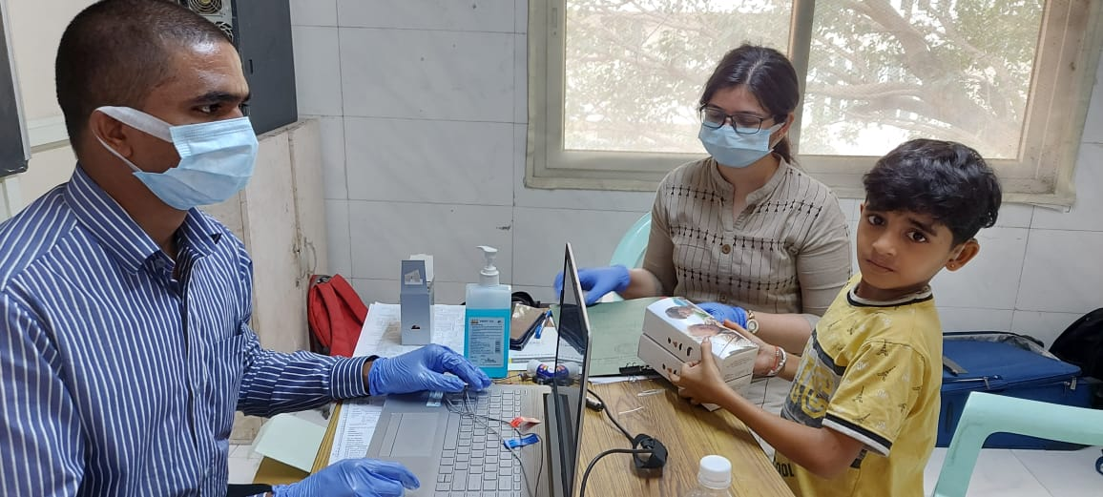

Total
Beneficiaries at OSCs
OPD Cases
Free Hearing aids issued
Speech-Language Therapy
Content Here

Slide 5
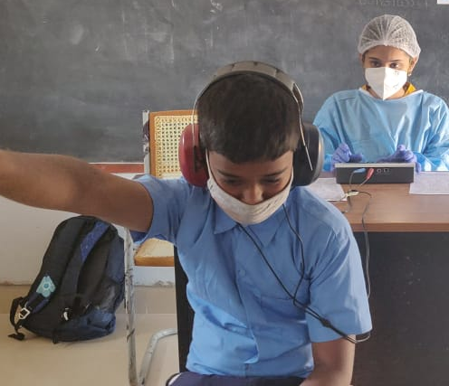
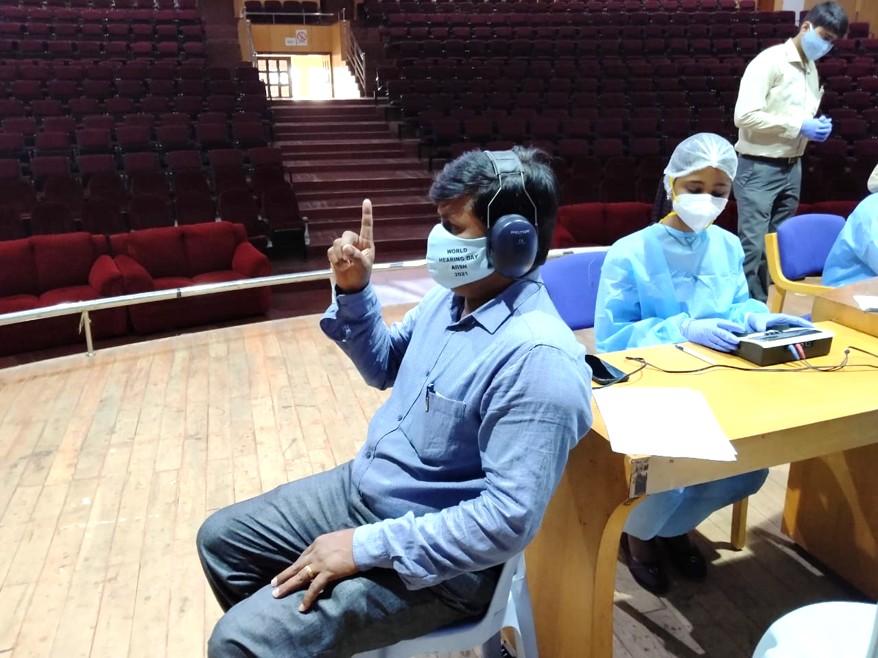
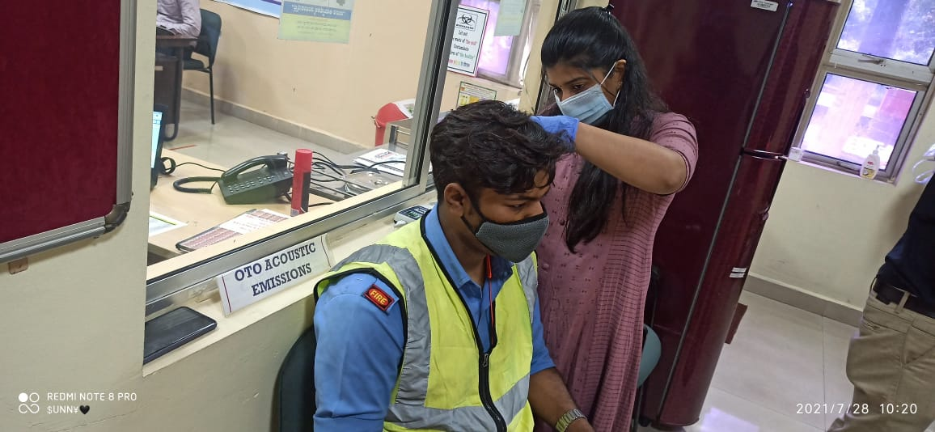
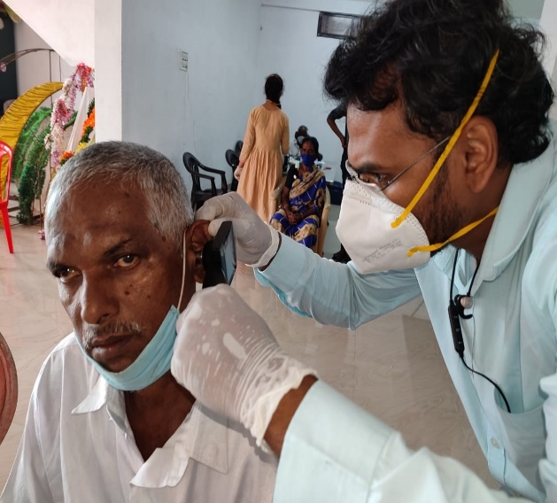
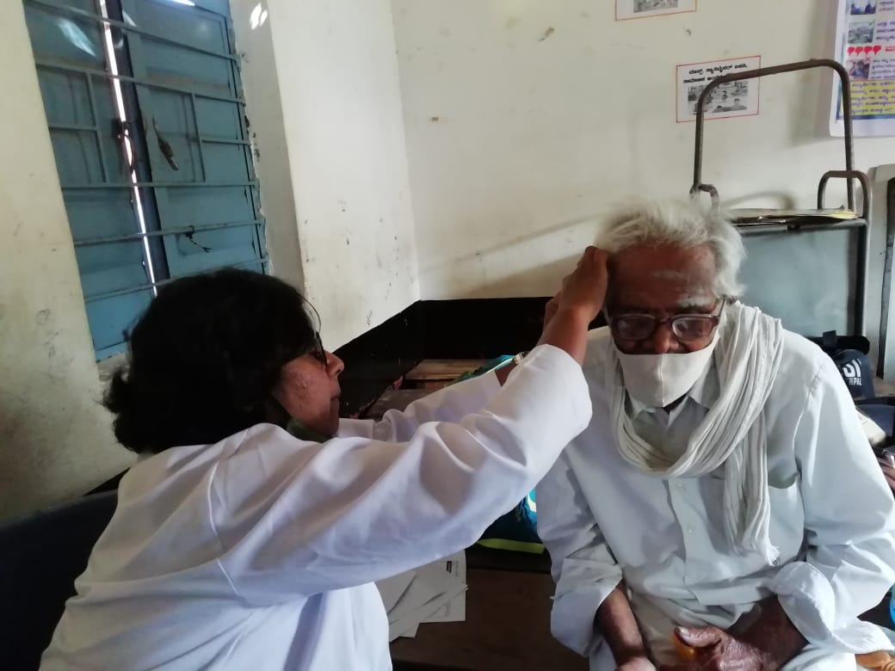
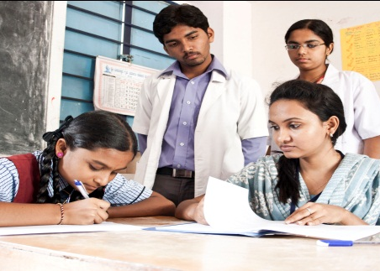
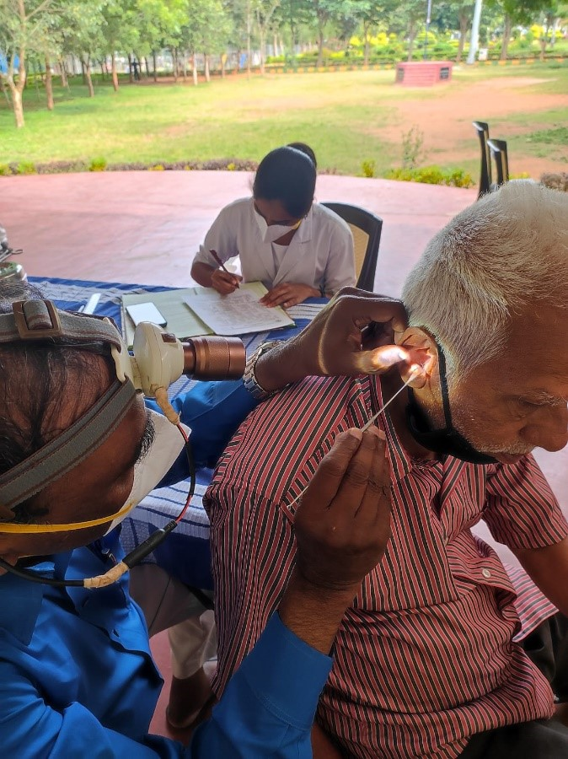
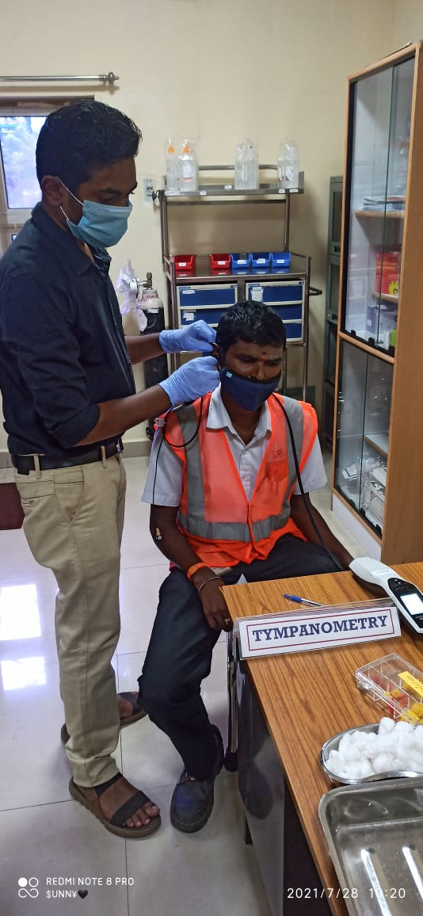
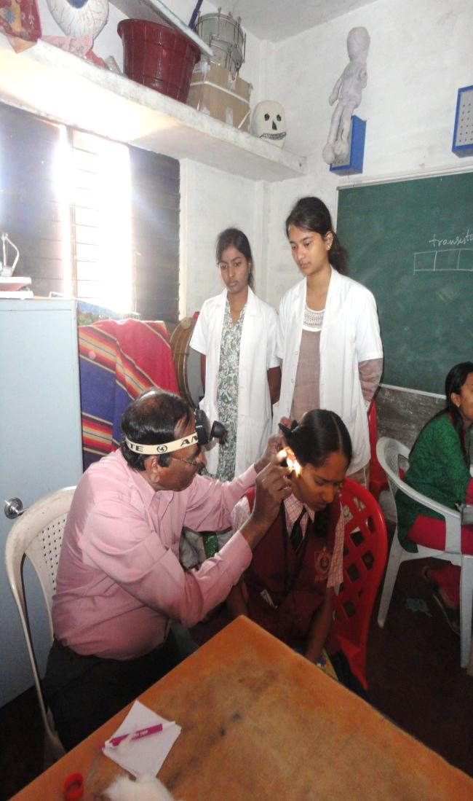
Total Screened
Total Registered
10688
Total Screened
2214
493
2214
Total Screened
19127
Total at-risk
795
Total at-risk
2214
292
Total at-risk
2214
1945
School Screening
Industrial Screening
Elderly Screening
Camp

Slide 6
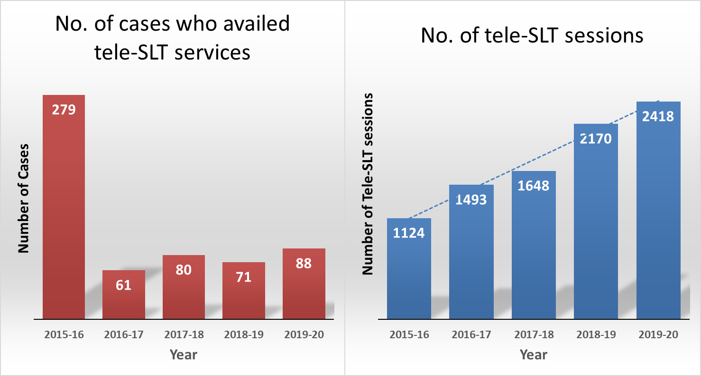

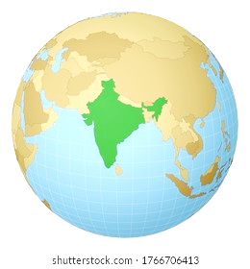

Tele-Therapy
State-wise Data
(2015-2020)
States | #Cases | # Sessions | States | #Cases | # Sessions
Karnataka | 123 | 2862 | Himachal Pradesh | 2 | 125
Kerala | 23 | 614 | Odisha | 18 | 79
Tamil Nadu | 13 | 607 | Haryana | 3 | 75
Jharkhand | 6 | 497 | Chattisgarh | 3 | 53
Assam | 11 | 473 | West Bengal | 2 | 49
Maharashtra | 10 | 245 | Andhra Pradesh | 4 | 44
Rajasthan | 13 | 200 | Madhya Pradesh | 4 | 35
New Delhi | 8 | 131 | Telangana | 2 | 14
Gujarat | 3 | 114 | Uttarakhand | 2 | 13
Uttar Pradesh | 9 | 112 | Goa | 1 | 1
Tele-Sessions – Speech-Language Therapy
Total Cases: 260 Total Sessions: 6343

Slide 7
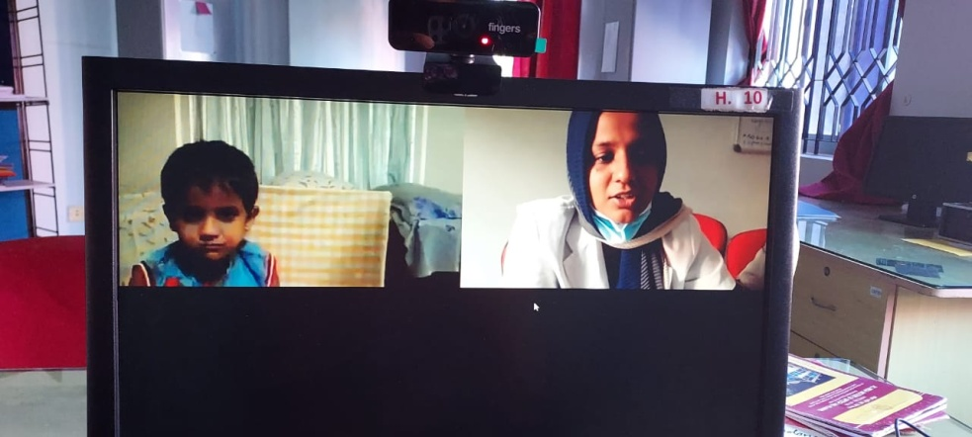
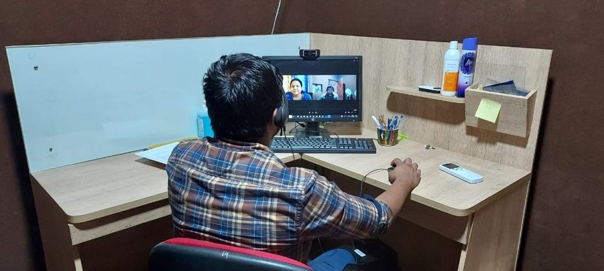
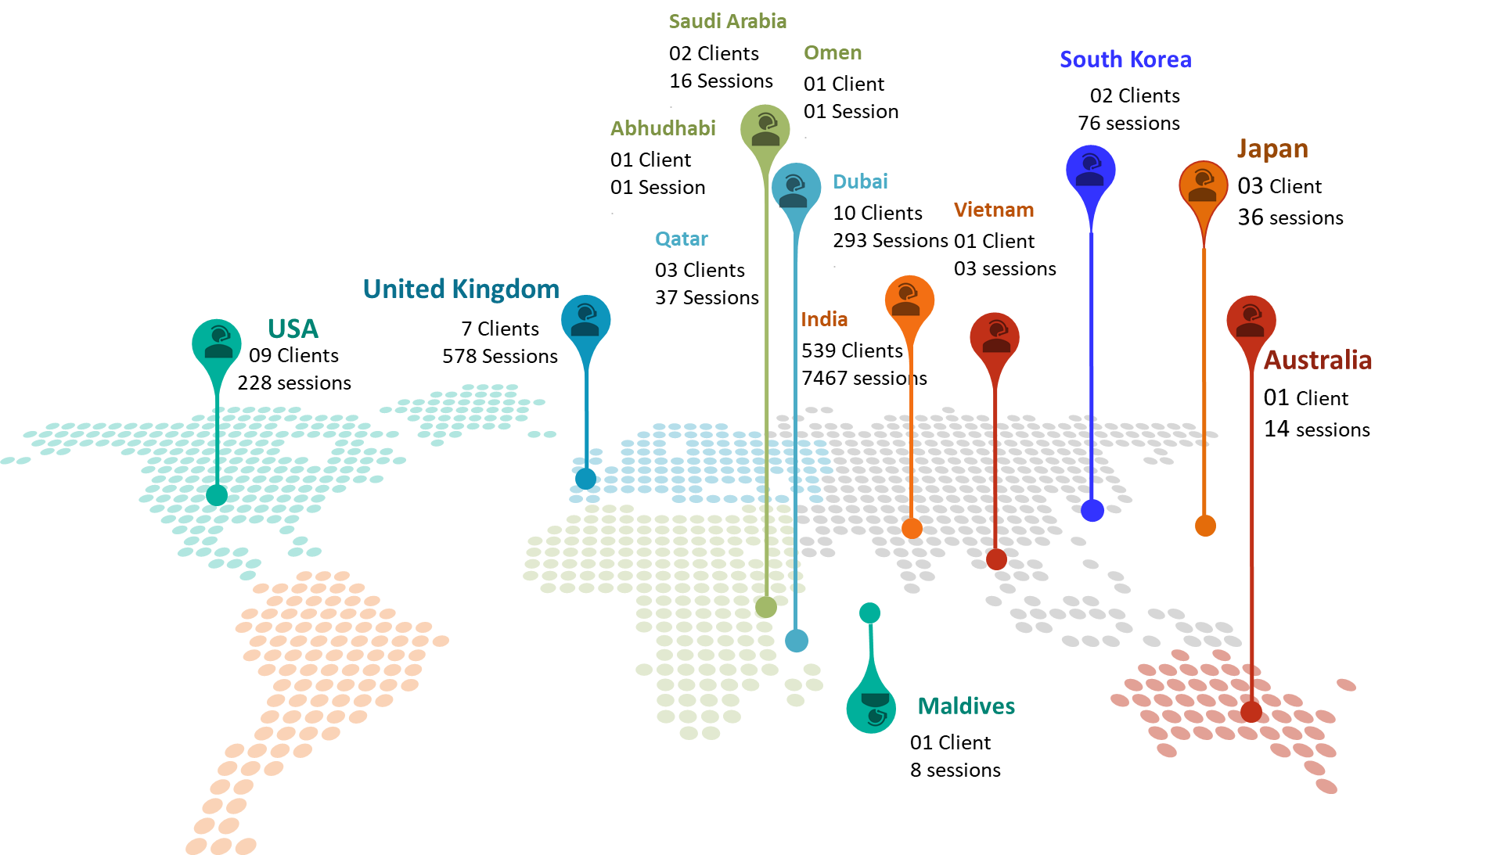
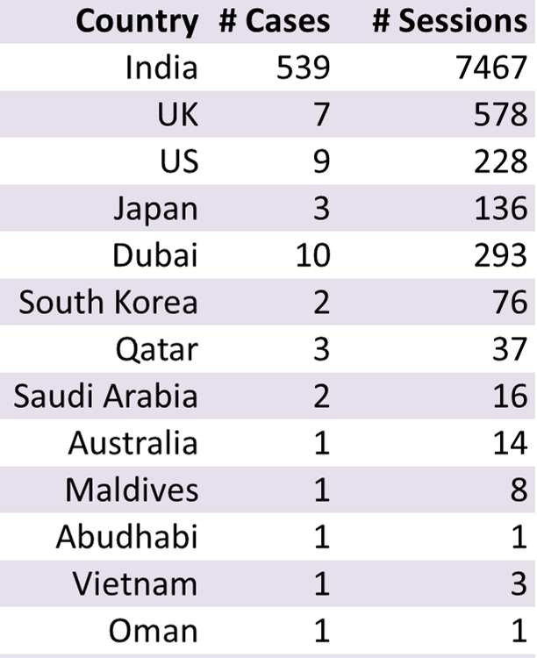
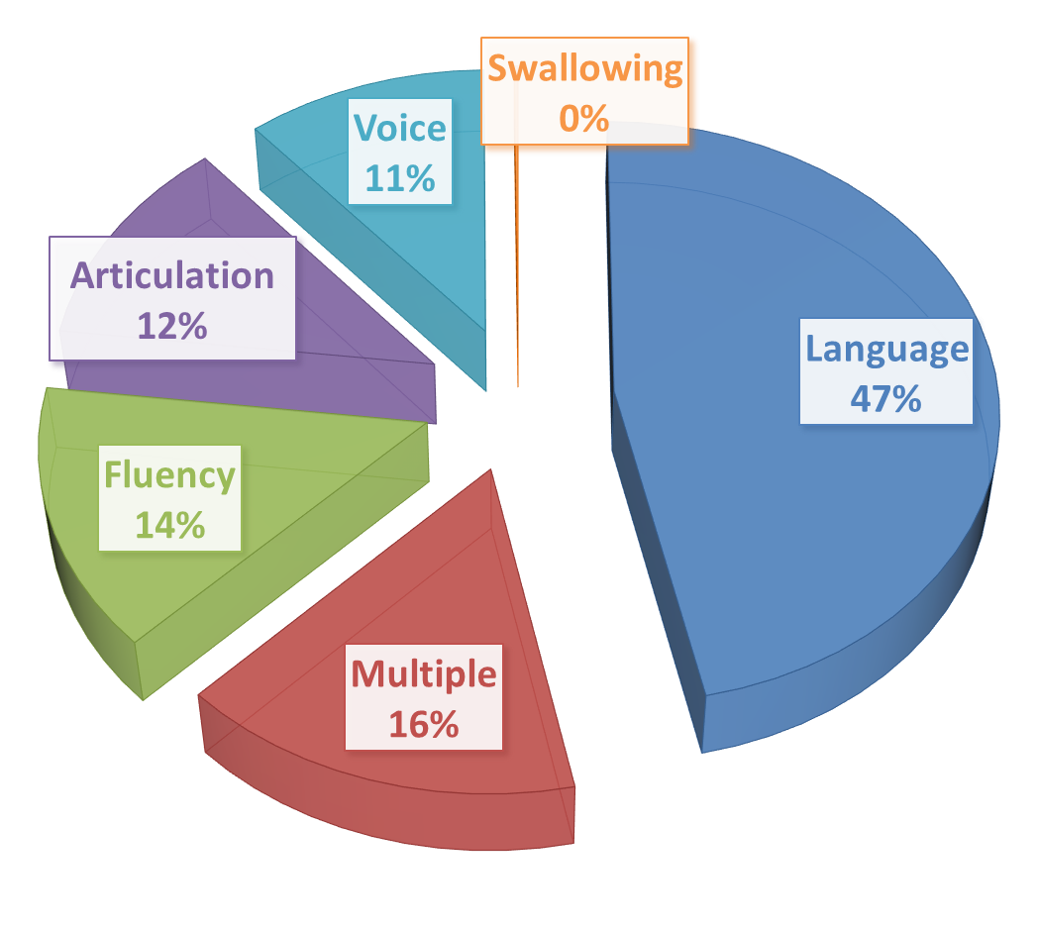
Global-wise Data
(2015-2020)
2015
01
India
2016
+5
USA UK Dubai
Vietnam Oman
2017
+3
Japan
Maldives
Saudi Arabia
2018
+2
South Korea
Abudhabi
2019
+2
Australia
Qatar
Total Countries: 13
Total Cases: 580 Total Sessions: 8858

