Slide 1
Clinical Care
2017-18
2018-19
2019-20
73909
74002
2016-17
72419
69490
One of the most comprehensive Clinical Care Facility for assessment and rehabilitation of persons with communication disorders in the World
All India Institute of Speech and Hearing
2021-22

Slide 2
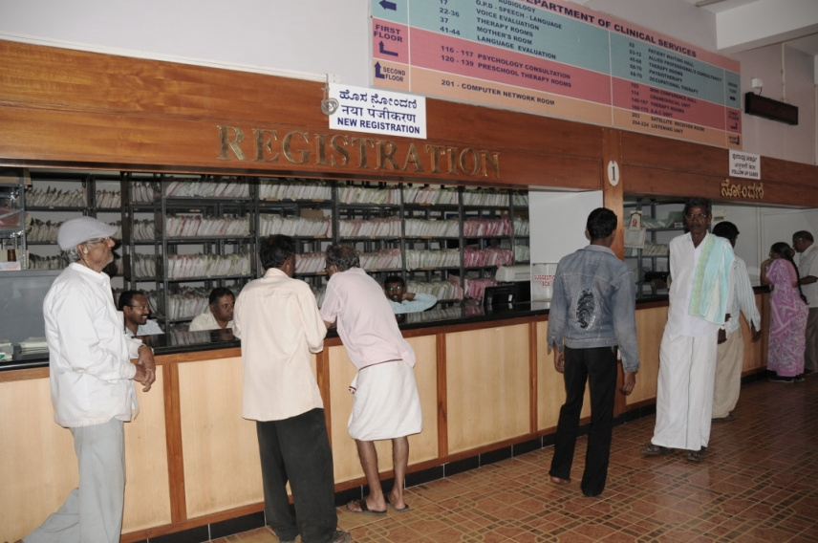
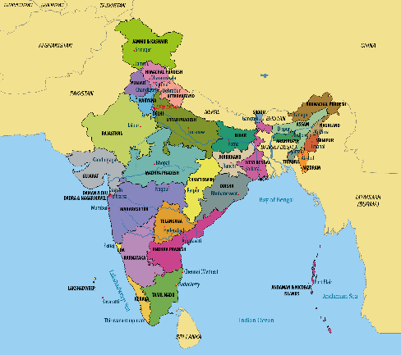
Patient Diversity
Rest of the World
India
All India Institute of Speech and Hearing
2021-22

Slide 3
Person-centred coordinated care
Audiologist
Speech- language pathologist
Physio/
Occupational
therapist
Clinical
Psychologist
Otorhino-laryngologist
Medical Specialists

Slide 4
General Evaluation
Speech-Language
Audiology
All India Institute of Speech and Hearing
2021-22

Slide 5
Referred Evaluation
Otorhinolaryngology
Clinical Psychology
All India Institute of Speech and Hearing
2021-22

Slide 6
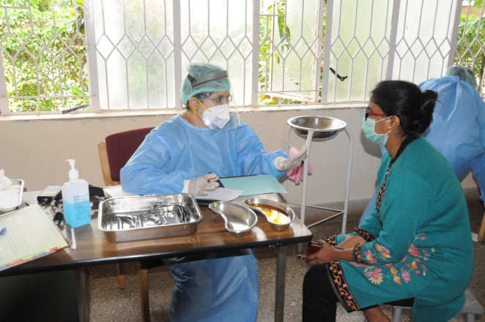
Medical Speciality & Allied Health
Clinical Highlights
Consultancy Service on:
Neurology,
Pediatrics,
Phono surgery
Plastic surgery
Orthodontics
Allied Health Services on:
Physiotherapy
Occupational Therapy
All India Institute of Speech and Hearing
2021-22

Slide 7
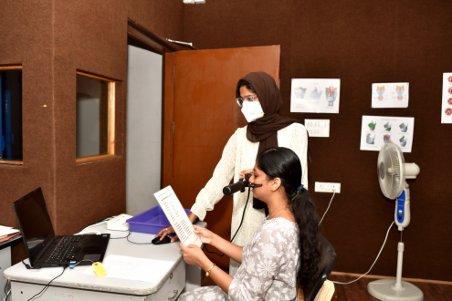
Specialized Clinical Services
Alternative & Augmentative Communication Unit, Autism Spectrum Disorders Unit, Clinic for Elderly Persons with Language Disorders, Fluency Unit, Implantable Hearing Devices Unit, Learning Disability Clinic, Motor Speech Disorders Unit, Neuropsychology Unit, Phonology Unit, Professional Voice care Unit, Structural Orofacial Anomalies Unit, Swallowing Disorders Unit, Vertigo Unit, Voice Clinic
Clinical Highlights
All India Institute of Speech and Hearing
2021-22

Slide 8
Specialized Clinical Services
Alternative & Augmentative Communication Unit, Autism Spectrum Disorders Unit, Clinic for Elderly Persons with Language Disorders, Fluency Unit, Implantable Hearing Devices Unit, Learning Disability Clinic, Motor Speech Disorders Unit, Neuropsychology Unit, Phonology Unit, Professional Voice care Unit, Structural Orofacial Anomalies Unit, Swallowing Disorders Unit, Vertigo Unit, Voice Clinic
Clinical Highlights
All India Institute of Speech and Hearing
2021-22

Slide 9
Specialized Clinical Services
Alternative & Augmentative Communication Unit, Autism Spectrum Disorders Unit, Clinic for Elderly Persons with Language Disorders, Fluency Unit, Implantable Hearing Devices Unit, Learning Disability Clinic, Motor Speech Disorders Unit, Neuropsychology Unit, Phonology Unit, Professional Voice care Unit, Structural Orofacial Anomalies Unit, Swallowing Disorders Unit, Vertigo Unit, Voice Clinic
Clinical Highlights
All India Institute of Speech and Hearing
2021-22

Slide 10
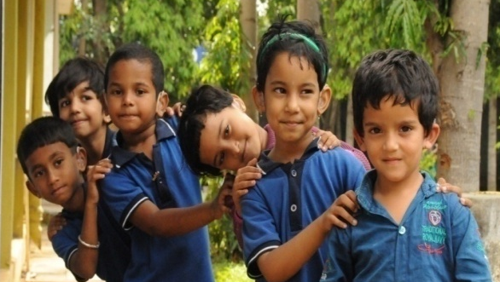
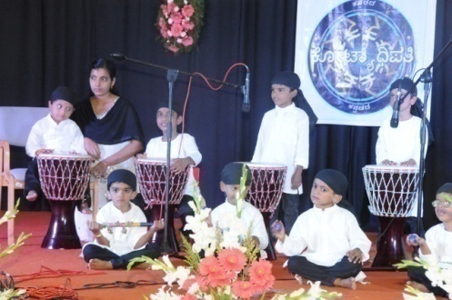
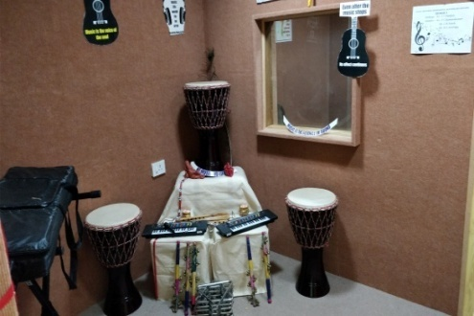
Special Education Services
Special Education Assessment
Parent Infant Programme
Pre-school Programme
Clinical Highlights
Curricular Support Service
Parent Empowerment
Music Therapy
Smart Class Rooms
LiboToy
All India Institute of Speech and Hearing
2021-22

Slide 11
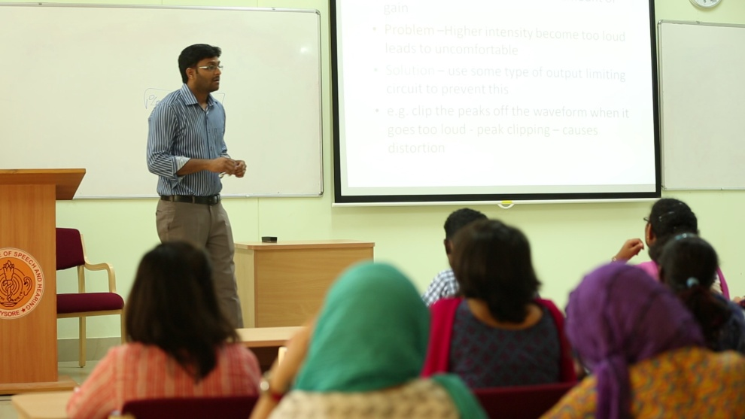
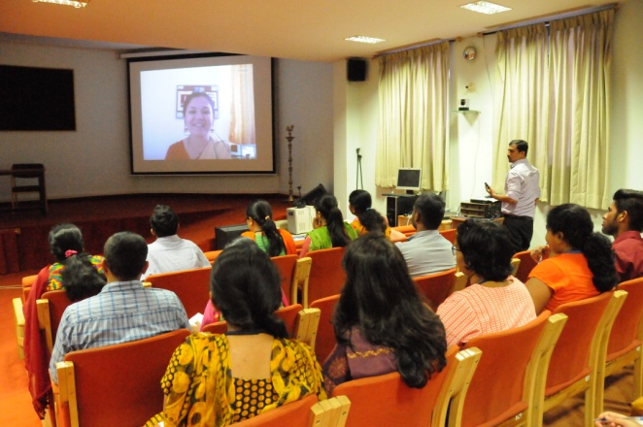
Physical Infrastructure
Classrooms
20 smart classrooms spanning across 2 academic buildings and 57,000 sq.ft.
Conference Halls
2 conference halls, two a/c, with a total seating capacity of 680.
Computer Centre
A modern computer centre with high speed internet facility
All India Institute of Speech and Hearing
2021-22

Slide 12
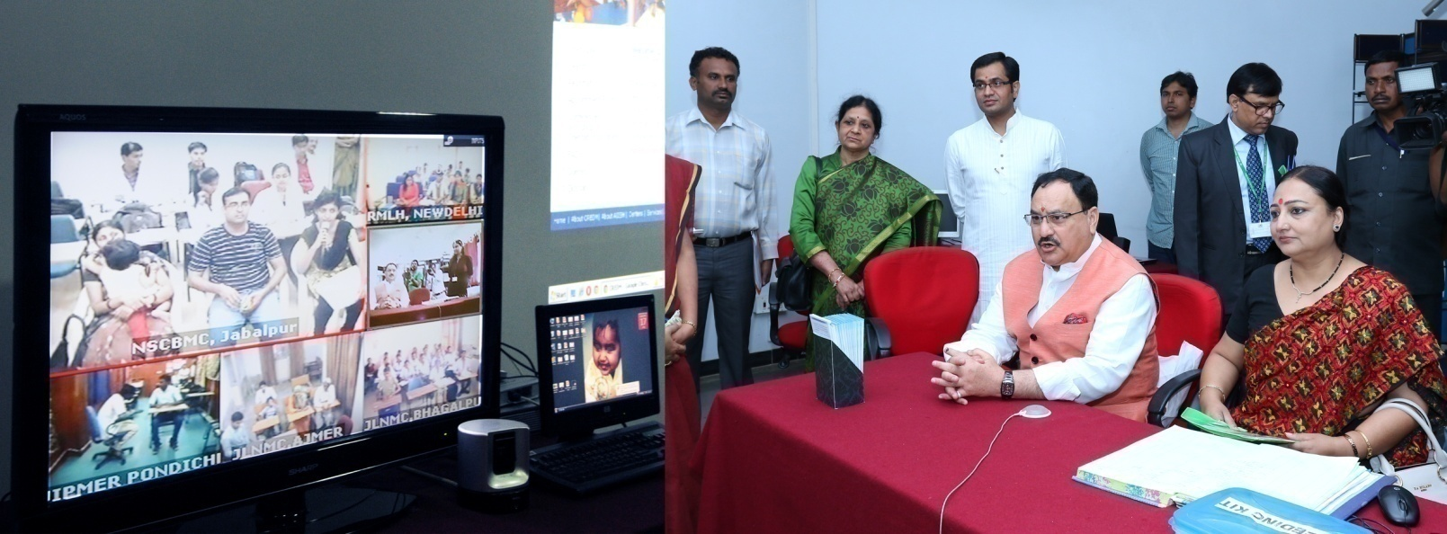
Video Conferencing System
State-of-the-art video conference set up linked through MPLS VPN to DHLS centers and can be connected to any part of the world through ISDN link.
Physical Infrastructure
All India Institute of Speech and Hearing
2021-22

Slide 13
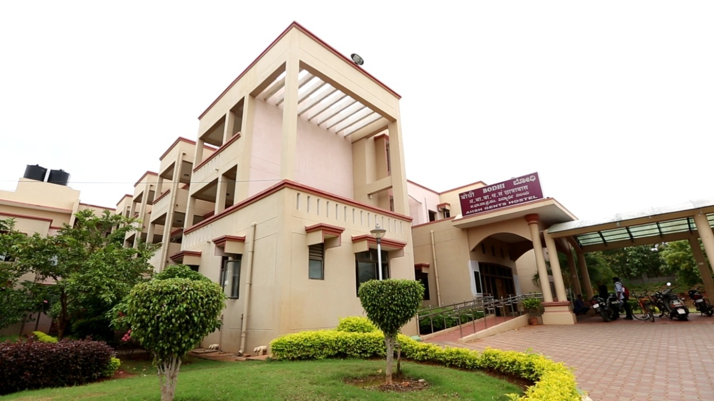
Hostels
Ladies hostel: 189 Rooms. spanning across 84000 sf. Ft)
Gents hostel: 189 Rooms. spanning across 84000 sf. Ft)
Recreation rooms
Telephone service
Unlimited free broadband with WiFi
Physical Infrastructure
All India Institute of Speech and Hearing
2021-22

Slide 14
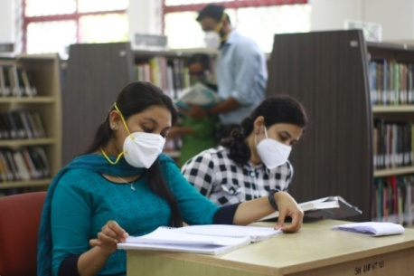
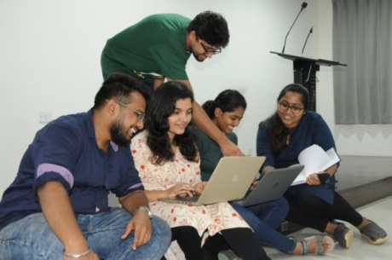
Library Information Center
Print & E-Books
Print & E-Journals
Bound Volumes & Online Archives
Standards
Rare Books
Supporting Service
Institutional Repository
Integrated Library Management System
Language Lab
Institute Journal Platform
Library Advisory Council
Web OPAC
Remote Access Service
Online ISBN
Offers Open Elective Course for PG Programmes
Spacious Reading Halls
Opens 12 hours on Working Days & 8 hours on Saturdays
Special Collections on Academic Writing & English Communication
All India Institute of Speech and Hearing
2021-22

Slide 15
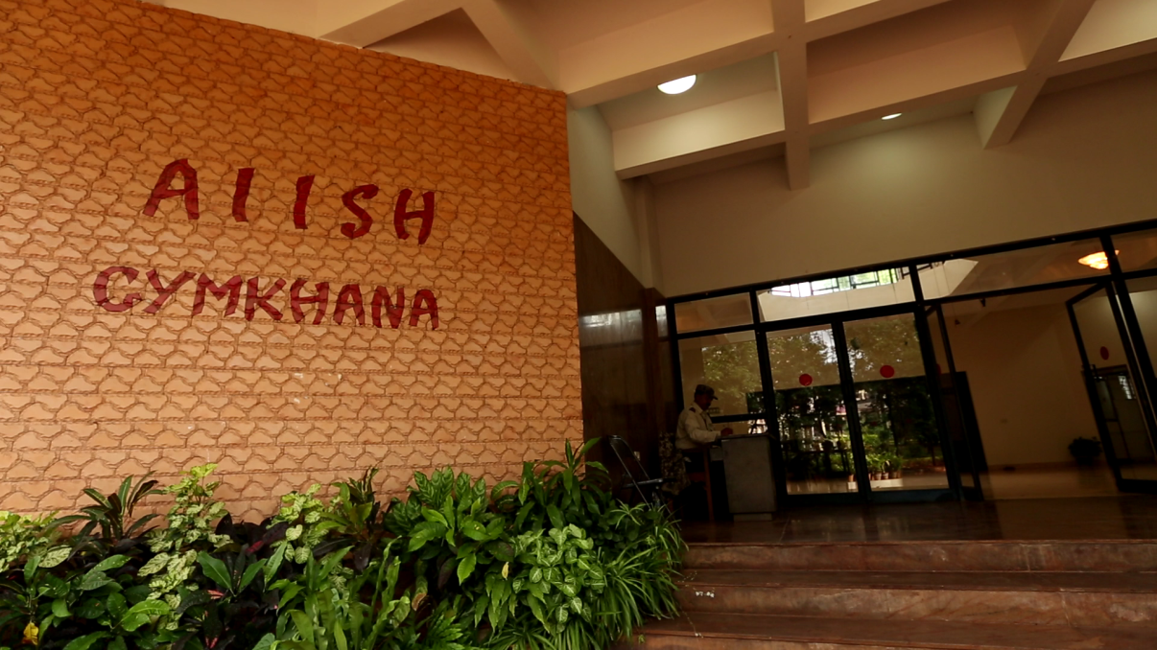
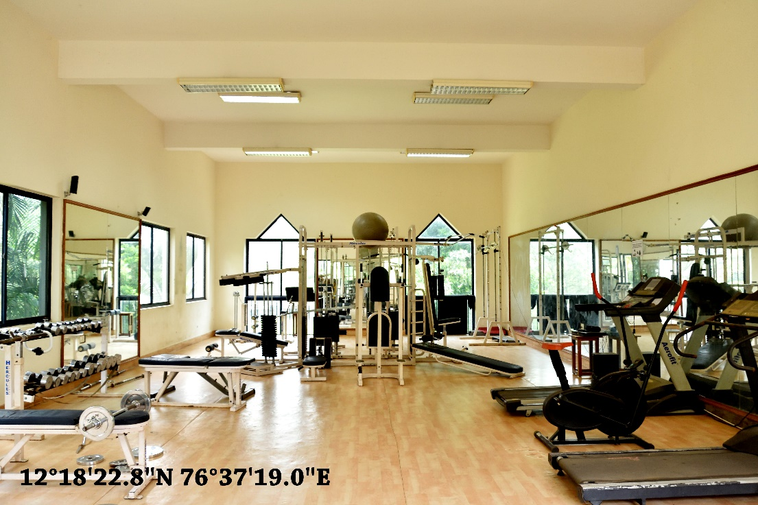
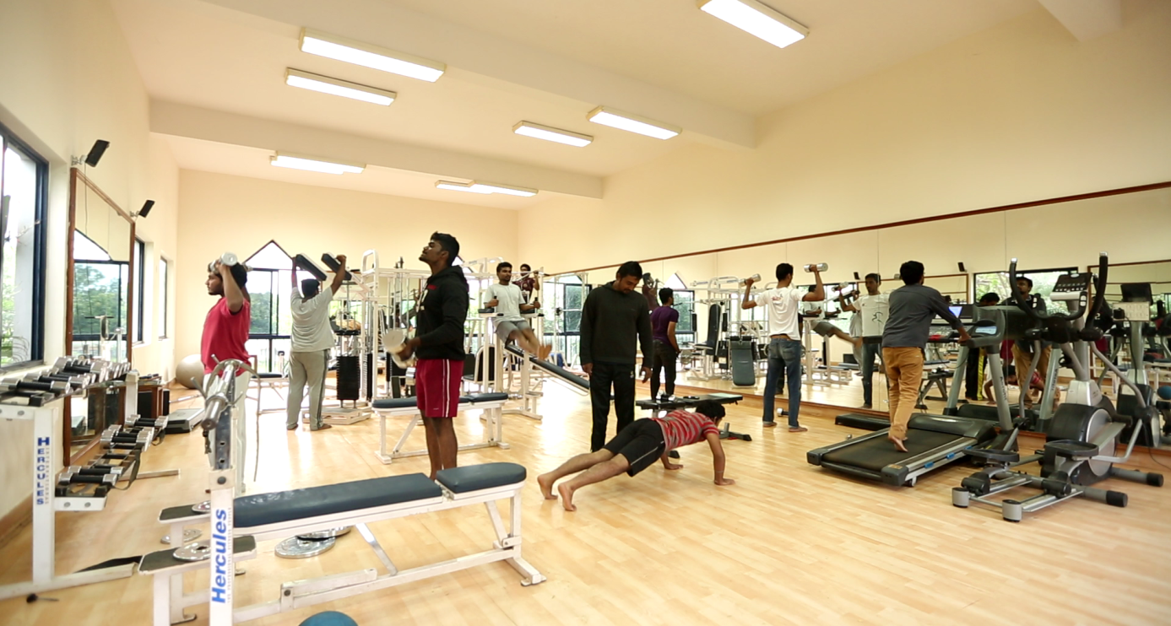
Sports Complex, Cultural Centre & Play Grounds
Well-equipped Gymnasium with trainer
Indoor Sports Rooms
Cultural Centre: AIISH Gymkhana
14000 sq.ft. building
Spacious play grounds
Physical Infrastructure
All India Institute of Speech and Hearing
2021-22

Slide 16
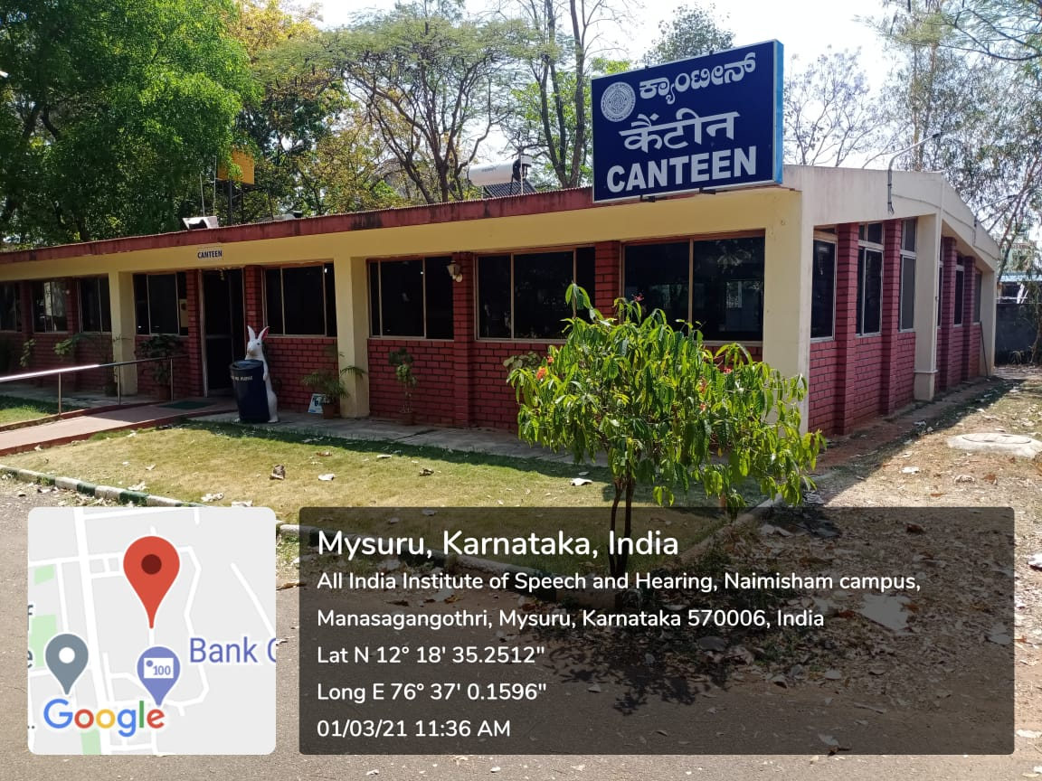
Canteen
Full fledged canteen catering to the staff, students and patients.
Modern kitchen with best of the amenities
Physical Infrastructure
Staff Quarters
55 nos. of B, C, D & E type quarters for the staff with a living area of 42000 sf. ft.
All India Institute of Speech and Hearing
2021-22

Slide 17
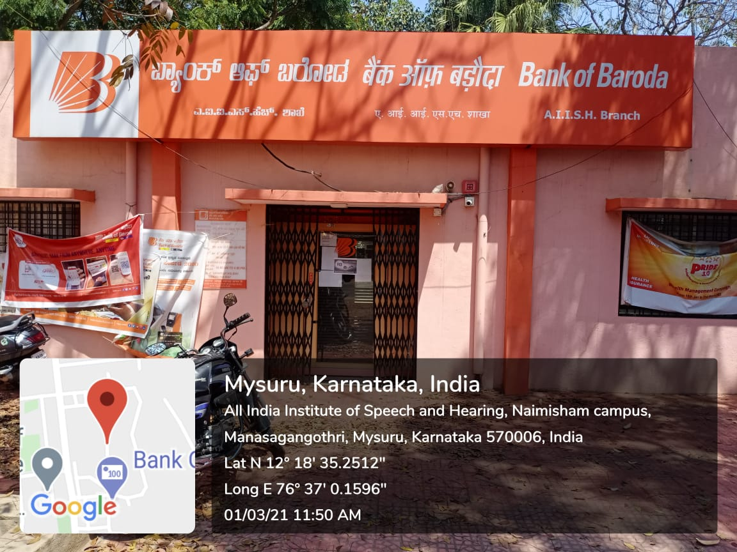
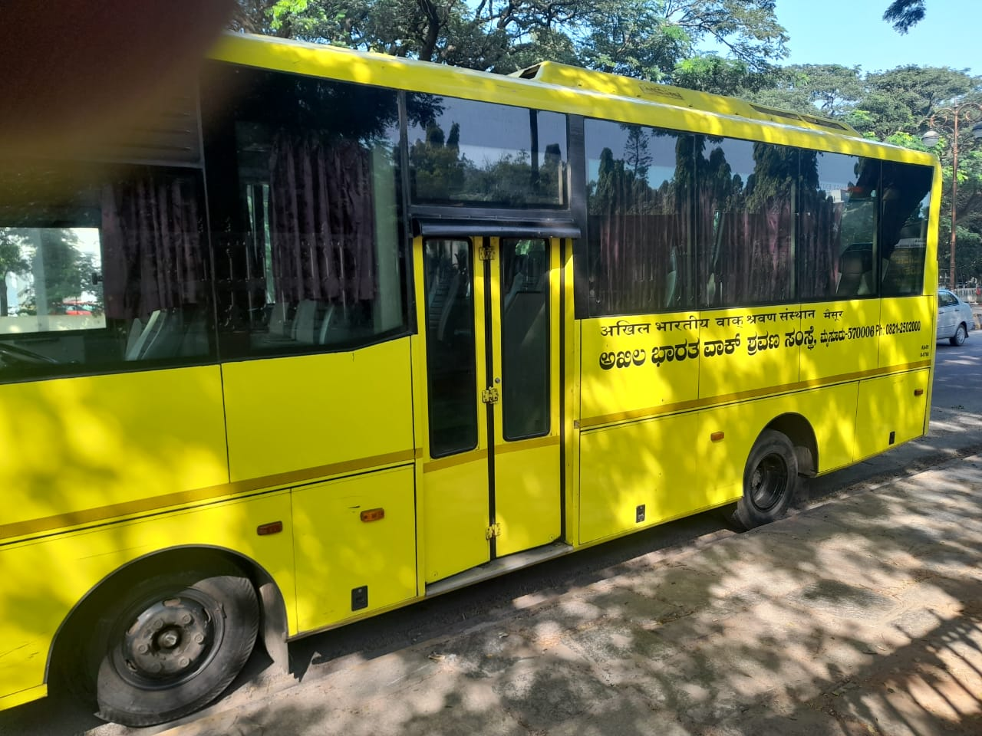
Bank & ATM
Physical Infrastructure
The Institute bank with
Bank of Baroda (BOB)
BOB AIISH Branch & ATM in the main campus
Transport Facility
Two buses
Seating capacity:24+42
All India Institute of Speech and Hearing
2021-22

Slide 18
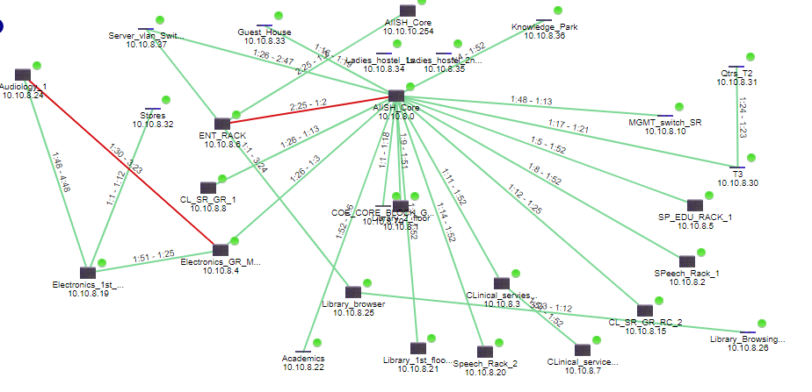
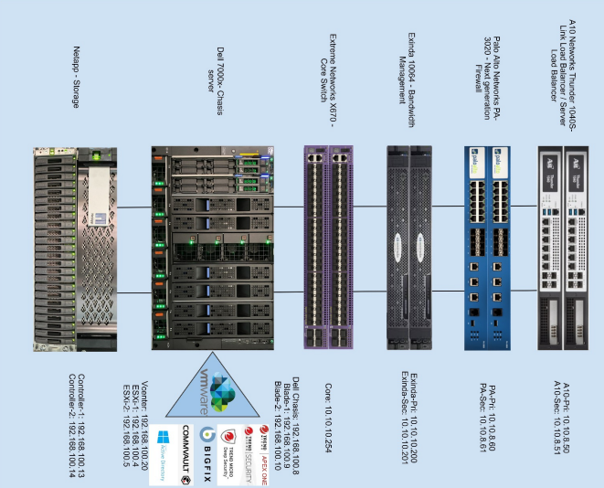
IT Infrastructure
State-of-the-art computer network with a 10 Gbps LAN with Dell Chasis server with 2 blade server and 600 systems, with 150 Mbps dedicated internet link
Extended network through MPLS VPN link connecting to DHLS centres
Wi-Fi networking
In-house email server which supports 250 e-mail ID and 10 Gb of backup
Physical Infrastructure
All India Institute of Speech and Hearing
2021-22

Slide 19
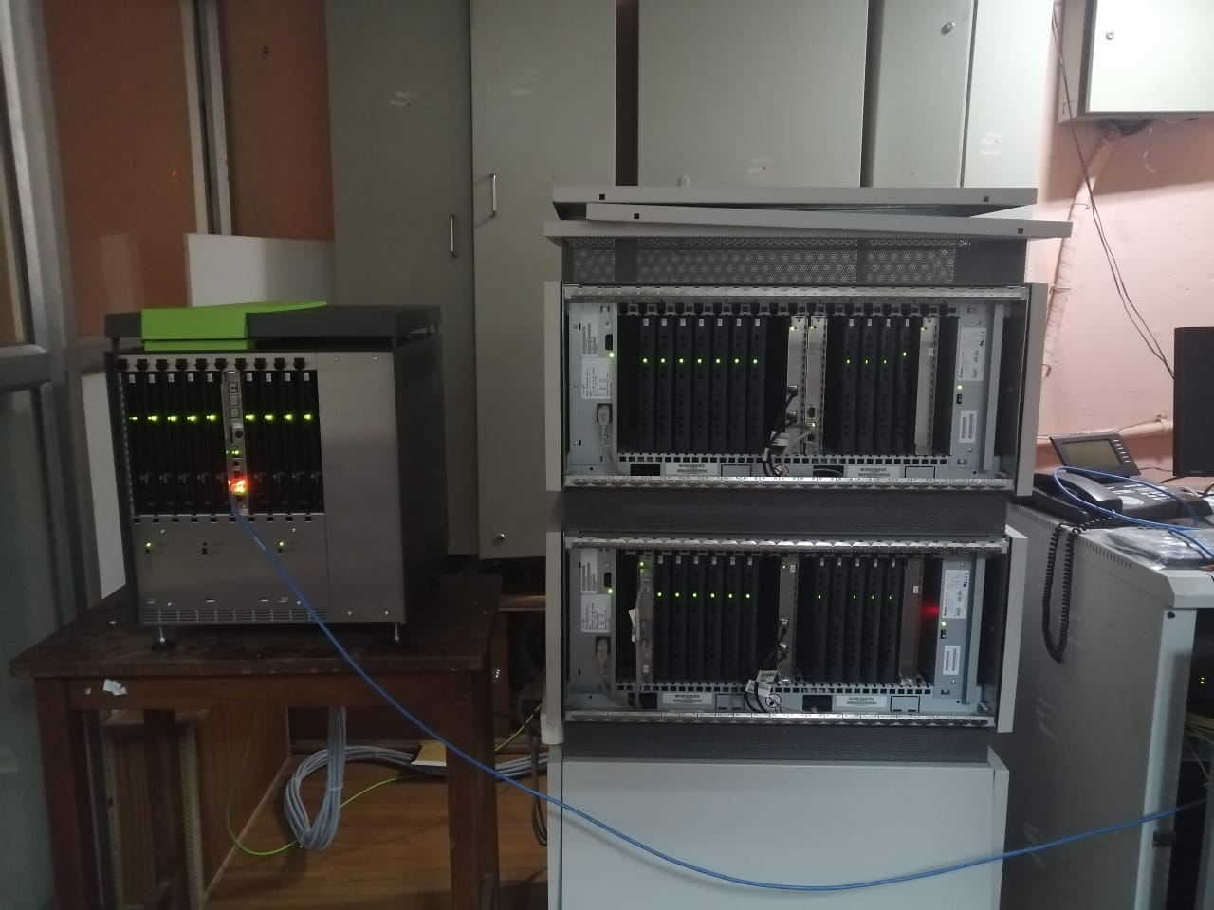
Electrical & Electronic Infrastructure
Uninterrupted power back up provided by one 500 KVA, one 250 KVA and one 125 KVA diesel generators with automatic switching ON facility. 11 KVA electrical substation with 1000 KVA HT transformer.
Siemens Hipath 4000 V 6.0 EPABX System 1000 intercoms and Unify Openscape X8 216 intercoms extension system with Direct Inward Dialing, IP Telephony, Soft Phones and call billing software..
Physical Infrastructure
All India Institute of Speech and Hearing
2021-22

Slide 20
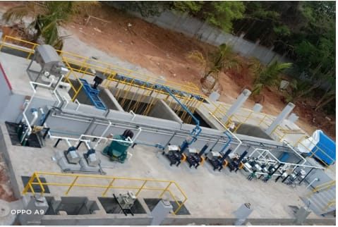
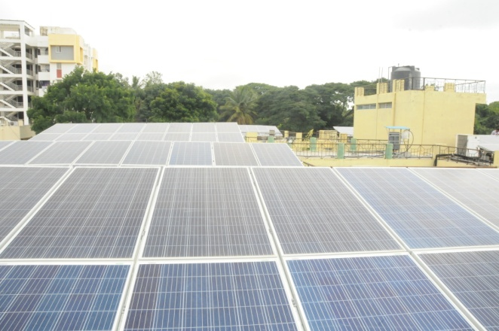
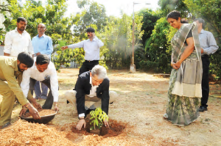
Green Campus Infrastructure…
Physical Infrastructure
Sewage Treatment Plant
Water Harvesting
Solar Energy
Tree Plantation
All India Institute of Speech and Hearing
2021-22

Slide 21
Green Campus Infrastructure
Physical Infrastructure
Energy and Green Auditing
All India Institute of Speech and Hearing
2021-22

Slide 22
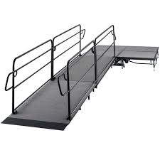
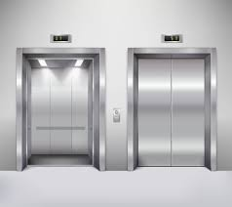
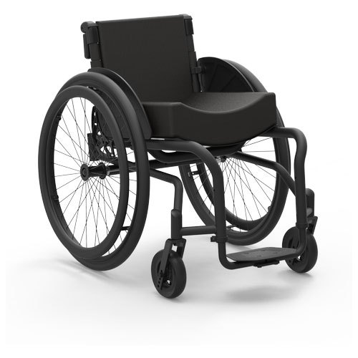
Disable-friendly Environment
Physical Infrastructure
Ramp
Lift
Wheel Chair
All India Institute of Speech and Hearing
2021-22

Slide 23
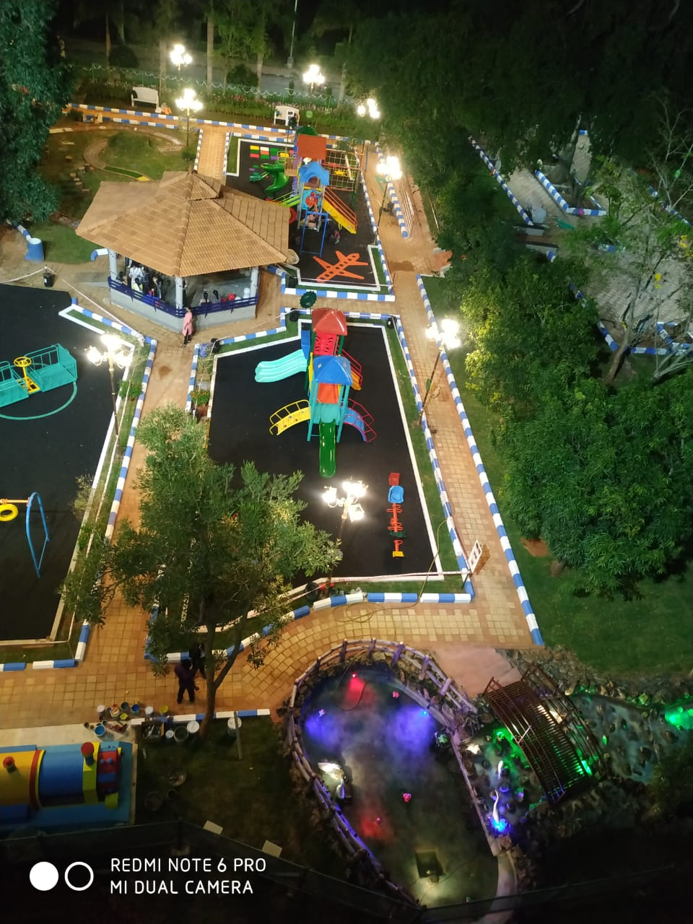
Inclusive Therapy Park
Breaking barriers through play.....
To provide an inclusive environment during play for children with special needs
To facilitate independent play skills in children with communication disorders
To make them experience the joys of playing together
To provide a holistic development to its beneficiaries
To facilitate the motor skills of adults and elderly with communication disorders
FINANCIAL SUPPORT: Funded by the Ministry of Health and Family Welfare, Government of India and the Mysore City Corporation.
Physical Infrastructure
All India Institute of Speech and Hearing
2021-22

Slide 24
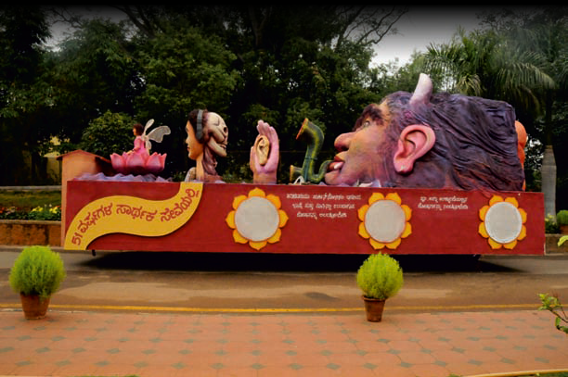
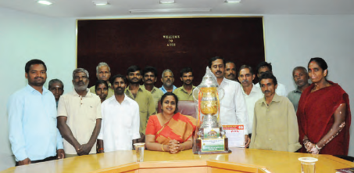
Awards & Laurels
World Hearing Day Contributions - World Health Organization, Geneva
World Hearing Day Contributions - International Association of
Communication Sciences and Disorders, Switzerland
Best Execution of Official Language – Raj Bhasha Sansthan
Tableau on noise pollution and its hazards- International Dasara Procession
Well garden maintenance and flower and vegetable pots arrangement-
Dept. of Horticulture, Govt. of Karnataka
All India Institute of Speech and Hearing
2021-22

Slide 25
Other Activities
AIISH Alumni Association
Active since 2011
Serves as a forum to promote and foster the relationship between the alumni, present students, staff, and the management of AIISH
Alumni
Management
Students & staff
All India Institute of Speech and Hearing
2021-22

Slide 26
Implementation of Right to Information Act, 2005
Reservation Policy Implementation
Technological Consultancy Services
Official Language Implementation
Swatch Bharath
Other Activities
All India Institute of Speech and Hearing
2021-22

Slide 27
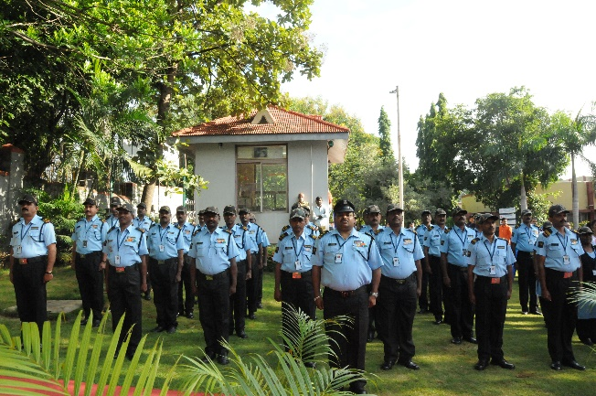
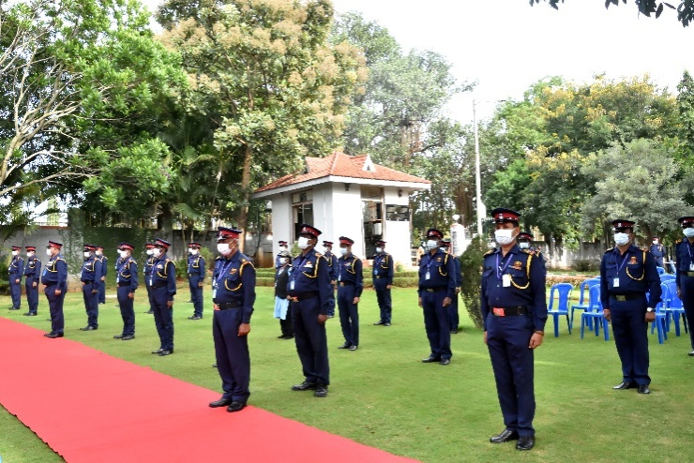
Campus Security
Security Officer – 1 no
Security Supervisors – 3 nos
Security Guards – 33 nos
Personnel
All India Institute of Speech and Hearing
2021-22

Slide 28
Thank You

