Slide 1
LIBRARY & INFORMATION CENTRE
All India Institute of Speech & Hearing
WELCOMES
NAAC PEER TEAM

Slide 2
Information Resources
Print books
Print journals
Print journal archive
E-books
E-journals
E-Journal archive
Standards
Online Databases
AIISH Publications
CD-ROMs
Rare Books

Slide 3
Major Infrastructure & Facilities
Integrated Library Management System
Computer Centre
Electromagnetic Security System
Exclusive Website
Institutional Repository
Language Lab
Spacious Reading Halls
Web OPAC
Web Server

Slide 4
Information Services
Book circulation
Plagiarism detection
Reference management
Remote login
ISBN service
Scholarly writing support
ERMED
N-LIST

Slide 5
WORKSHOPS & TRAINING
Electronic Information Resources & Services
Plagiarism and Academic Integrity
Academic Writing
Reference Management Software
Searching Online databases
Scholarly writing support tool
Orientation Programmes
Open Elective Course, 3rd Semester PG, UoM

Slide 6
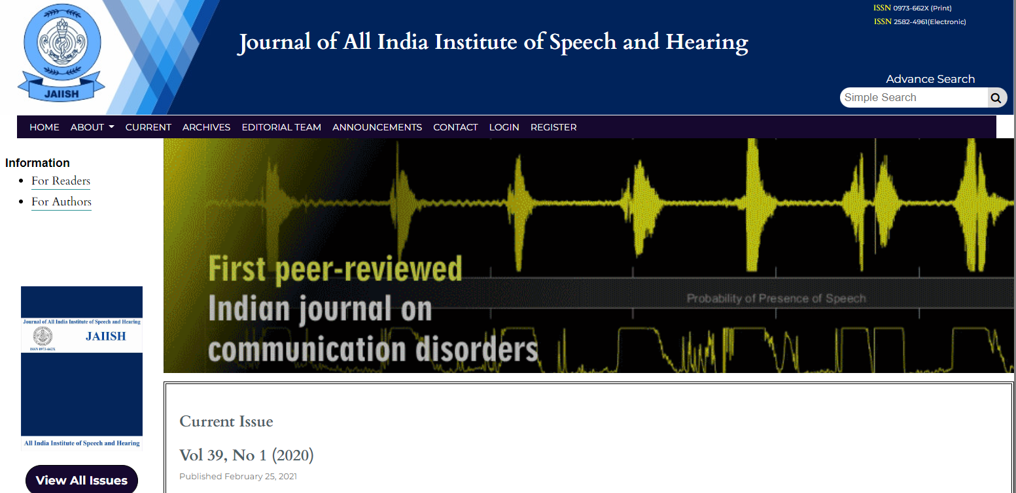
Research Projects..
E-JAIISH

Slide 7
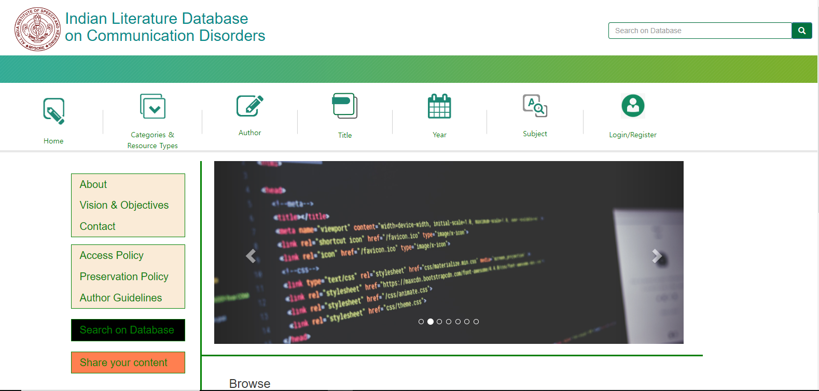
…Research Projects…
Indian Literature Database on Communication Disorders

Slide 8
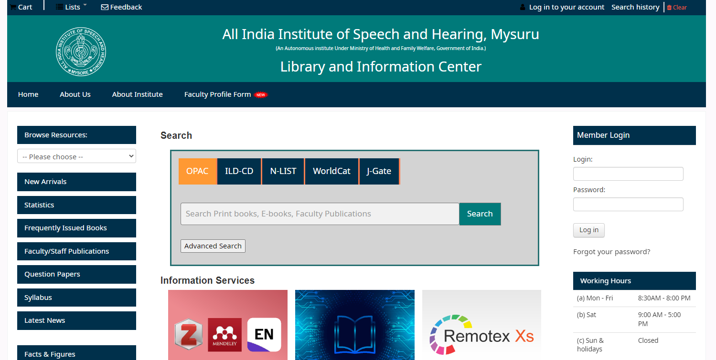
…Research Projects…
Library Webportal

Slide 9
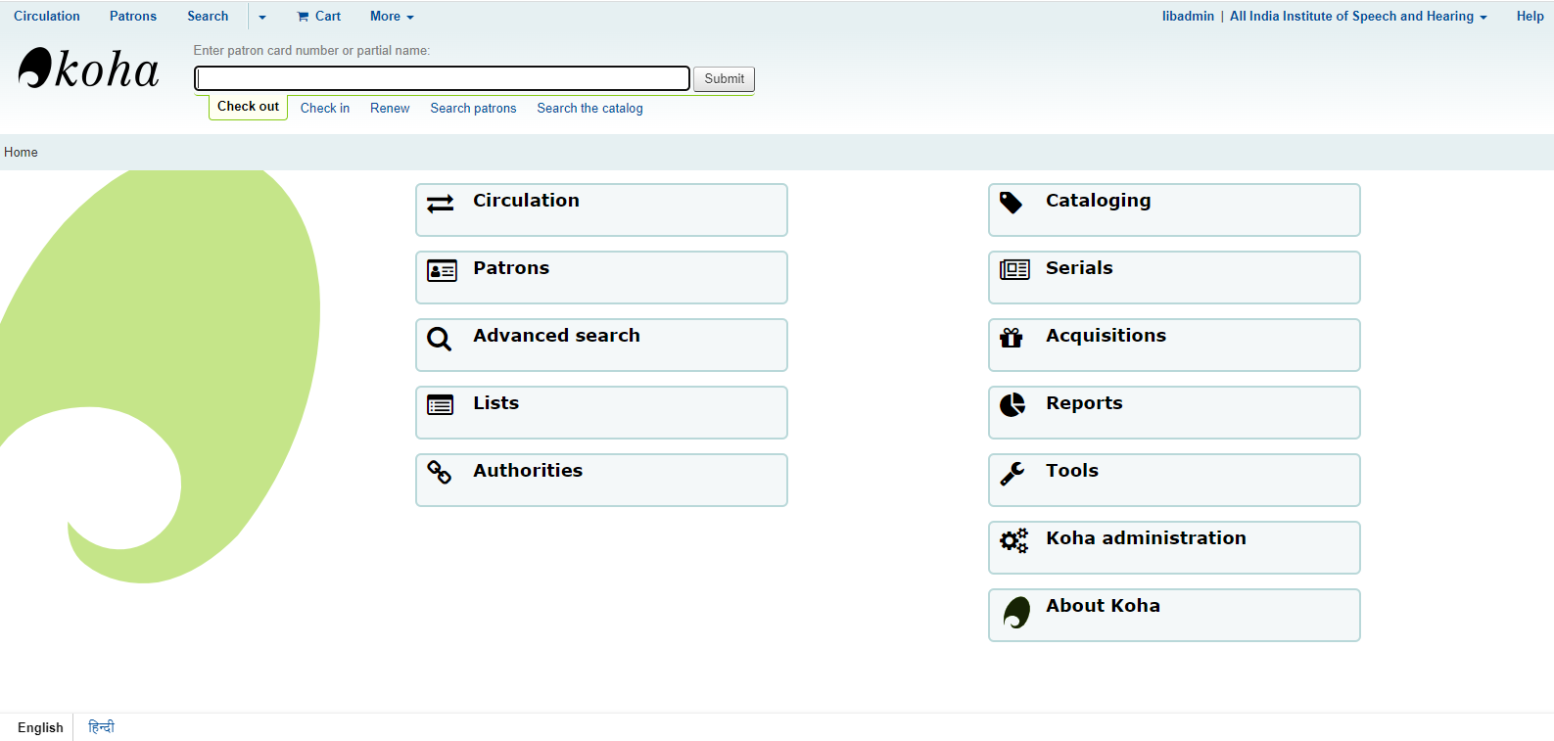
…Research Projects…
WEB OPAC

Slide 10
…Research Projects…
E-Learning Platform

Slide 11
Personnel
Core Team
1) Dr.Shijith Kumar C, (Library & Information Officer)
2) Mr. Nandeesha, B, (Asst. Library & Information Officer)
3) Mr. Nidheesh David Kuruvila, (Sr. Library & Information Assistant)
4) Mr. Nanjunda Swamy, M. (Sr. Library & Information Assistant)
5) Mr. Lokesh, P, (Assistant Grade-III)
Support
1) Mr. Mahendra, Clerical Assistant (Out Source- Contract)
2) Ms. Bhanu, Clerical Assistant (Out Source- Contract)
3) Mr. Hanumantha, MTS (Out Source- Contract)
4) Mr. Suresh, MTS (Out Source- Contract)
5) Ms. Rekha, MTS (Out Source- Contract)
6) Mr. Pradeep, MTS (Out Source- Contract)

Slide 12
Future Plans
Massive Open Online Courses- MOOCs
Multimedia Repository
Research Data Repository

Slide 13
SWOT ANALYSIS
Strength
Dedicated Staff
Availability of Fund
Support from Authority
Weakness
Lack IT Professionals
Threat
Lack of Indian Resources in the field
Reduced physical visit
Opportunity
National Information Centre on Communication Disorders

Slide 14
THANK YOU

