Slide 1
20.12.2021
WELCOME
LIBRARY
&
INFORMATION CENTRE
NAAC TEAM

Slide 2
Resources and Infrastructure
Core Members
1) Dr.Shijith Kumar C, Library & Information Officer
2) Mr. Nandeesha, B, Asst. Library & Information Officer
3) Mr. Nidheesh David Kuruvila, Sr.Library & Information Asst.
4) Mr. Nanjunda Swamy, Sr. Library & Information Asst.
5) Mr. Lokesh, P, Assistant Grade-III
Support
1) Mr. Mahendra, Clerical Assistant (Out Source- Contract)
2) Ms. Bhanu, Clerical Assistant (Out Source- Contract)
3) Mr. Hanumantha, MTS ((Out Source- Contract)
4) Mr. Suresh (Out Source- Contract)
5) Ms. Rekha (Out Source- Contract)
6) Mr. Pradeeep, (Out Source- Contract)
Total Strength: 5 + 6

Slide 3
Information Sources
Books
Print Journals
Print Journal Archives
E-Books
E-Journals
E-Journal Archives
Standards
Online Databases
AIISH Publications
CD-ROMs
Rare Books

Slide 4
Information Services
Book Circulation
Plagiarism Detection
Reference Management
Remote Login
ISBN Service
E-JAIISH
ERMED
NLIST

Slide 5
Major Infrastructure & Facilities
Automatic Gate Register
Computer Centre
E-Learning Platform
Electromagnetic Security System
Exclusive Website
Institutional Repository
Language Lab
Spacious Reading Halls
Web OPAC

Slide 6
WORKSHOPS & TRAINING
Workshops on Electronic Information Resources & Services
Workshops on Plagiarism and Academic Integrity
Workshop on Academic Writing
Training on Reference Management Software
[
Training on online databases
Training on writing support tool
Orientation Programmes
OPEN ELECTIVE COURSE

Slide 7
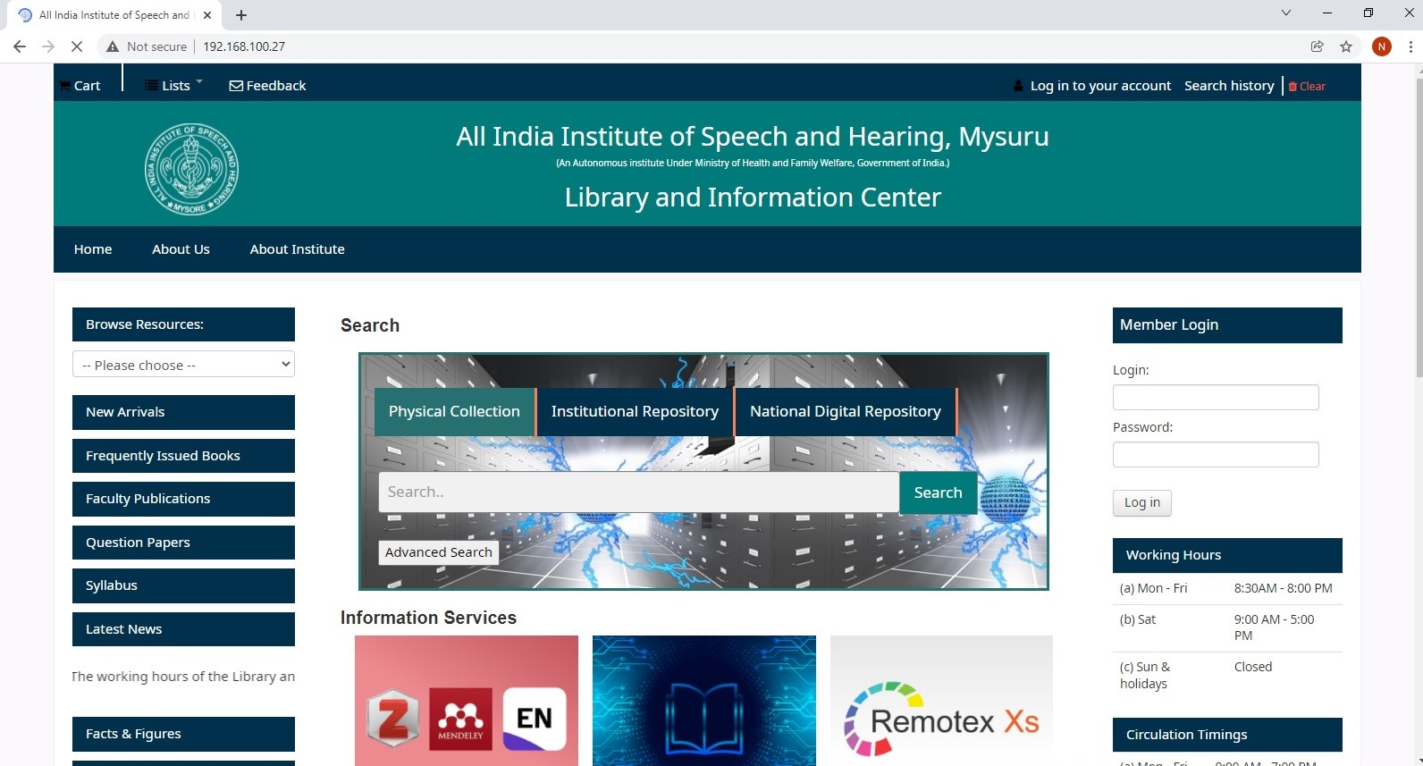
Research Projects
Library Webportal

Slide 8
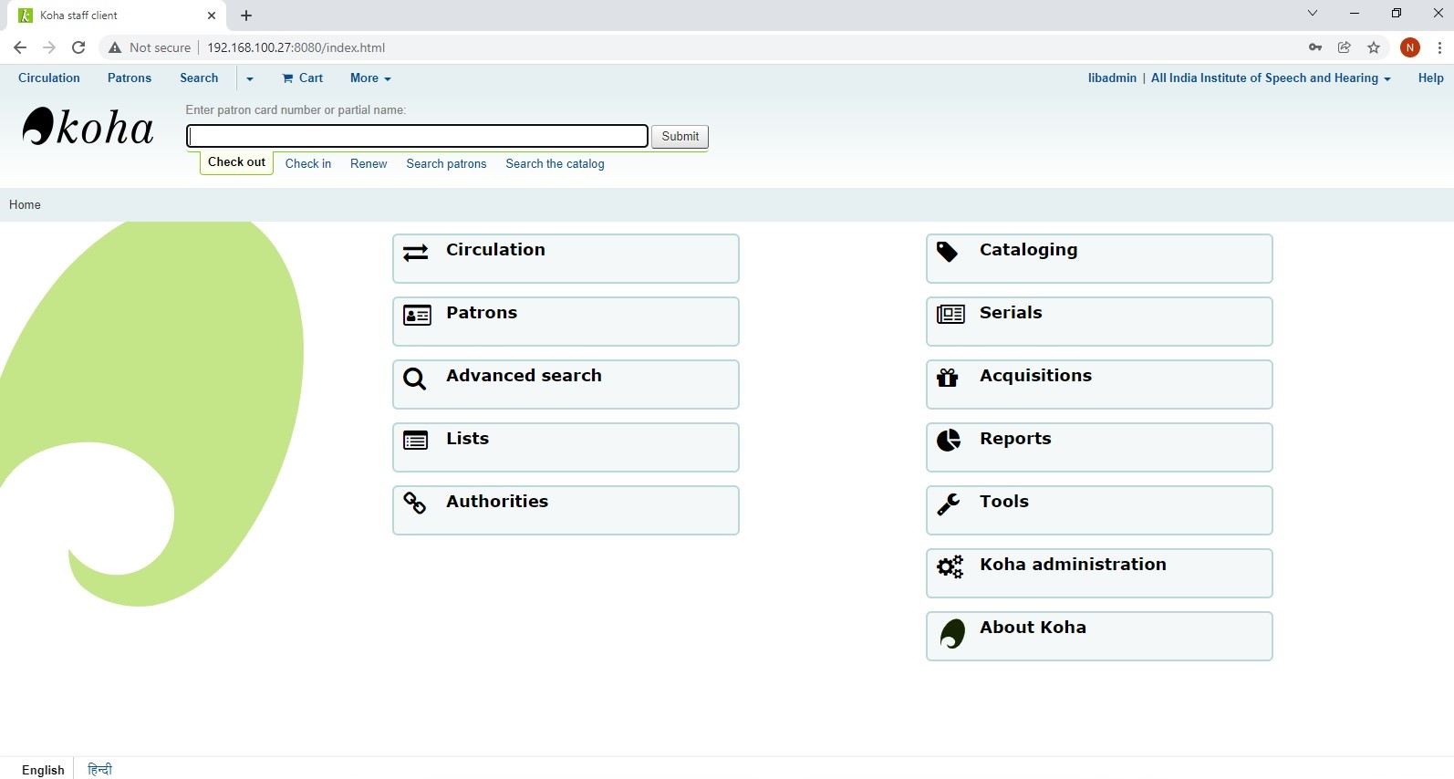
Research Projects
WEB OPAC

Slide 9
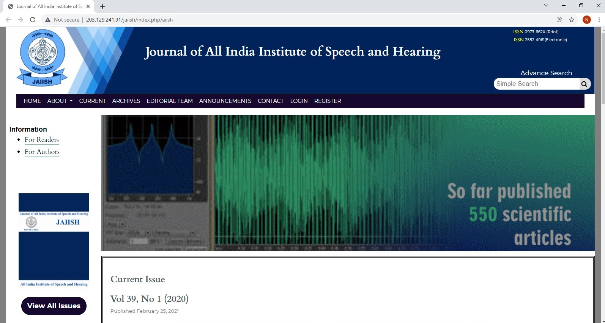
Research Projects
E-JAIISH

Slide 10
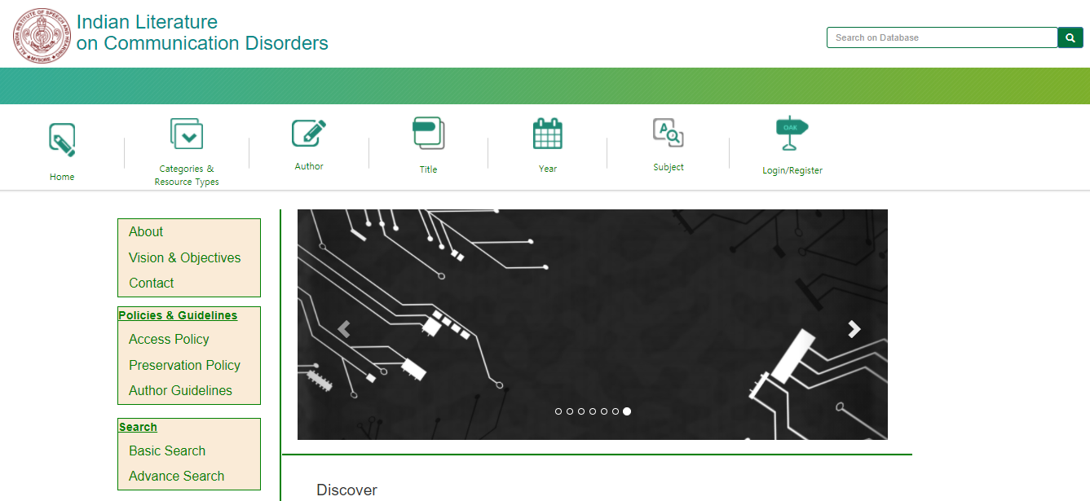
Research Projects
Indian Literature on Communication Disorders

Slide 11
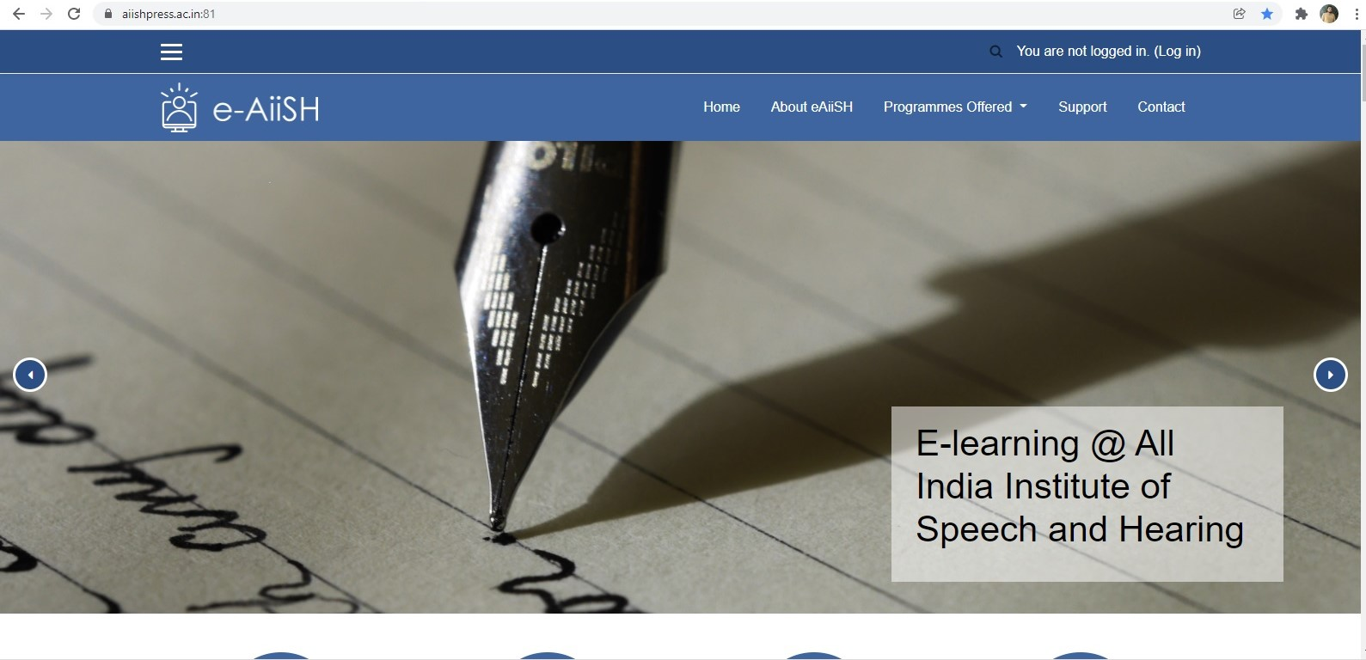
Research Projects
E-Learning@AIISH

Slide 12
SELF STUDY
Dedicated Staff
Availability of Fund
Support from Authority
Lack of support of IT Professionals
National Information Centre on Communication Disorders
Lack of Indian Resources in the field

