Slide 2
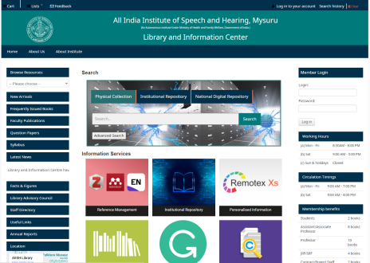
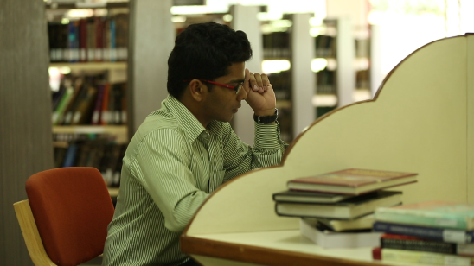
Library Information Center
Print & E-Books
Print & E-Journals
Bound Volumes & Online Archives
Standards
Rare Books
Institutional Repository
Integrated Library Management System
Language Lab
Institute Journal Platform
Offers Open Elective Course for PG Programmes
Spacious Reading Halls
Opens 12 hours on Working Days & 8 hours on Saturdays
Special Collections on Academic Writing & English Communication
Library Advisory Council
Web OPAC
Remote Access Service
Online ISBN
Supporting Service
All India Institute of Speech and Hearing
2021-22

