Slide 1
2015-2020 (1st April 2015 to 31st March 2020)
All India Institute of Speech and Hearing
Library and Information Centre ______
Facts & Figures

Slide 2
Information Resources
Resources
Books 22623
Print Journal Archives 3270
E-Books 176+NLIST
E-Journals 51+ERMED
Standards 74
Online Databases 05
Print Journals 09
E-Journal Archives 35
AIISH Publications 126
CD-ROMs 445
Rare Books 189
Faculty Publications 731

Slide 3
Print Books
E-Journals
S/N | Year | Added | Total
1 | 2015-16 | 623
2 | 2016-17 | 445
3 | 2017-18 | 491
4 | 2018-19 | 314
5 | 2019-20 | 467
S/N | Year | Nos
1 | 2015-16 | 106
2 | 2016-17 | 110
3 | 2017-18 | 98
4 | 2018-19 | 104
5 | 2019-20 | 108
Databases
S/N | Year | Nos
1 | 2015-16 | 02
2 | 2016-17 | 02
3 | 2017-18 | 02
4 | 2018-19 | 05
5 | 2019-20 | 05

Slide 4
Institutional Repository
196
ARF Projects
475
Independent Projects
27
PG Diploma Projects
1474
112
PG Dissertations
PhD Thesis

Slide 5
Expenditure on Resources & Services
2015-16
13,538,408
10,803,027
12,410,769
12,573,311
2,218,009
2016-17
2017-18
2018-19
2019-20

Slide 6
Books Loans
2015-16
818
2016-17
1279
2017-18
7415
2018-19
7148
2019-20
6599

Slide 7
Library Visits
2015-16
774
2016-17
1092
2017-18
2018-19
2019-20
2442
3549
4749

Slide 8
Online Database Usage
2015-16
02
3028
2016-17
02
3308
2017-18
02
3812
2018-19
05
40871
2019-20
05
13828

Slide 9
E-Journals Usage
2015-16
106
33435
2016-17
110
31135
2017-18
98
27655
2019-20
2018-19
104
30412
104
30412
108
24034

Slide 10
Information Services

Slide 11
Book Circulation
Online Public Access Catalogue
Plagiarism Detection
Bibliographic Management
Remote Login
ISBN Service

Slide 12
Language Lab
NLIST
ERMED
Scholarly Writing Support Service
E-JAIISH
Question Papers, Syllabus and Faculty Publications
E-Learning@AIISH

Slide 13
Workshops / Training

Slide 14
S/N | Title of the training program/ Seminar/Conference/ Workshop/ Symposium | Date
1 | Workshop on Electronic Information Resources & Services (1st BSc Students) | 29.06.2015
2 | Workshop on Electronic Information Resources & Services (1st MSc Students) | 03.08.2015
3 | Training for Anti-Plagiarism Software (Students) | 21.07.2015 11.08.2015 18.08.2015
4 | Workshop on Electronic Information Resources & Services (Diploma Students) | 08.10.2015
5 | Lecture on Information Sources: Types, Structure and Evaluation (1st Year BSc Students) | 16.10.2015
6 | National Workshop on Information Management using Koha and WordPress | 28-31 January 2016
7 | Workshop on Electronic Information Resources & Services (1st BSc & BEd (HI) Students) | 21.07.2016

Slide 15
S/N | Title of the training program/ Seminar/Conference/ Workshop/ Symposium | Date
8 | Workshop on Electronic Information Resources & Services (Research Scholars) | 04.11.2016
9 | Workshop on Electronic Information Resources & Services | 25.11.2017
10 | Workshop on Electronic Information Resources & Services (1st Year BSc Students) | 02.07.2018
11 | Workshop on J-Gate Database Service | 02.10.2018
12 | Workshop on Writing Support Service (Grammarly) | 03.10.2018
13 | Workshop on Electronic Information Resources & Services (1st Year MSc Students) | 26.10.2018 30.10.2018
14 | Orientation Programme on Turnitin Software | 22.03.2019
15 | Workshop on Academic Writing | 27.03.2019
16 | Workshop on Electronic Information Resources & Services (1st Year MSc Students) | 26.07.2019
17 | Workshop on Electronic Information Resources & Services (1st Year BSc Students) | 01.08.2019

Slide 16
S/N | Title of the training program/ Seminar/Conference/ Workshop/ Symposium | Date
1 | Online Training Programme on Auto-formatting of Research Manuscripts using the Typeset Solution | 22.05.2020
2 | Webinar on Web of Science | 28.08.2020
3 | Webinar on Academic Integrity & Plagiarism | 17.09.2020
4 | Webinar on Managing References using Mendeley | 18.09.2020
5 | Webinar on Grammarly Writing Support Tool | 24.09.2020
6 | Webinar on JGate and COMDISDOME/ LLBA databases | 25.09.2020

Slide 17
Research Projects

Slide 18
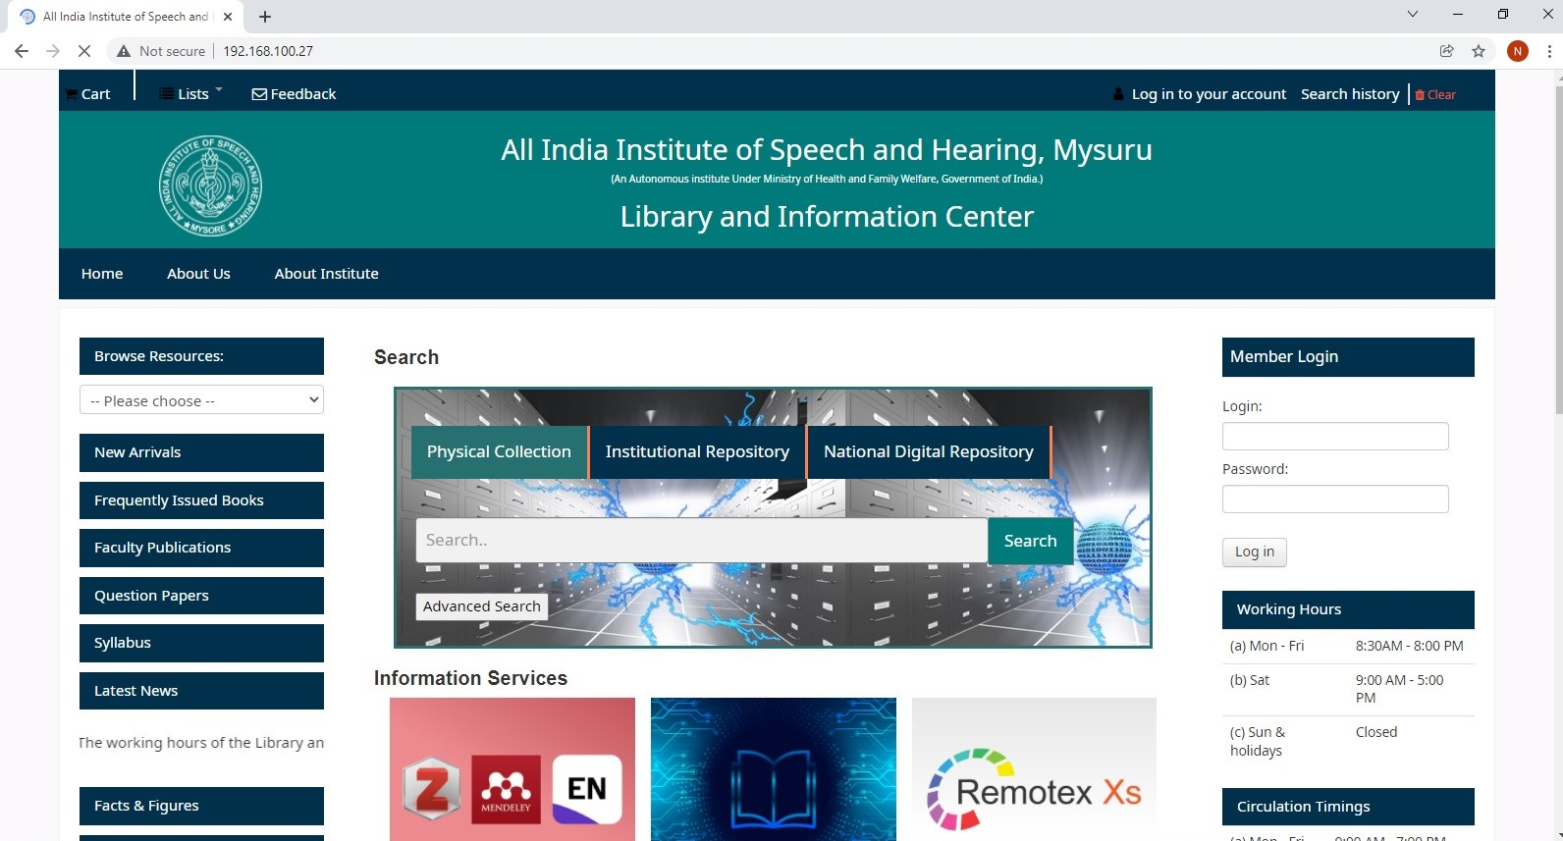
Library Webportal

Slide 19
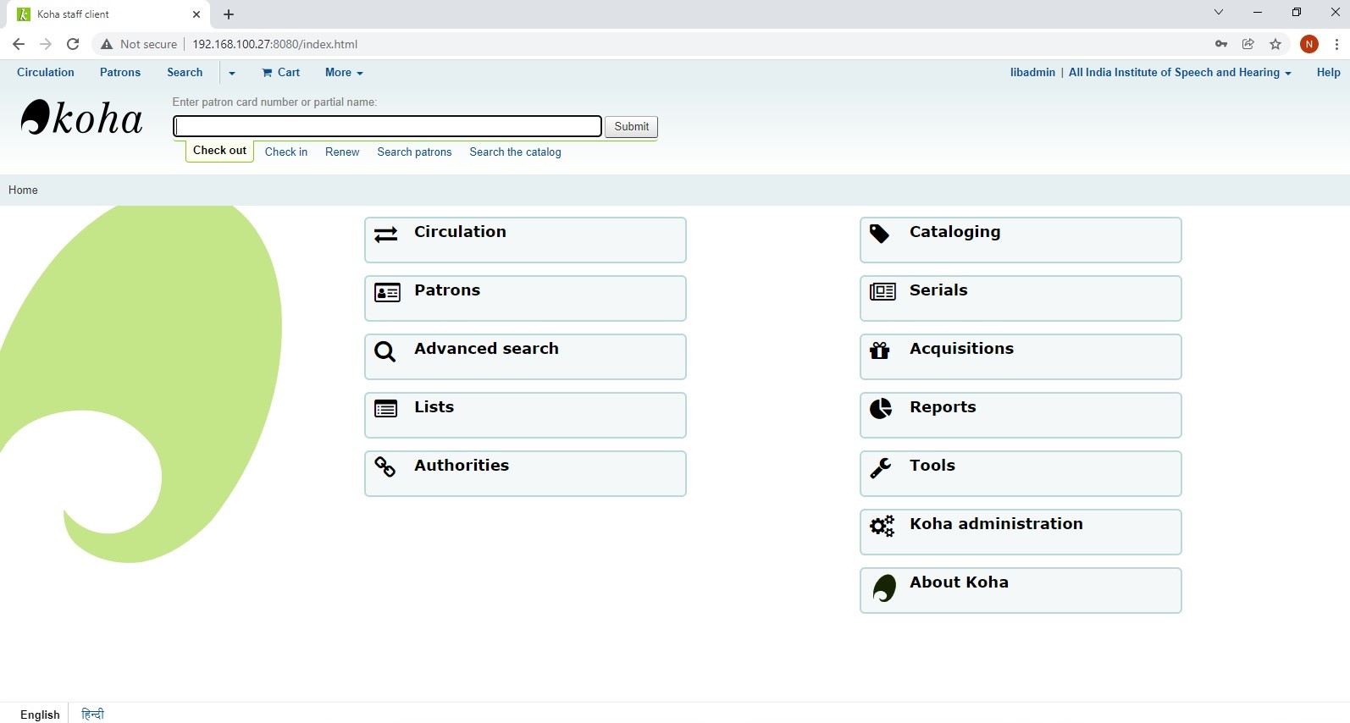
WEB OPAC

Slide 20
E-JAIISH

Slide 21
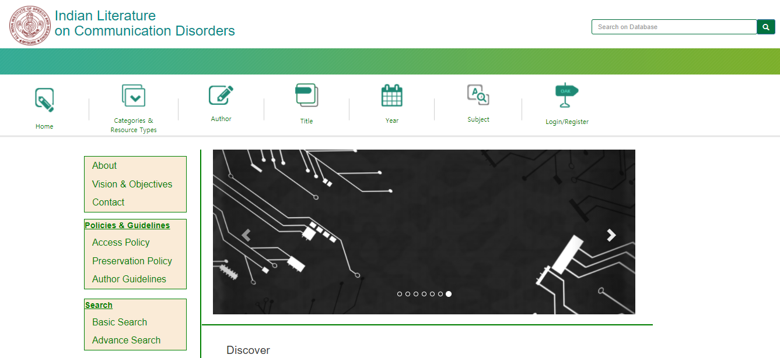
Indian Literature on Communication Disorders

Slide 22
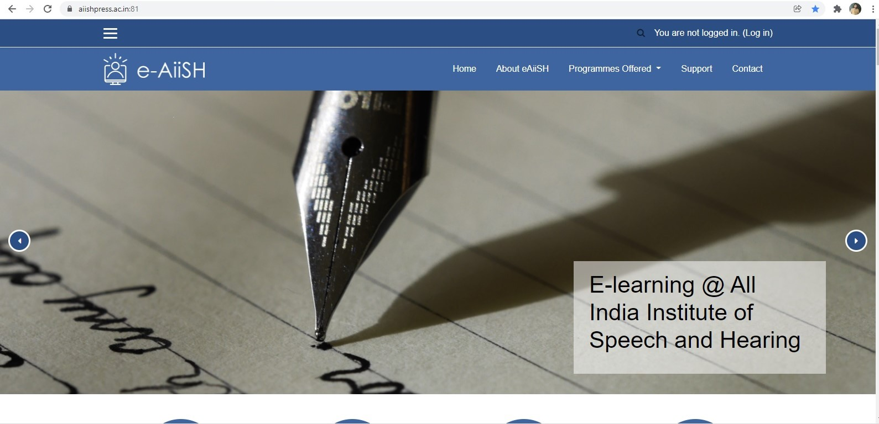
E-Learning@AIISH

Slide 23
Stack II
Bound Volumes /
General Collections

Slide 24
Publications

Slide 25
Shijith Kumar, C., Nanjundaswamy, M. and Nandeesha, B. (2017). Design and Development of a National Literature Database on Communication Disorders: A Study. In proceedings of the ‘National Conference on Libraries and Transformation: Issues and Challenges’ DoS and Research in Library and Information Science, Tumkur University, Tumakuru (30th December 2017) Page no. 171-181.
Shijith Kumar, C. (2018). Some reflections on UGC regulations on promotion of academic integrity and prevention of plagiarism. University News, 56(52), 24-30.

Slide 26
Nandeesha, B. (2020). Country-wise study of speech and hearing literature based on Scimago database. In Pramanathan, U., Kavitha, R., Stephen, G. & Selvam, M. (Eds.), Handbook of metric studies for library and information science scholars (pp. 47-53). SK Research Group of Companies Publication.
Nandeesha, B. (2020). Google scholar: an overview. In Ramasamy, K. & Mani, M. (Eds.), Google era librarianship: tools, technologies and skills (pp. 111-119). Muthra Publishers.

Slide 27
Nandeesha, B. (2021). Opportunities and implementation of big data management in academic libraries: strategic approach and discovering a solution. In Sangeeta Namdev Dhamdhere (Ed.), Big data applications for improving library services (pp. 34-47). IGI Global. 10.4018/978-1-7998-3049-8.
Nandeesha, B. (2021, February). Emerging trends in library services In Rathinasabapathy, G., Veeranjaneyulu, K. & Srinivas, V. (Eds.) International Conference on Agriculture Librarians and User Community (ICALUC-2021) on Management of Knowledge Resource Centres in the Networked Digital Environment: Trends, Challenges and Opportunities (pp. 211-217). University of Agriculture Sciences, GKVK, Bangalore.

