Slide 1
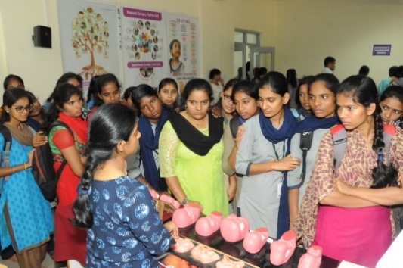
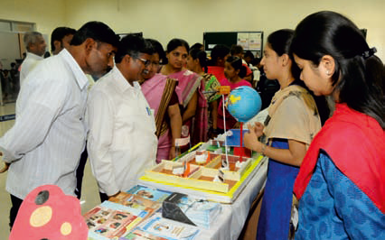
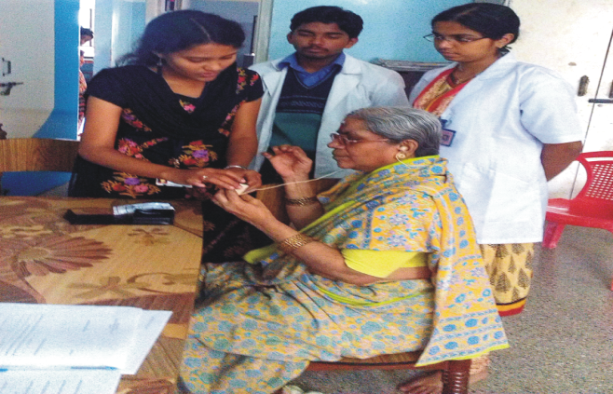
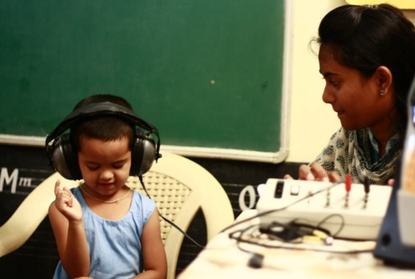
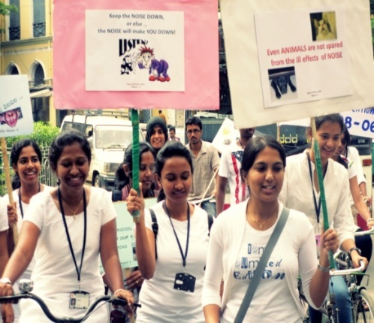
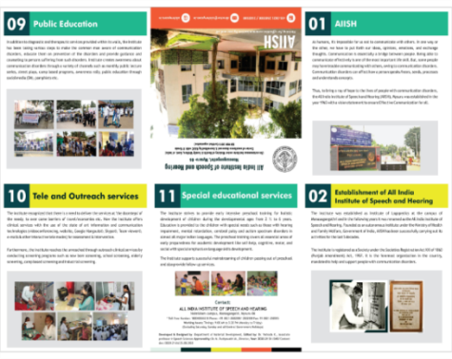
Public Education
Target/ controlled reach
Commemoration Days
Screening camps
Information pamphlets
Orientation programs
Monthly public lecture
Open Day
Rallies & Street Plays

Slide 2
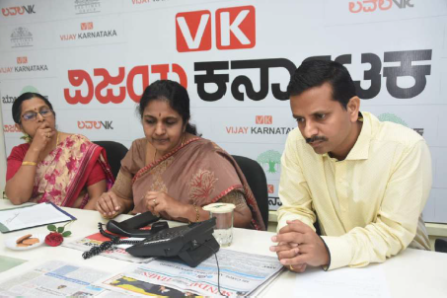
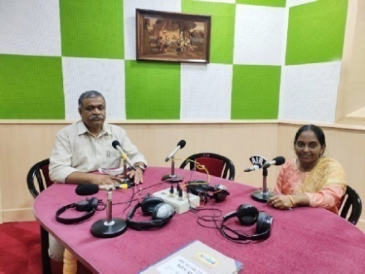
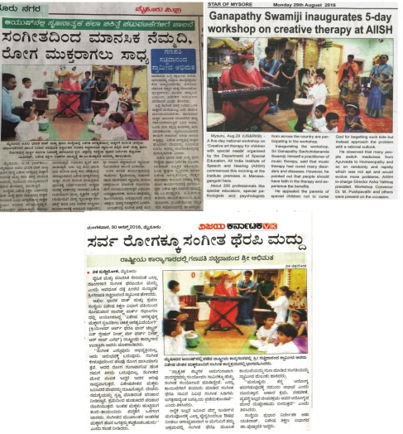
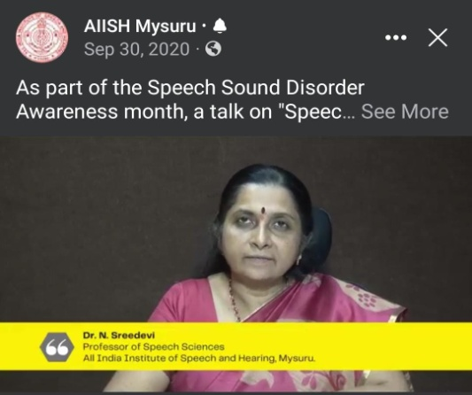
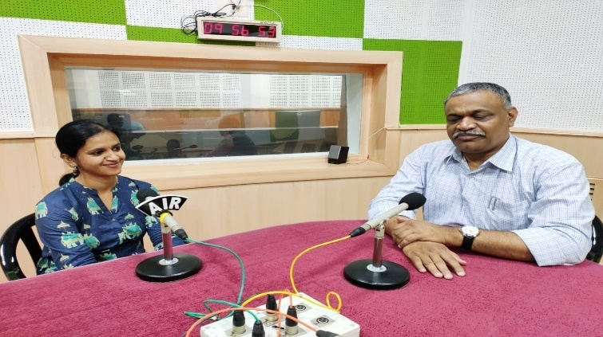
Public Education
Uncontrolled reach
YouTube videos
AIR programs
Social media based
Facebook live
TV talk shows
Phone-in programs
Press articles
Advertisements

Slide 3
Public Education
Uncontrolled reach
YouTube videos
YouTube videos
AIR programs
Social media based
Social media based
Facebook live
Facebook live
TV talk shows
Press articles
TV talk shows
Phone-in programs
Phone-in programs
Advertisements
Advertisements

