Slide 1
Finance & Accounts
All India Institute of Speech and Hearing
2021-22

Slide 2
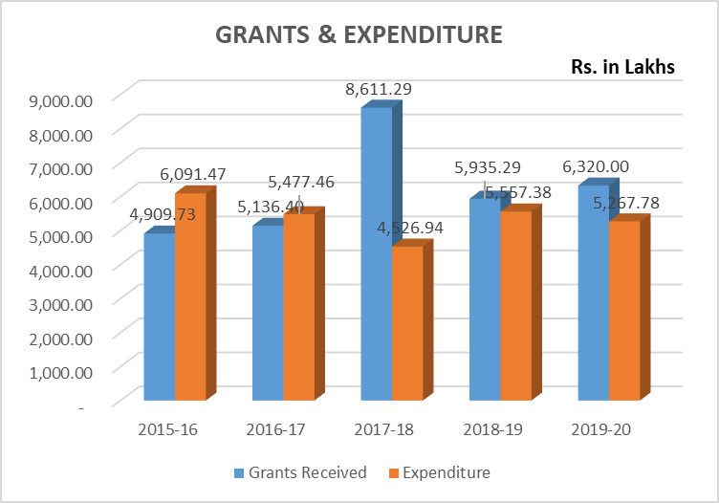
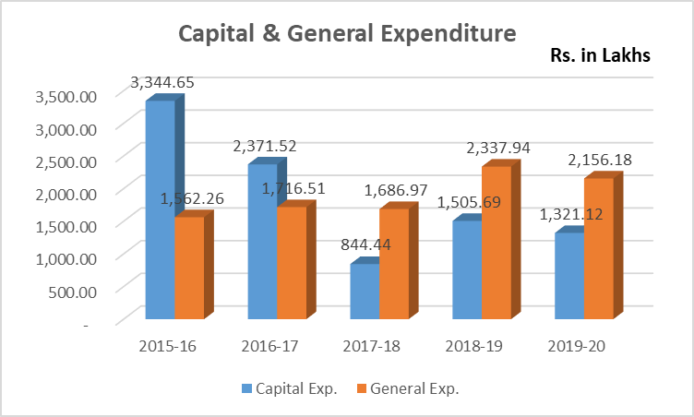
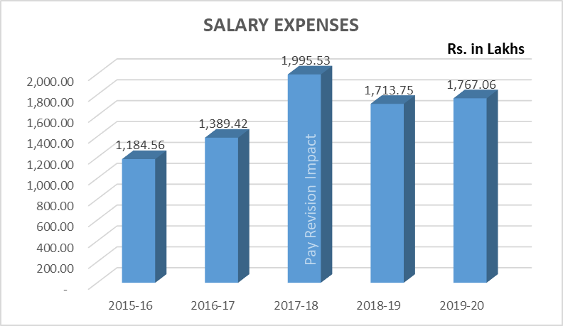
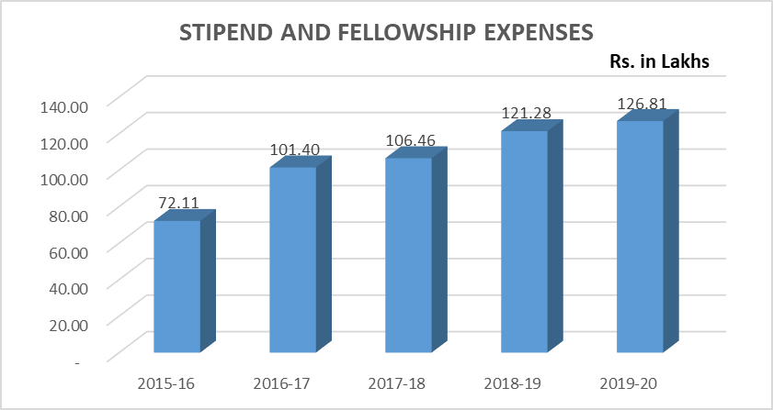
Finance & Accounting
All India Institute of Speech and Hearing
2021-22

Slide 3
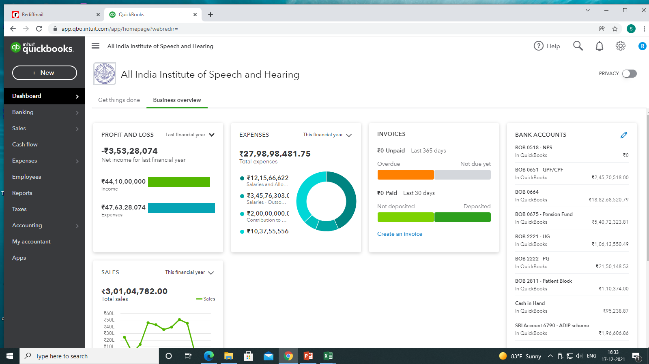
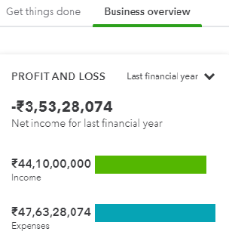
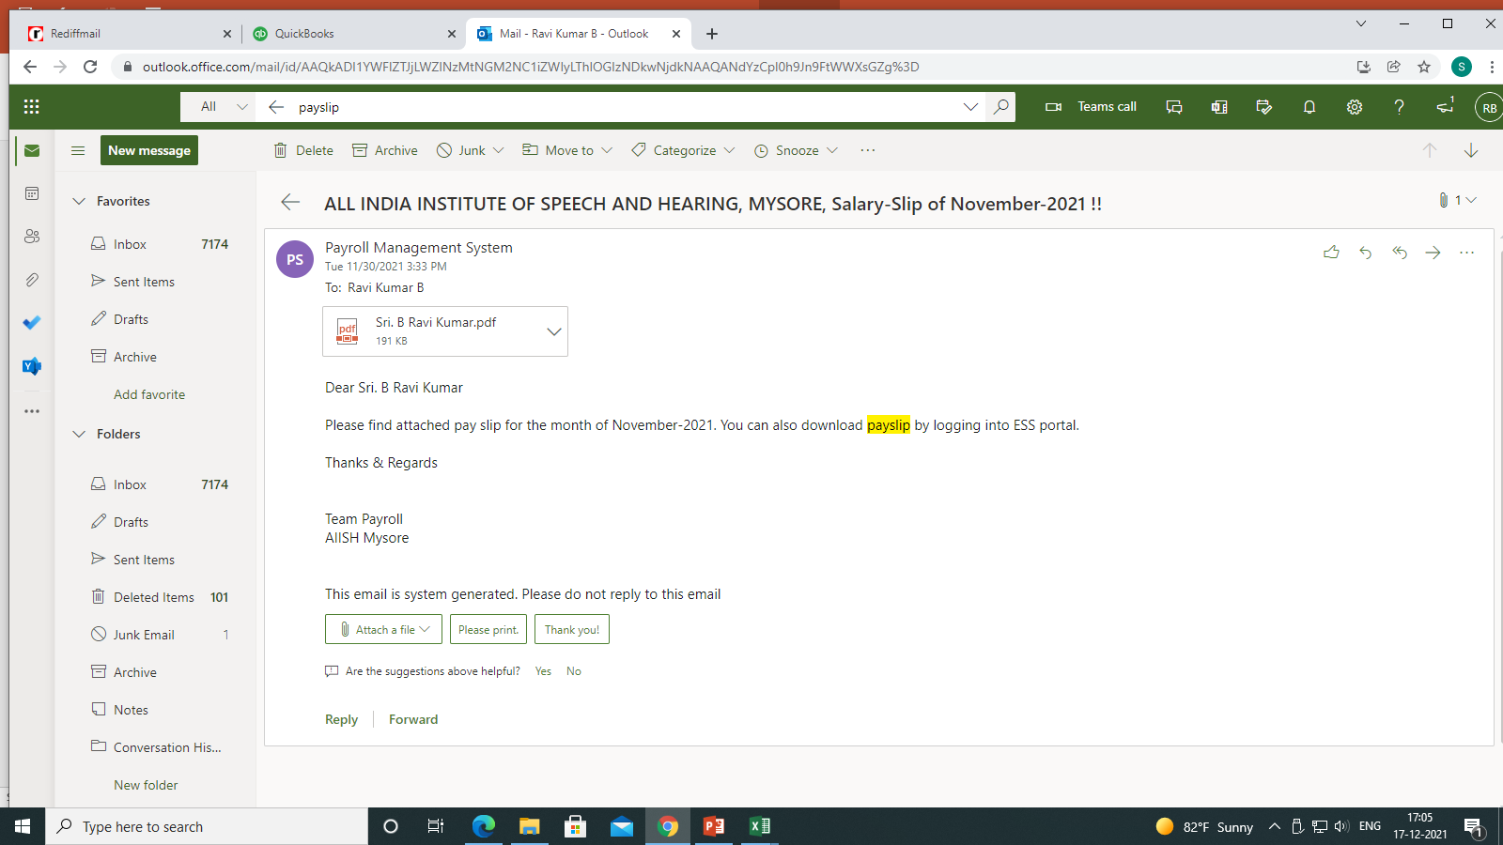
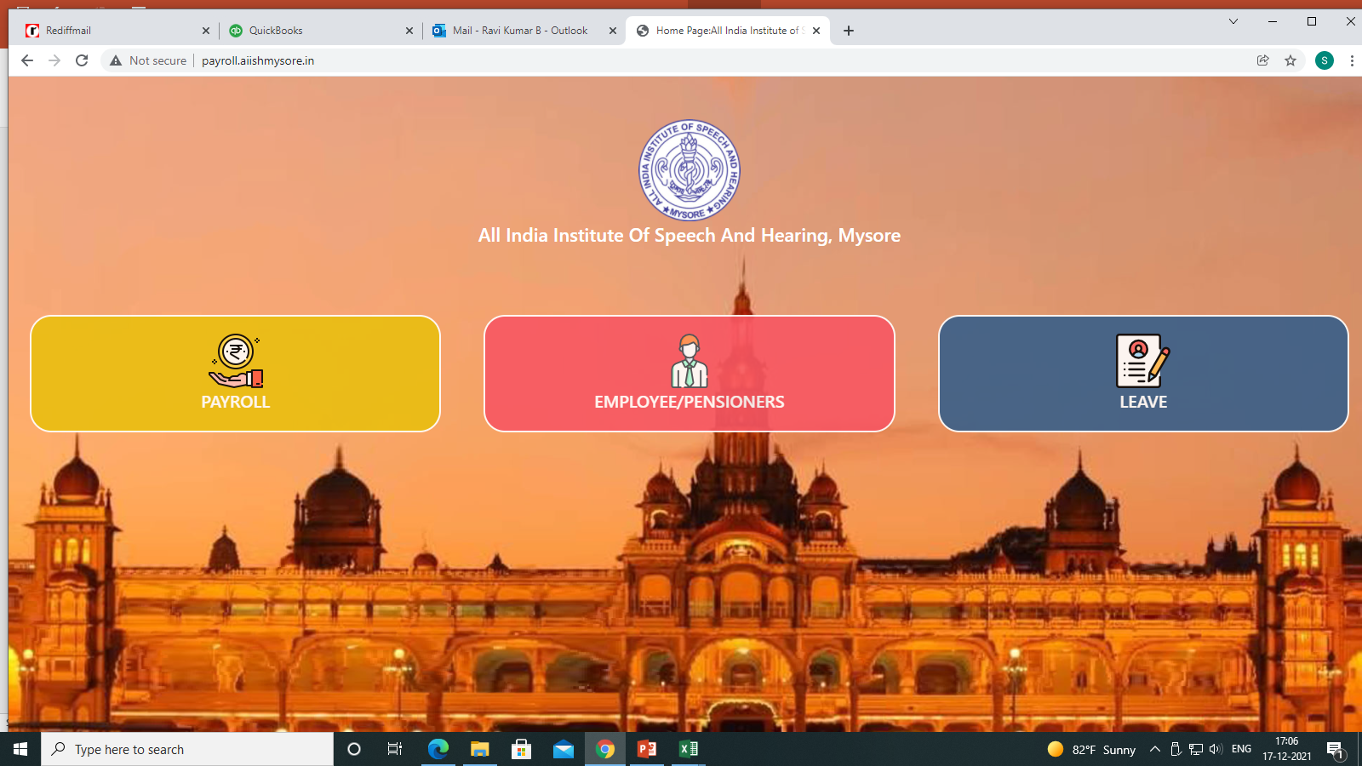
Accounting Software
Web based Software
Real time accounting
Computerization
Backward integration of Instant Purchase Orders
Forward integration
Instant mail alerts on payments to suppliers
Salary & Leave
Management module
Salary updating software to the Employees
Leave management
Employee self-Service
All India Institute of Speech and Hearing
2021-22

