Slide 1
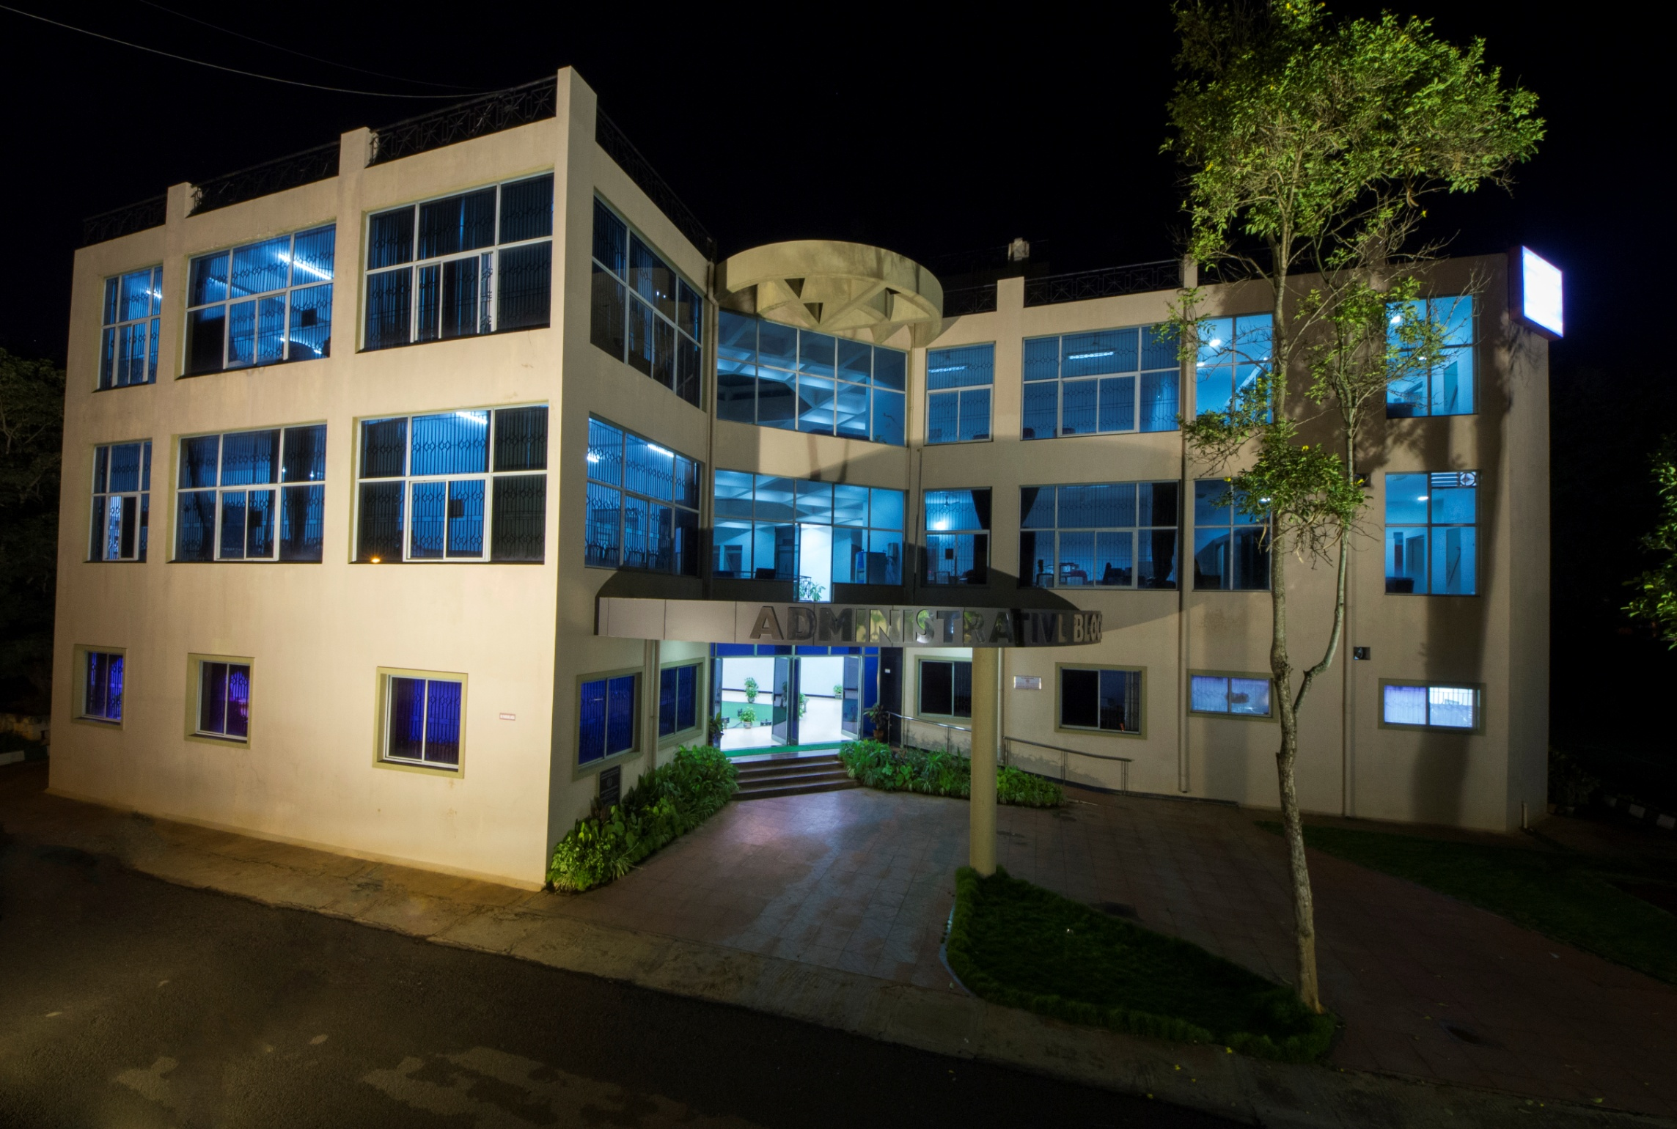
All India Institute of Speech and Hearing
Manasagangotri, Mysuru

Slide 2
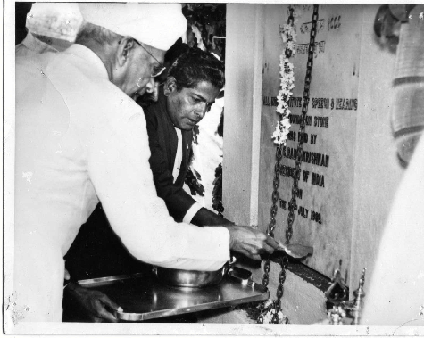
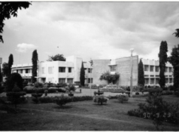
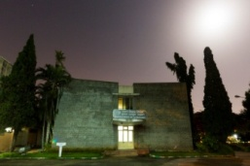
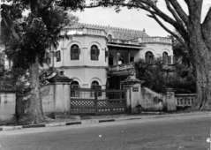
Introduction
A fifty-four year old autonomous organization in the field of communication disorders fully funded by the Ministry of Health & Family Welfare, Govt. of India. Situated in Manasagangothri, Mysuru, Karnataka, it is a unique institute pertaining to the field in the Asian sub-continent.
All India Institute of Speech and Hearing
2021-22

Slide 3
Vision, Mission, Objectives
Introduction
Vision: To be a world-class institution for human resource development, conducting need-based research, striving for excellence in clinical services, creating awareness and public education in the field of communication disorders.
Mission: To promote, sustain and provide globally-competitive, compassionate, ethically sound human resource, quality education, original research, clinical services, and public awareness in the field of communication disorders.
Objectives: Manpower generation in the area of communication and its disorders, conducting research, rendering clinical services and educating the public on issues related to communication disorders.
All India Institute of Speech and Hearing
2021-22

Slide 4
Credentials
College with Potential for Excellence - UGC
A Grade Accreditation - NAAC
9001-2008 Quality Certification - ISO
Centre of Excellence in the area of Deafness - WHO
Centre of Excellence in the area of Communication Disorders - MoHFW, GOI
Centre for Advanced Research in Speech and Hearing - UGC
Nodal Centre for the Implementation of the National Programme on Prevention and Control of Deafness - MoHFW, GOI
Collaborative Organization for the Rashtriya Bal Swasthya Karyakram (RBSK), under the MoHFW, GOI
Science & Technology Institute by the Department of Science and Technology, GOI
Centre of Excellence MoHFW, GOI
Member, World Hearing Forum, WHO
Introduction
All India Institute of Speech and Hearing
2021-22

Slide 5
Organizational Structure
Executive Council
Introduction
Finance Committee
Academic Sub Committee
Director
Dean Infrastructure
Dean Research
Academic
Administration
Central Facilities
Maintenance Section
Departments/Centre
Accounts
Engineering
Audiology
Clinical Psychology
Clinical Services
Electronics
Material Development
Otorinolaryngology
Special Education
Speech Language Sciences
Speech Language Pathology
Prevention of Communication Disorders
Tele-center for Persons with Communication Disorders
Horticulture
Library and Information Centre
Public Information Office
All India Institute of Speech and Hearing
2021-22

Slide 6
Chairman, Executive Council
(Shri.Mansukh L. Mandaviya,
Hon. Union Health Minister)
Director
(Dr. M. Pushpavathi)
Dean, Research
(Dr. P. Manjula)
Dean, Infrastructure
(Dr. Sunder Raju)
Chairman, Academic Sub Committee
(Dr. M. Pushpavathi)
Academic Coordinator
(Dr. Ajith Kumar U)
Academic Management

Slide 7
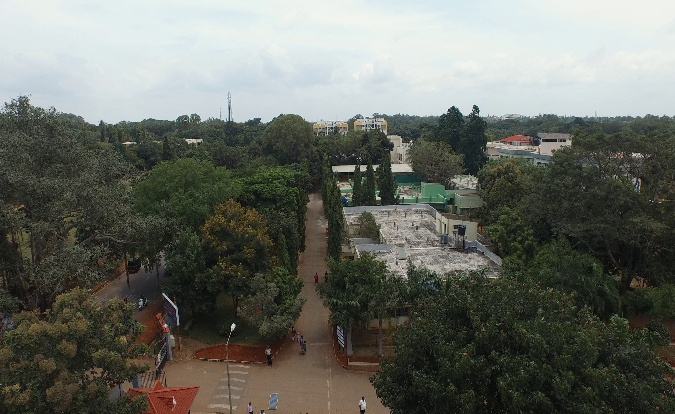
…….
11 Departments
Eleven departments spanning across seven multi-storied buildings having advanced infrastructure facilities.
Units / Cells
31 Centres
12 outreach service centres across the state, 6 DHLS centres and 13 Newborn Screening Centres across the country.
AIISH-like Institutions
Kanpur, Tripura
All India Institute of Speech and Hearing
2021-22

Slide 8
Campus
Main campus, Naimisham spreads across a total area of 29 acres in Manasagangotri, Mysuru, Karnataka.
The second campus, Panchavati spreads across a total area of 5 acres and is located 500m away from the main campus in Manasagangotri.
The third new campus is in Varuna, Mysore spreads across 10 acres and is under development.
All India Institute of Speech and Hearing
2021-22

Slide 9
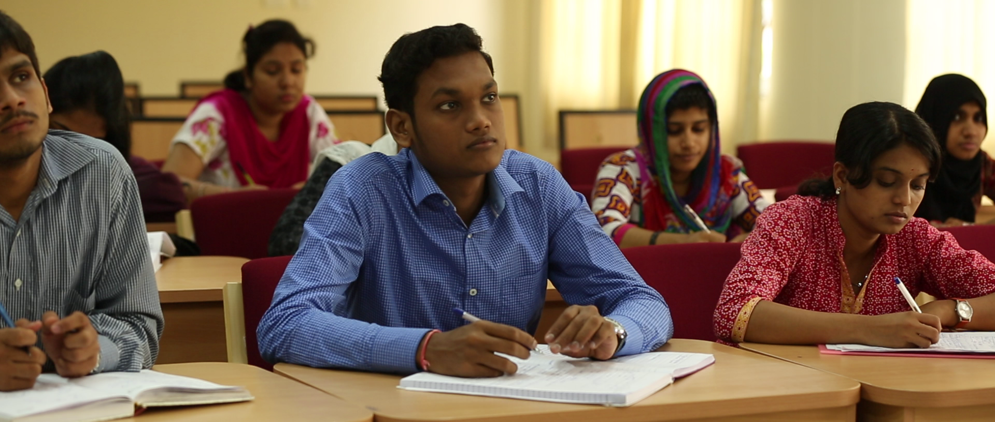
Academic Highlights
Multi-disciplinary Academic Programmes
Long-term Training Programmes
Ranging from Diploma to Postdoctoral
Short-term Training Programmes
On various aspects of communication disorders
All India Institute of Speech and Hearing
2021-22

Slide 10
Affiliating Bodies
Academic Highlights
Rehabilitation Council of India, New Delhi
University of Mysore, Mysuru
All India Institute of Speech and Hearing
2021-22

Slide 11
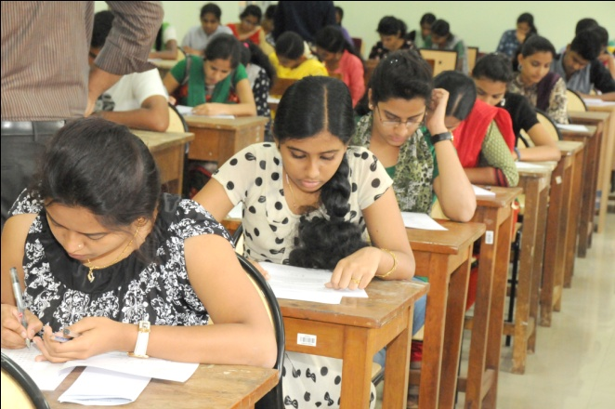
Academic Highlights
Admission and Enrolment
B.ASLP
M.Sc. Audiology
M.Sc. SLP
Diplomas
Ph.D
National Level Entrance Examinations
Admission based on
B.Ed Spl. Edu (HI)
M.Ed Spl. Edu (HI)
Marks obtained in
Qualifying Exams
All India Institute of Speech and Hearing
2021-22

Slide 12
Student Diversity
Academic Highlights
Gender
Geography
Admission based o
Community
All India Institute of Speech and Hearing
2021-22

Slide 13
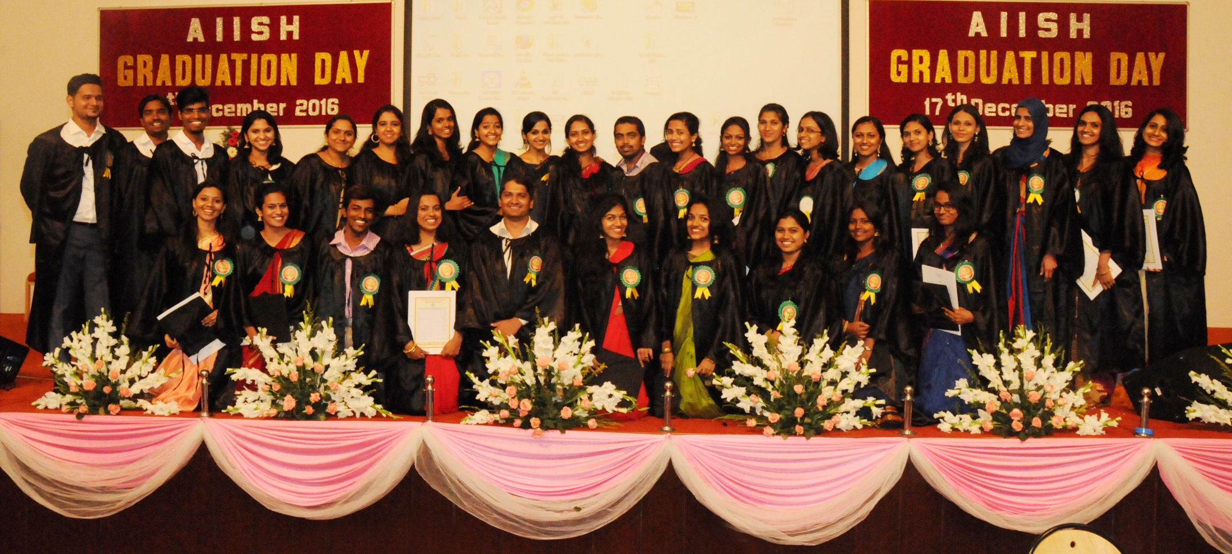
Academic Highlights
Internship
For B.ASLP students
One-Year Duration
Postings at AIISH Clinics & at reputed govt. medical institutions
All India Institute of Speech and Hearing
2021-22

Slide 14
Student Assessment & Evaluation
Academic Highlights
B.ASLP
B.Ed Spl. Edu (HI)
M.Sc. Audiology
M.Sc. SLP
M.Ed. Spl. Edu (HI)
Credit Based Choice System (CBCS)
Diploma
Internal Assessment & Semester End Exam
All India Institute of Speech and Hearing
2021-22

Slide 15
Curriculum
Academic Highlights
Frequent revision
Support Employability Skills
AIISH around the World
All India Institute of Speech and Hearing
2021-22

Slide 16
Interdisciplinary Approach
Academic Highlights
Research Projects /
Dissertations
Elective Options in
Curriculum
Seminars / Conferences/
Workshops/Trainings
Seminars / Conferences/
Interdisciplinary Subject in
Curriculum
All India Institute of Speech and Hearing
2021-22

Slide 18
Curriculum Enrichment
Academic Highlights
Lectures on Environment, Human Rights, Professional ethics, Gender Equity
Outreach Activities
Curriculum Enrichment
Public Education
Screening for
communication disorders
Observation of
commemorative days
All India Institute of Speech and Hearing
2021-22

Slide 19
Student Performance
Academic Highlights
B.ASLP
B.Ed Spl. Edu (HI)
M.Sc. Audiology
M.Sc. SLP
M.Ed. Spl. Edu (HI)
Average Pass percentage is above 90 %
All India Institute of Speech and Hearing
2021-22

Slide 20
Organization of Scientific Events
Communication disorders and associated fields, research methodology, Academic integrity
Academic Highlights
Seminars/Workshops/
Training/Guest Lectures
Beneficiaries
Staff and Students
Other professionals across the globe
All India Institute of Speech and Hearing
2021-22

Slide 21
Maintenance of Academic Integrity
Workshops/
Training Programmes
Plagiarism Detection Facility
Academic Highlights
Clinical Code of Conduct
Biometric Attendance System
All India Institute of Speech and Hearing
2021-22

Slide 22
Faculty Strength/contribution
17
16
16
14
14
2019-2020
2017-18
2018-19
Professors
Associate Prof./Readers
Asst. Professors
Academic Highlights
2015-16
2016-17
Invited talk delivered
Research at various levels
Scholarly review
Mentoring
Expert Talks
Clinical Care
Outreach Services
Public Education
Corporate Activities
All India Institute of Speech and Hearing
2021-22

Slide 23
Faculty Recharge
Faculty calibration
As per the ISO 9001-2015
Staff enrichment programme
On recent advances on the profession to meet continuing education needs
Academic Highlights
Sponsorship for attending professional events with duty leave, TA/DA
Assessment Promotion Scheme
All India Institute of Speech and Hearing
2021-22

Slide 24
Feedback & Evaluation
From Parents
From Employers
Academic Highlights
From Alumni
From Students
Alumni Meet
Parents Meet
Faculty Evaluation
Feedback Analysis &
Corrective Measures
All India Institute of Speech and Hearing
2021-22

Slide 25
Research Highlights
Promotes research on Communication and its Disorders with special reference to clinically relevant applied research on Causes, Control and Prevention of Communication Disorders
Govt. of India Funding Agencies & International Organizations
Extramural Research Projects
Funded by
Institute from AIISH Research Fund
Intramural Research Projects
All India Institute of Speech and Hearing
2021-22

Slide 26
Extramural Research Funding Agencies
Department of Bio Technology
Department of Science & Technology
Indian Council of Medical Research
University Grants Commission
UNICEF
World Health Organization
Research Highlights
All India Institute of Speech and Hearing
2021-22

Slide 27
Funded Research Projects
AIISH-Funded Research
Extramural Research
Research Highlights
Completed Funded Research Projects in 5 Years
All India Institute of Speech and Hearing
2021-22

Slide 28
Funded Research Projects
AIISH-Research Fund: Amount Spent in 5 Years
Research Highlights
All India Institute of Speech and Hearing
2021-22

Slide 29
Doctoral Research
Main areas of research
Speech, language, hearing sciences, and disorders, Clinical Linguistics and Special Education
Types
Part-time - for working professionals
Fulltime -with fellowship
Research Highlights
Postgraduate Research
M. Sc. Audiology
M. Sc. SLP
MS. Ed.
Part of Postgraduate Degree Programmes
All India Institute of Speech and Hearing
2021-22

Slide 30
Scientific Publications
v
National and International Journals
Research
Highlights
Scientific books
Contributors: Faculty, Technical Staff and Students
All India Institute of Speech and Hearing
2021-22

Slide 31
Scientific Presentations
Scientific paper presentations in National and International Conferences & Seminars
Research Highlights
ISHACON
CIGICON
Voice India society
NSA
All India Institute of Speech and Hearing
2021-22

Slide 32
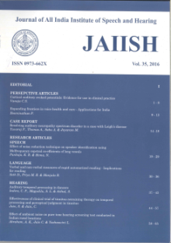
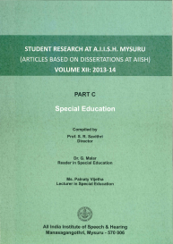
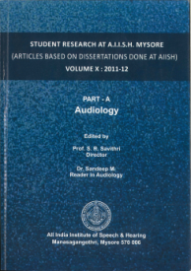
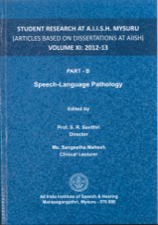
Publication of Scientific Journals
Peer-reviewed National Scientific Journal
The Journal of All India Institute of Speech and Hearing (JAIISH)
Research Highlights
Current issue: Wolters Kluwer - Medknow-https://www.jaiish.com/
Back volumes: www.aiish.ac.in
Postgraduate Research based Scientific Journals
1. Student Research at AIISH: Audiology
2. Student Research at AIISH: Speech-Language Pathology
3. Student Research at AIISH: Special Education
All India Institute of Speech and Hearing
2021-22

Slide 33
Other Scientific Publications
Product Development Cell
Research Highlights
Professional learning books
Public Education books
Public Education pamphlets
Test & Therapy materials
Format of Publication
Print
Electronic
Print + Electronic
All India Institute of Speech and Hearing
2021-22

Slide 34
Research Governance
Center for Research Development
Research Coordination Section
Research Ethics Committee
Research Evaluation Committee
Dean Research
Research Highlights
All India Institute of Speech and Hearing
2017-18

Slide 35
Research Labs
Forensic speech science and technology
Central prosthetics
Psychoacoustic
Audiology practical
Research highlights
Epidemiology
Articulograph
Acoustic testing
Speech & language pathology
Language science
24 No.
Prosody
Hearing aid
Speech physiology
Phonology
Fluency
Electrical
Electrical brain imaging
English language
Neurophysiology
Rehabilitation engineering
Speech science and swallowing
Human genetics
Electrophysiology
Electronics & instrumentation
All India Institute of Speech and Hearing
2021-22

Slide 36
Student Support Services
Educational Stipend
Educational Stipend in five years (Total amount `37,79,463)
2019-20
2018-19
2017-18
2016-17
2015-16
` 3,29,950
`5,65,065
`10,05,014
`11,06,135
`7,73,299
All India Institute of Speech and Hearing
2021-22

Slide 37
New Student Orientation
Student Support Services
[[To get from Academic Section]]
All India Institute of Speech and Hearing
2021-22

Slide 38
Enhancement of Clinical & Research Acumen
Student Support Services
Clinical Conferences
Journal Clubs
In order to enhance the clinical and research acumen of students, the institute conducts journal clubs and clinical conferences on communication disorders under the guidance and supervision of faculty members. They provide ample opportunities for the students to participate and apply critical analytical skills in both clinical care and research.
All India Institute of Speech and Hearing
2021-22

Slide 39
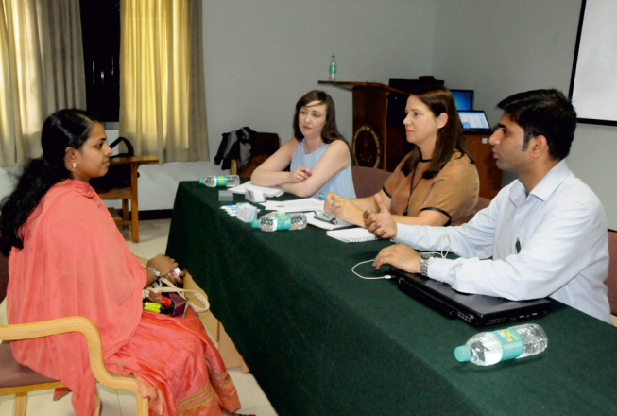
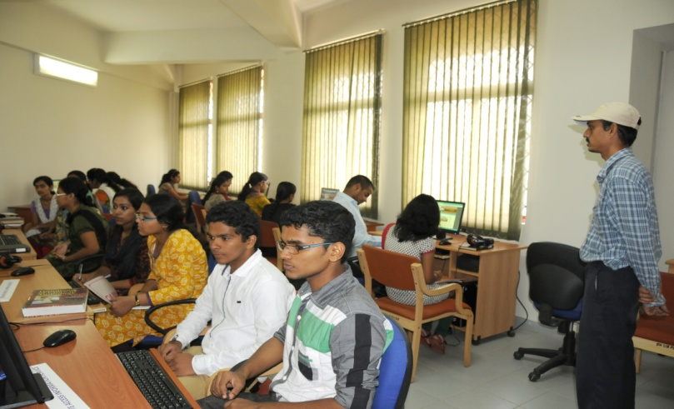
Career & Professional Development Support
Clinical Conferences
Journal Clubs
Student Support Services
Placement Cell
Language Lab
All India Institute of Speech and Hearing
2021-22

Slide 40
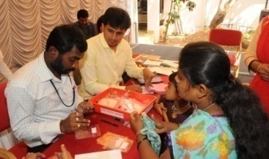
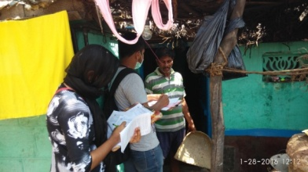
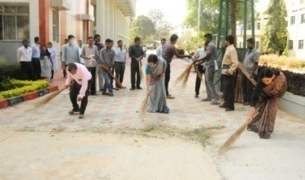
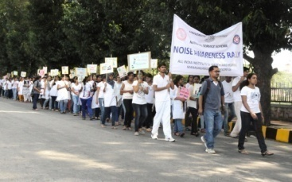
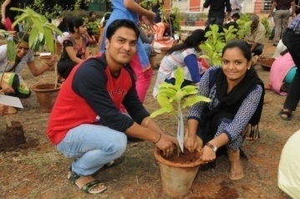
Inculcating Social Responsibility
Awareness Rallies on Communication Disorders
Student Support Services
Survey on Communication
Disorders
Tree Planting
Conducting Special Camps
Cleaning of Public Places
All India Institute of Speech and Hearing
2021-22

Slide 41
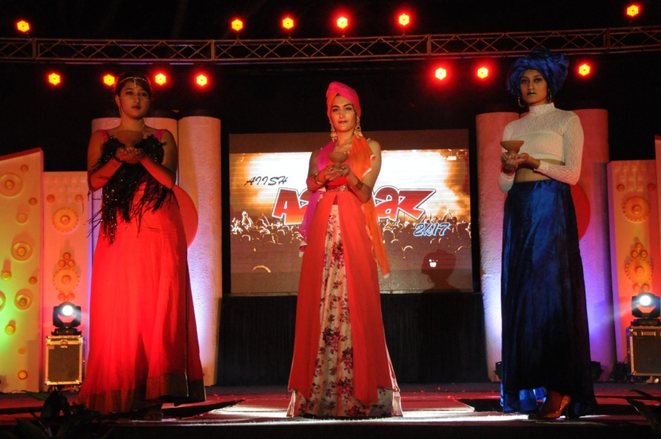
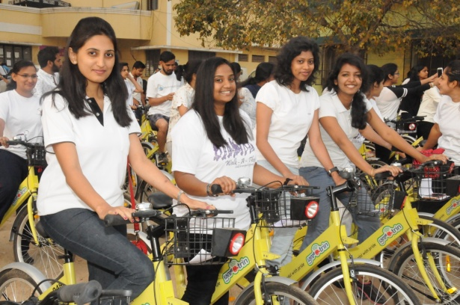
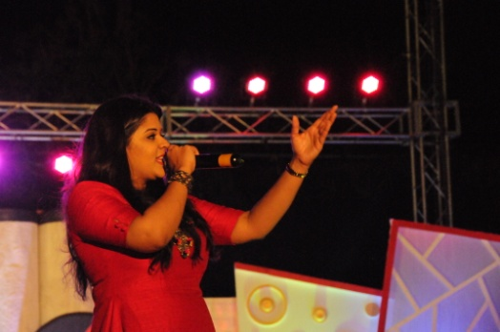
Cultural & Sports Activities
Student Support Services…
AIISH Gymkhana
An association of Institute staff
and students
Platform for recreational, social and cultural activities
Co-ordinate sports, art, cultural and literary activities
All India Institute of Speech and Hearing
2021-22

Slide 42
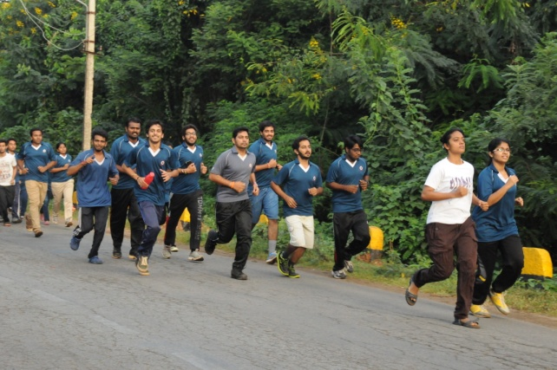
AIISH National Service Scheme
Student Support Services…
AIISH National Service Scheme
AIISH Gymkhana
2 NSS Units
The Units contribute to the Institute’s aim
of all round development of its students.
Involve the students in activities which ultimately helps them integrate with society efficiently.
All India Institute of Speech and Hearing
2021-22

Slide 43
Other Supporting Services
Teaching evaluation & feedback
Health Care
Anti-ragging Cell
Student Grievance Cell
Sexual Harassment Committee
Mentorship
Round the clock security service
Other Supporting Services
Student Support Services
All India Institute of Speech and Hearing
2021-22

Slide 44
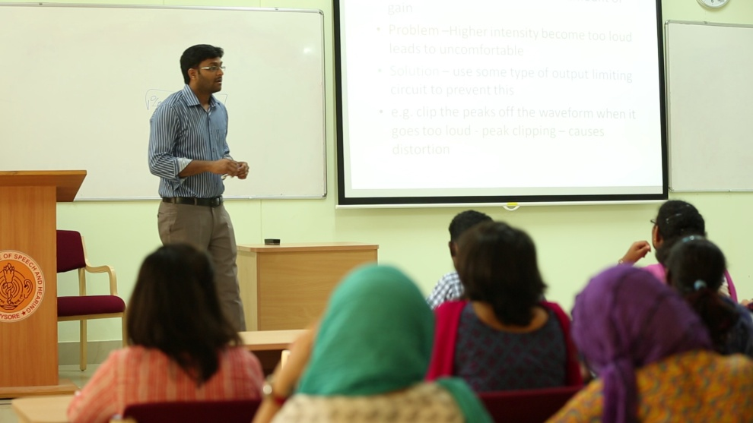
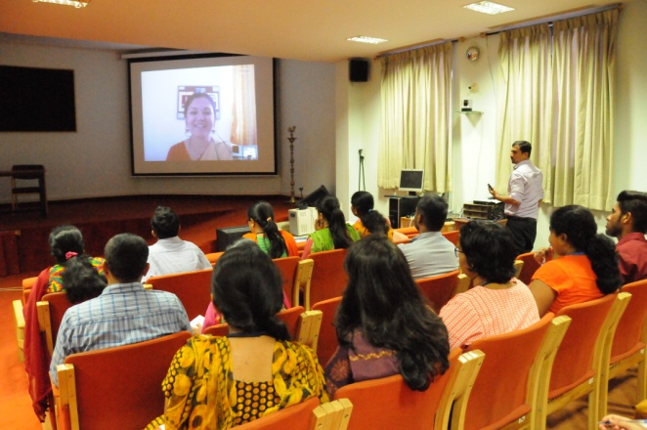
Classrooms
20 smart classrooms spanning across 2 academic buildings and 57,000 sq.ft.
Physical Infrastructure
Conference Halls
2 conference halls, two a/c, with a total seating capacity of 680.
Computer Centre
A modern computer centre with high speed internet facility
All India Institute of Speech and Hearing
2021-22

Slide 45
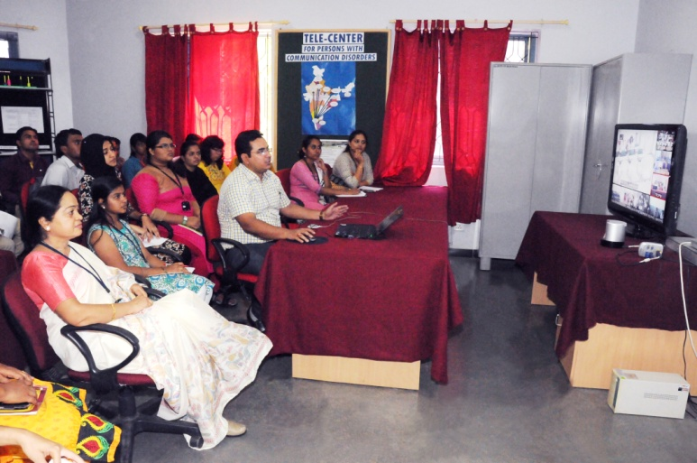
Video Conferencing System
State-of-the-art video conference set up linked through MPLS VPN to DHLS centers and can be connected to any part of the world through ISDN link.
Physical Infrastructure
All India Institute of Speech and Hearing
2021-22

Slide 46
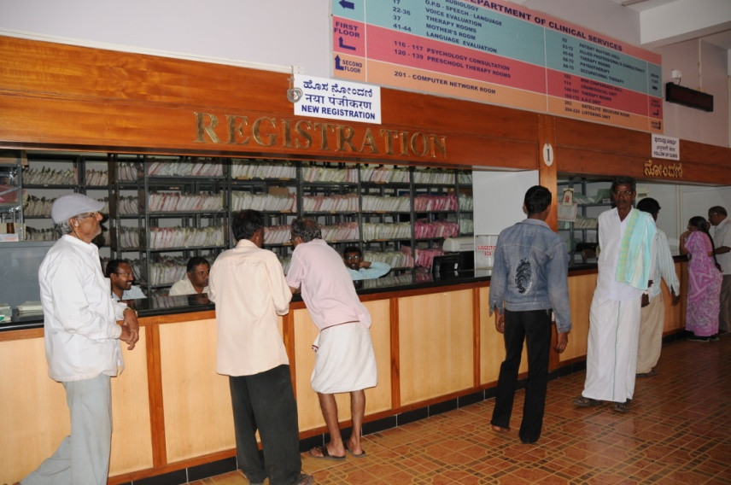
Clinical Highlights
Patient Registration
Comprehensive range of clinical services on communication disorders
Patient Registration in 5 Years
2019-20
2018-19
74002
2017-18
73909
2016-17
72419
2015-16
69490
69079
All India Institute of Speech and Hearing
2017-18

Slide 47
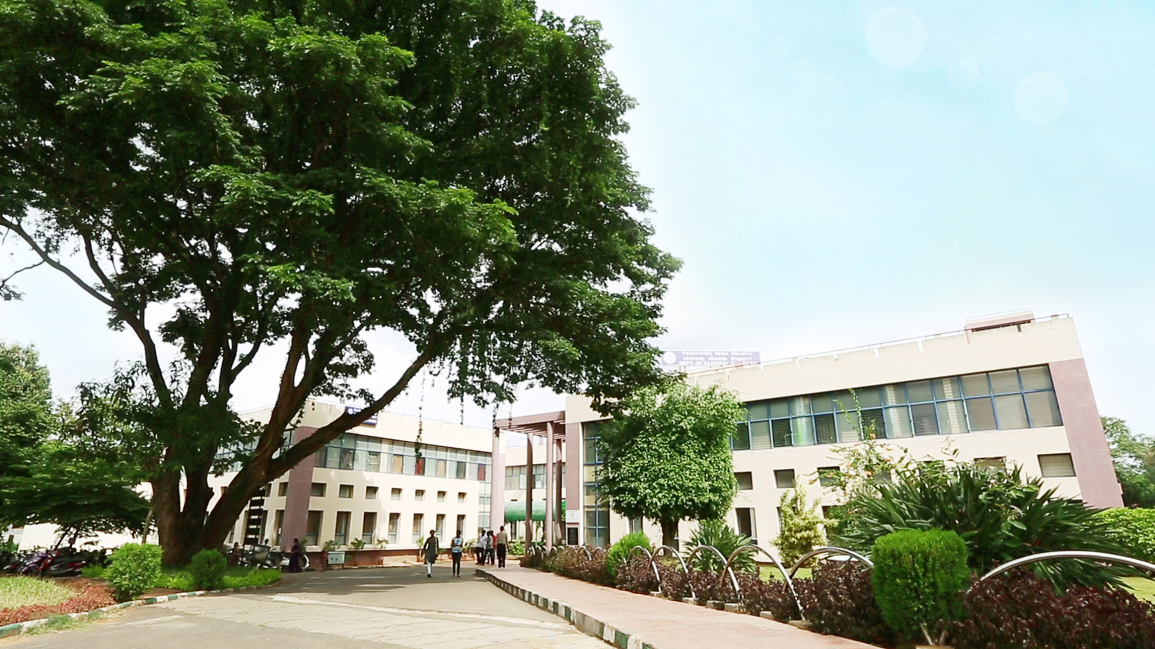
Clinical Units
Two OPDs
2 OPDs
Physical Infrastructure
Audiology
Speech
14 Special Clinics
Total area: 66,000 sq. ft.
All India Institute of Speech and Hearing
2021-22

Slide 48
Medical Speciality & Allied Health
Consultancy Service on:
Neurology,
Pediatrics,
Phono surgery
Plastic surgery
Orthodontics
Allied Health Services on:
Physiotherapy
Occupational Therapy
Clinical Highlights
All India Institute of Speech and Hearing
2017-18

Slide 49
Specialized Clinical Services
Clinical Highlights
Alternative & Augmentative Communication Unit, Autism Spectrum Disorders Unit, Clinic for Elderly Persons with Language Disorders, Fluency Unit, Implantable Hearing Devices Unit, Learning Disability Clinic, Motor Speech Disorders Unit, Neuropsychology Unit, Phonology Unit, Professional Voice care Unit, Structural Orofacial Anomalies Unit, Swallowing Disorders Unit, Vertigo Unit, Voice Clinic
All India Institute of Speech and Hearing
2017-18

Slide 50
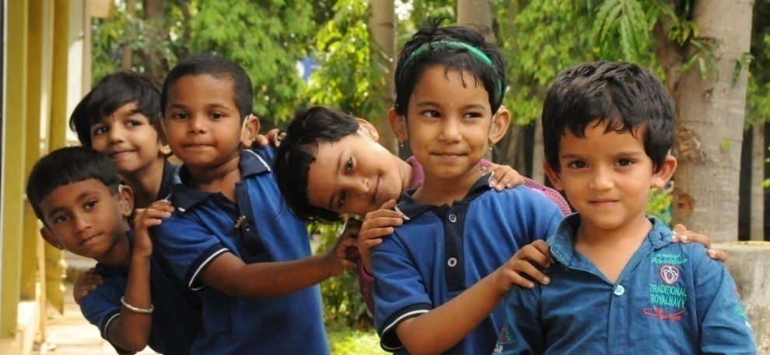
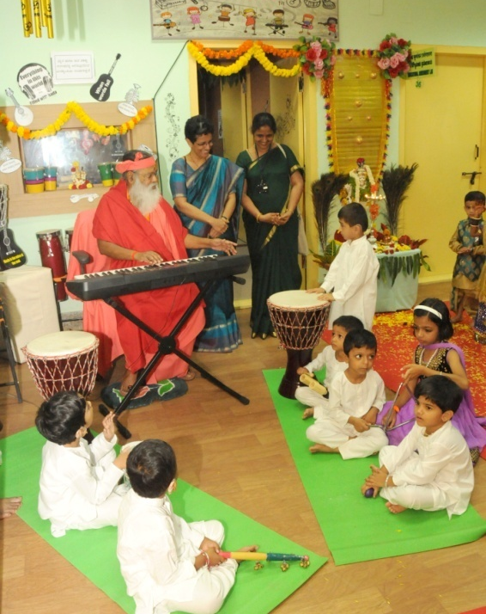
Special Education Services
Special education assessment, parent infant programme, Preschool parent empowerment, preschool programme, preschool bridge course, curricular support service
Clinical Highlights
2012-13
2013-14
2014-15
2015-16
2016-17
204
221
231
225
224
Preschool Admission in 5 Years
All India Institute of Speech and Hearing
2017-18

Slide 51
Outreach Services
Screening Programmes for Communication Disorders
Elderly Screening
Industrial Screening
School Screening
Camp-based Screening
Itinerant Service at schools
Mainstream School Adoption
Clinical Care at Outreach Service Centres
All India Institute of Speech and Hearing
2017-18

Slide 52
Public Education
Monthly Public Lectures
Preparation and dissemination of Public Education Materials
Public Awareness Programmes
Rallies & Street Plays
Screening Camps
Open Day Celebrations
Observation of Commemorative Days
Social Media based Activities
Public Orientation Programme
Public Education Services
All India Institute of Speech and Hearing
2020-21

Slide 53
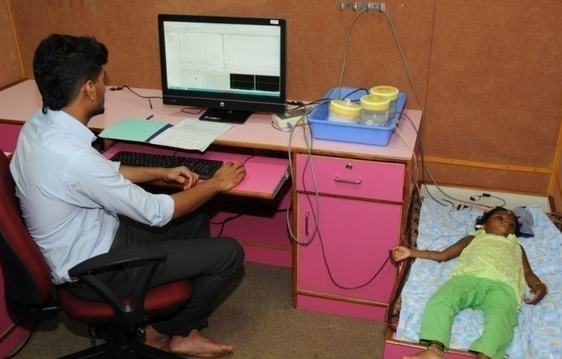
Clinical Support Services
Clinical Support Services
Distribution of Hearing Aids
Counseling & Guidance
Issue of Disability Certificates
Hearing Aid Distribution in 5 Years
All India Institute of Speech and Hearing
2020-21

Slide 54
Physical Infrastructure
Classrooms
20 smart classrooms spanning across 2 academic buildings and 57,000 sq.ft.
Conference Halls
2 conference halls, two a/c, with a total seating capacity of 680.
Computer Centre
A modern computer centre with high speed internet facility
All India Institute of Speech and Hearing
2021-22

Slide 55
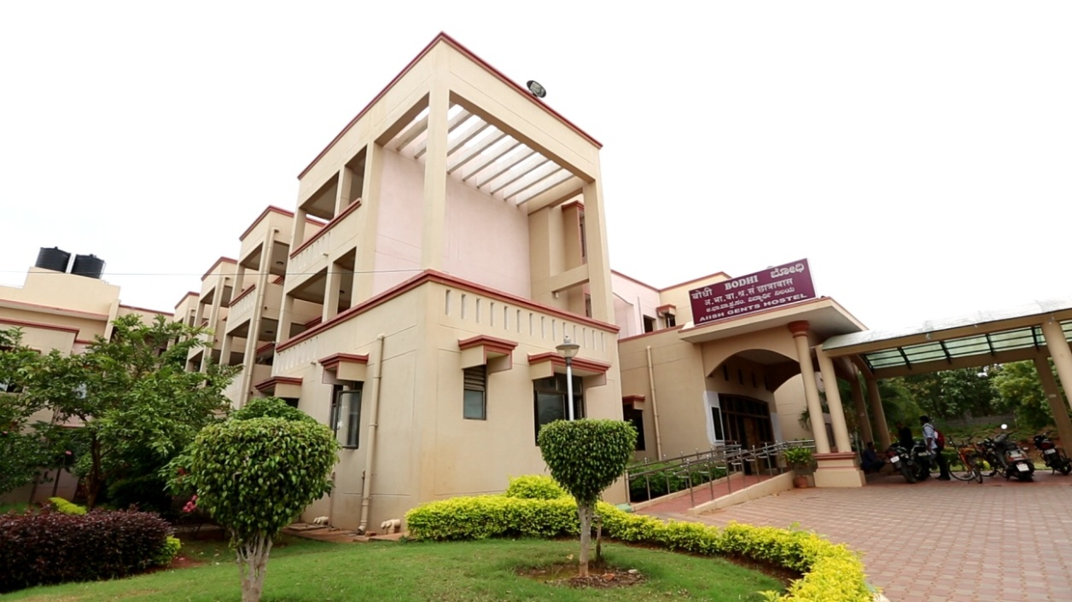
Hostels
Ladies hostel: 189 Rooms. spanning across 84000 sf. Ft)
Gents hostel: 189 Rooms. spanning across 84000 sf. Ft)
Recreation rooms
Kitchen garden (Gireesh)
Unlimited free broadband and a telephone service with
Physical Infrastructure
All India Institute of Speech and Hearing
2021-22

Slide 56
Print & E-Books
Print & E-Journals
Bound Volumes & Online Archives
Standards
Rare Books
Institutional Repository
Integrated Library Management System
Language Lab
Institute Journal Platform
Offers Open Elective Course for PG Programmes
Spacious Reading Halls
Opens 12 hours on Working Days & 8 hours on Saturdays
Special Collections on Academic Writing & English Communication
Library Advisory Council
Web OPAC
Remote Access Service
Online ISBN
Library Information Center
Physical Infrastructure
All India Institute of Speech and Hearing
2021-22

Slide 57
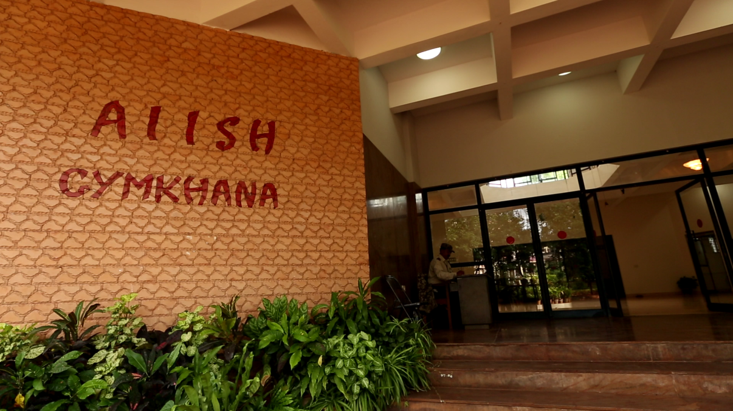
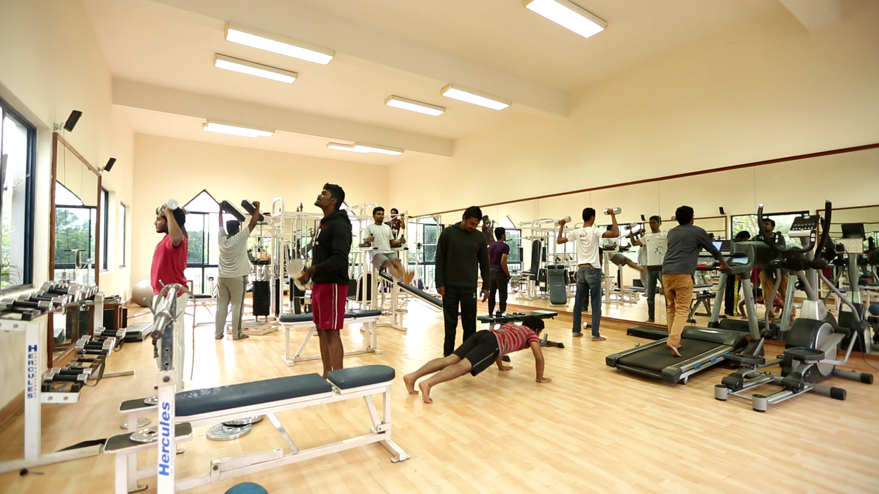
Sports Complex and Cultural Centre
Well-equipped gymnasium, sports complex and cultural centre in a 14000 sq. ft. building named AIISH Gymkhana
Campus Infrastructure
All India Institute of Speech and Hearing
2021-22

Slide 58
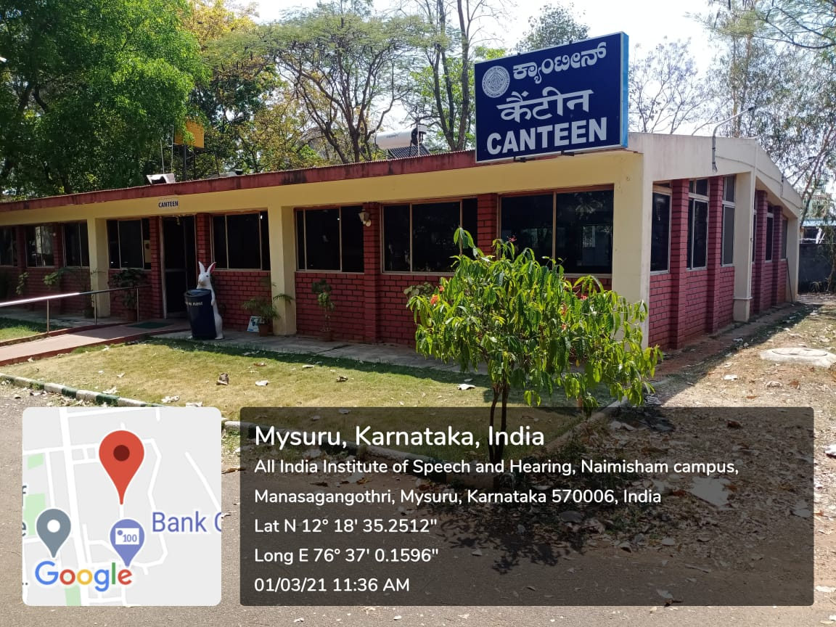
Canteen
Full fledged canteen catering to the staff, students and patients.
Modern kitchen with best of the amenities
Physical Infrastructure
Staff Quarters
55 nos. of B, C, D & E type quarters for the staff with a living area of 42000 sf. ft.
All India Institute of Speech and Hearing
2021-22

Slide 59
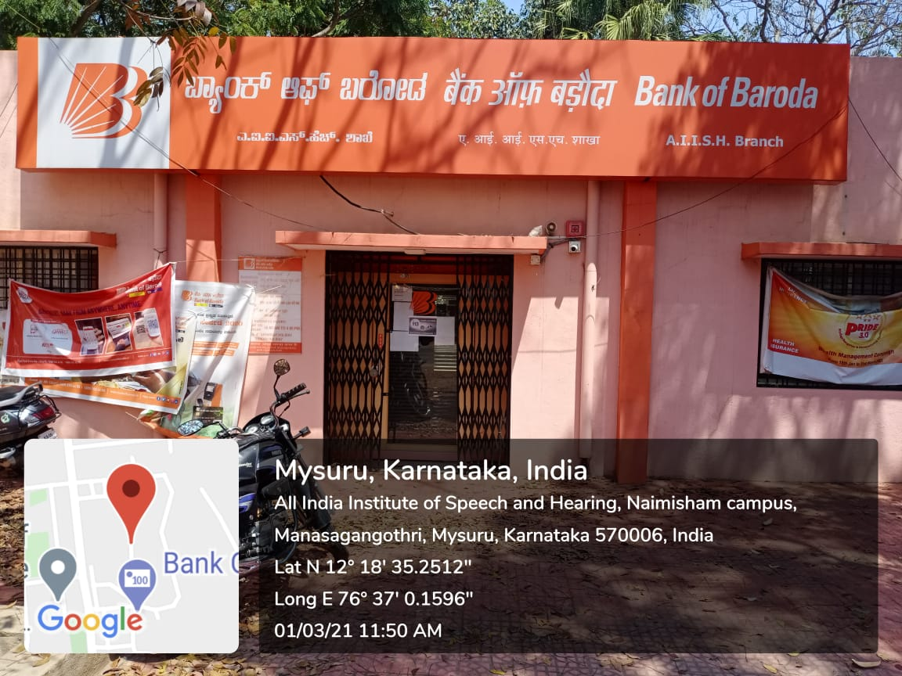
Bank & ATM
Physical Infrastructure
The Institute bank with Bank of Baroda
Bank of Baroda, AIISH Branch & ATM functions in the main campus
All India Institute of Speech and Hearing
2021-22

Slide 60
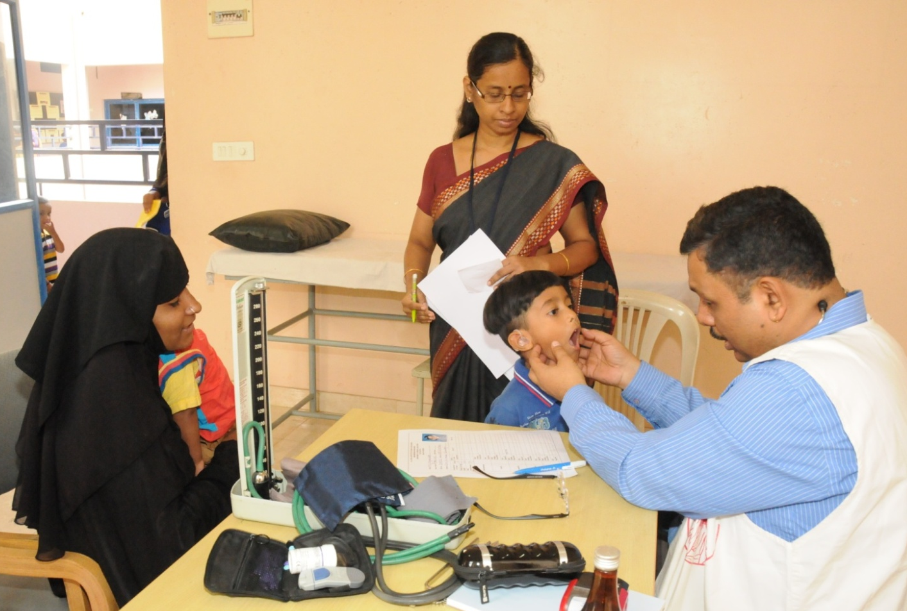
Health Centre
Physical Infrastructure
A full-fledged facility
Functions alongside the Dept. of ENT
Presence of a Senior Medical Officer.
All India Institute of Speech and Hearing
2021-22

Slide 61
IT Infrastructure
State-of-the-art computer network with a 1 Gbps LAN comprising 5 servers and 400 systems, with 32 Mbps dedicated internet link
Extended network through MPLS VPN link connecting to DHLS centres
Wi-Fi networking
In-house email server which supports 1000 e-mail ID and 10 Gb of backup
Physical Infrastructure
All India Institute of Speech and Hearing
2021-22

Slide 62
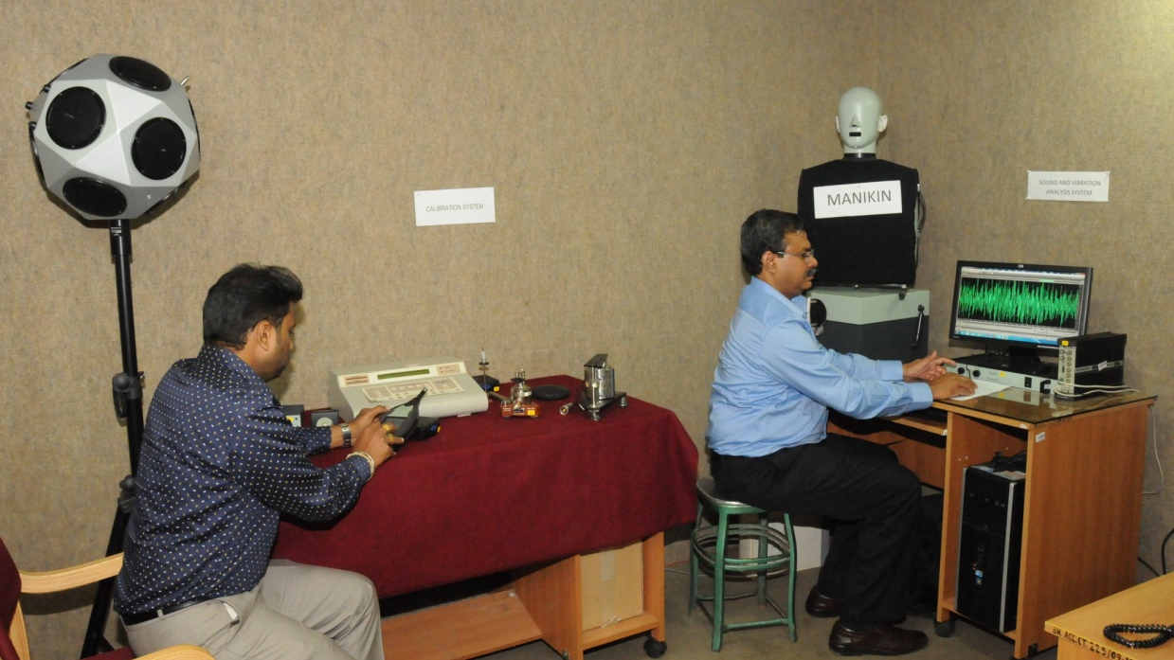
Electrical & Electronic Infrastructure
Uninterrupted power back up provided by one 250 KVA and 2x125KVA diesel generators with automatic switching ON facility.
11 KVA electrical substation with 315 KVA HT transformer.
Siemens Hipath 4000 EPABX with 1000 intercoms with Direct Inward Dialing, IP telephony, soft phones and call billing.
Physical Infrastructure
All India Institute of Speech and Hearing
2021-22

Slide 63
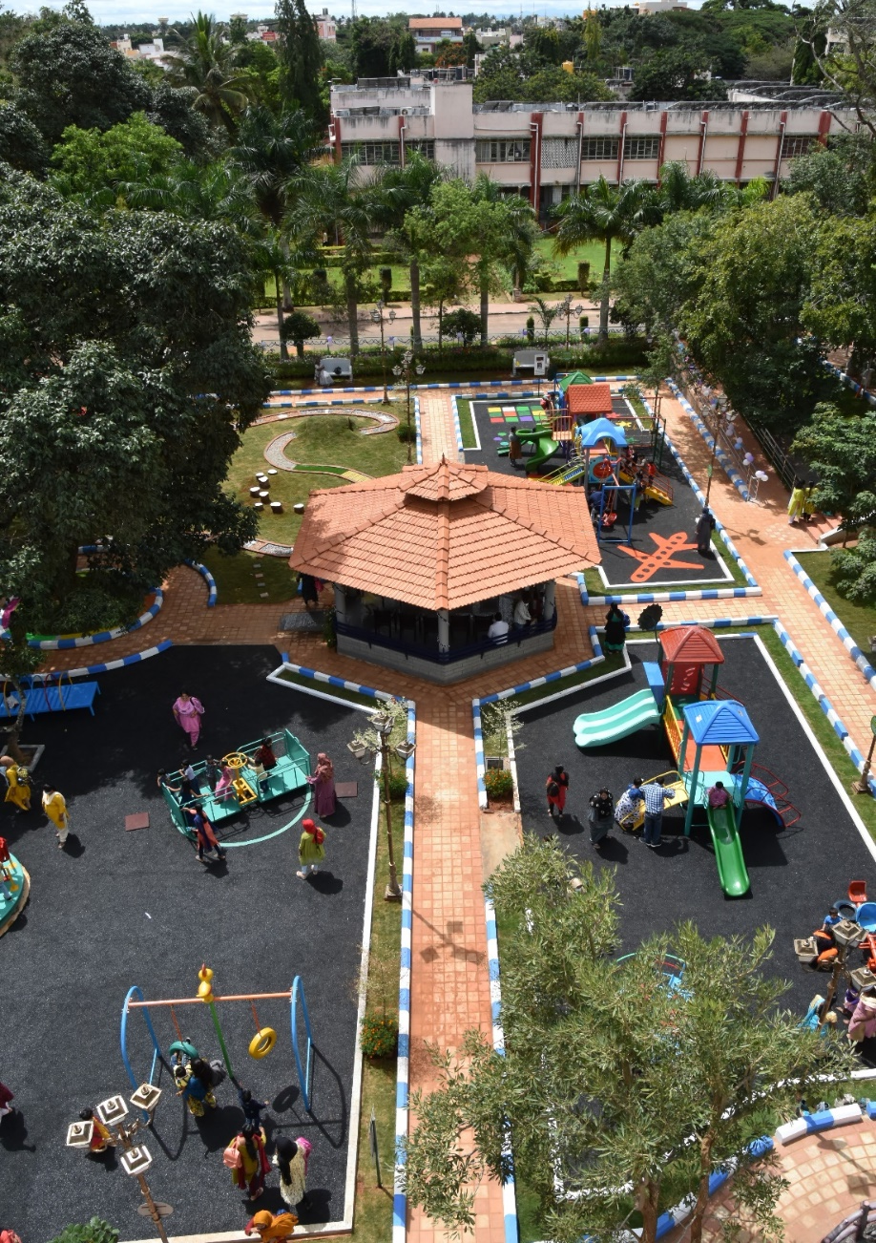
Inclusive Therapy Park
Breaking barriers through play.....
To provide an inclusive environment during play for children with special needs
To facilitate independent play skills in children with communication disorders
To make them experience the joys of playing together
To provide a holistic development to its beneficiaries
To facilitate the motor skills of adults and elderly with communication disorders
FINANCIAL SUPPORT: Funded by the Ministry of Health and Family Welfare, Government of India and the Mysore City Corporation.
Physical Infrastructure
All India Institute of Speech and Hearing
2020-21

Slide 64
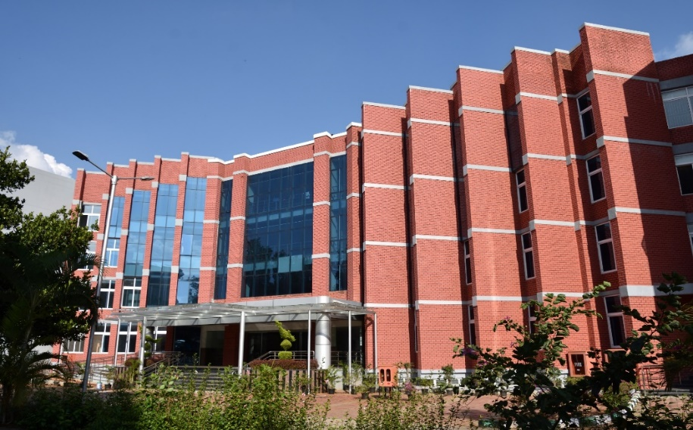
Centre of Excellence
Housed in building with G + 3 floors & consists of the following 12 units
Center for prevention of communication disorders and epidemiological research and cognitive behavioral sciences in communication disorders
Center for speech and language disorders in children, Adults and senior citizens
Centre for Informatics and Patents and Rehabilitation engineering, Acoustics & Biomedical engineering (CRAB)
Center for hearing sciences
Center for Hearing impairment in children,
adults and senior citizens
Center for persons with swallowing disorders
Center for persons with tinnitus and
vestibular disorders
Center for Speech and Language Sciences
Center for AAC and sign language
Center for Surgical Rehabilitation of
communication disorders
Center for public education in communication disorders
Publication wing
Physical Infrastructure
All India Institute of Speech and Hearing
2020-21

Slide 65
Video Conferencing System
State-of-the-art video conference set up linked through MPLS VPN to DHLS centers and can be connected to any part of the world through ISDN link.
Physical Infrastructure
All India Institute of Speech and Hearing
2021-22

Slide 66
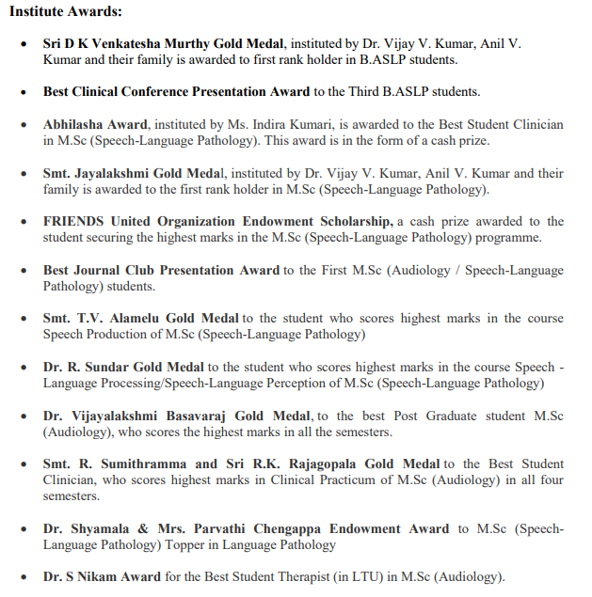
Awards for Academic and Clinical Excellence
Student Support Services
All India Institute of Speech and Hearing
2021-22

Slide 67
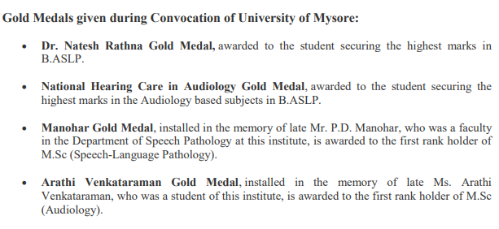
Awards for Academic and Clinical Excellence
Awards & Laurels
All India Institute of Speech and Hearing
2021-22

Slide 68
AIISH Alumni Association
The alumni association has been registered as AIISH Alumni Association (AAA) (Reg. No. 182:11-12 dated 9.9.2011).
The member of registered members has shown a steady increase over the years.
The social networking sites they have established enable constant communication among the members and with their parent faculty and the institute. So far there are 140 life members in the association.
The AIISH Alumni Association (AAA) serves as a forum to promote and foster the relationship between the alumni, present students, staff, and the management of AIISH with the basic objective of exchanging ideas which, besides being mutually beneficial, will generally help to serve the Alma Mater in achieving excellence in technical education and contribute to improving the quality of life of the general public as visualized by founder fathers of AIISH.
Others
All India Institute of Speech and Hearing
2020-21

Slide 69
Salient Features/ Best Practices
Unique Curriculum
Exclusive Academic Section
Distinctive Research Labs related to Communication Disorders
Model Pre-School
Cultural Centre with dedicated building
Full-fledged Sports Facilities
Exclusive Academic Section
State-of-the Art Infrastructure
Hearing Aid Dispensing
Outreach Service Centers
Newborn Screening Centers
All India Institute of Speech and Hearing
2020-21

Slide 70
Other Activities
Implementation of Right to Information Act, 2005
Personnel Management
Reservation Policy Implementation
Technological Consultancy Services
Official Language Implementation
All India Institute of Speech and Hearing
2020-21

Slide 71
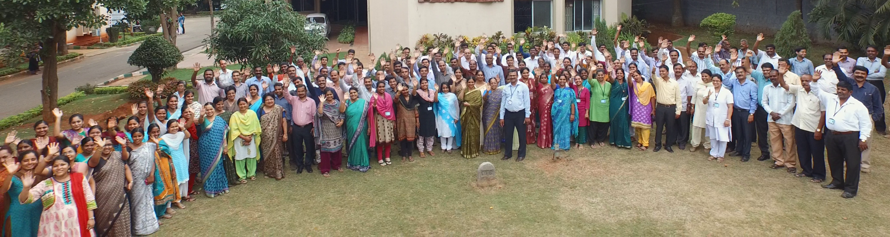
Personnel
Total Staff Strength
366
Regular Staff
173
Group-A 46; Group-B 65, Group-C 47 & Multi-tasking staff 15
Contract Staff
110
Professors 10
Associate Professors 21
Assistant Professors 17
Outsourced
140
Faculty
48
All India Institute of Speech and Hearing
2021-22

Slide 72
Financial Highlights
Grant Received
Year | Non-Plan | Plan | Total
2012-13 | ₹ 10, 14, 12, 383.00 | ₹ 25, 41, 48, 026.00 | ₹ 35, 55, 60, 409.00
2013-14 | ₹ 12, 41, 16, 000.00 | ₹ 41, 51, 08, 000.00 | ₹ 53, 92, 24, 000.30
2014-15 | ₹ 14, 46, 49,000.00 | ₹ 41, 93, 49, 000.00 | ₹ 56, 39, 98,000.00
2015-16 | ₹ 15, 71, 54, 000.00 | ₹ 33, 38, 19, 000.00 | ₹ 49, 09, 73, 000.00
2016-17 | ₹ 16, 77, 09,000.00 | ₹ 34, 59, 31, 000.00 | ₹ 51, 36,40,000.00
Expenditure
Year | Non-Plan | Plan | Total
2012-13 | ₹ 15, 43, 73, 761.30 | ₹ 11, 52, 78, 979.00 | ₹ 26, 96, 52, 740.30
2013-14 | ₹ 16, 62, 42, 555.30 | ₹ 10, 95, 97, 278.00 | ₹ 27, 58, 39, 833.30
2014-15 | ₹ 19, 35, 59, 080.33 | ₹ 12, 92, 34, 489.00 | ₹ 38, 36, 46, 713.93
2015-16 | ₹ 13, 35, 59, 803.70 | ₹ 14, 11, 21, 864.50 | ₹ 38, 13, 18, 867.51
2016-17 | ₹ 19, 51, 22, 389.13 | ₹ 15, 79, 75, 420.00 | ₹ 40, 19, 55, 812.88
Year | Income Generated
2012-13 | ₹ 4, 17, 45, 165.50
2013-14 | ₹ 4, 23, 51, 522.80
2014-15 | ₹ 6, 08, 53, 144.60
2015-16 | ₹ 6, 47, 87, 129.48
2016-17 | ₹ 4, 25, 03, 969.13
All India Institute of Speech and Hearing
2020-21

