Slide 1
All India Institute of Speech & Hearing, Mysuru
Welcomes
Smt. K. K. Shailaja Teacher,
Former Minister of Health,
Hon’ble Member of Legislative Assembly
Govt. of Kerala
22.11. 2021

Slide 2
All India Institute of Speech and Hearing, Mysore
An autonomous institute
Under
Ministry of Health and Family Welfare,
Govt. of India
----------------
Founded in 1965
----------------
Introduction

Slide 3
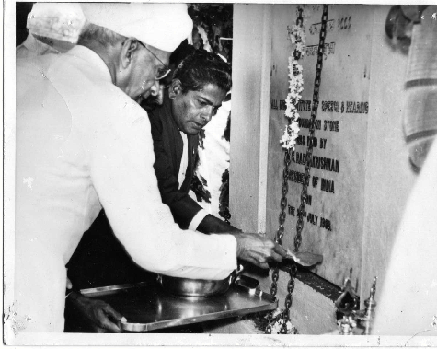
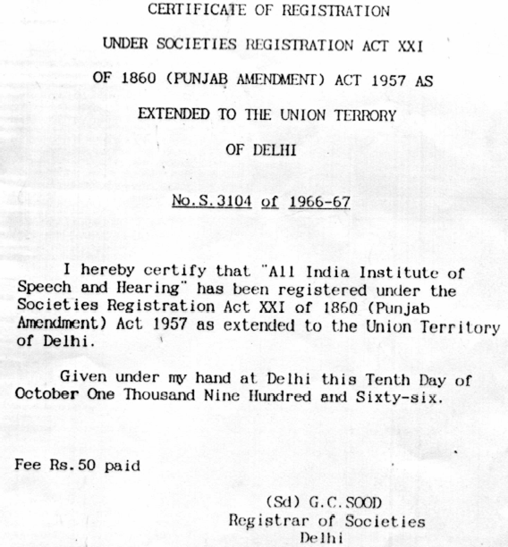
AIISH GENESIS
Foundation stone laid on
25.07.1966
by Dr. S. Radhakrishnan
Hon’ble President of India
A registered Society under
Indian Societies Registration Act of XXI of 1860 (Punjab Amendment, 1957) w.e.f 10th October 1966

Slide 4
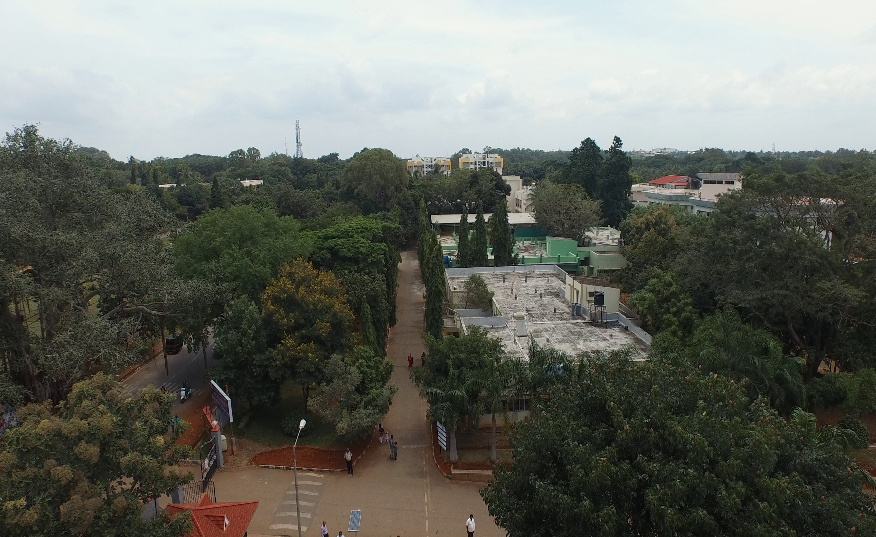
Physical Infrastructure
Campuses
Main Campus, Naimisham
29 acres
Panchavati Campus
(500m away from the main campus)
5 acres
Gents Hostel
International Guest House
Sports complex
Varuna Campus (new)
10 acres (14 km away from the main campus)
Model pre-school
11 Departments
Audiology
Clinical Psychology
Clinical Services
Electronics
ENT
Special Education
Speech Language Pathology
Speech Language Sciences
POCD
TCPD
Material Development
13 Outreach Service Centers (19 upcoming)
Eight DHLS centres and
14 New Born Screening Centers

Slide 5
Vision, Mission, Objectives
Mission
To promote, sustain and provide globally - competitive,
compassionate, ethically sound human resource,
quality education,
original research,
clinical services, and
public awareness in the field of communication disorders.
Vision
To be a world-class institution for human resource development, conducting need-based research, striving for excellence in clinical services, creating awareness and public education in the field of communication disorders.
Objectives
(1) Manpower generation in the area of
communication and its disorders,
(2) conducting research,
(3) rendering clinical services and
(4) educating the public on issues related to communication disorders.

Slide 6
Communication Disorders
Speech disorders
Language disorders
Hearing disorders

Slide 7
Speech Disorders
Voice Disorders
Articulation Disorders
Fluency Disorders

Slide 8
Language Disorders
Childhood language disorders- delay in the acquisition of language ,intellectual disorder, Autism spectrum disorders, learning disability
Adult language disorders – Aphasia, dementia

Slide 9
Communication Disorders
Hearing Disorders
Congenital ( from birth)
Acquired ( due to accidents, infections )
Aging
Vertigo
Tinnitus
NIHL
CAPD
Rehabilitation
Based on the condition
Medical treatment – medication / surgery ,
Hearing aid and cochlear implant followed by speech language Therapy
Other rehabilitation by team members

Slide 10
Causes for the Speech and Hearing Problems
During Pregnancy : Complications such as excessive vomiting , malnutrition, Vitamin Deficiency, Measles , Mumps , Frequent radiation, drugs , stroids, convulsions , drinking and smoking
Delivery: Forceps delivery, prolonged delivery , asphyxia ,
After the delivery : Neonatal jaundice , convulsions, low birth weight

Slide 11
Rehabilitation- Team work
Paramedical
Audiologist and Speech language pathologist
Special educator
Physio therapist
Occupational therapist
Clinical psychologists
Medical Professionals
ENT doctors
Consultants
Plastic surgeon
Pediatrician
Neurologist
Orthodentist
Physician

Slide 12
OBJECTIVES
Manpower Development
Clinical Services
Research
Public Education & Outreach Services

Slide 13
Objective 1
Manpower Development
The oldest institute in the country
Started M. Sc in Speech and Hearing in 1966
1 Post Doctoral Program
5 Ph.D programs
[Aud, SLP, S & H, Spl. Edn (HI), Linguistics]
3 Post Graduate programs
[M.Sc (Aud), M.Sc (SLP), M.Ed. Spl.Ed (HI)]
2 Under Graduate programs
[BASLP, B.Ed. Spl.Ed (HI)]
2 PG Diploma programs
[Clinical Linguistics,
Forensic Speech Science and Technology]
3 Diploma programs
[DHAET, DHLS & DECSE (HI)]

Slide 14
Institute with a difference
Best Institute in South East Asia to cater exclusively to persons with speech and hearing impairment.
The institute with largest academic output in Asia in the field of speech and hearing.
Academic Program | Number of students passed till date
Graduate program | 1766
Post Graduate program | 1553
Doctoral program | 107

Slide 15
Objective 2
Clinical Services
Number of Patients: 2020-21
43397
New patients: 13432
Follow up patients: 29965
Hearing evaluation
Newborn Screening
Hearing aid prescription and fitting
Cochlear implant mapping
Voice Evaluation
Speech production and articulation assessment
Speech therapy
11 Special clinics/ Units
Preschool training centre

Slide 16
Objective 2
Clinical services
HEARING
Hearing evaluation & Newborn Screening
Hearing aid prescription and fitting
Earmould making
Cochlear implant mapping

Slide 17
Objective 2
Clinical Services
ENT
Ear examination
Throat examination
Nasal examination
Vertigo clinic

Slide 18
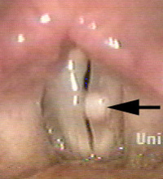
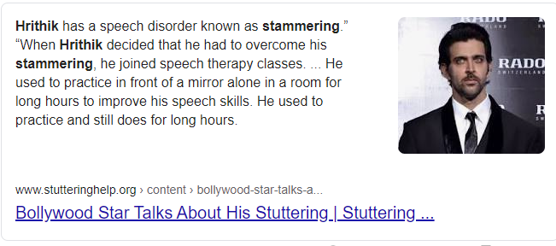
Speech Disorders
Delay in the development of speech and language
Poor articulation- cleft lip and palate
Voice problem – Cancer of larynx, loss of voice, nodule, polyp
Stammering/ stuttering
Speech problem due to Parkinsons disease, cerebral palsy

Slide 19
Objective 2
Clinical Services
SPEECH
Voice Evaluation
Speech production and articulation assessment
Swallowing assessment
Assessment of lung capacity

Slide 20
Objective 2
Clinical services
THERAPY
Speech therapy
Voice therapy
Auditory verbal therapy
Occupational therapy and physiotherapy

Slide 21
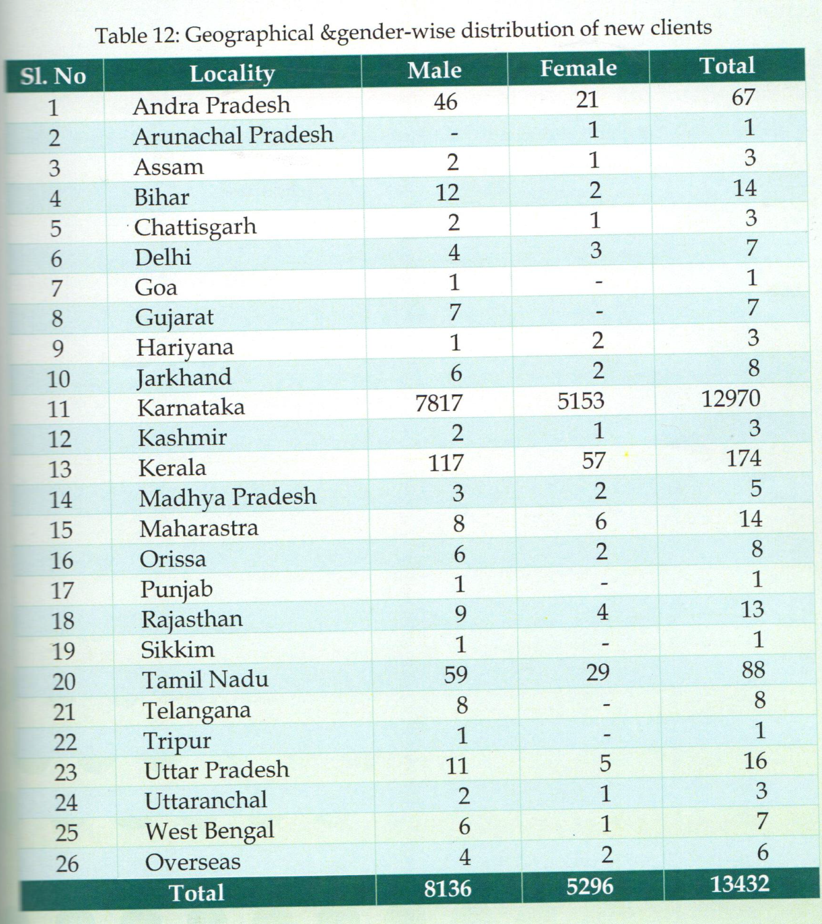
Geographical distribution of new cases 2020-21

Slide 22
Objective 2
.
Clinical services
SPECIAL CLINICS/ UNITS
AAC – Alternative and Augmentative Communication
ASD – Autism Spectrum Disorders
CAEPLD – Clinic for Adult Elderly Persons with Language Disorders
Fluency Unit
LD Clinic – Learning Disability Clinic
MSD – Motor Speech Disorders
Phonology Clinic
USOFA – Unit for Structural and Oro-facial Anomalies
Voice Clinic
Implantable Hearing Devices Unit
Hearing Devices Dispensing Unit
U-SAFE: Unit for sensory adaptation for Education
SUMERU: Special Use of Music in Educational Readiness and Up-building
SEA-U: Special Educational Assessment Unit

Slide 23
Objective 2
Clinical services-Client Support
PRE-SCHOOL
Services
Early stimulation / intervention services for children below 2 ½ years
Early intensive preschool training for holistic development of children in the developmental ages from 2 ½ to 6 years.
Disorders
Autism spectrum disorders,
cerebral palsy,
hearing impairment,
mental retardation, and
delayed development.
Languages
Kannada, Malayalam, Hindi and English
Malayalam Speaking Children availing our Pre-School Services
 | 2016-17 | 2017-18 | 2018-19 | 2019-20 | 2020-21
Preschool | 43 | 50 | 46 | 34 | 35
Parent Infant Program | 19 | 25 | 20 | 8 | 4
Preschool Parent Empowerment Program | 28 | 53 | 57 | 66 | 30
Curricular Support Services | 6 | 8 | 4 | 3 | 8

Slide 24
Objective 2
Clinical services-Client Support
PRE-SCHOOL
Empowering caregivers of children with communication disorders
Periodic orientation programmes for enriching parent knowledge and skill on various topics related to training children with communication disorders
Practical training in developing special teaching learning material for children with communication disorders

Slide 25
Objective 3
Research
Research Projects: 2020-21
Extramural – 12
(Funded by – DST, DBT, MHRD, ICMR, etc.)
Intramural – 46
(Funded by – AIISH Research Fund)
Doctoral Research – 95

Slide 26
Objective 3
Research
LABS
Forensic speech science and technology
Central prosthetics
Psychoacoustic
Audiology practical
Epidemiology
Articulograph
Acoustic testing
Speech & language pathology
Language science
23 Labs
Prosody
Hearing aid
Speech physiology
Phonology
Fluency
Electrical
Electrical brain imaging
Neurophysiology
Rehabilitation engineering
Speech science and swallowing
Human genetics
Electrophysiology
Electronics & instrumentation

Slide 27
Objective 4
Public Education & Outreach Services
Centers across the country
14 New Born Screening Centers
13 Outreach Service Centers
(19 upcoming)
8 Study Centers for Diploma programs
Communication Disorder Screening Camps
Monthly Public Lecture
Tele Intervention
Social Media

Slide 28
Objective 4
PUBLIC EDUCATION
CAMPS

Slide 29
Objective 4
PUBLIC EDUCATION
ORIENTATION

Slide 30
Objective 4
PUBLIC EDUCATION
OUTREACH SERVICES

Slide 31
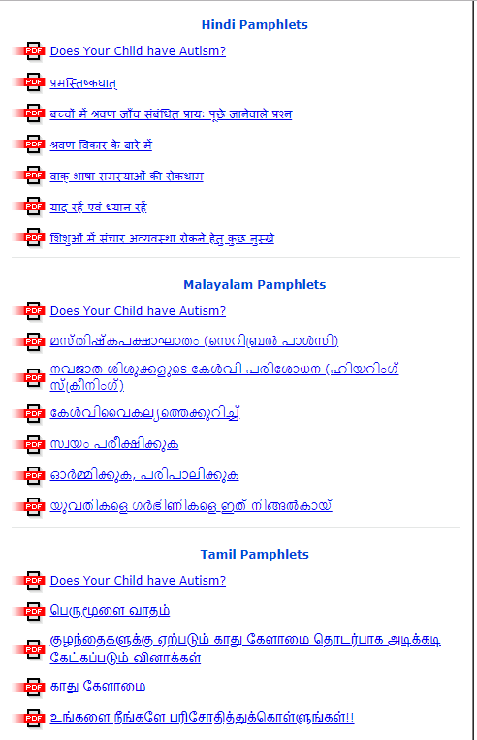
Objective 4
PUBLIC EDUCATION
MATERIAL DEVELOPMENT

Slide 32
Staff Strength
1. Regular Staff
Group | Sanctioned Strength | Filled Strength
Group A | 97 | 46
Group B | 91 | 65
Group C | 54 | 47
Group C (MTS) | - | 15
Total | 242 | 173
2. Contract Staff
Particulars | Filled Strength
Teaching Staff | 10
Non-Teaching Staff | 86
Project Staff | 14
Total | 110

Slide 33
Budget
Budget Allocation: 2020-21
131.5 Crores

Slide 34
Recognitions
Center of Excellence in the Area of Deafness (WHO)
Center of Advanced Research (UGC)
Science and Technology Institute (DST).
Center of Excellence (MoH & FW)
Centre for Advanced Research and College with Potential for
Excellence(UGC)
Accredited by NAAC with highest A Grade
ISO 9001:2015 certified
Nodal Centre for the implementation of National Programme
for Prevention and Control of Deafness (NPPCD)
Nodal Centre for Rashtriya Bal Swasthya Karyakram (RBSK) of
Ministry of Health and Family Welfare, Govt. of India.
Member of World Hearing Forum of WHO

Slide 35
New Initiative: Centre of Excellence
Sl. No | Item | Rs. in Crores
1 | Building | 73.00
2 | Staff | 21.6
3 | Furniture | 6.23
4 | Equipment | 47.64
5 | Others | 7.02
 | TOTAL | 155.49

Slide 36
Centres to be housed in the building
Five Research Centres | Center for Speech and Language Sciences
 | Centre for Hearing Sciences
 | Centre for Prevention of Communication Disorders & Epidemiological Research & Cognitive Behavioural Science in Communication Disorder
 | Centre for Rehabilitation engineering, Acoustics & Biomedical engineering (CRAB)
 | Centre for AAC & Sign Language
Five Clinical Centres | Centre for speech and language disorders in Children, Adults and senior citizens
 | Centre for persons with tinnitus and vestibular disorders
 | Centre for Hearing Impairment in Children, Adult & Senior citizens
 | Centre for persons with swallowing disorders
 | Centre for Surgical Rehabilitation of Communication Disorders
Two Outreach Centres | Publication wing/ Library and Information Centre
 | Centre for public education in communication disorders

Slide 37
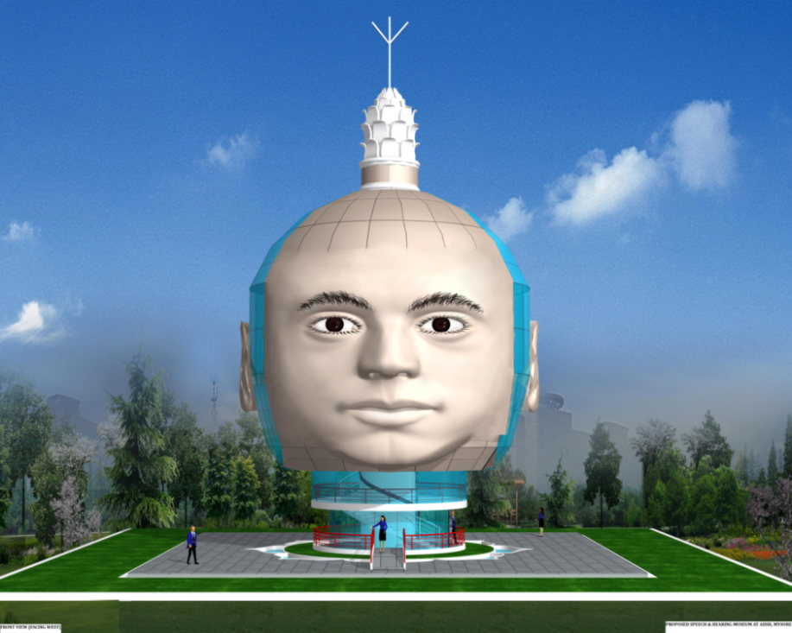
New Initiative: Speech and Hearing Museum
Reckoned to be the first of its kind in the world
Unique architectural Design
Innovative way of exhibiting : Touch, Feel & Learn
Holistic approach – normal physiology, disorders,
prevention and rehabilitation
Basic & Advanced Sections for general and
professional visitors
Accessibility

Slide 38
New Initiative
Setting up AIISH Like institutions across the country
Procedure
State Govt. should provide 15-20 acres of Land free of cost.
State Govt. should send a formal request to Secretary, MoHFW,
New Delhi with a copy to Director, AIISH, Mysore.
AIISH will prepare a DPR and submit to MoHFW for approval
If approved, AIISH will set up the institute and mentor it for 5 years
Ongoing
AIISH Kanpur – Construction of the building initiated.
AIISH Agartala – State Govt. allocated the land.
AIISH Raipur – State Govt. has identified the land

Slide 39
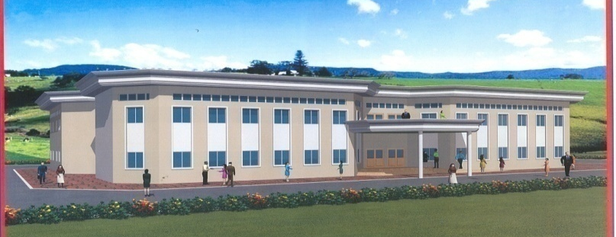
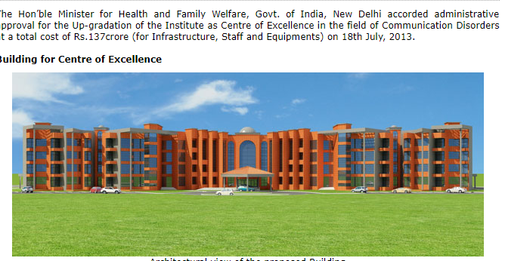
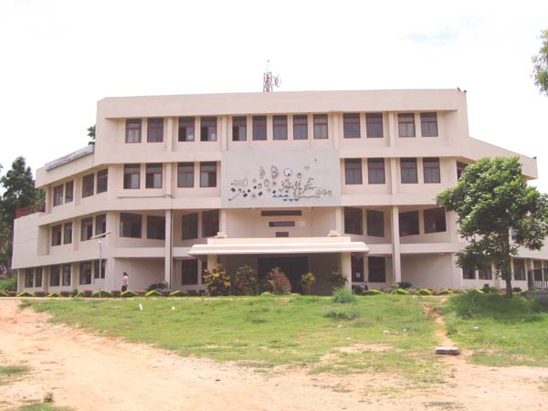
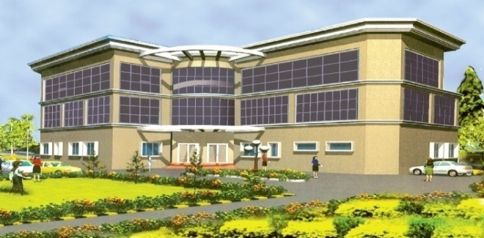
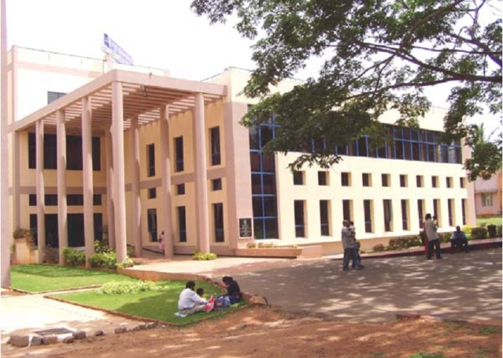
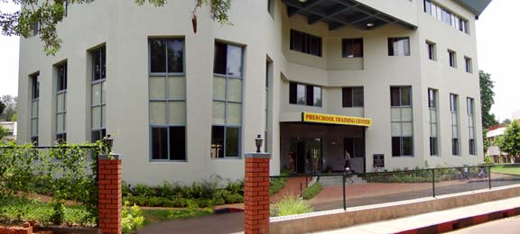
www.aiishmysore.in

