Slide 1
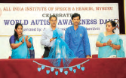
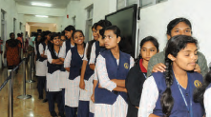
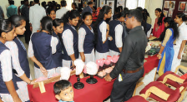
2019-20
Page 7 – Autism Awareness day
Page 10 – Open day

Slide 2
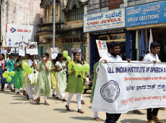
Page 11 – Walkathon
Page 12 – hearing aid repair camp

Slide 3
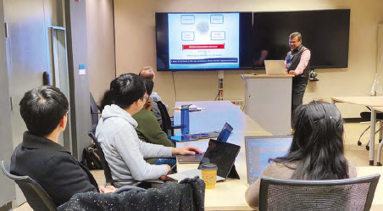
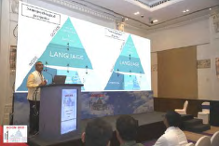
Page 25 – Dr. Ajish’s photo
Page 26 – Dr. Goswami’s photo

Slide 4
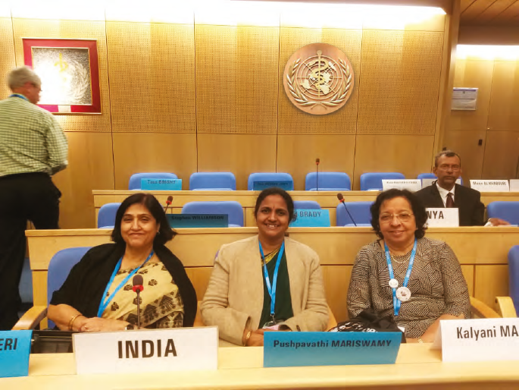
Page 39 – Director at WHO

Slide 5
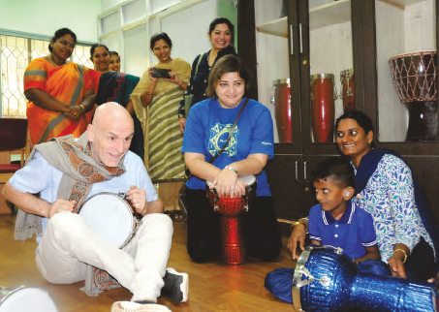
Page 42 – Workshop seminar

Slide 6
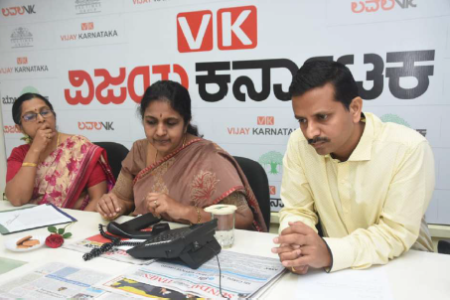
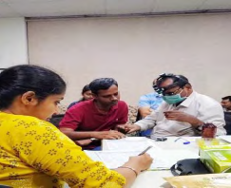
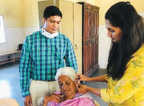
Page 118 – phone in programme
Page 121 & 122 – Industrial screening & elderly screening

Slide 7
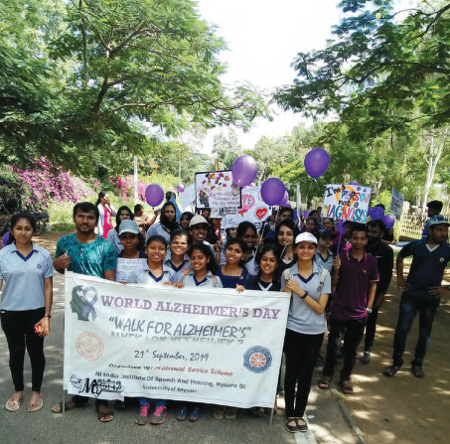
Page 130 – walkathon

Slide 8
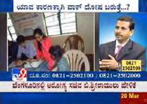
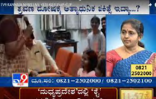
Page 135 – TV programme

Slide 9
Page 136 – Social media

Slide 10
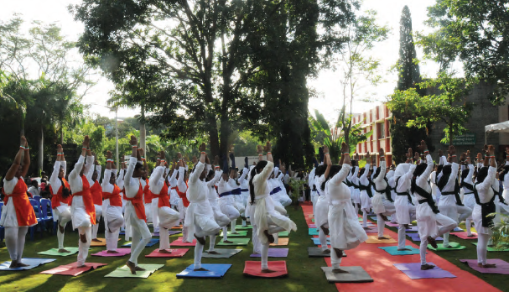
Page 138 – yoga day celebration

Slide 11
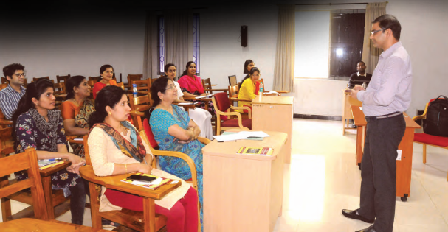
Page 144 – OLIC

Slide 12
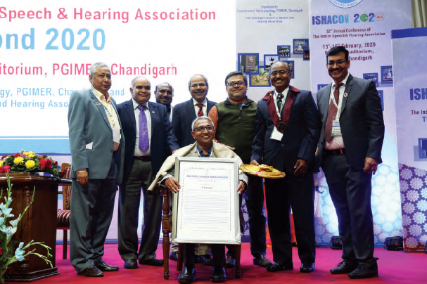
Page 148 – Dr. Goswami’s award

Slide 13
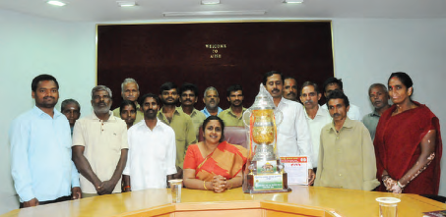
Page 157 – Horticulture trophy

Slide 14
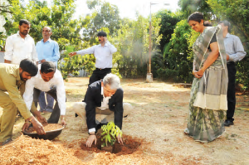
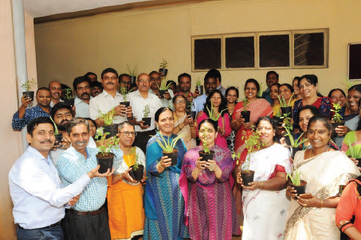
Page 163-164
Swachh bharat

