Slide 1
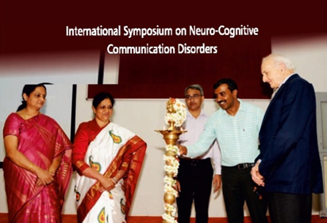
Page-8 - Golden jubilee celebration
Page- 15 –
International Symposium on Neuro Cognitive Communication Disorder

Slide 2
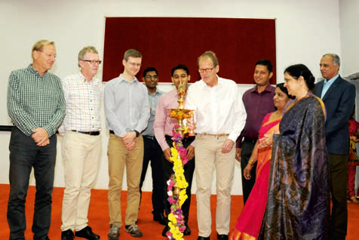
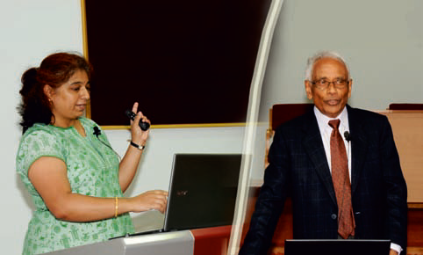
Page-19 –
International Seminar on hearing science
Page- 20 –
Guest lectures from AIISH alumni

Slide 3
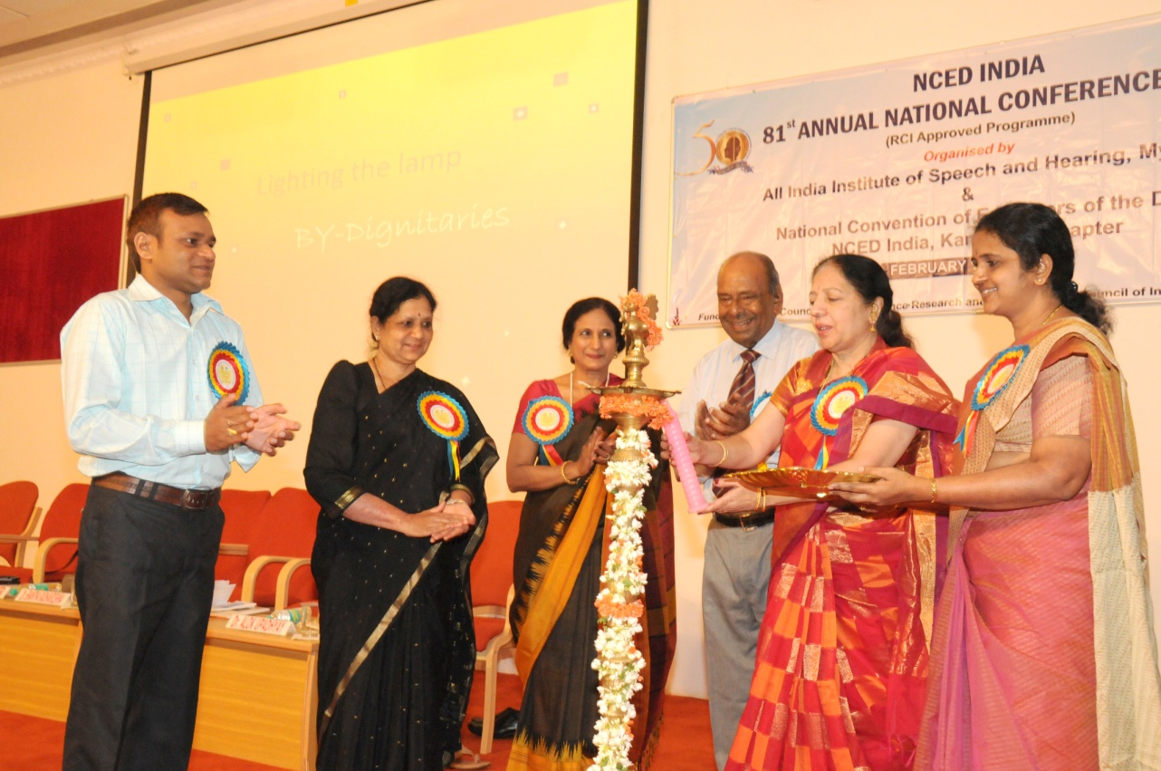
Page - 25
NCED Conference
Page – 45
Information on Peer Evaluation

Slide 4
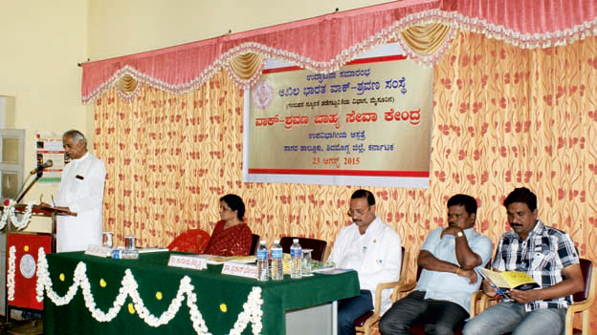
Page – 113 – OSC inauguration

Slide 5
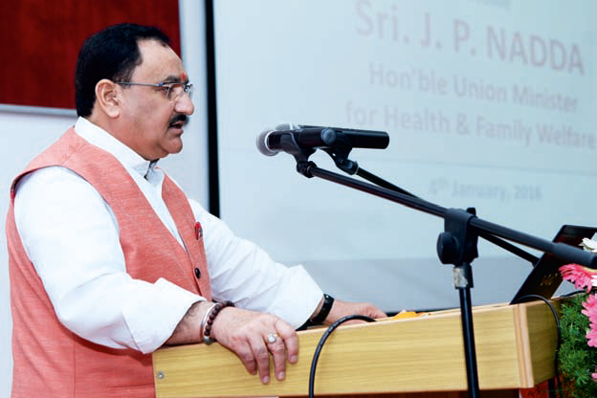
Page – 117 – Orientation to Asha Workers

Slide 6
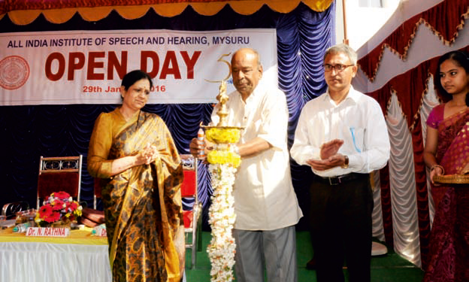
Page – 117 – Orientation to Asha Workers

Slide 7
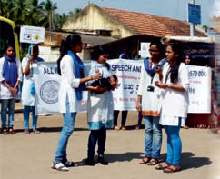
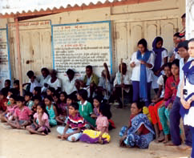
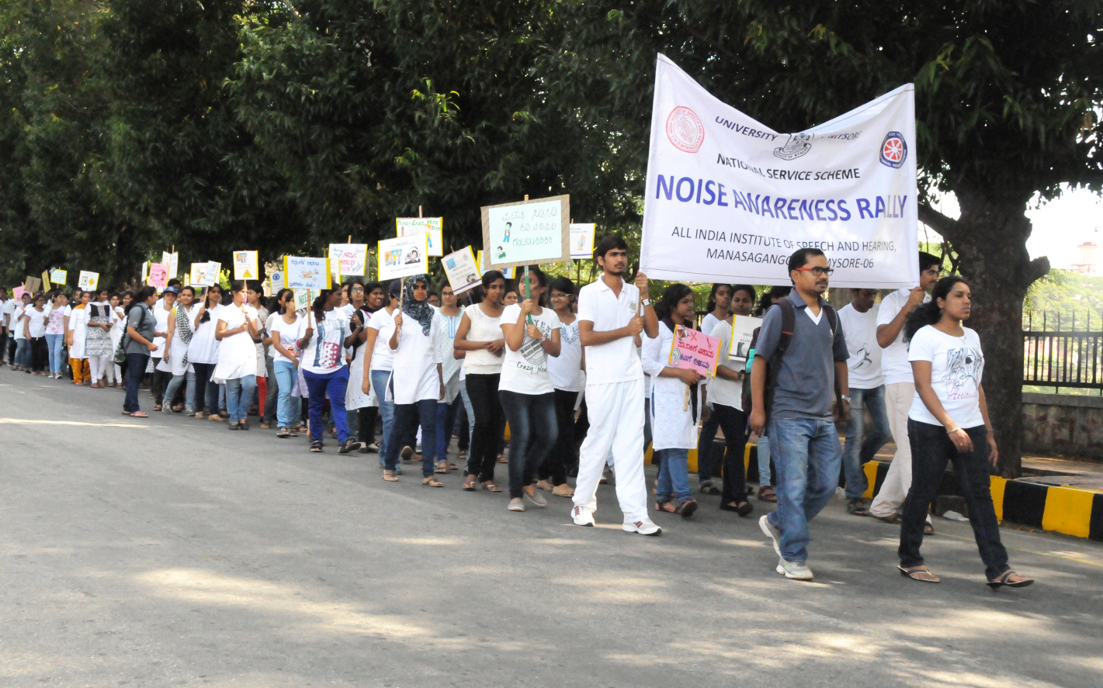
Page – 128 – Streetplay & Noise Awareness rally

Slide 8
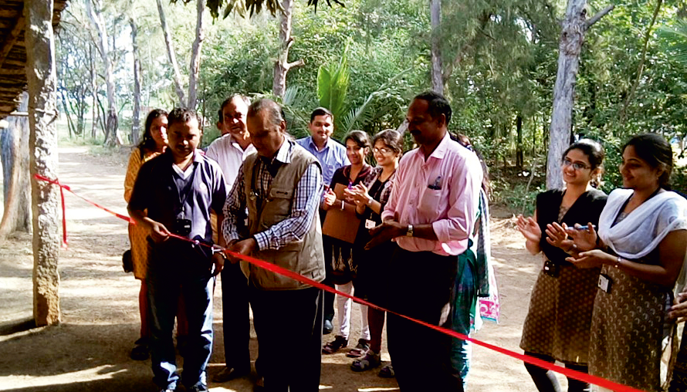
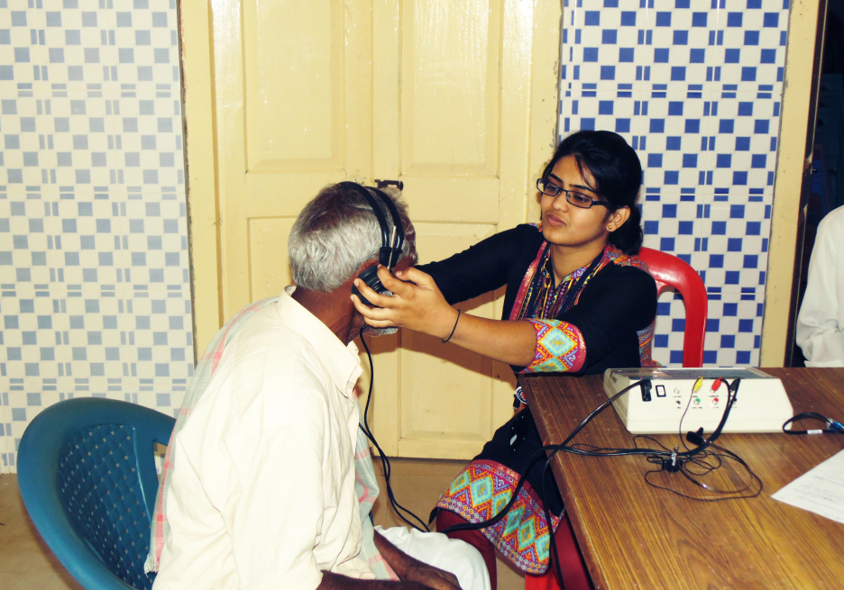
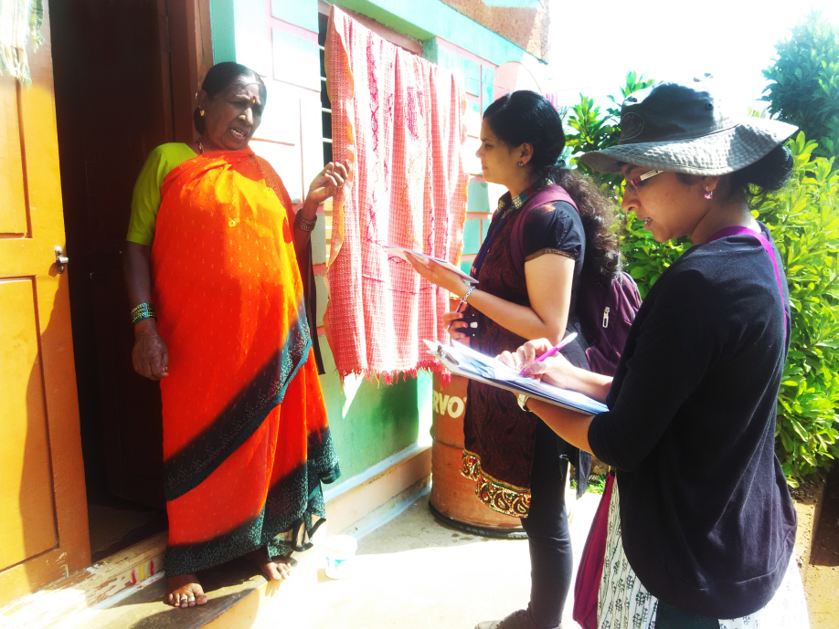
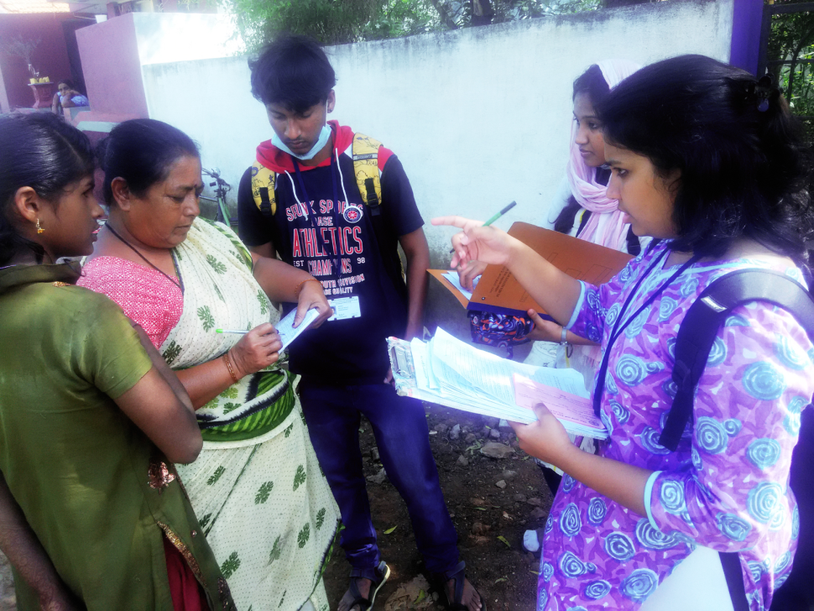
Page – 139, 140 – NSS Page

Slide 9
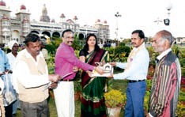
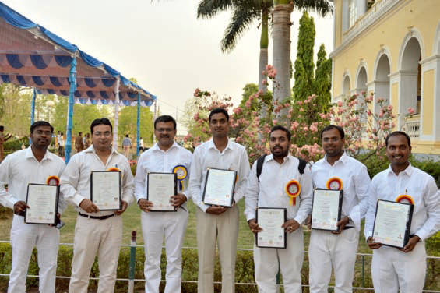
Page – 147 – Horticulture Award
Page – 149 – Ph.D. Awardees

