Slide 1
Members of Internship and Placement Cell
Name | Portfolio
Dr. Geetha C | Chairperson
Mrs. Sahana V | Member
Mr. Vikas M D | Member

Slide 2
Number of BASLP Internship students

Slide 3
Number of BASLP External students

Slide 4
Number of students placed

Slide 5
Number of posts advertised

Slide 6
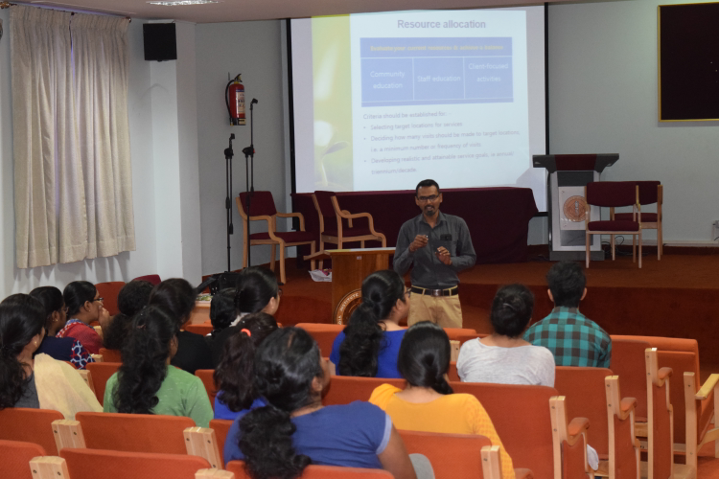
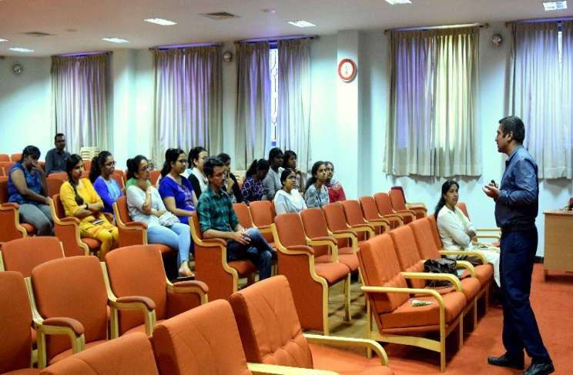
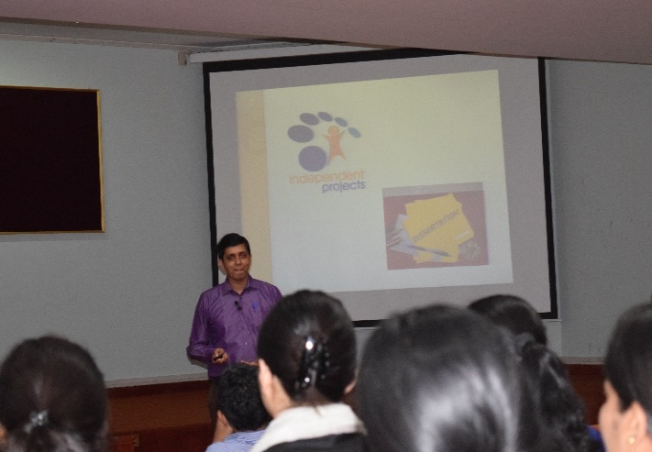
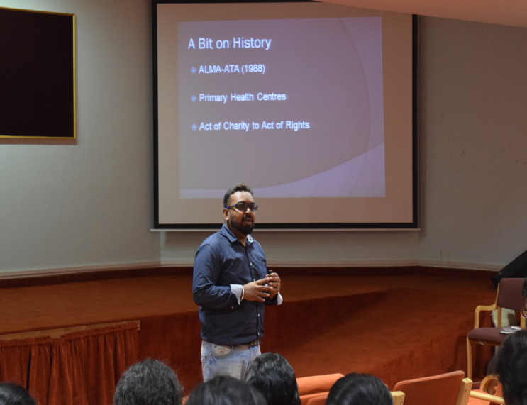
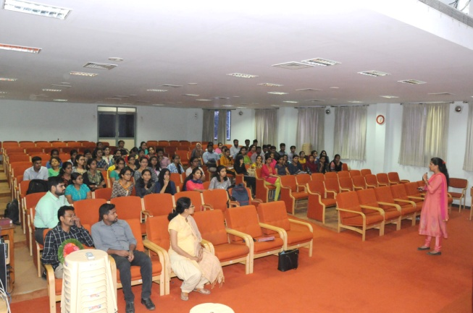
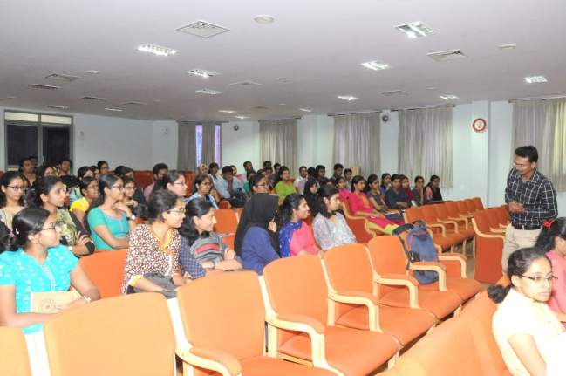
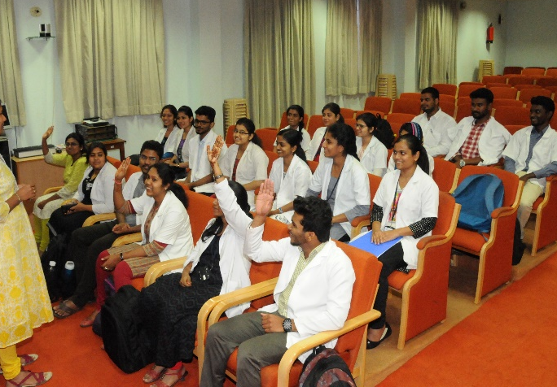
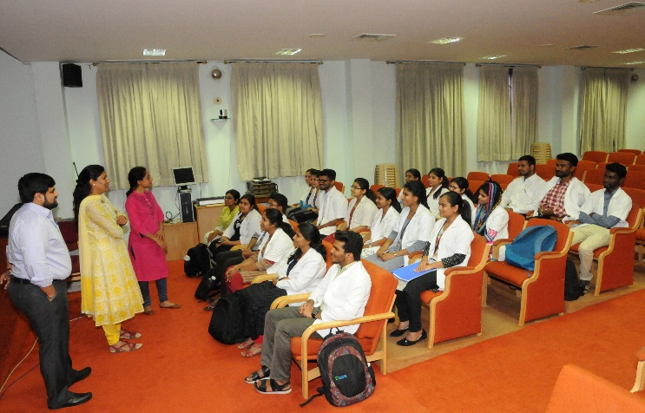
Orientation to Internship students

Slide 7
Working hours Tuesdays & Thursdays
Afternoon

