Slide 1
Research at AIISH
AIISH is recognized as
- Centre for Advance Research by UGC
- Science and Technology Institute by DST.

Slide 2
Centre for Research & Development
To promote research, ensure quality & ethics in research

Slide 3
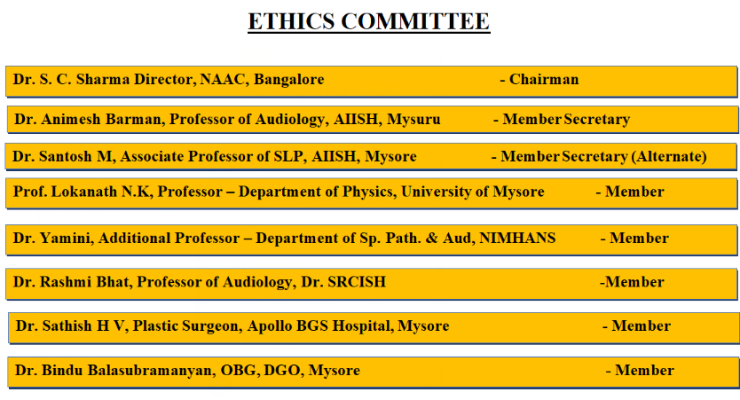
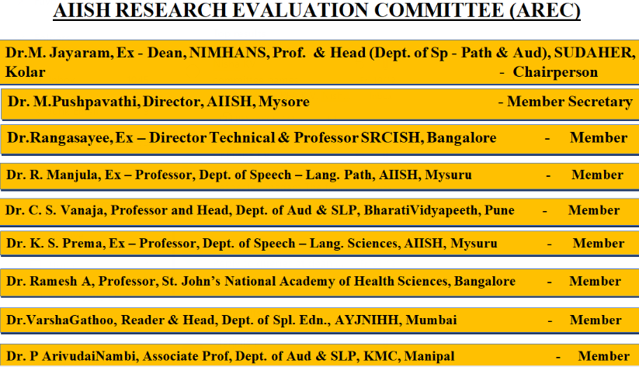

Slide 4
Research at AIISH
Research in the area of communication disorders
One of the major objectives
Vision: to conduct need-based research
Mission: to promote, sustain and provide original research
To achieve this:
Labs with good infrastructure having state-of-the-art equipment (Electrical brain imaging, next gen sequencing lab, swallowing lab) , human resource
to encourage large scale research and longitudinal studies, the institute extended the grant for ‘AIISH Research Fund’ from one year to three years duration
Collaborative research at National and International levels to meet global standards
Journals & books in Library & Information center
ICT application for research (softwares, statistical tools, plagiarism sw)

Slide 5
Research activities at AIISH
Faculty / Staff members level
Student level
Hard core course at PG level
Soft core course – Dissertation
Journal Club
Ph.D.
Scientific papers in
National and international scientific fora
Peer reviewed journal publications
Student Research at AIISH, a serial publication based on the postgraduate research at the Institute.
Scientific papers in
National and international scientific fora
Peer reviewed journal publications
Projects
Extramural (Govt: DST, DBT…)
Intramural (AIISH Research Funds)
19 faculty recognized as Ph.D. Guides of Mysore Univ. & some in External Univ.

Slide 6
No. of faculty members recognized as Guides for Ph.D. (UoM)
2019-20 | 2018-19 | 2017-18 | 2016-17 | 2015-16
20 | 19 | 17 | 16 | 15
Note: Faculty members are also serving as Ph.D guides in external universities
No. of faculty members awarded fellowship/ financial support for research/ collab research
2019-20 | 2018-19 | 2017-18 | 2016-17 | 2015-16
27 | 17 | 12 | 31 | 9

Slide 7
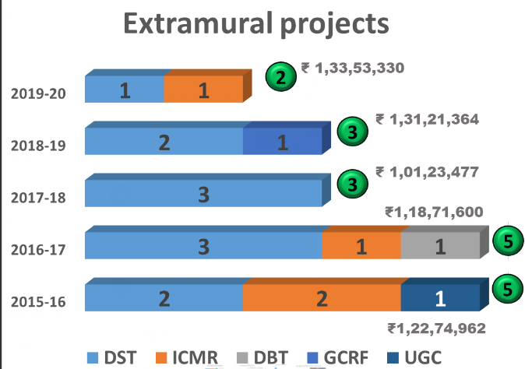
Extramural Projects (New: 6; Ongoing: 5)

Slide 8
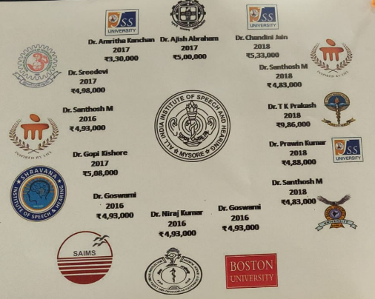
Number of collaborative projects/ activities in the last 5 years
2019-20 | 2018-19 | 2017-18 | 2016-17 | 2015-16
00 | 05 | 04 | 04 | 00

Slide 9
 | Research Collaboration
 | Collaborative activities for research, faculty exchange, student exchange, industry-internship etc. per year for the last five years
 | Year of collaboration | Name of the collaborating agency with contact details | Title of the Collaborative activity | Names of the participants | Source of financial support | Duration | Nature of the activity
 | 2018 | KMC, Mangalore | Automatic quantification of the glottal area in the stroboscopic videos using deep neural network | Mr. Rahul Krishnamurthy | ARF | 1 year | Research
 | 2018 | JSS Medical College, Mysore | Electrophysiological Assessment of Auditory and Vestibular Neural Functioning in Individuals with Diabetes Mellitus | Dr. M Bhanukumar, Mr. Vipin Ghosh & Mr. Kumari Apeksha | ARF | 1 year | Research
 | 2018 | BharatiVidyapeetha, Pune | Construction and Validation of a Short Version of the Impact Scale for Assessment of Cluttering and Stuttering (ISACS) | Dr. PallaviKelkar | ARF | 1 year | Research
 | 2018 | SOAHS, MAHE, Manipal | Vocal Dose and Immediate Effects of the Straw Phonation Exercises on Parameters of Vocal Loading in Carnatic Classic Singers | Dr. UshaDevadas | ARF | 1 year | Research
 | 2018 | JSS Medical College, Mysore | Relationship between Auditory Abilities and Iron Deficiency Anemia in Adolescent Girls | Dr. Chetak K B & | ARF | 1 year | Research
 |  |  |  | Mr. Vipin Ghosh
 | 2017 | JSS Medical College, Mysore | Feasibility of Standardized Neuropsychological tests in assessment of patients with Aphasia | Dr. Nawab A Khan | ARF | 1 year | Research
 | 2017 | Rajiv Gandhi Institute of Technology, Kottayam, Kerala | Automation of Malayalam Articulation test using automatic speech recognition techniques | Dr. Leena Mary | ARF | 1 year | Research
 | 2017 | Madanapalle Institute of Technology and Science Mandanapalle, Andra Pradesh | Motor equivalence and speech kinematics in normal and pathological speech production | Dr. NVSNM Ganesh Sinisetty | ARF | 1 year | Research
 | 2017 | Shravana Institute of Speech and Hearing, Ballari | Reading impairments in Kannada-English bilinguals individuals with fluent & non-fluent types of aphasia | Dr. Sunil Kumar Ravi | ARF | 1 year | Research
 | 2016 | SreeChitraTriunnal Institute of Medical Sciences & Technology (SCTIMST) | A Descriptive Study on the Video-Fluroscopic Measures of Neurogenic Dysphagia in Patients with Stroke and Motor Neuron Disease | Dr. Muralidharan Nair, | ARF | 1 year | Research
 |  |  |  | Ms. Manju Mohan &
 |  |  |  | Dr. Sylaja
 | 2016 | Boston University Sargent College 635 Commonwealth Ave. Boston, MA | Field-testing of ‘Constant Therapy’ in Hindi and Kannada | Dr. Swathi Kiran | ARF | 1 year | Research
 | 2016 | School of Allied Health Sciences, Manipal University | Prevalence and risk factors of voice problems and knowledge of vocal health in professional Carnatic singers and non-singers | Dr. UshaDevdas | ARF | 1 year | Research
 | 2016 | Sri Aurobindo Institute of Medical Sciences Indore, DAVV University | Effect of cochlear implantation and surgery technique on cervical vestibular evoked myogenic potential | Mr. Sachchidanand Sinha | ARF | 1 year | Research

Slide 10
Eg. Of MoU:

Slide 11
To encourage collaborative research…
Interaction with AIISH Alumni working in academic and research centres abroad has been initiated to encourage collaboration
List of researchers and labs across globe are collected & being updated
List of reviewers in different areas of communication disorders prepared & being updated

Slide 12
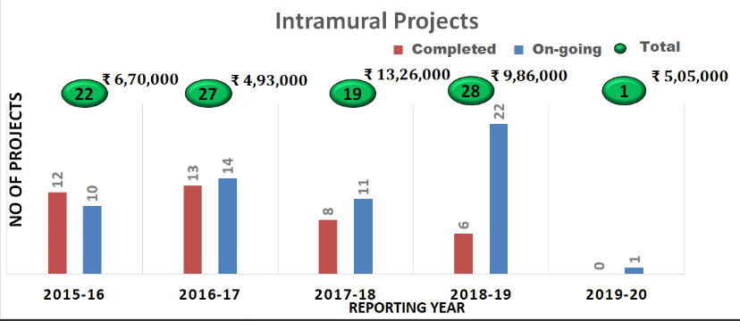
Intramural research projects: AIISH Research Funds (ARF)
Established in 2001
To promote multidisciplinary research
AIISH Research Evaluation Committee (AREC)
AIISH Ethics Committee

Slide 13
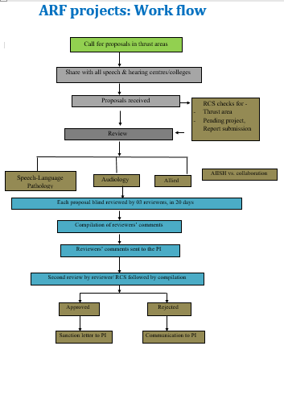
ARF Project – Work flowchart

Slide 14
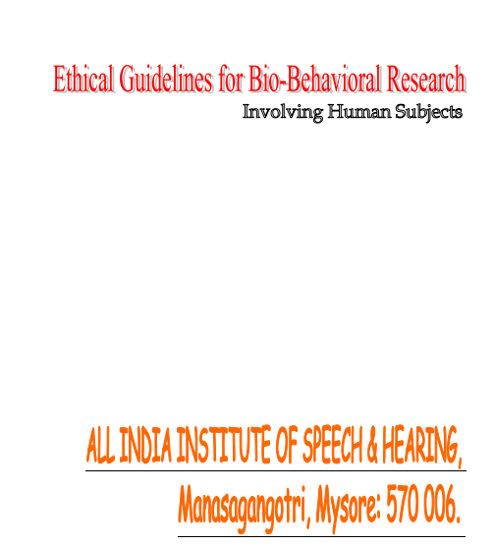
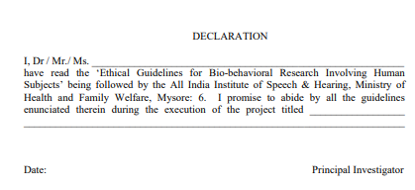
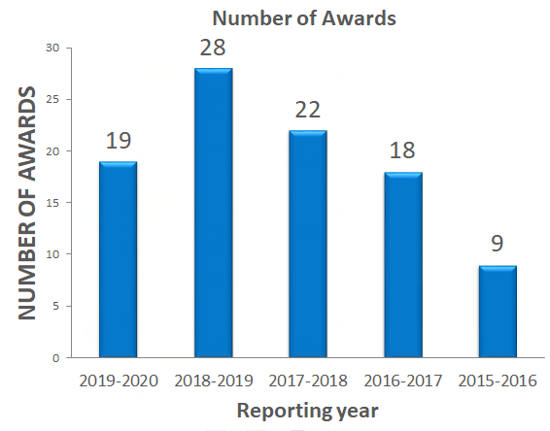
Research Publications & Awards (Code of ethics for research ensured)
There is an AIISH ethical committee to oversee implementation of research projects & student research work
to preserve and protect the rights, privileges, power and liberties of subjects.
several principles and standards of behavior that every research practitioner needs to adhere.
Guidelines given for research ethics are followed
Plagiarism check - starting from research proposal stage to report submission stage

Slide 15
Thank You..

