Slide 1
DEPARTMENT OF PREVENTION OF COMMUNICATION DISORDERS
(POCD)
प्रेषण विकृति रोकथाम विभाग​
Out-reach department launched in the year 2008
To reach people directly and facilitate prevention of communication disorders
Establishment
Motto
Dr. N. Sreedevi
Prof. & Head
Department of POCD
AIISH, Manasagangothri, Mysuru -6.

Slide 2
Head of the department
On campus
NBS
Faculty – 02
(Deputed)
ENT specialist - 01
Audiologist Grade I- 08
Audiologist Grade 2- 04
MTS -01
OSC
SHT- 04
SHT- 06
Audiologist Grade I -09
Audiologist Grade I- 07
SLP Grade I- 12
Total: 55

Slide 3
World Health Organization, 2021
Census, Government of India, 2011
430 million of the world’s population have disabling hearing loss
34 million (9%) of this group are children
Disability in India – approx. 3%
Hearing impairment (19%) listed as the second leading disability
Speech impairment (7.5%) as the fifth highest disability
WHO Future Estimates
In 2050,
2.5 Billion world wide -1 in 4 people- will have hearing loss!!!!
Notes:
WHO (2018) he prevalence of hearing impairment (HI) in India is around 6.3% (63 million people suffering from significant auditory loss)

Slide 4
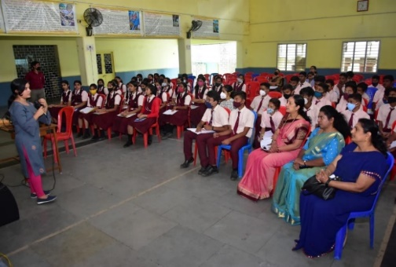
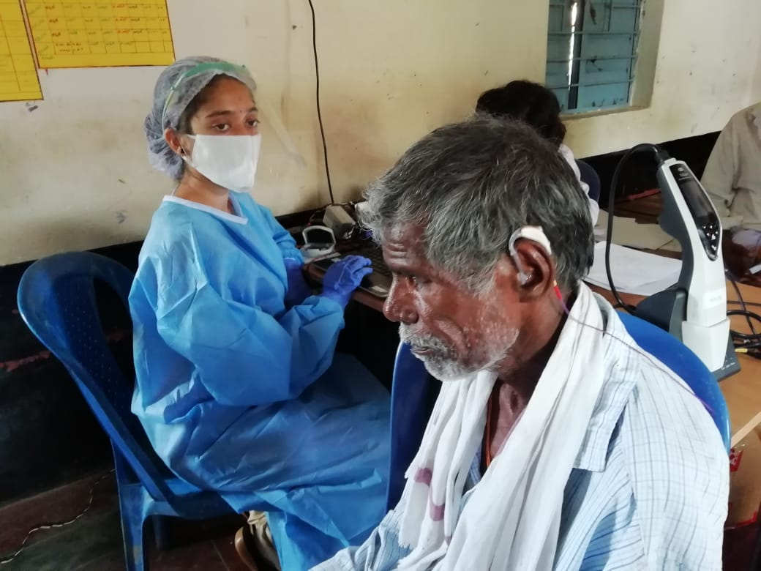
I
Primary Prevention
II
Secondary Prevention
III
Tertiary Prevention
IV
Epidemiological Research
V
Human Resource Development
Sensitizing the public on communication disorders and their prevention
Early identification and assessment of communication disorders
Early rehabilitation and management of communication disorders
Carrying out epidemiological research related to communication disorders
Out reach clinical training of UG and PG students
Objectives of the department

Slide 5
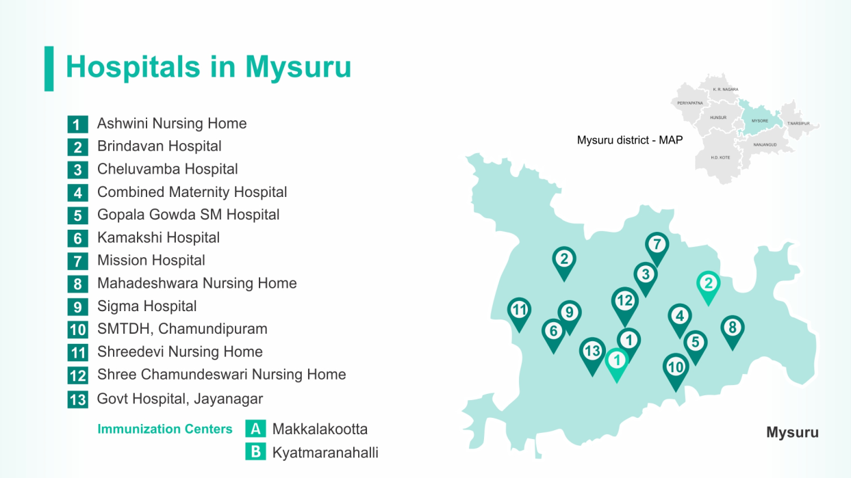
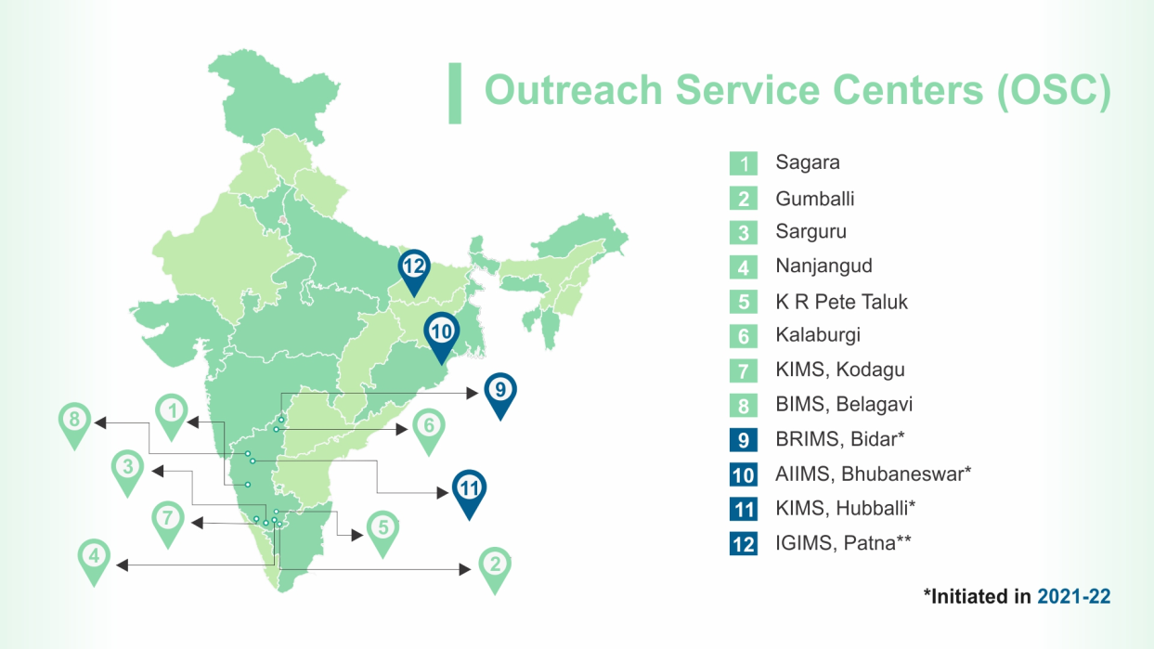
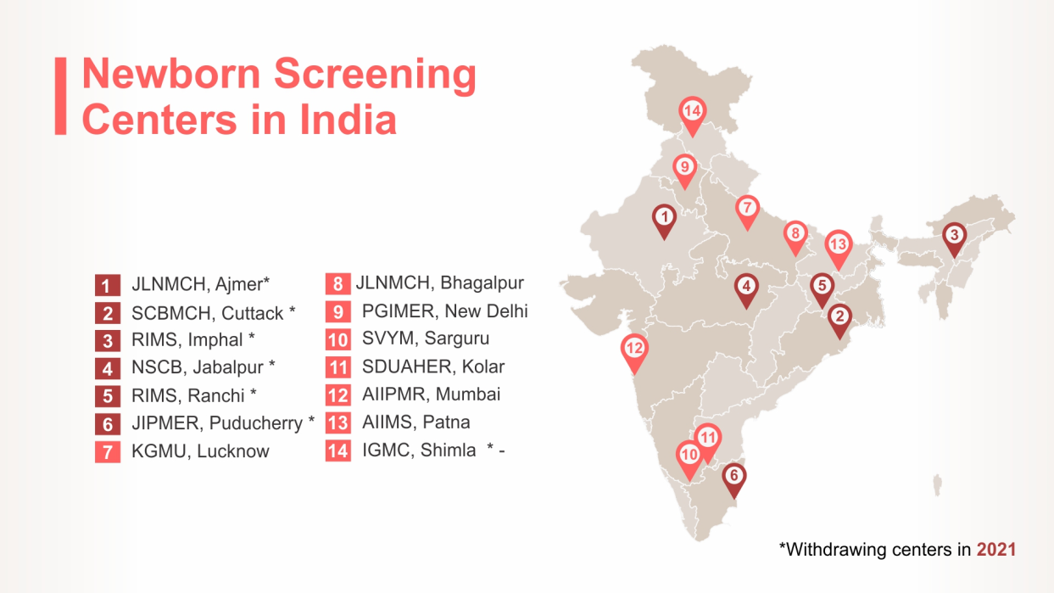
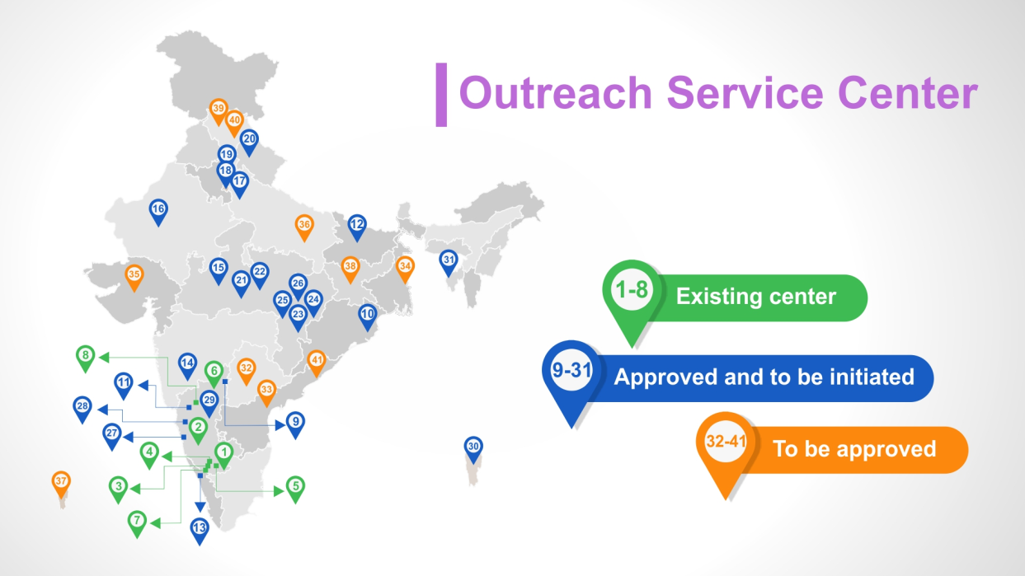
Notes:
We work to achieve these objectives not just at AIISH but many centers throughout India.

Slide 6
Primary Prevention
Radio/TV talks/ Media/ Newspaper Articles
Secondary Prevention
Newborn Hearing Screening
School Screening
Industrial Screening
Elderly & Bedside Screening
Tertiary Prevention
Speech & Language Therapy
Hearing Aid Issue
ENT Services
Counselling & Guidance
Orientations/ Webinars
Pamphlets/Posters
Street Plays & Rallies
Assessments at OSCs

Slide 7
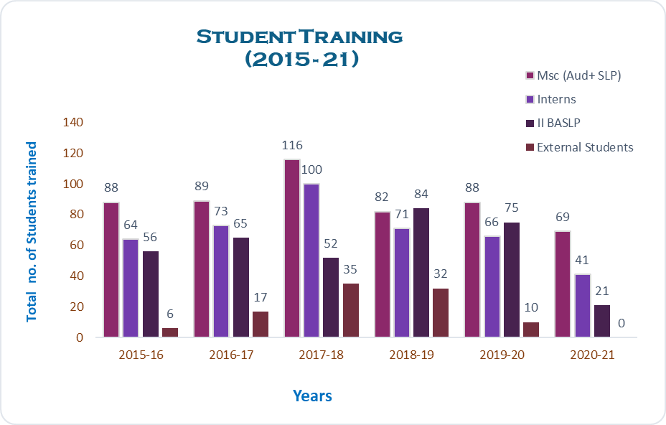
Students Degree | Numbers
Under graduates | 706
Post graduates | 463
External Interns | 100
Total | 1269
HUMAN RESOURCE DEVEOPMENT (2015 to 2021)
Notes:
As part of human resource development, clinical training on prevention, early identification, and community based rehabilitation of communication disorders were provided for undergraduate and postgraduate students.

Slide 8
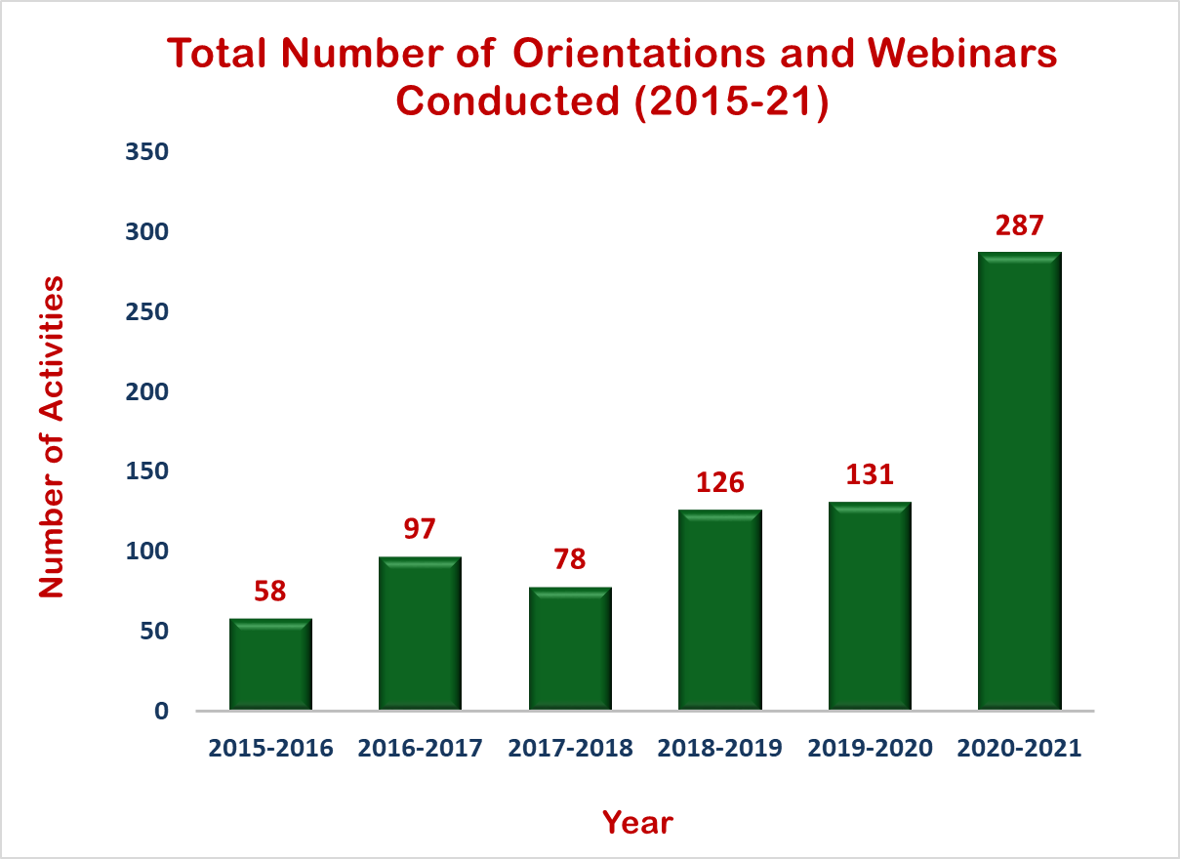
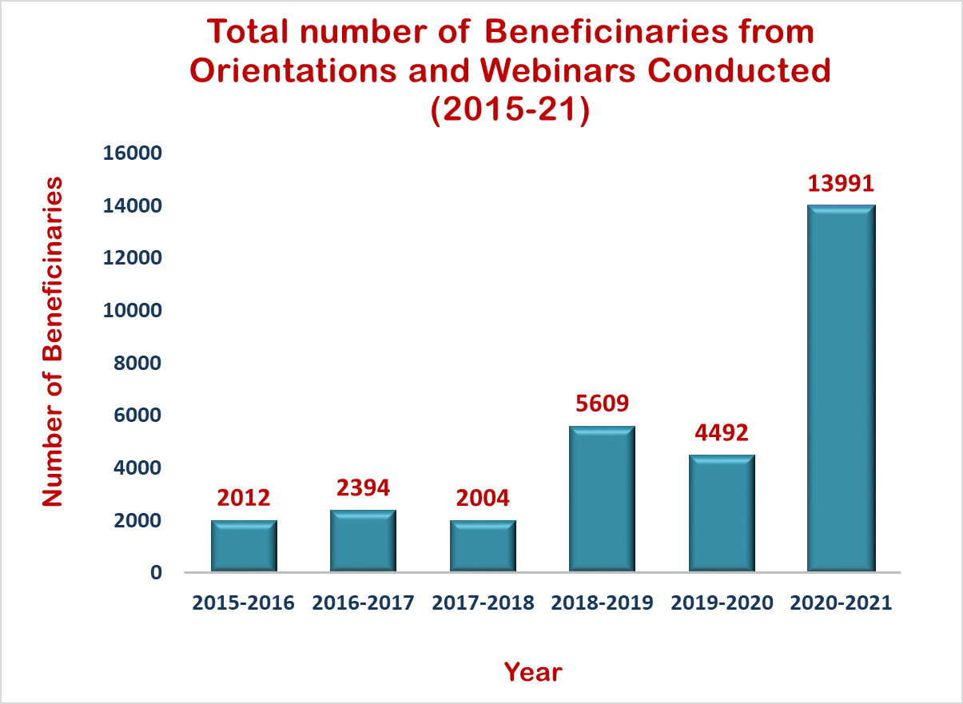
TOTAL
Activities | 777
Beneficiaries | 30502
PRIMARY PREVENTION: PUBLIC EDUCATION (2015 to 2021)
Notes:
Public education involves raising awareness about different types of communication disorders, their prevention, early detection, appropriate referral, and timely management among the general public and various other professionals like …………

Slide 9
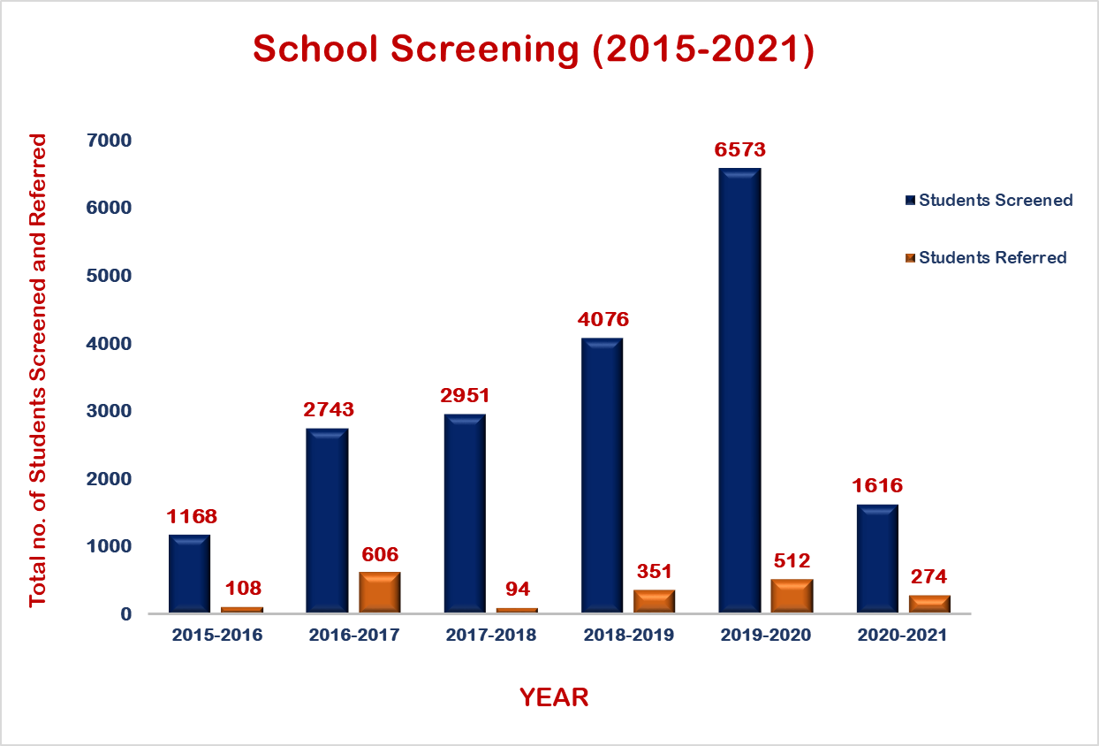
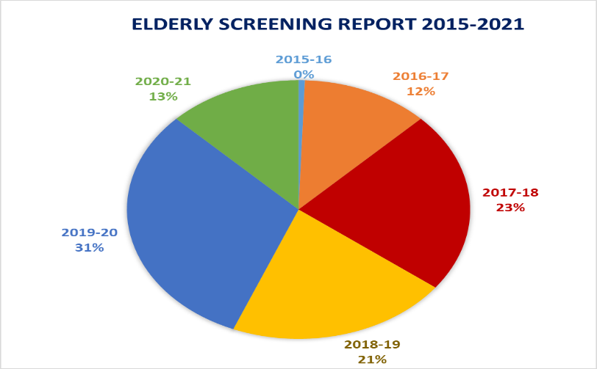
SCREENING | BENEFICIARY No.
Industrial | 2214
School | 19127
Elderly | 507
Total | 21848
SECONDARY PREVENTION: INDUSTRIAL, SCHOOL AND ELDERLY SCREENING (2015 to 2021)
Notes:
Elderly screening total number is missing in the graph

Slide 10
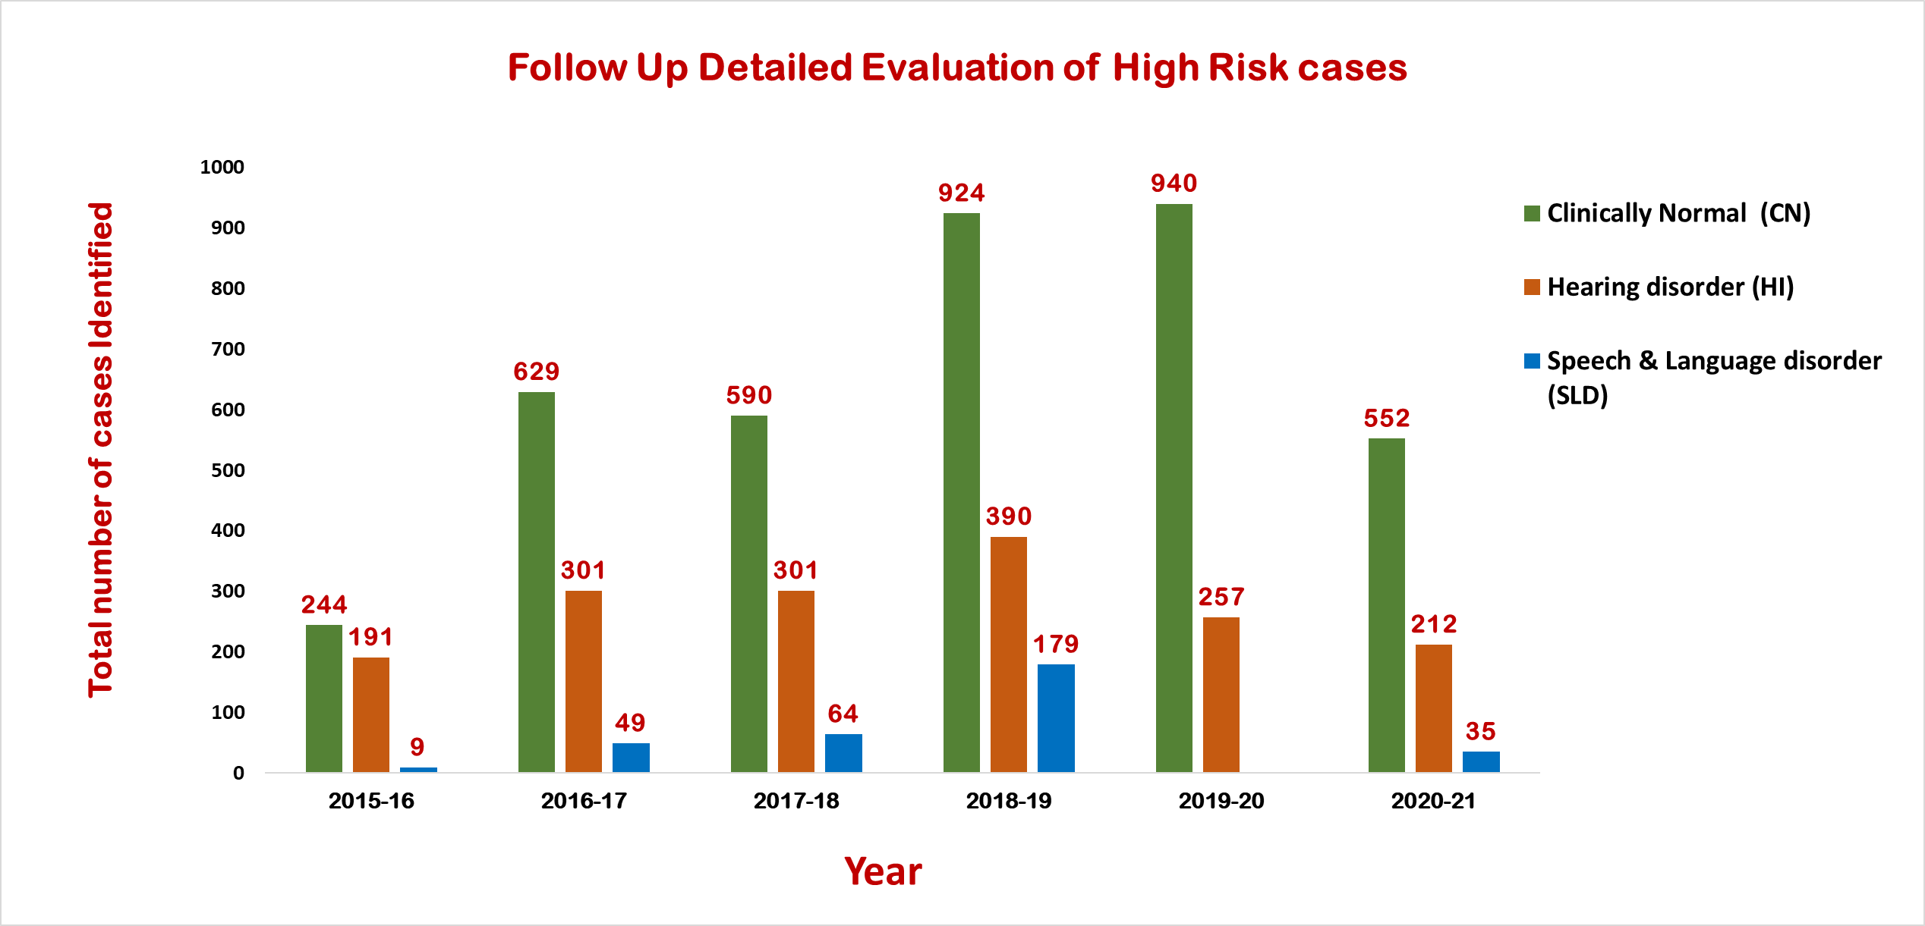
 | Total Numbers
Screened | 246166
Identified At Risk | 23066
 | Total Numbers
Phone follow up of babies | 10123
Detailed evaluations of babies | 5867
Babies identified with Hearing loss | 1652
Babies identified with Speech-Language Disorder | 336
SECONDARY PREVENTION: NEW BORN HEARING SCREENING (2015 to 2021)
Notes:
All the new-born infants are screened for their hearing within 1-2 days after birth.

Slide 11
ACTIVITY | TOTAL BENEFICIARY
New Registrations for assessment | 14809
Testing at Camps | 10688
Total Tested | 25497
Free Hearing aids Dispensed | 974
Speech Language Therapy | 2097
Total Treated | 3071
SECONDARY AND TERTIARY PREVENTION: AIISH-OSC Activities (2015 to 2021)

Slide 12
Research Type | National and International Conference presentations | National and International Publications | Awards and Recognitions | Projects | Total
Number | 27 | 02 | 03 | 01 | 33
2. MUKESH AWARD FOR BEST PAPER IN AUDIOLOGY:
A paper titled “Prevalence of Hearing Impairment and Risk Factors in New-borns under Neonatal Hearing Screening Program in Southern City of Karnataka” received best paper award at 51st National Conference of Indian Speech and Hearing Association held between 8th to 10th Feb, 2019 at Bangalore, Karnataka.
1. BEST POSTER PRESENTATION CATEGORY:
A Paper titled “Effect of inclusion of automated auditory brainstem response in the new-born hearing screening- a preliminary study” was presented at Indian Academy of Cerebral Palsy – XIII National conference IACPCON 2018, held from 23rd to 25th November 2018, at Calcutta Medical College, Kolkata.
3. BEST POSTER PRESENTATION AWARD UNDER THE CATEGORY OF SPEECH-LANGUAGE PATHOLOGY:
Swapna, N., & Seshasri, D. (2019). “Maternal Satisfaction and Perception of Feeding Cues in New-borns with and without High Risk Factors-A Preliminary Survey”. Paper Presented at 12th ISHA-Kerala State Branch, Kasargod, Kerala, India on 26th – 27th Oct, 2019.
EPIDEMIOLOGICAL RESEARCH
Notes:
Research Numbers to be added – Publications and Total

Slide 13
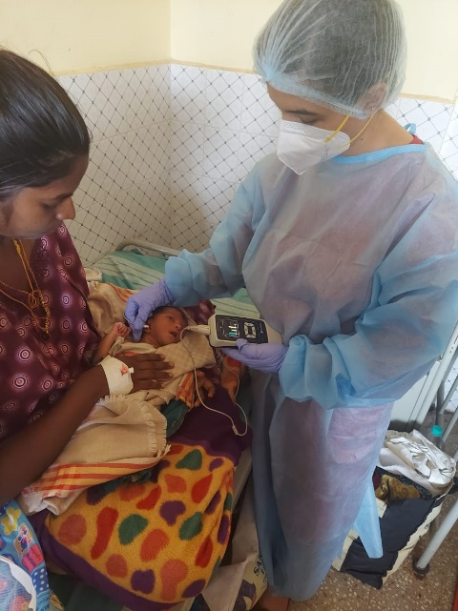
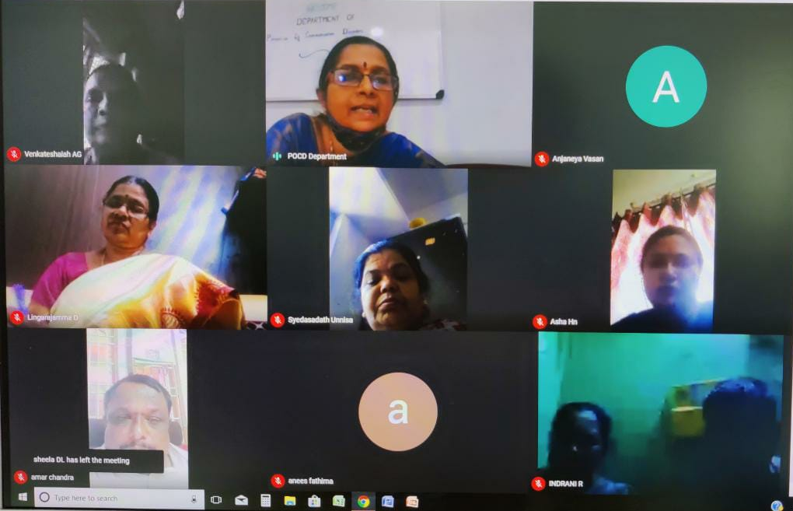
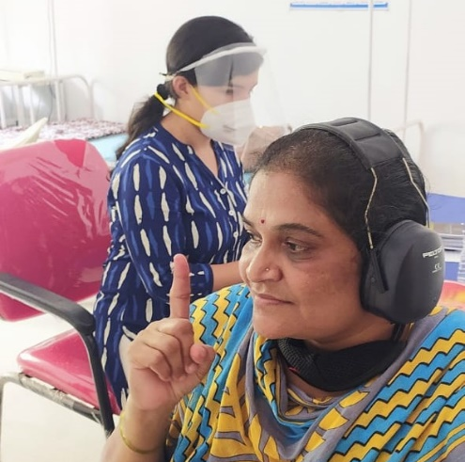
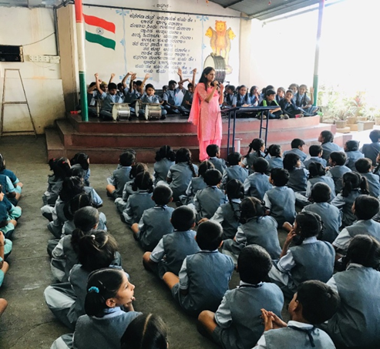
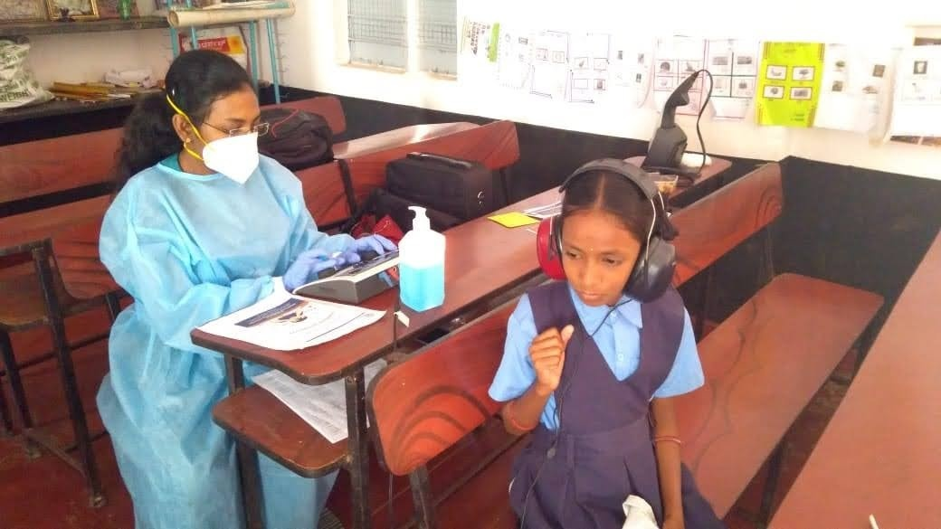
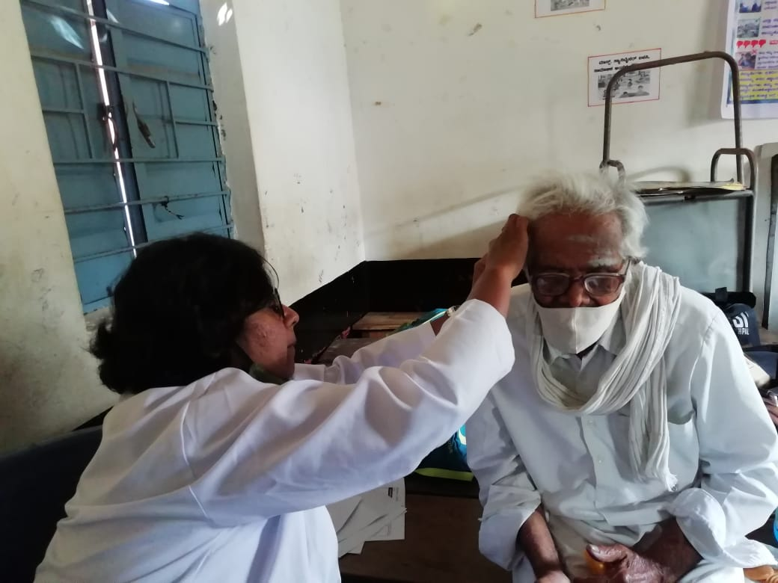
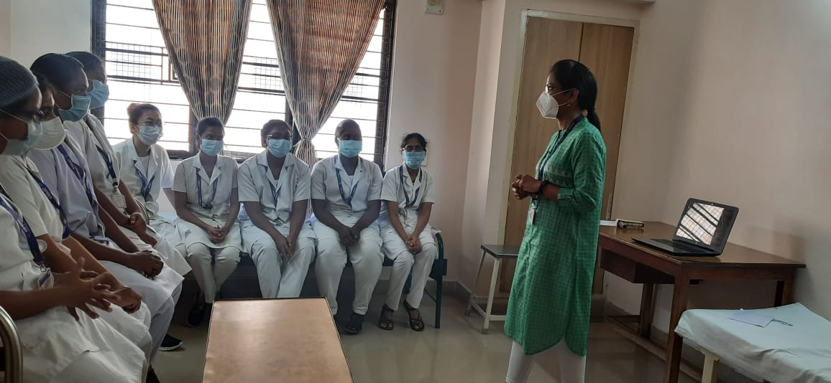
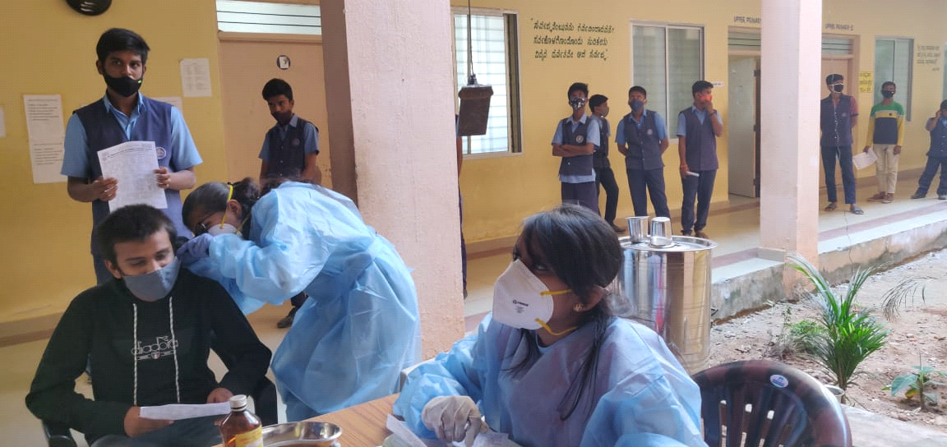
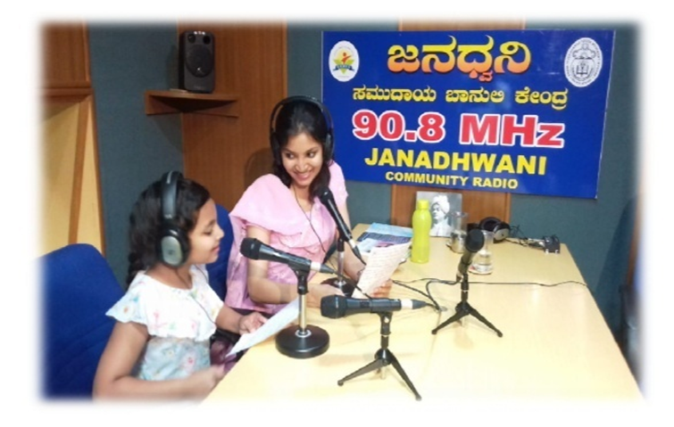
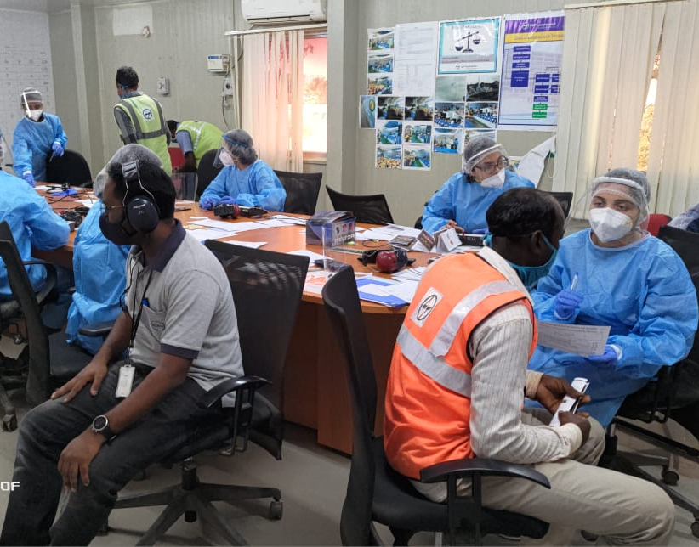
GLIMPSES OF ACTIVITIES AT POCD, OSC AND NBS CENTERS
Notes:
PHOTO GALLERY

