Slide 1




DEPARTMENT OF PREVENTION OF COMMUNICATION DISORDERS
(POCD)
प्रेषण विकृति रोकथाम विभाग​
Out-reach department launched in the year 2008
To reach the unreached directly and facilitate prevention of communication disorders
Establishment
Motto
Dr. N. Sreedevi
Prof. & Head
Department of POCD
AIISH, Manasagangothri, Mysuru -6.

Slide 2
Head of the department
On campus
NBS
Faculty – 02
(Deputed)
ENT specialist - 01
Audiologist Grade I- 08
Audiologist Grade 2- 04
MTS -01
OSC
SHT- 04
SHT- 06
Audiologist Grade I -09
Audiologist Grade I- 07
SLP Grade I- 12
Total: 55

Slide 3


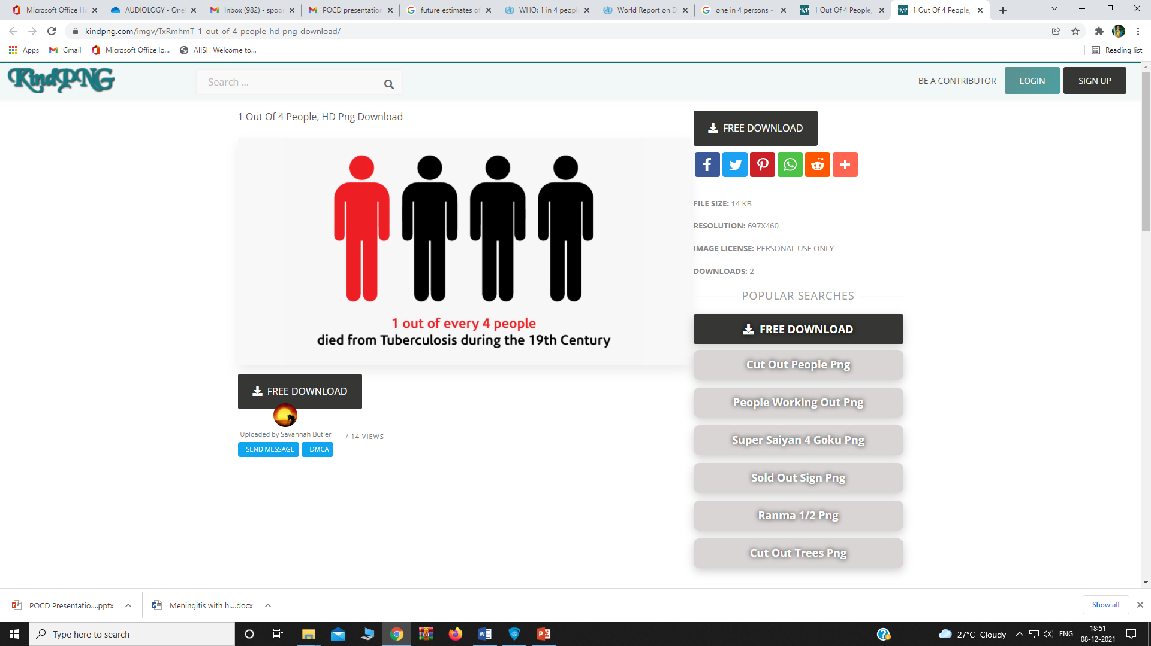
World Health Organization, 2021
Census, Government of India, 2011
430 million of the world’s population have disabling hearing loss
34 million (9%) of this group are children
Disability in India – approx. 3%
Hearing impairment (19%) listed as the second leading disability
Speech impairment (7.5%) as the fifth highest disability
WHO Future Estimates
In 2050,
2.5 Billion world wide -1 in 4 people- will have hearing loss!!!!
Notes:
WHO (2018) he prevalence of hearing impairment (HI) in India is around 6.3% (63 million people suffering from significant auditory loss)

Slide 4
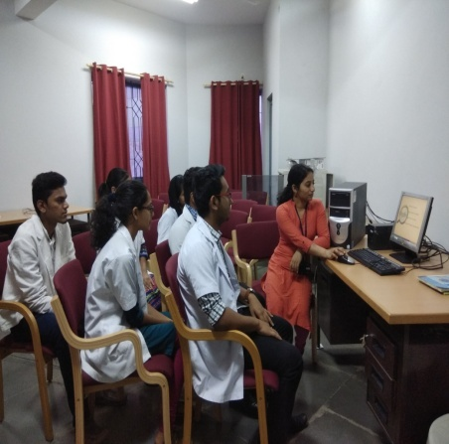
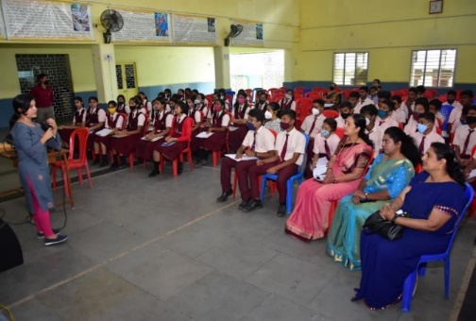
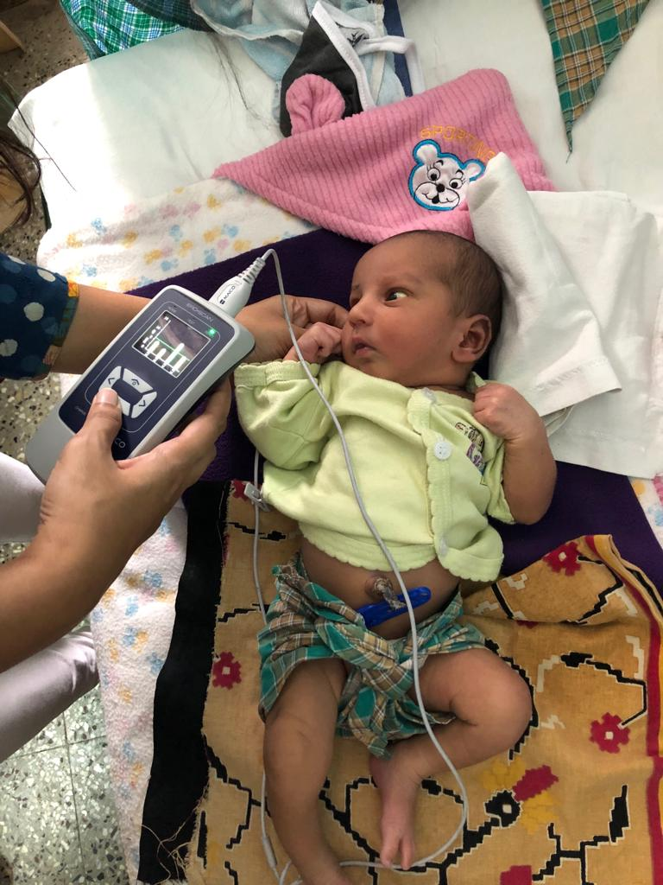
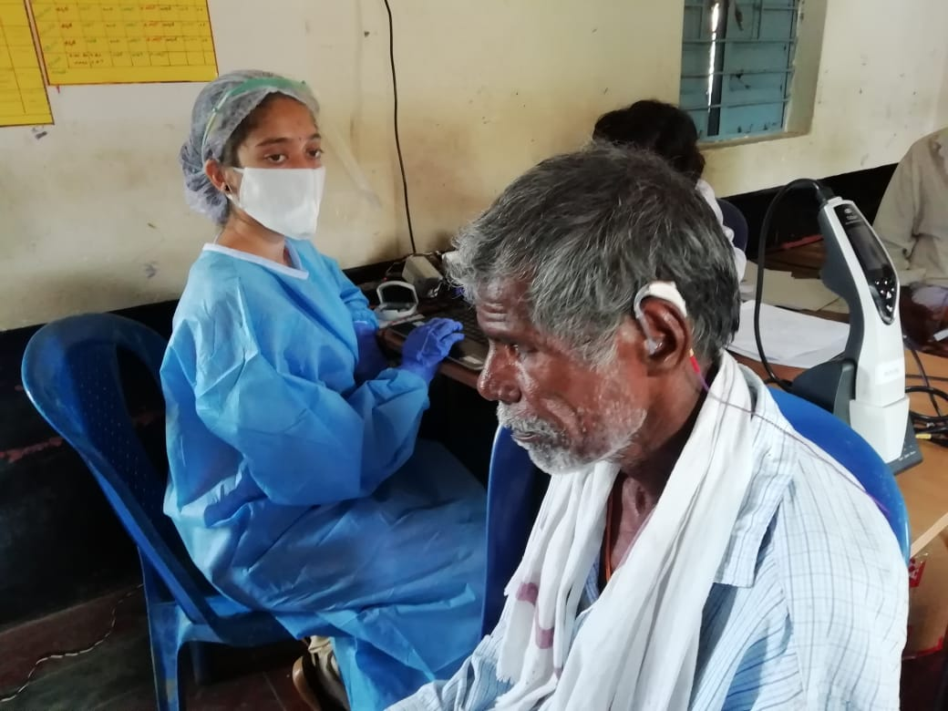

I
Human Resource Development
II
Primary Prevention
III
Secondary Prevention
IV
Tertiary Prevention
V
Epidemiological Research
Out reach clinical training of UG and PG students
Sensitizing the public on communication disorders and their prevention
Early identification and assessment of communication disorders
Early rehabilitation and management of communication disorders
Carrying out epidemiological research related to communication disorders
Objectives of the department

Slide 5

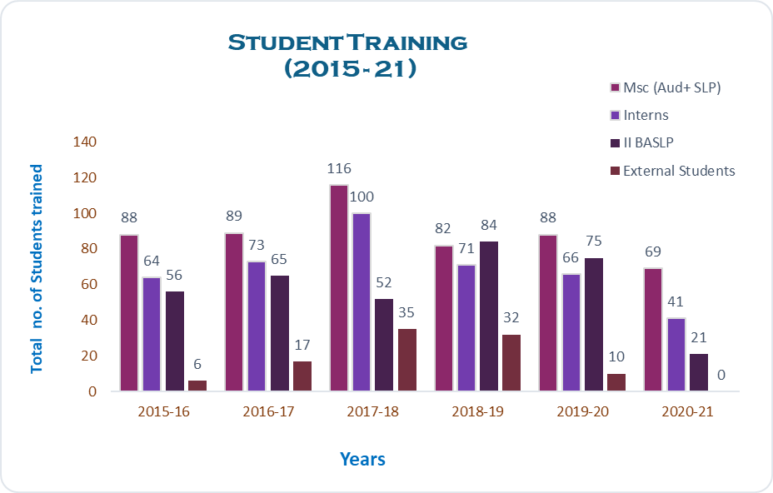
2015-2020: Total post-graduate students: 463
Under-graduate students: 706
Internship students:
External students: 100
HUMAN RESOURCE DEVEOPMENT (2015 to 2021)
Notes:
As part of human resource development, clinical training on prevention, early identification, and community based rehabilitation of communication disorders were provided for undergraduate and postgraduate students.

Slide 6
Primary Prevention
Radio/TV talks/ Media/ Newspaper Articles
Secondary Prevention
Newborn Hearing Screening
School Screening
Industrial Screening
Elderly & Bedside Screening
Tertiary Prevention
Speech & Language Therapy
Hearing Aid Issue
ENT Services
Counselling & Guidance
Orientations/ Webinars
Pamphlets/Posters
Street Plays & Rallies
Assessments at OSCs

Slide 7
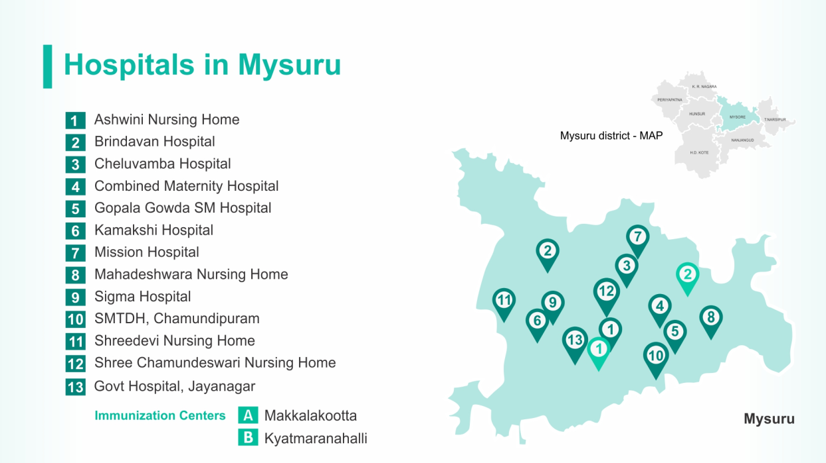
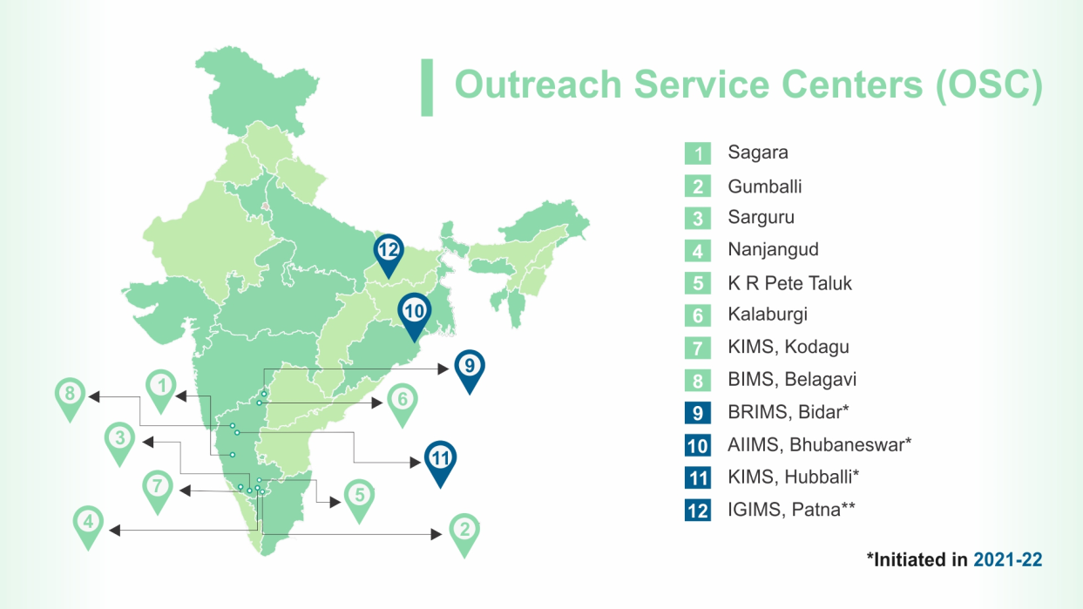

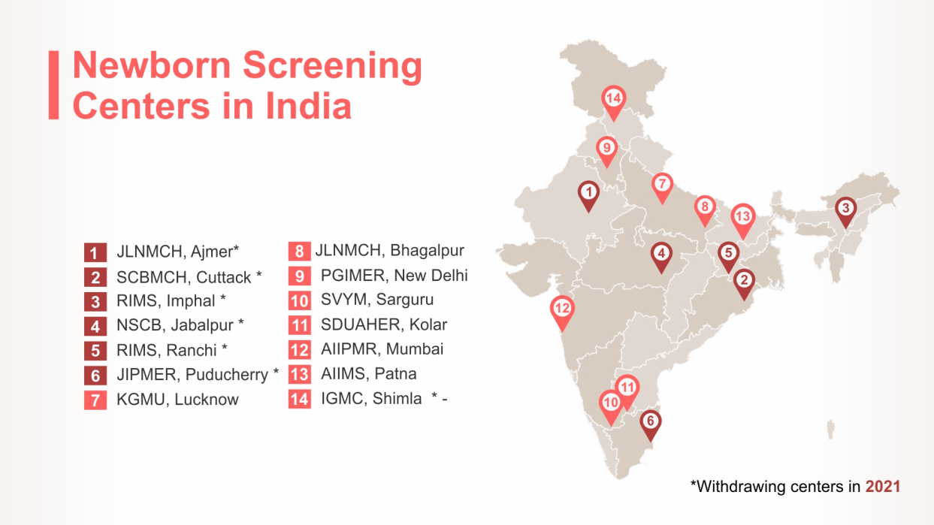
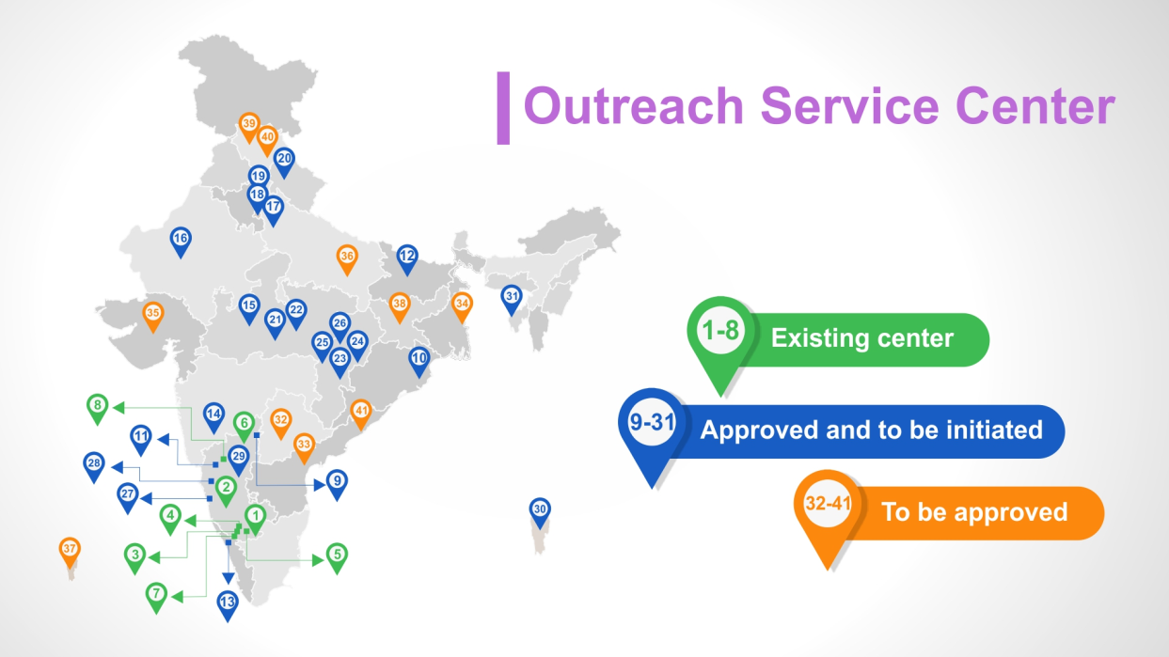
Notes:
We work to achieve these objectives not just at AIISH but many centers throughout India.

Slide 8
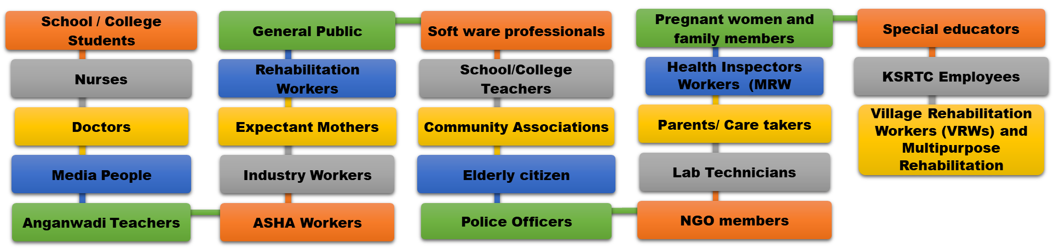
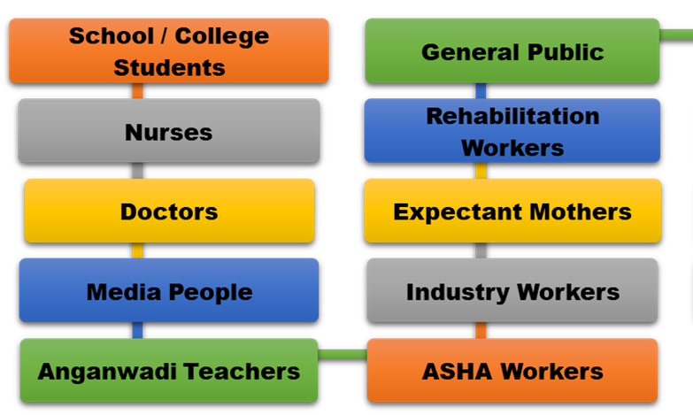
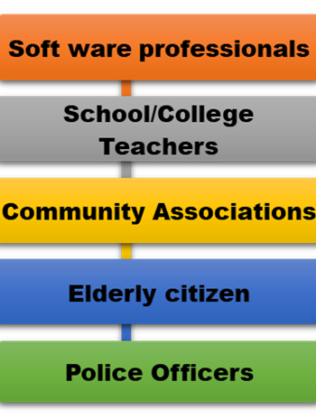
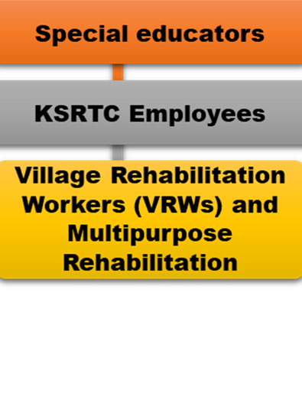
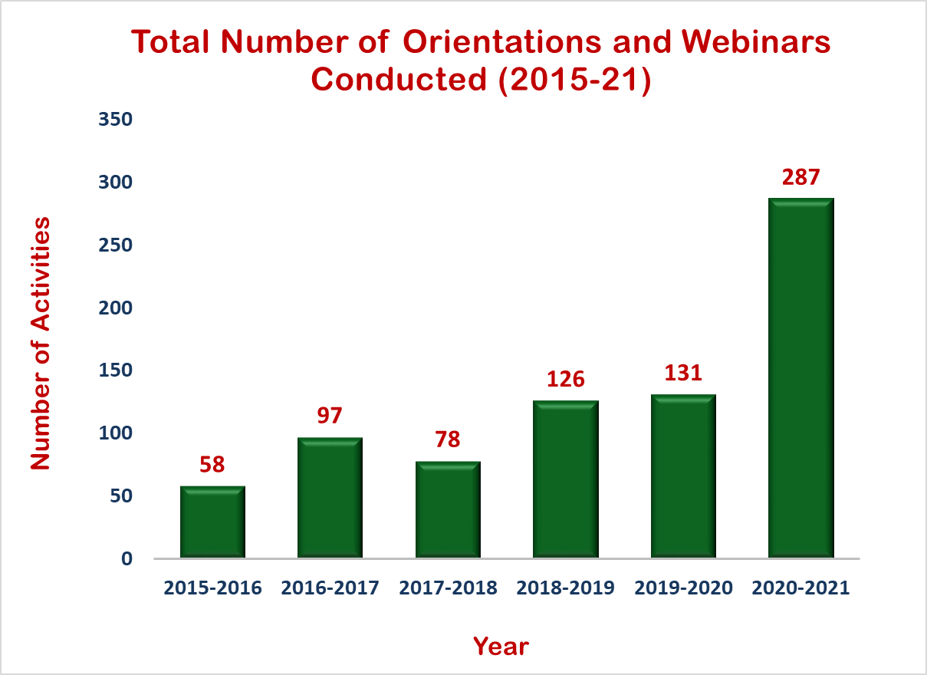
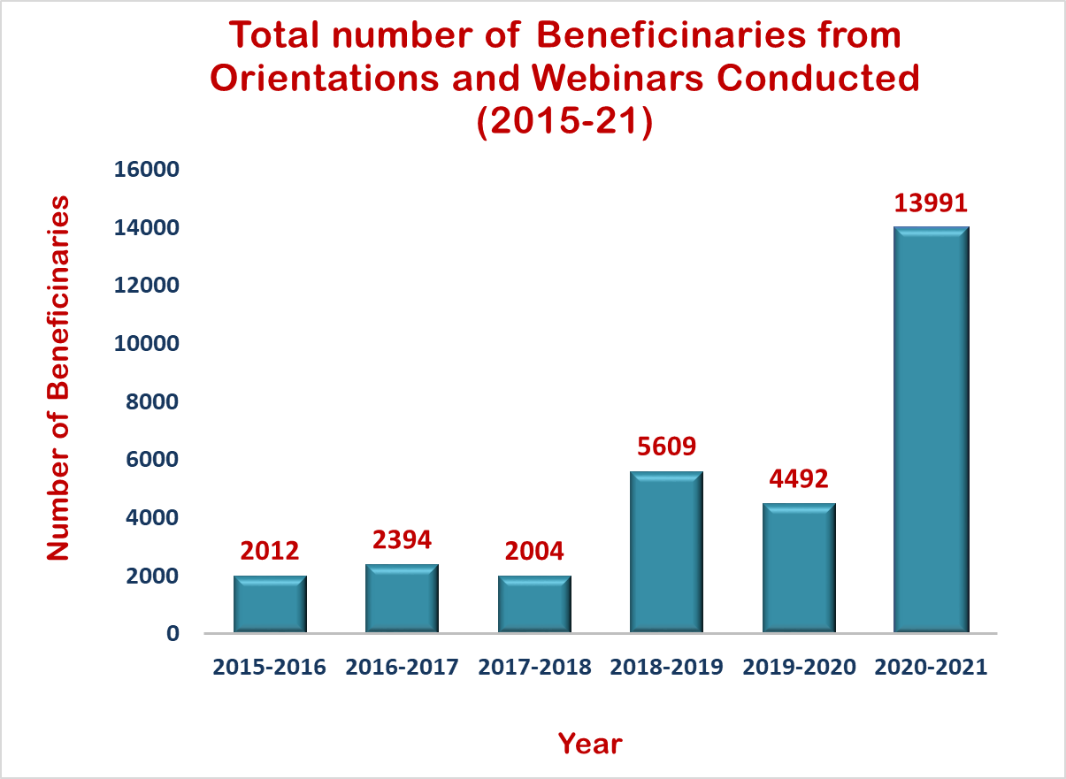
2015-2020: No. of orientations & webinars: 490
Total No. of beneficiaries: 16517
PRIMARY PREVENTION: PUBLIC EDUCATION (2015 to 2021)
Notes:
Public education involves raising awareness about different types of communication disorders, their prevention, early detection, appropriate referral, and timely management among the general public and various other professionals like …………

Slide 9
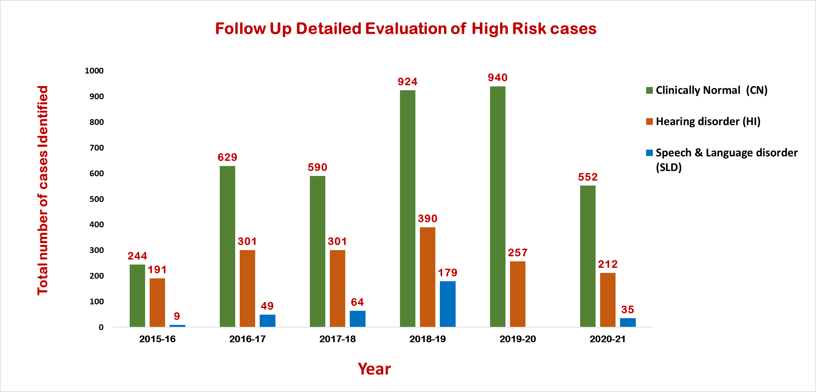
2015 to 2020: New-born babies followed up:5068
Total No. of babies identified :1741
2015 to 2020: New-born babies screened:246166
Total No. of babies referred: 23066
SECONDARY PREVENTION: NEW BORN HEARING SCREENING (2015 to 2021)
Notes:
All the new-born infants are screened for their hearing within 1-2 days after birth.

Slide 10
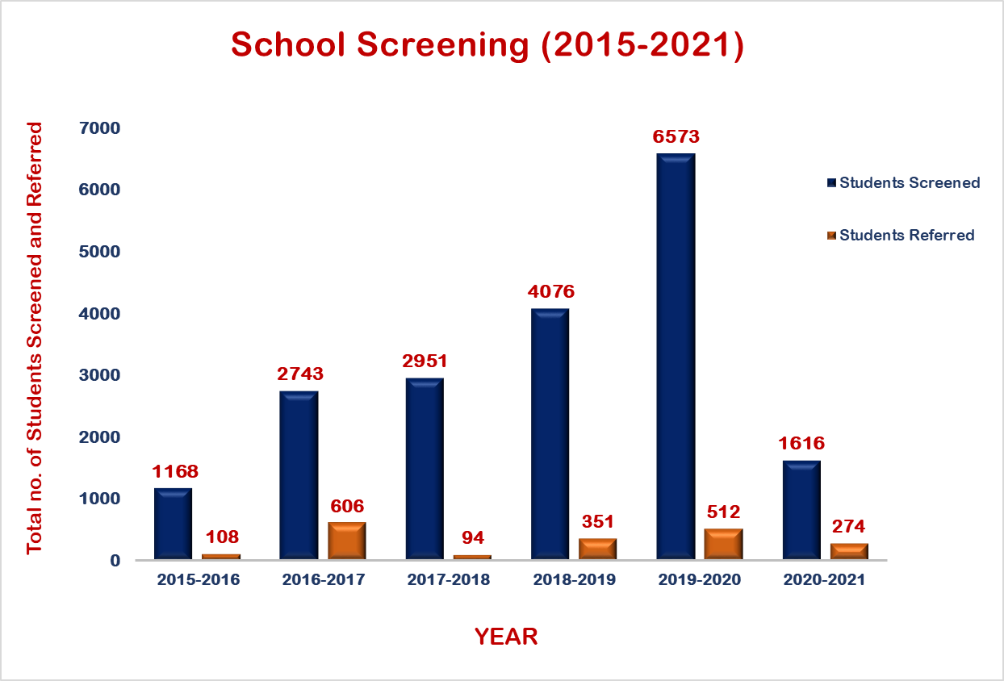
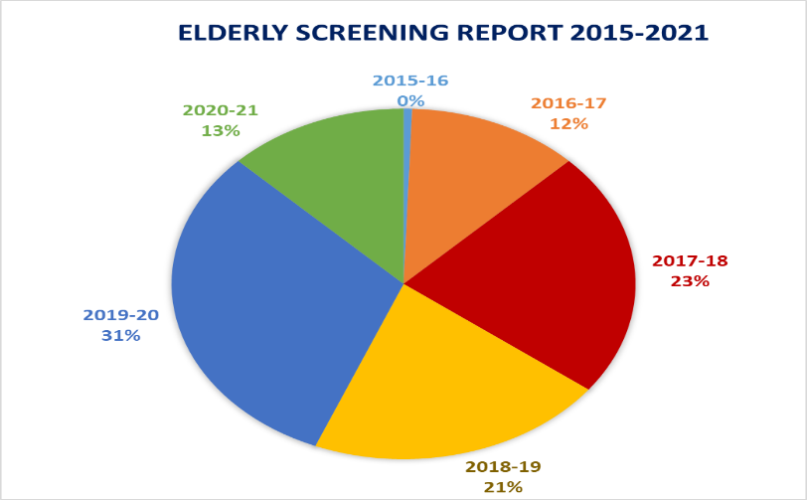
2015 to 2020: Total No. of children screened: 17511
Total No. of children referred: 1671
2015 to 2020: Total No. of Employees screened: 1231 No. of employees referred: 484
2015 to 2020: Total No: of elderly scrrened:443
SECONDARY PREVENTION: INDUSTRIAL, SCHOOL AND ELDERLY SCREENING (2015 to 2021)
Notes:
Elderly screening total number is missing in the graph

Slide 11
2015 to 2020: No. of hearing aids dispensed:737
2015 to 2020: No. of cases registered:11622
2015 to 2020: No. of clients who attended therapy:1564
2015 to 2020: No. of beneficiaries:8046
TERTIARY PREVENTION: AIISH-OSC Activities (2015 to 2021)

Slide 12


National and International Conference presentations | National and International Publications | Awards and Recognitions | Projects | Total
27 | 02 | 03 | 01 | 33
2. MUKESH AWARD FOR BEST PAPER IN AUDIOLOGY:
“Prevalence of Hearing Impairment and Risk Factors in New-borns under Neonatal Hearing Screening Program in Southern City of Karnataka” received best paper award at 51st National Conference of Indian Speech and Hearing Association -8th to 10th Feb, 2019 at Bangalore, Karnataka.
1. BEST POSTER PRESENTATION CATEGORY:
A Paper titled “Effect of inclusion of automated auditory brainstem response in the new-born hearing screening- a preliminary study” was presented at Indian Academy of Cerebral Palsy – XIII National conference IACPCON 2018, at Calcutta Medical College, Kolkata.
3. BEST POSTER PRESENTATION AWARD UNDER THE CATEGORY OF SPEECH-LANGUAGE PATHOLOGY:
Swapna, N., & Seshasri, D. (2019). “Maternal Satisfaction and Perception of Feeding Cues in New-borns with and without High Risk Factors-A Preliminary Survey”. -12th ISHA-Kerala State Branch, Kasargod, Kerala, India 2019.
EPIDEMIOLOGICAL RESEARCH
Notes:
Research Numbers to be added – Publications and Total

Slide 13
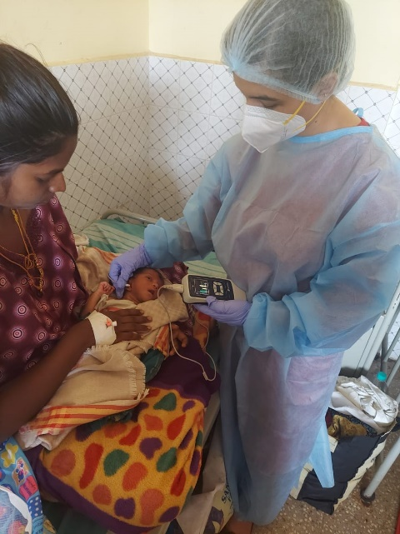
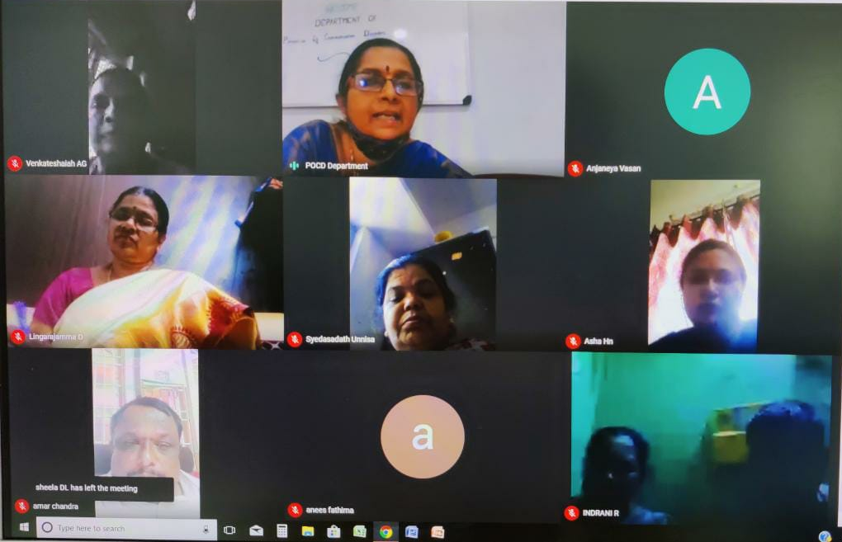
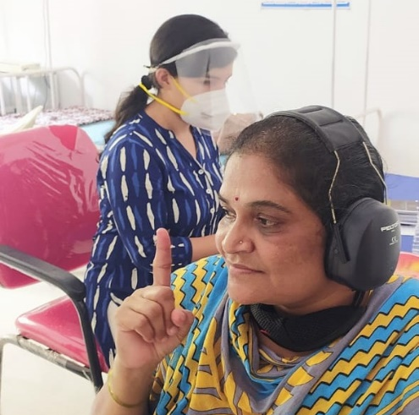
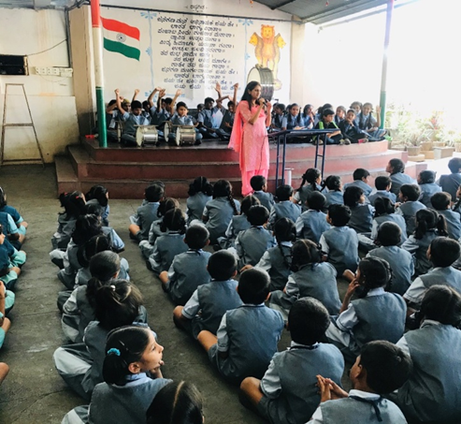
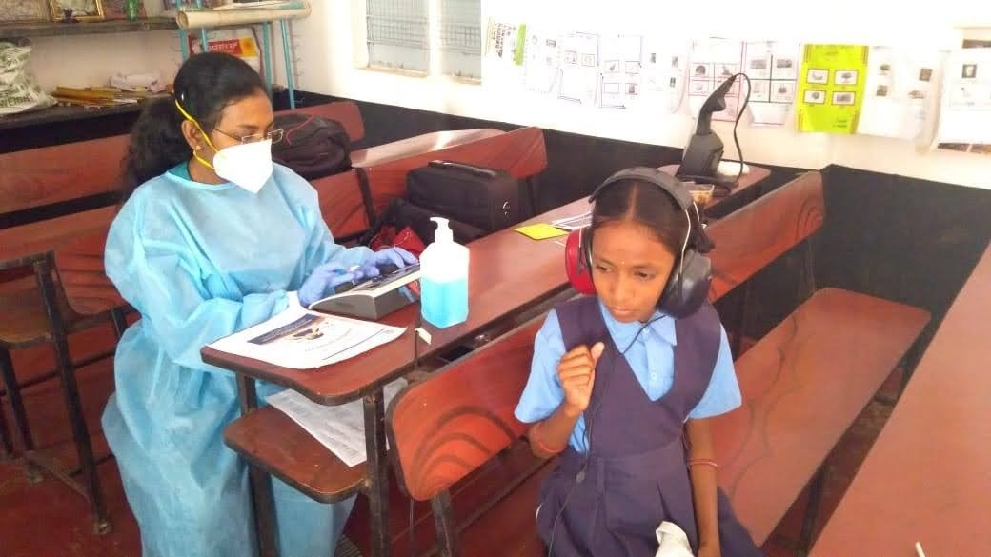
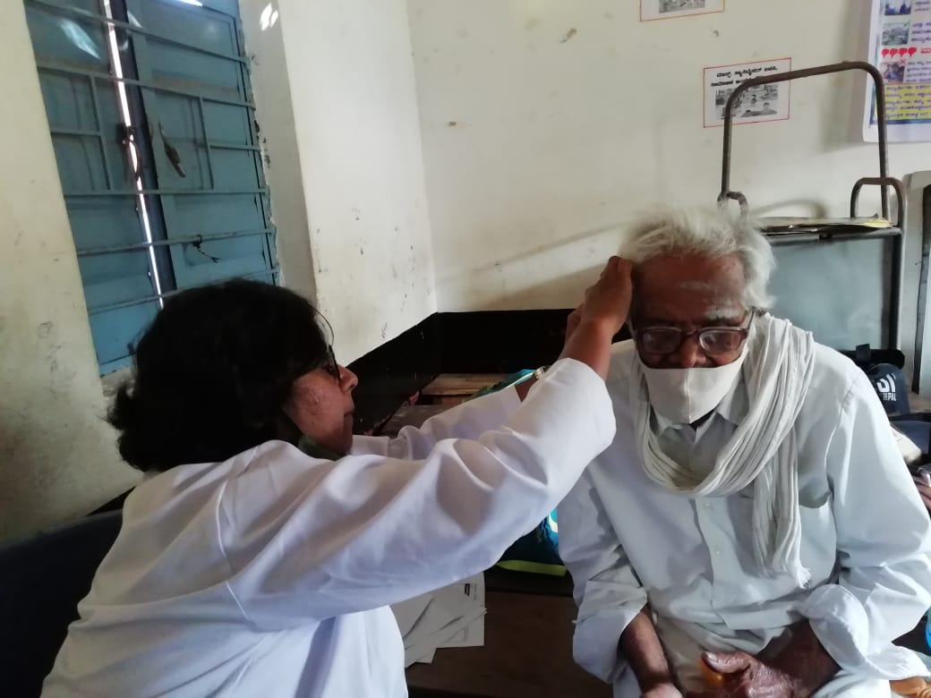

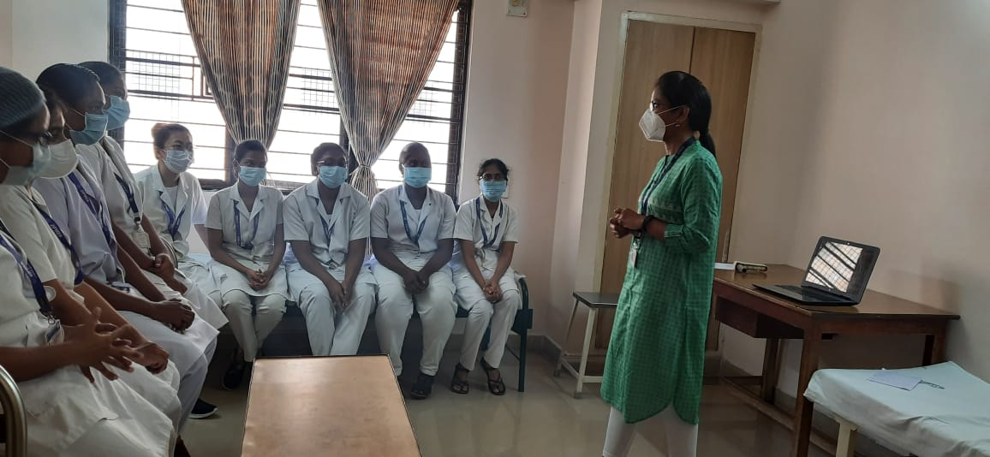
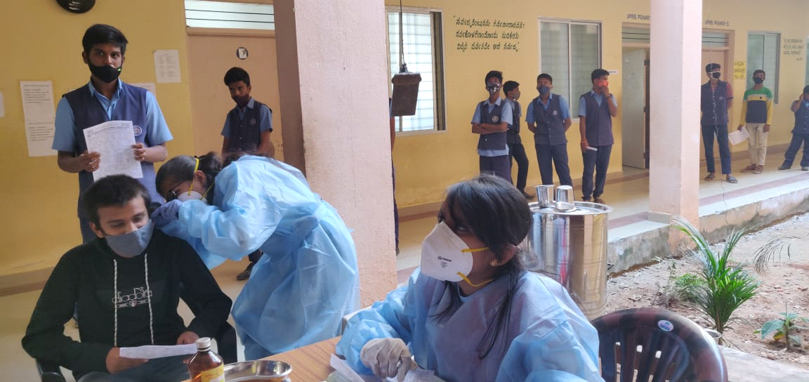
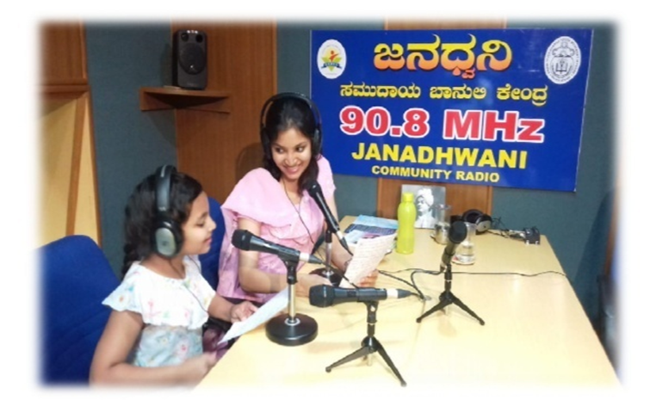
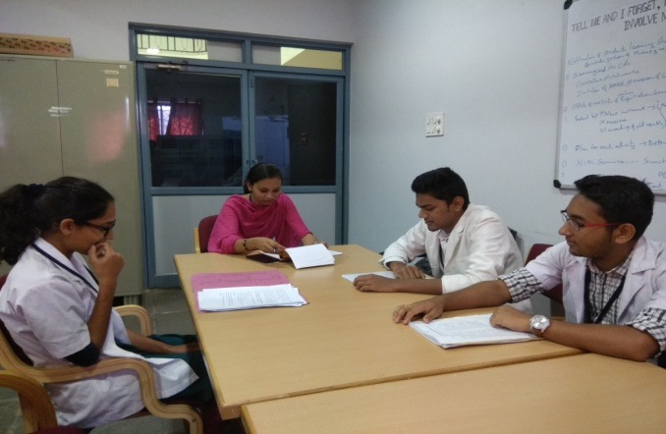
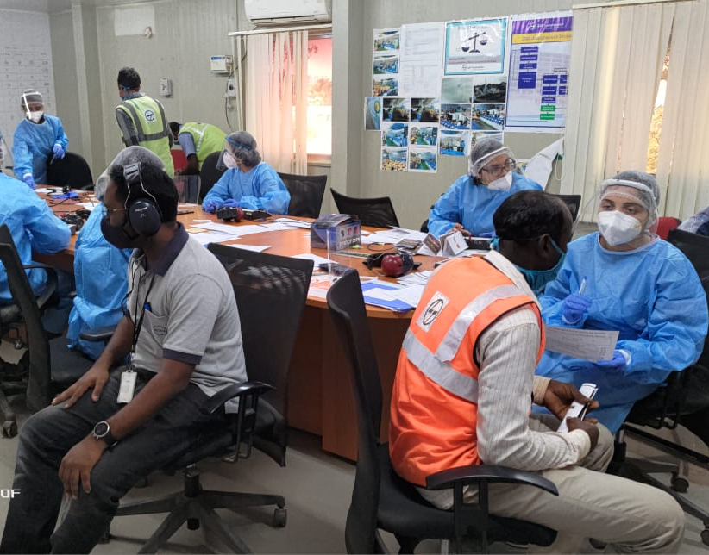
GLIMPSES OF ACTIVITIES AT POCD, OSC AND NBS CENTERS
Notes:
PHOTO GALLERY

Slide 14




